Slide 1
颁奖晚宴菜单（二选一）
菜单A
风味六味碟
Six treasures combination
七彩鲍丝羹
Boiled shredded abalone with vegetable
盐水煮大虾
Poached king prawn
一品宝塔肉
Braised streaky pork
杏鲍菇牛柳
Wok-fried beef fillet with mushroom
水煮毛血旺
Boiled cuttle fish,squid and bean sprout with chili
烟熏走地鸡
Marinated chicken
鲜鱿炖胶白
Braised Chinese cabbage with cuttlefish
干烧海鲈鱼
Braised perch
清炒时蔬
Stir-fried vegetable
海味蛋炒饭
Fried rice with seafood
一品荷花酥
Deep-fried pastry with shredded coconut stuffing
合时水果盘
Seasonal fresh fruit platter
菜单B
风味六味碟
Six treasures combination
酸辣参丝羹
Braised sea cucumber with assorted cereals
干烧大对虾
Braised king prawn with sweet and chili sauce
金汤烩鱼肚
Stewed fish maw in superior soup
秘制牛肋骨
Roasted beef rib with special sauce
XO 酱 花 枝 蚌
Fried geoduck in XO sauce
雀蛋稻香肉
Braised streaky pork with egg
当红脆皮鸡
Deep-fried crispy chicken
油泼牙片鱼
Steamed flounder fish with hot oil
清炒菜心
Stir-fried vegetable
海味蛋炒饭
Fried rice with seafood
红豆沙圆子
Sweet red bean sour
合时水果盘
Seasonal fresh fruit platter

Slide 2
茶歇菜单（四选二）
茶歇A - 1
Freshly baked biscuits Chef choice
现烤饼干 厨师长推荐
Seasonal slice fruits
时令水果(切片)
Sable cookies
法国莎堡曲奇
Lemon tart
柠檬塔
Classic cheese cakes
经典芝士蛋糕
Freshly brewed coffee, decaffeinated or fine selection of tea
咖啡，无咖啡因咖啡或精选茗茶
茶歇A - 2
Freshly baked biscuits Chef choice
现烤饼干 厨师长推荐
Seasonal slice fruits
时令水果(切片)
Double chocolate brownie
巧克力布朗尼
Sacher cake
沙架蛋糕
Cream cheese Danish Blueberry
蓝莓奶油芝士丹麦
Freshly brewed coffee, decaffeinated or fine selection of tea
咖啡，无咖啡因咖啡或精选茗茶
茶歇B - 1
Shandong peanuts / assorted nuts / Chips / Dried fruits
山东脆花生米 / 什锦杂豆 / 薯片 / 小干果
Seasonal slice fruits
时令水果(切片)
Mini chocolate croissant
迷你巧克力牛角
Fresh fruits Danish
水果丹麦
Chocolate hazelnut mousse cake
巧克力榛子慕斯蛋糕
Freshly brewed coffee, decaffeinated or fine selection of tea
咖啡，无咖啡因咖啡或精选茗茶
茶歇B - 2
Shandong peanuts / assorted nuts / Chips / Dried fruits
山东脆花生米 / 什锦杂豆 / 薯片 / 小干果
Seasonal slice fruits
时令水果(切片)
Coconut Danish
椰丝丹麦
Opera slice
歌剧蛋糕
Fruits tartlets
水果挞
Freshly brewed coffee, decaffeinated or fine selection of tea
咖啡，无咖啡因咖啡或精选茗茶

Slide 3
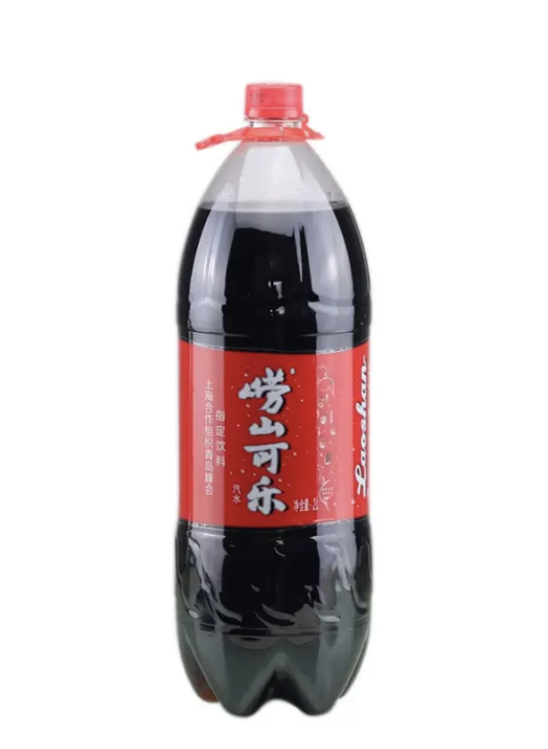
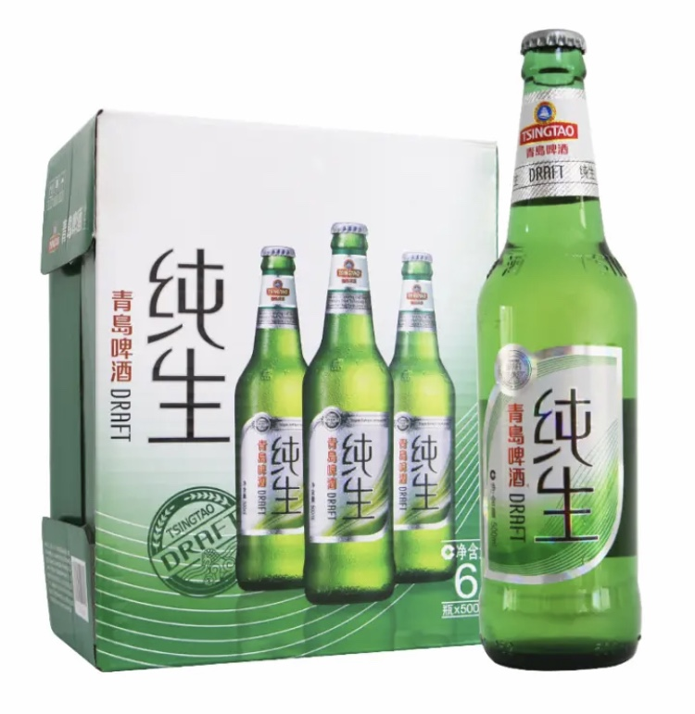
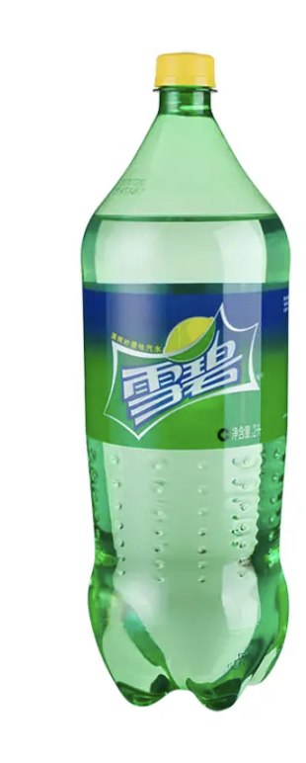
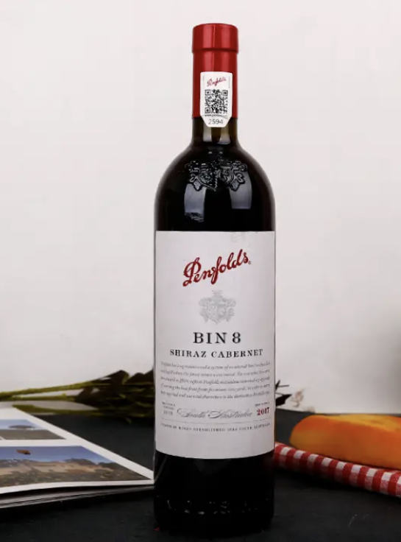
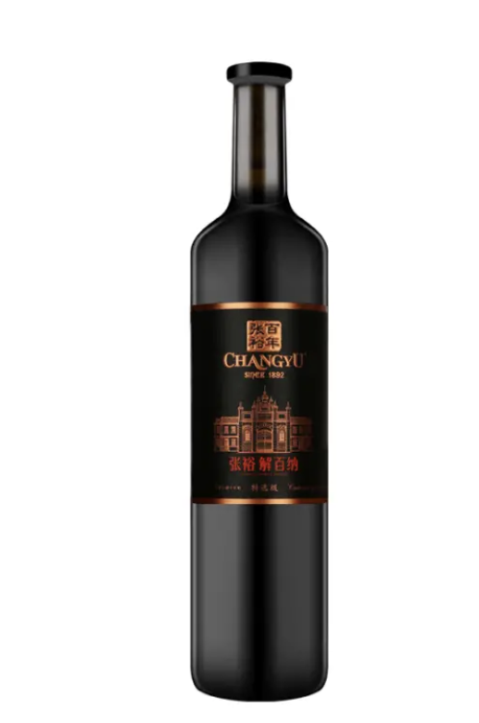
晚宴酒水
红酒（二选一）
崂山可乐*1瓶+雪碧*1瓶/桌 2L
青岛啤酒*8瓶/桌
500ML
8元/瓶
奔富8 红酒*2瓶/桌
750ML
230元/瓶
张裕第九代特选级解百纳 红酒*2瓶/桌
750ML
170元/瓶

Slide 4
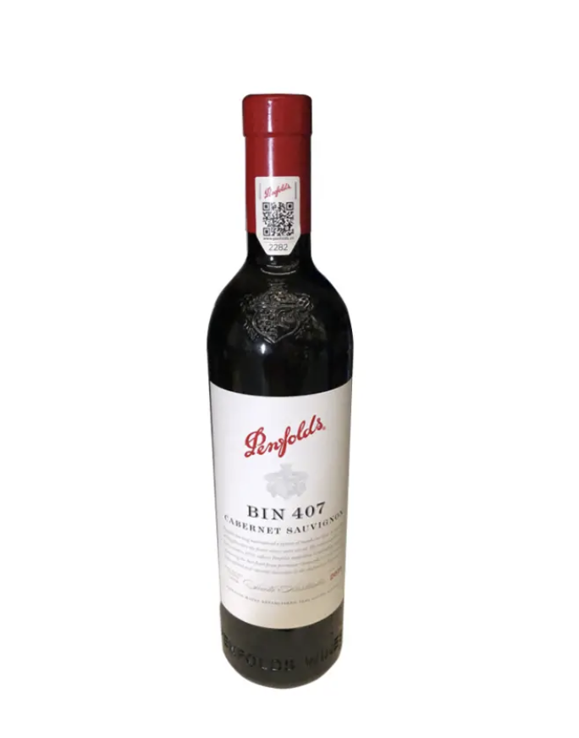

VIP酒水
奔富407 赤霞珠红葡萄酒 750ml
主桌*4
VIP房间*2
备*2
710元/瓶
干白葡萄酒 750ml
VIP房间*2
800元/瓶

Slide 5
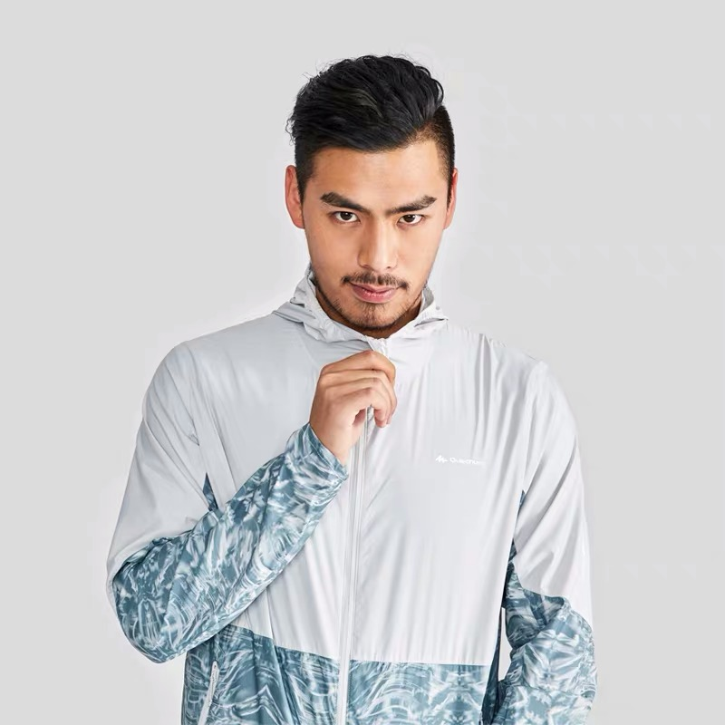
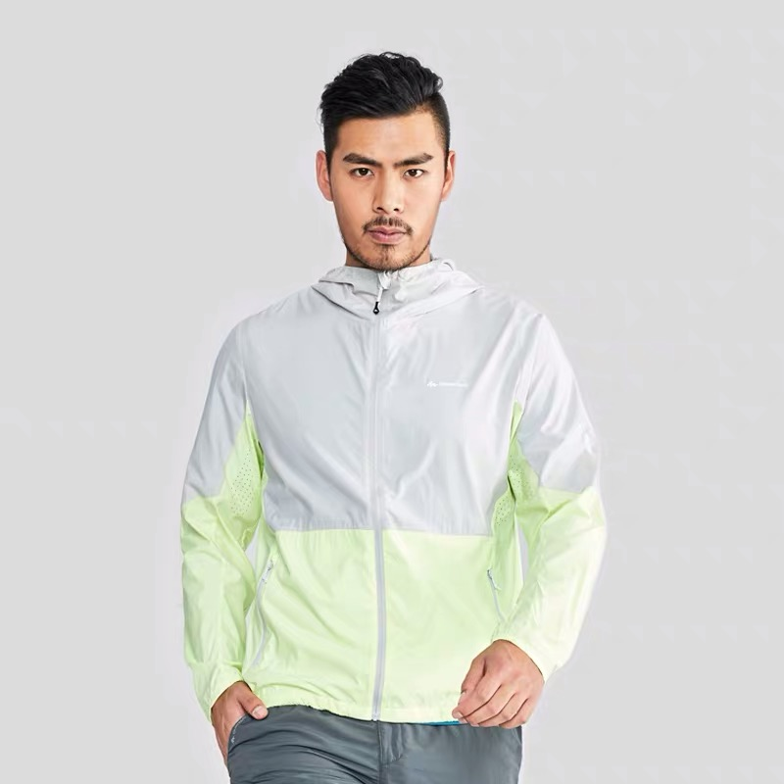

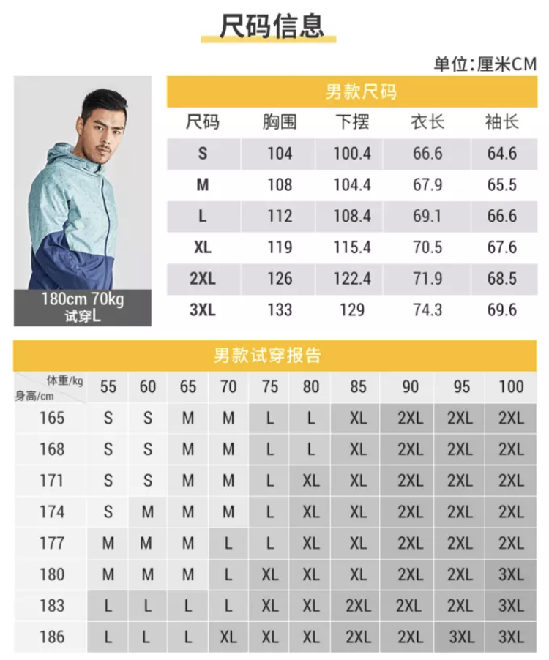

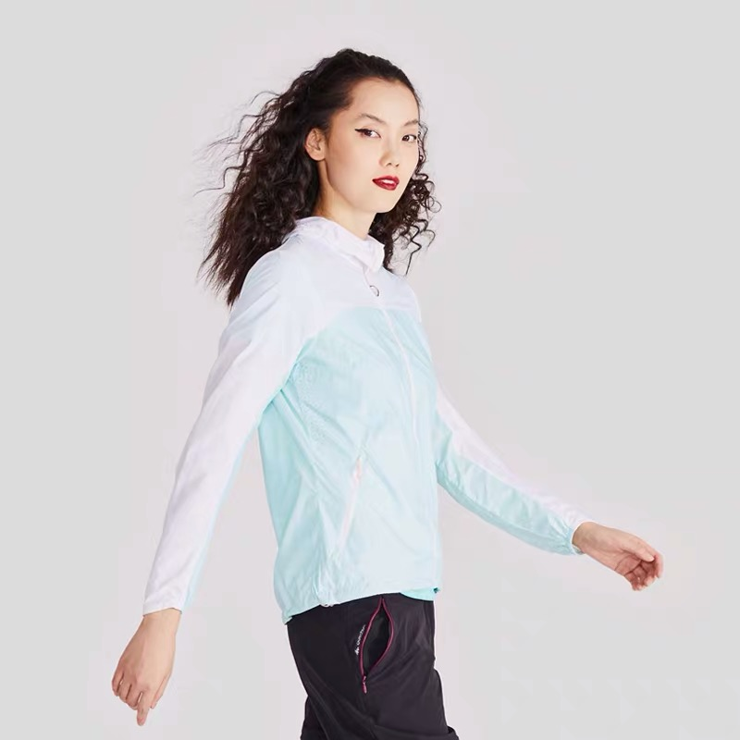
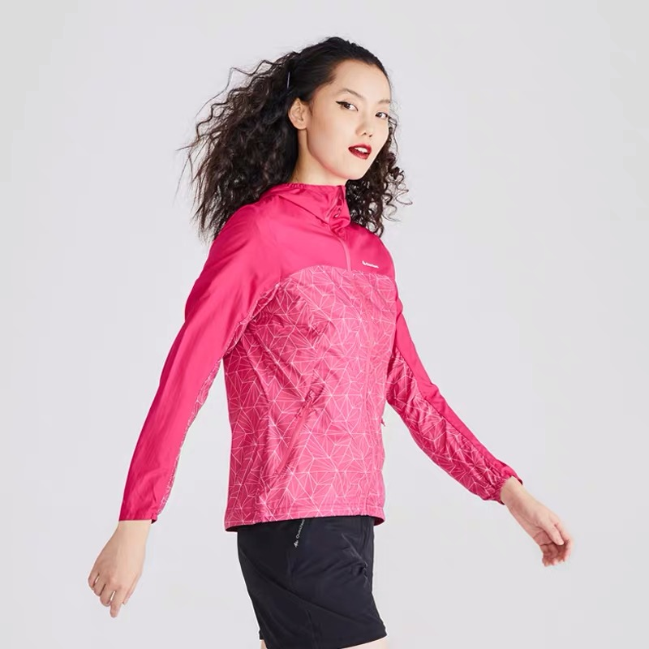
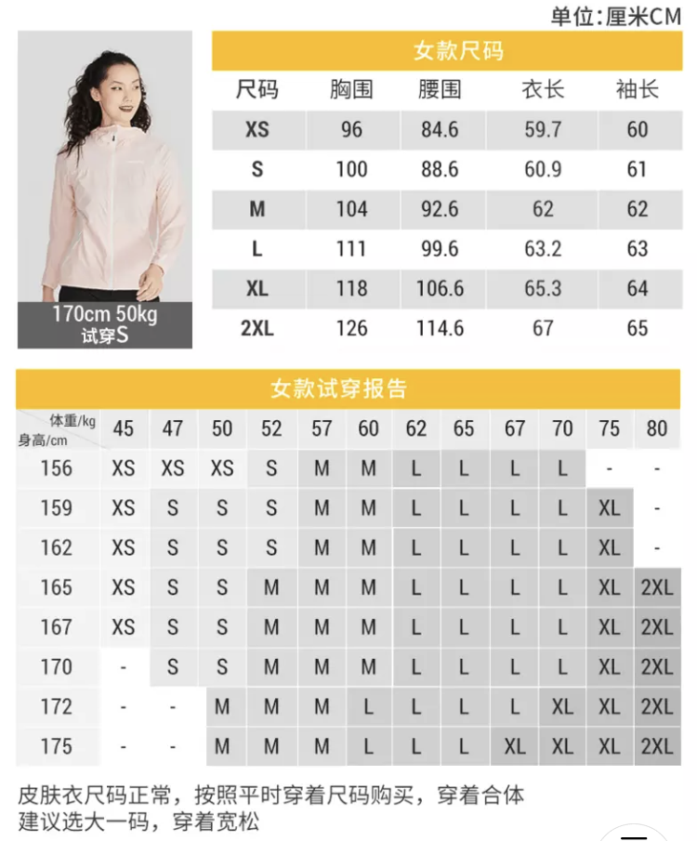
帆船团建物料 – 防晒衣
男士 灰色拼接
男士 灰绿拼接
男士 蓝色
女士 纯白色
女士 浅绿色拼接
女士 玫红色拼接

Slide 6
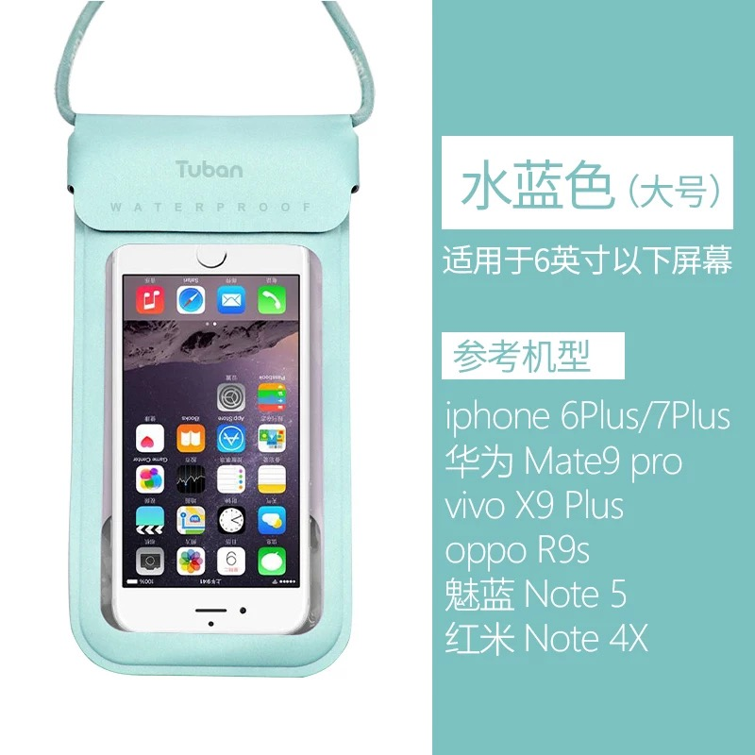
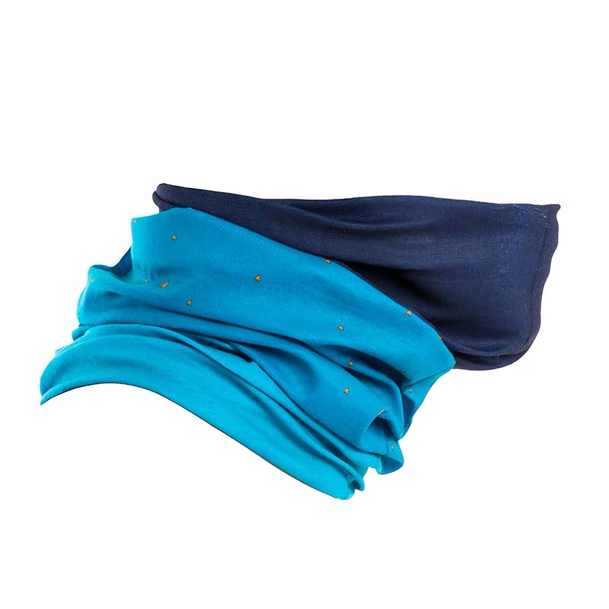
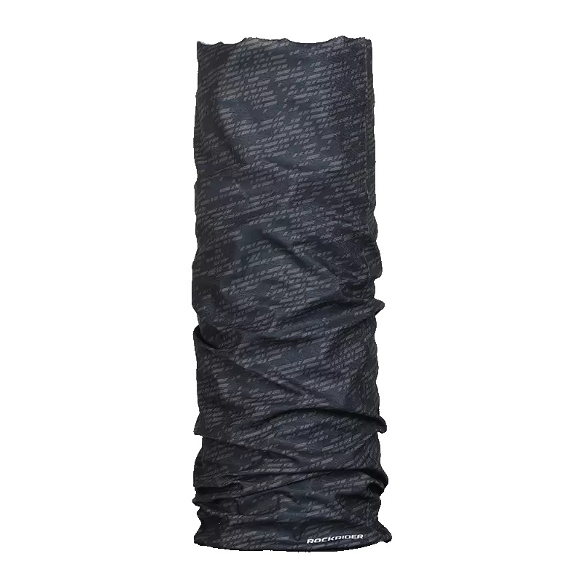
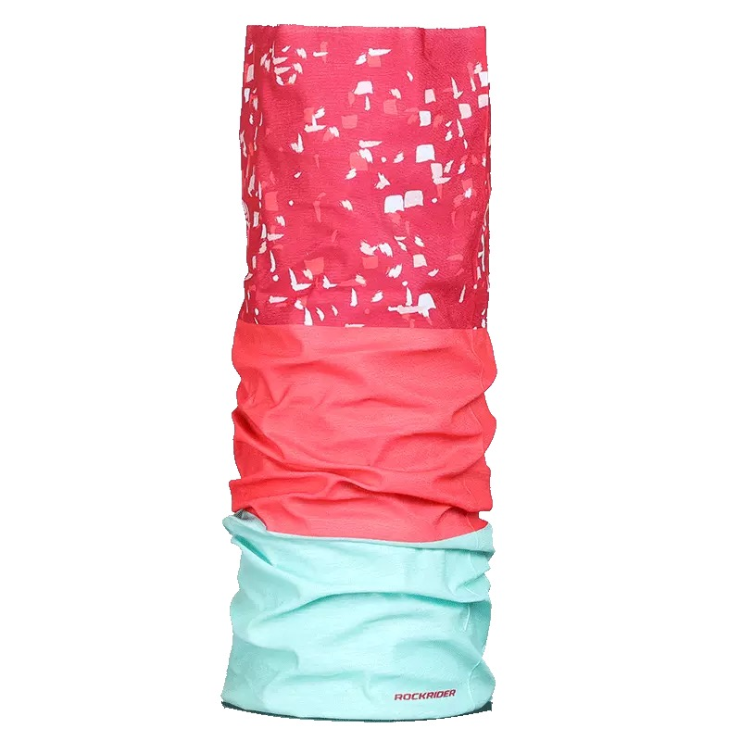
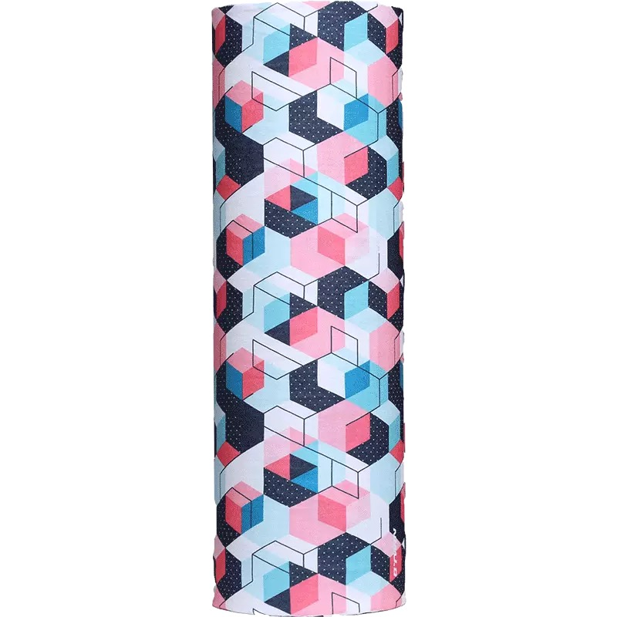

帆船团建物料 – 防晒防水
头巾
手机防水袋
深蓝色阶
烟灰碎花
橙绿条纹
蓝粉碎花
安耐晒防晒喷雾

Slide 7
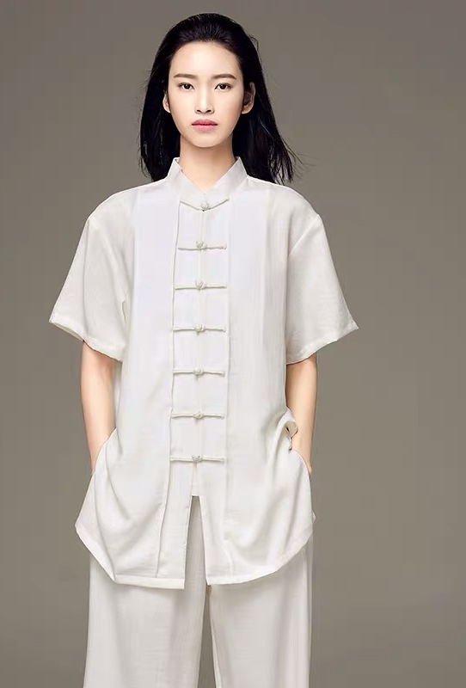
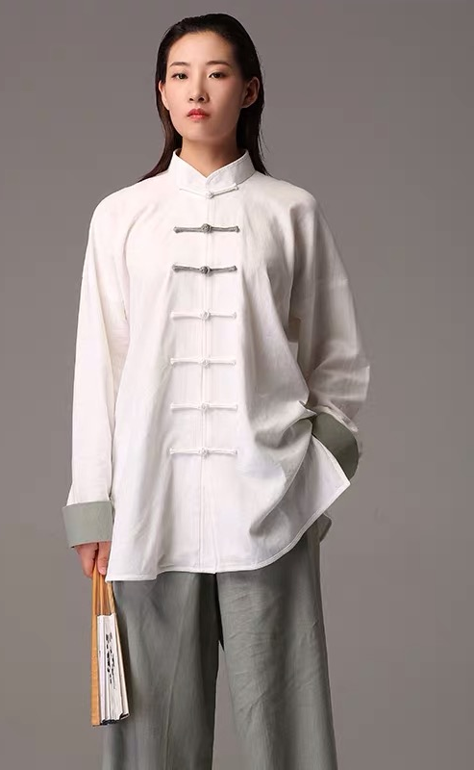
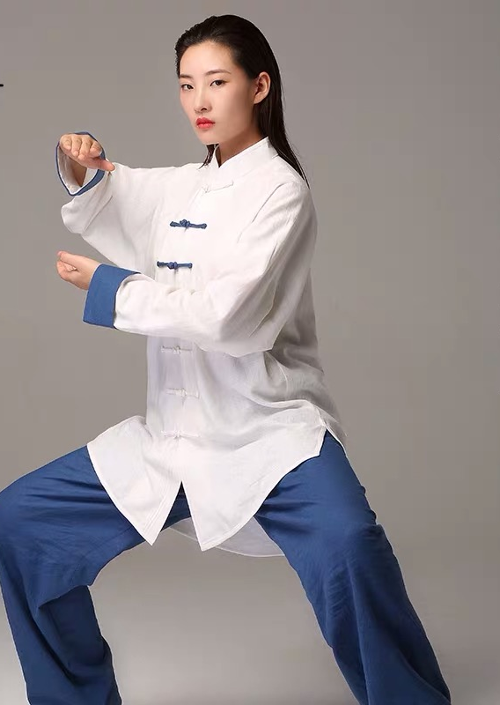
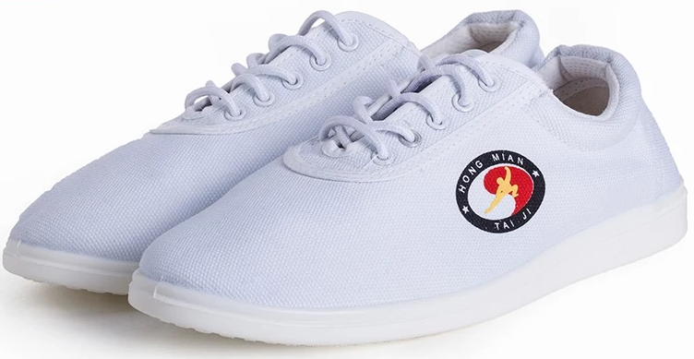
崂山书院团建物料 – 太极
款式一 皓月白
材质：天丝麻
款式二 白青双色
材质：亚麻
款式二 白蓝双色
材质：亚麻
太极鞋
材质：棉

