Slide 1

泉州富力万达文华酒店
Wanda Vista Quanzhou

Slide 2
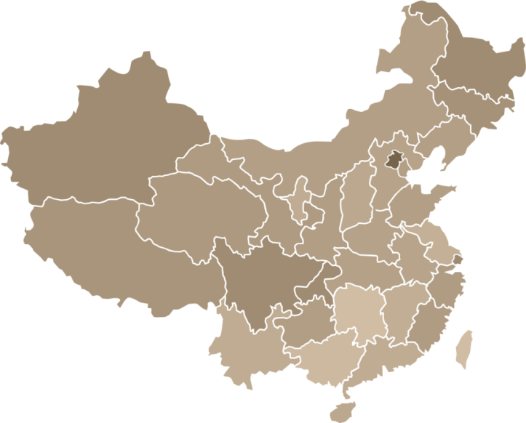
城市介绍
About Quanzhou
泉州北接福州、莆田，南毗厦门，东望台湾宝岛，西接三明、龙岩。
Quanzhou is adjacent to Fuzhou and Putian in the north , and near Xiamen in the south. To the east of Quanzhou is Taiwan island and to the west is Sanming and Longyan,
现辖鲤城、丰泽、洛江、泉港4个区，晋江市、石狮市、南安市3个县级市，惠安、安溪、永春、德化4个县。
Quanzhou has jurisdiction over four districts, three county-level cities and four counties.
Four districts: Licheng, Fengze, Luojiang, and Quangang..
Three county-level cities: Jinjiang, Shishi , and Nanan.,
Four counties: Huian, Anxi, Yongchun, Dehua.
泉州 Quanzhou
台湾 Taiwan
厦门 Xiamen
广州 Guangzhou
深圳 Shenzhen
香港 Hong Kong
澳门 Macau

Slide 3
城市介绍
About Quanzhou
飞机
北京2小时30分钟
上海1小时30分钟
台湾1小时30分钟
杭州1小时
深圳1小时
广州1小时
动车
上海8小时
宁波3小时
深圳4小时
福州1小时20分钟
厦门40分钟
公路
上海10-12小时
杭州10小时50分钟
福州2小时30分钟
厦门1小时10分钟
By Plane
2.5 hours from Beijing
1.5 hours from Shanghai
1.5 hour from Taiwan
1 hour from Hangzhou
1 hour from Shenzhen
1 hour from Guangzhou
By Train
8 hours from Shanghai
3 hours from Ningbo
4 hours from Shenzhen
1 hour 20 minutes from Fuzhou
40 minutes from Xiamen
By Car
10-12 hours from Shanghai
10 hours 50 minutes from Hangzhou
2.5 hours from Fuzhou
1 hour and 10 minutes from Xiamen
泉州 Quanzhou
台湾 Taiwan
厦门 Xiamen
广州 Guangzhou
深圳 Shenzhen
香港 Hong Kong
澳门 Macau

Slide 4

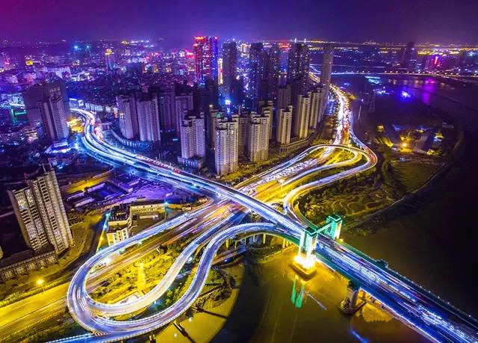
城市介绍
About Quanzhou
泉州位于福建东南沿海，与台湾隔海相望，是我国著名侨乡和台胞祖籍地。泉州市总人口突破700多万，
旅居海外的泉州籍华侨750多万、港澳同胞75万、台湾同胞900万。
Quanzhou is located on the southeastern coast of Fujian, and across the sea from Taiwan. It is famous as the hometown of overseas Chinese and Taiwan compatriots. The population of Quanzhou is over 7 million. Overseas Chinese from Quanzhou is over 7.5 million. In addition, there are 750 thousand Quanzhou people in Hong Kong and 9 million Quanzhou people in Taiwan.

Slide 5
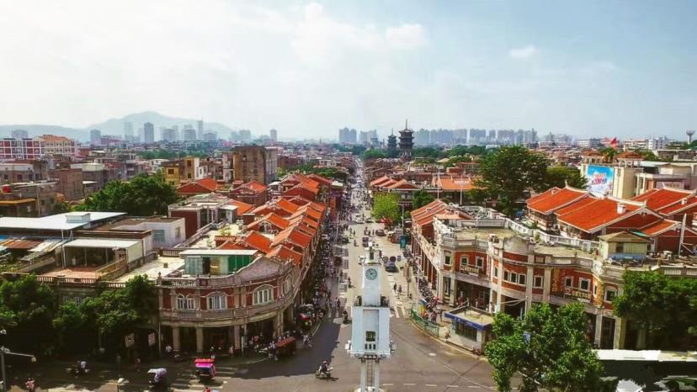
城市介绍
About Quanzhou
泉州又称鲤城、刺桐城，古代“海上丝绸之路”的起点。宋元时期泉州被誉为“东方第一大港”，与古波斯、阿拉伯、印度等国家均有贸易往来。当选首届“东亚文化之都”，成为我国唯一入选城市。泉州市区全年的空气质量优良率高达97% 。
Quanzhou is also called the Licheng or Erythrina city . It is the starting point of marine silk road and the oriental biggest port in Song and Yuan Dynasty . Quanzhou is the only city selected as the Culture City of East Asia in China. The good air quality rate of Quanzhou is 97% over the year.
泉州生产总值持续十四年福建省第一，有一批在全国有影响力的产业集群：鞋业、陶瓷、服装、茶业、石材、水暖、石雕、石化。泉州市的中国驰名商标和中国名牌数量均居福建省第一，全国地级市第一。
The GDP (Gross Domestic Product) of Quanzhou ranks No. 1 in Fujia for 14 years. It is famous for manufacturing industry , such as shoes industry, ceramic industry, fashion industry, tea industry, stone industry, water heating and so on. Quanzhou has the most Chinese well known trademarks and brands in Fujian and this amount ranks first for all the prefecture-level cities in China.

Slide 6


旅游景点
Tourist Attractions
开元寺
Kaiyuan Temple
清源山
Qingyuan Mountain
西湖公园
West Lake Park
郑成功史迹
Historical Sites of Zheng Cheng-gong
洛阳桥
Luoyang Bridge
安溪清水岩
Anxi Qingshuiyan Temple
崇武古城
Chongwu Ancient Town
少林寺
Shaolin Temple

Slide 7
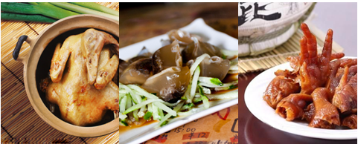
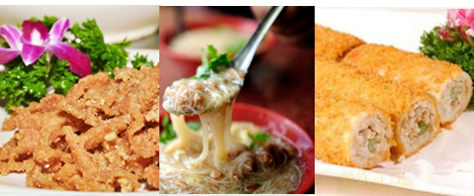
特色美食
Local Delicacy
姜母鸭
Jinjiang Ginger Duck
土笋冻
Sea Worm Jelly
洪懒鸡爪
Honglai Chicken Feet
醋肉
Vinegar Pork
面线糊
Noodle Paste
鱼卷
Fish Roll

Slide 8
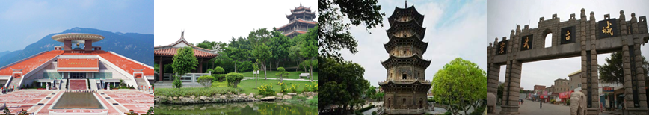
泉州一日游线路
One-day Tour in Quanzhou
开元寺、闽台缘博物馆、老君岩造像、崇武古城
Kaiyuan Temple, Qingyuan Mountain, Laojun Rock, Chongwu Ancient Town
南少林寺、开元寺、闽台缘博物馆、西湖公园
ShaolinTemple, Kaiyuan Temple, Fujian and Taiwan Museum , West Lake Park
开元寺、闽台缘博物馆、海西民间工艺馆、清源山风景区
Kaiyuan Temple, Fujian and Taiwan Museum, Haixi Folk Art Museum, Qingyuan Mountain
开元寺、老君岩造像、锦绣庄、崇武古城
Kaiyuan Temple, Laojun Rock, Jinxiuzhuang, Chongwu Ancient Town

Slide 9
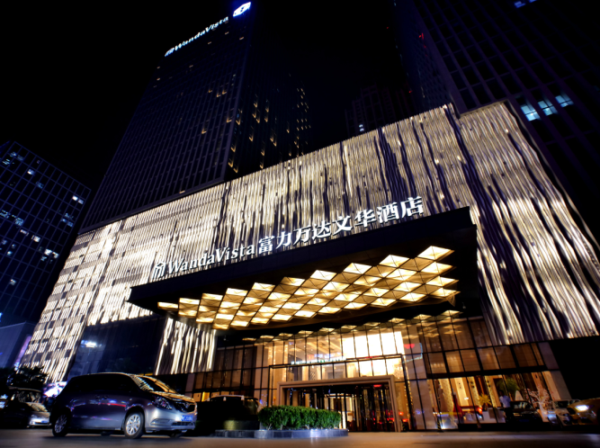
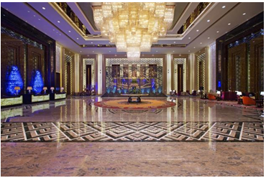
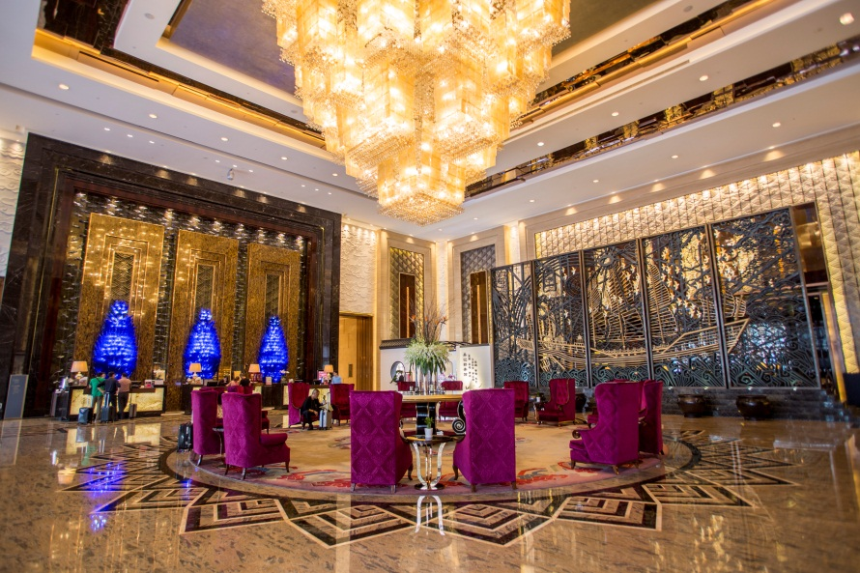
酒店介绍
About Hotel
泉州富力万达文华酒店坐落于城市核心地带－万达广场。酒店拥有314间精致客房和套房，包括“美食汇”全日餐厅、“品珍”中餐厅在内的多间食肆，更有城中首屈一指的1,378平方米无柱大宴会厅，充满东方温情的泉州富力万达文华酒店为莅临泉州的成功名仕提供私享服务和艺术氛围，让您的泉州之旅恣意舒展，尽享优雅体验。
Wanda Vista is located in down town core area of Quanzhou – Wanda Plaza. The hotel features 314 stylish rooms and suites, Café Vista casual all-day dining, ZHEN Chinese Restaurant, and a spectacular 1,378 square meters pillar-free Grand Ballroom. The hotel delights guests with oriental warmth, professional service and artistic atmosphere, which provide you an unforgettable elegant experience in Quanzhou .

Slide 10
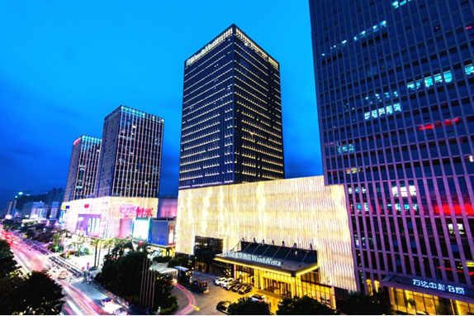
酒店介绍
About Hotel
泉州富力万达文华酒店是为崇尚品质生活的尊贵宾客，提供融合东方神韵与当地风情的精致服务，并营造优雅旅居感受的豪华酒店品牌。
Wanda Vista is a luxury hotel brand to provide elegant traveling experiences to distinguished guests who pursuit quality life.

Slide 11
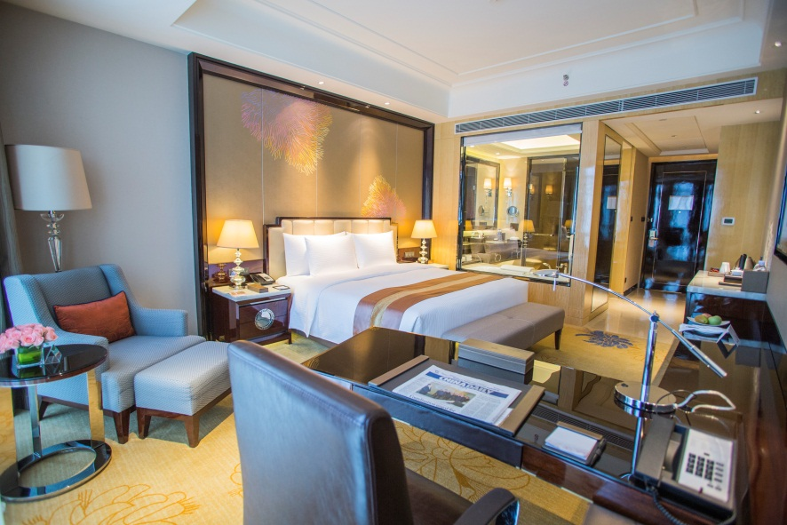
酒店客房
Guest Room
房型 Room Type | 数量 No of Rooms | 面积(平方米) Area (m²) | 标准售价 Price
大床房 King Size | 185 | 42 | RMB1,888
双人房 Twin Size | 97 | 42 | RMB1,888
豪华套房 Deluxe Suite | 28 | 101 | RMB3,688
行政套房 Executive Suite | 3 | 142 | RMB4,688
总统套房 Presidential Suite | 1 | 268 | RMB28,888

Slide 12
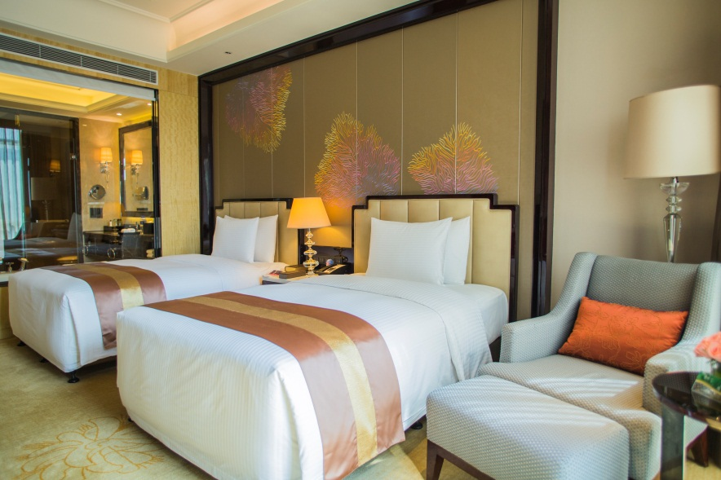
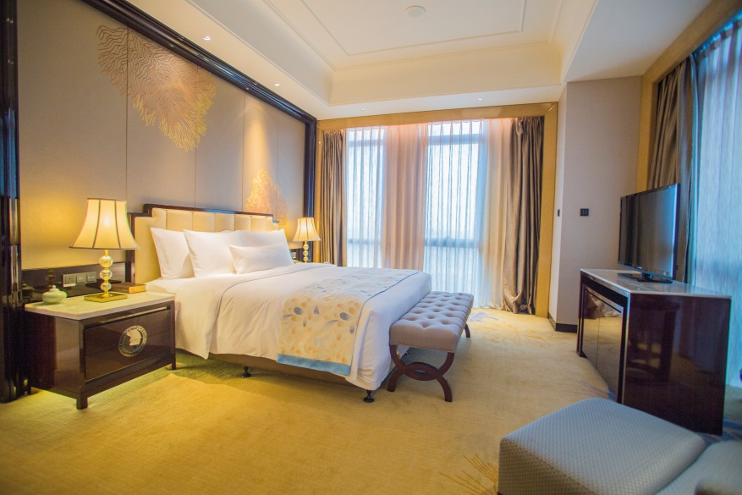
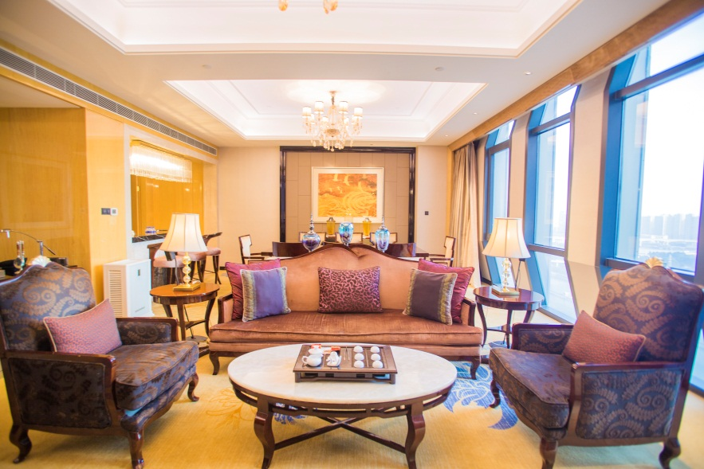
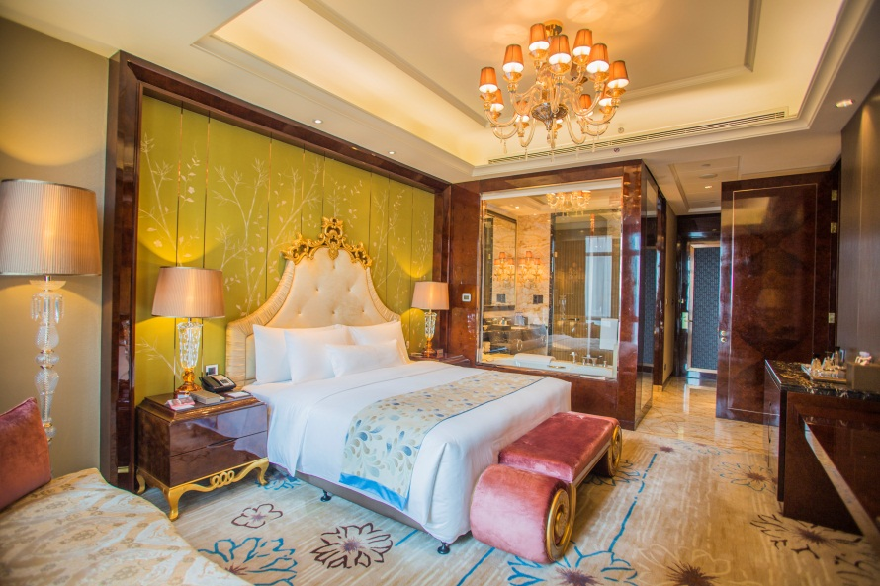
行政套房 Executive Suite
酒店客房
Guest Room
豪华客房 Twin Size
豪华套房 Deluxe Suite
总统套房 Presidential Suite

Slide 13

酒店客房
Guest Room
文华之床
妙梦助眠系列
24小时精选
42寸超大宽频飞利浦液晶电视
带广播及IPOD接口的高级数字时钟
超40个国际卫星电视频道、有线电视频道
免费宽带及市内唯一全部无线网络覆盖酒店
独立浴缸和淋浴间
浴缸电动卷帘
套房以上配浴室电视
热带雨林淋浴
落地窗
客房内密码储物柜
Bed of Vista
Dream Catcher
24 hours selections breakfast
42” Philips widescreen plasma TV
Radio & digital clock with iPod port
Over 40 satellite TV channels and cable channels
Free broadband and wireless internet access to rooms & public areas
Separate bath and shower stall
Electrical shower curtain in bath room
Bath TV in suites
Rainforest shower
Floor-to-ceiling windows
In-room number-code auto-locker

Slide 14

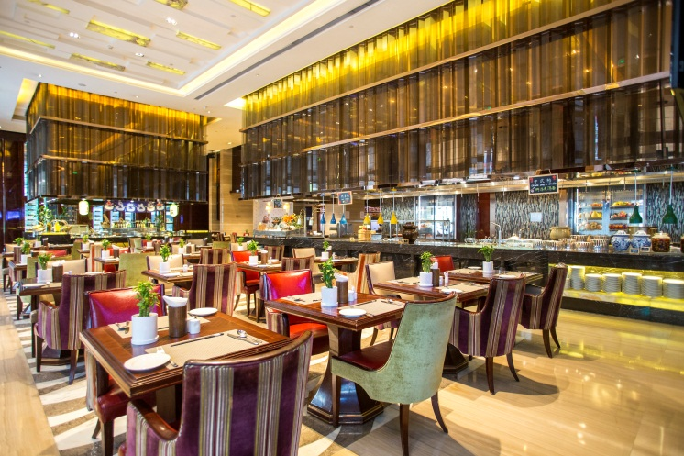
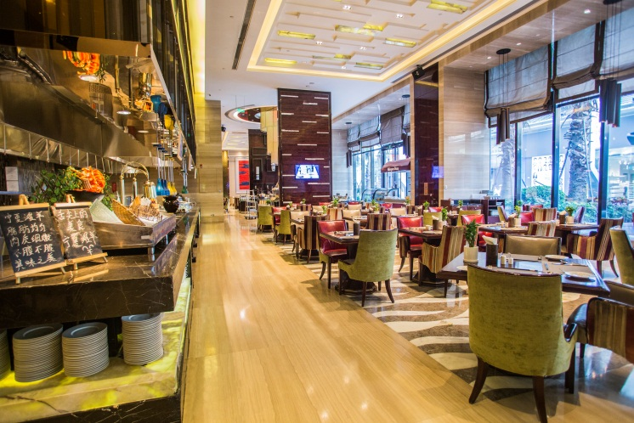
餐饮设施
Food & Beverage
美食汇—全日餐厅
Café Vista All-day Dining
地点/Venue: 酒店一楼 1F
营业时间/ /Business Hours: 6:30–22:30
座位/Capacity: 160
美食汇全新定义了国际酒店不可或缺的全日餐厅；为您贴心准备“外带早餐”，让您在高效工作之余感受家的温暖；“24小时精选”令您始终品尝心仪美味；汇聚各国佳肴的自助大餐以及别有情调的招牌零点，更是让您的午间聚会和晚间盛宴惊喜不断！
“Café” has renewed the definition of all-day dining that is indispensable for international hotels by introducing the “takeaway breakfast” to deliver the warmth of home during the busy travel, a global 24 hours selections and an international buffet serving brand dishes and cuisine that will surprise you and your friends during lunch and evening feasts.

Slide 15

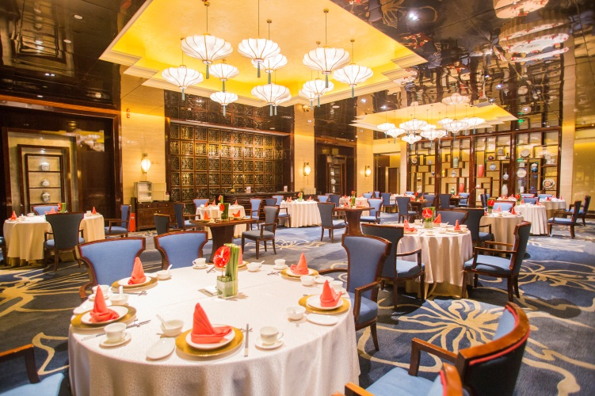
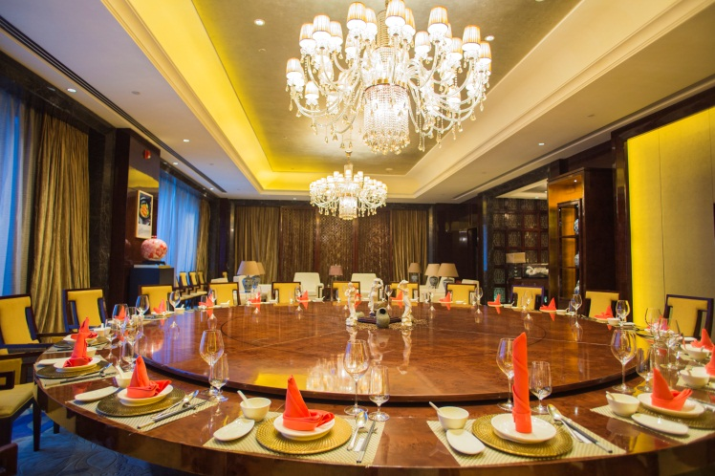
餐饮设施
Food & Beverage
品珍—中餐厅
ZHEN Chinese Restaurant
地点/Venue: 酒店二楼 2F
营业时间/Business Hours: 午餐 Lunch: 11:30–14:00
晚餐 Dinner: 17:00–22:00
座位/Capacity: 174
品珍中餐厅供应口味正宗的粤菜及部分闽南菜，每一道烹饪都突显厨师的独巨匠心。餐厅设有11间包间，地道的口味让您品尝后乐不思蜀，留恋忘返。
ZHEN-Chinese restaurant offers guests with authentic traditional Cantonese and local Minnan cuisines. Every dish reflects the chef’s great originality and ingenuity. The restaurant has 11 private dining rooms, which provide you with an unforgettable experience by delicious taste and a gorgeous atmosphere.

Slide 16

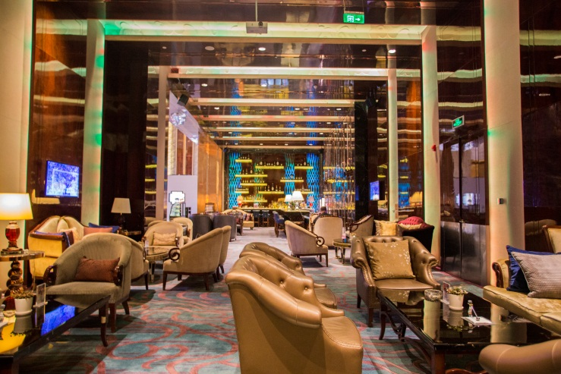
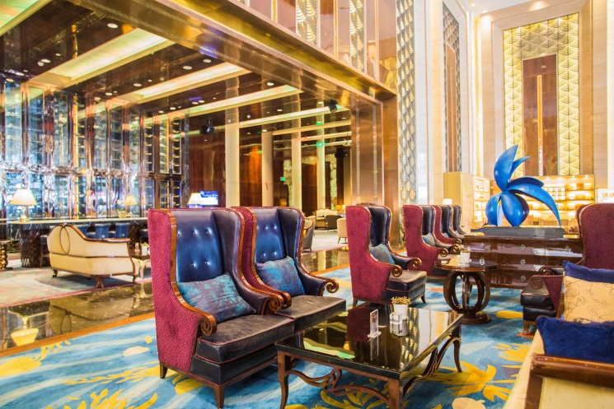
餐饮设施
Food & Beverage
大堂吧
Lobby Lounge
地点/Venue: 酒店一楼 1F
营业时间/Business Hours: 10:00–24:00
大堂吧提供各类咖啡、茶、鸡尾酒、各国啤酒、精选红酒及香槟。您可以和朋友在这舒适优雅浪漫的环境中悠闲地品茗畅谈。
Lobby Lounge offers variety of coffee, tea, cocktails, International beer, fine wine and premium champagne. Enjoy the leisure moment and delicate food with you friends in a modern and plush environment.

Slide 17
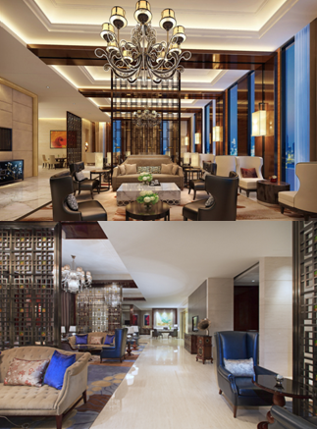
餐饮设施
Food & Beverage
行政酒廊
Executive Lounge
地点/Venue: 酒店23楼 23F
营业时间/Business Hours: 06:30–23:00
行政酒廊位于酒店23层，是商务客人的最佳选择。多样的房间设施设备、更多的私享空间、杰出的个性化贴身服务将会满足您各方面的需求，令您倍受关注！
Executive Lounge is located on the 23ed floor. It is the best choice for executive business travelers. Delights guests with extended room amenities, commodious private space, and personalized service.

Slide 18
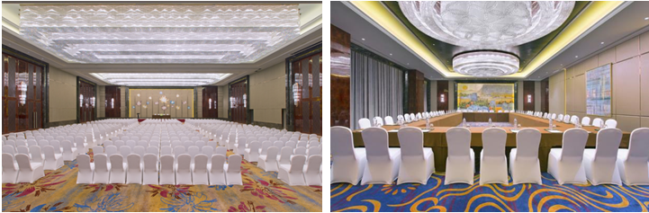
会议宴会
Meeting & Banquet
宴会、会议场地超2,600平方米，其中包括面积为1, 378平方米的无柱式大宴会厅，配有87平方米的先进液晶显示屏，其恢弘、瑰丽的设计在城中无出其右。10个多功能会议室为商务会议提供高等级的服务，先进的会议音响设施设备，如无线麦克风、专业音箱、手拉手会议设备等，可满足各类会议的需要；公共区域免费无线网络覆盖，可保证高速通畅的网络使用需要。
The hotel provides a large 2,600 square meters meeting and banquet space, which includes a pillar-free Grand Ballroom and 10 multi-function halls. The Grand Ballroom features with an 87 square meters high-tech LED screen . The hotel provides high quality catering service, advanced audiovisual facilities to satisfy all your needs. Also, free wireless internet covers the hotel’s public area to guarantee your need of high-speed internet.

Slide 19
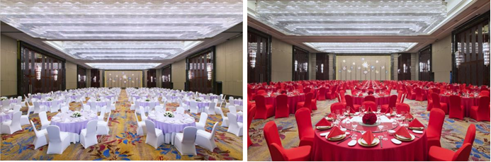
会议宴会
Meeting & Banquet
1,378平方米、层高8米及可接待千人浪漫婚礼的超级无柱式豪华大宴会厅，配备目前省内最大、清晰度最高的88平方米LED屏，是举办婚宴的理想首选。酒店自开业以来，已成功举办多场婚宴，一如既往地受到新人们的好评与喜爱，更被授予“中国最佳婚宴接待酒店”、“中国婚宴酒店奖杰出创新奖”等奖项。
The majestic pillar-free Grand Ballroom offers a 1,378 square meters meeting space and features with an 87 square meters high-tech LED screen. The hotel with a high reputation and has successfully held a lot of wedding since its opening . It has won lots of awards such as “ China’s Best Wedding Reception Hotel” and “China’s Outstanding Innovation Wedding Hotel”.

Slide 20
会议宴会
Meeting & Banquet
场地 Venue |  | 可容纳人数Capacity |  |  |  |  |  |  |  | 尺寸(m) LxWxH Dimensions | 面积 (㎡) Area
 |  | 剧院式Theatre | 课桌式Classroom | 酒会式Cocktail | 董事会 Board Meeting | U-型 U Shape | 圆桌型 Banquet | 回型 Hollow Shape | 自助餐 Buffet
三楼 3F | Grand Ballroom 大宴会厅 | 1300 | 700 | 1000 | - | - | 720 | - | 600 | 45.7x28.5x8 | 1378
 | Grand Ballroom 1 宴会厅1 | 380 | 220 | 300 | 80 | 90 | 220 | 100 | 220 | 28.5x14.6x8 | 440
 | Grand Ballroom 2 宴会厅2 | 400 | 220 | 300 | 80 | 90 | 220 | 100 | 220 | 28.5x16.2x8 | 488
 | Grand Ballroom 3 宴会厅3 | 380 | 220 | 300 | 80 | 90 | 220 | 100 | 220 | 28.5x14.9x8 | 450
 | Function Room 多功能厅 | 220 | 180 | 200 | 50 | 60 | 120 | 70 | 80 | 18.2x12.8x4 | 236
 | VIP Room 贵宾室 | - | - | - | - | - | - | - | - | 11.8x8.9x4 | 106
五楼 5F | Meeting Room 9 会议室9 | 60 | 45 | 40 | 26 | 30 | 30 | 40 | 80 | 10.9x8.2x4 | 90
 | Meeting Room 1会议室1 | 60 | 45 | 40 | 26 | 30 | 30 | 40 | - | 11.2x7.4x3.5 | 86
 | Meeting Room 2 会议室2 | 60 | 45 | 40 | 26 | 30 | 20 | 40 | - | 10.9x6.4x3.5 | 70
 | Board Meeting Room 董事会议室 | - | - | - | 26 | - | - | - | - | 12.9x7.7x3 | 100
 | Meeting Room 3 会议室3 | 60 | 45 | 40 | 26 | 30 | 30 | 40 | - | 11x7.7x3.5 | 86
 | Meeting Room 5 会议室5 | 40 | 30 | 30 | 20 | 20 | 20 | 25 | - | 7x7.5x3.5 | 55
 | Meeting Room 6 会议室6 | 30 | 30 | 30 | 20 | 20 | 10 | 25 | - | 6.6x7.5x3.5 | 50
 | Meeting Room 7 会议室7 | 50 | 30 | 40 | 26 | 20 | 20 | 25 | - | 8.2x7.5x3.5 | 66
 | Meeting Room 8 会议室8 | 60 | 45 | 40 | 26 | 20 | 20 | 25 | - | 9.2x7.5x3.5 | 69

Slide 21
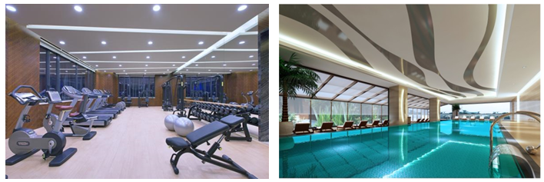
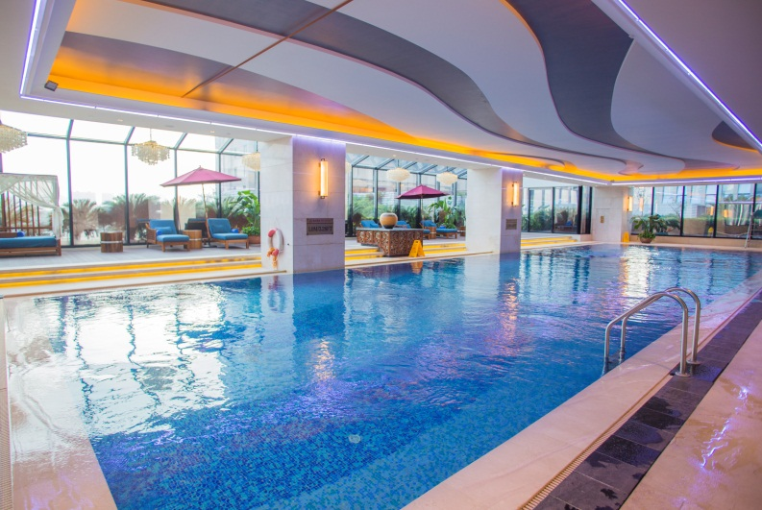
休闲娱乐
Recreation & Entertainment
健身中心
Health Club
地点/Venue: 酒店六楼 6F
营业时间/Business time: 06:00–23:00
自动循环的四季恒温室内游泳池，卫生安全。典雅幽静，配以全进口健身器械的健身房，是您强身健体的最佳选择。
Health Club is located on the 6th floor of the hotel, business hours are from 6:00 to 23:00. Swimming pool is automatically monitored by computer system which would automatically sterilized and recycled to keep a constant temperature. The gym, fitted with fully imported fitness equipment, provides a great choice for your exercise.

Slide 22
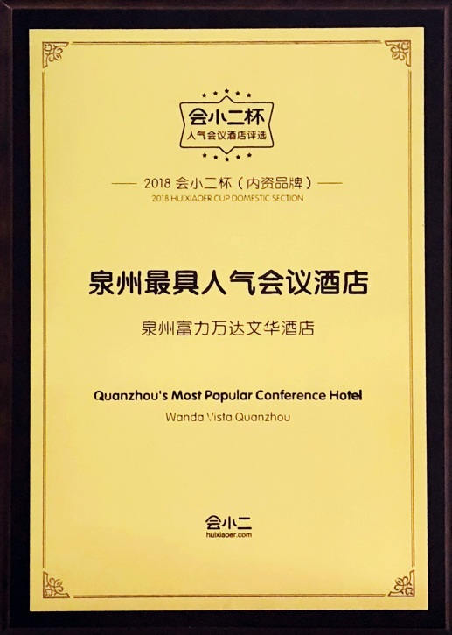
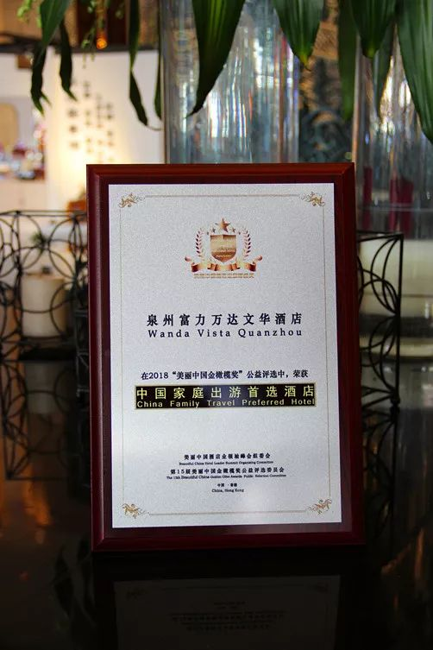
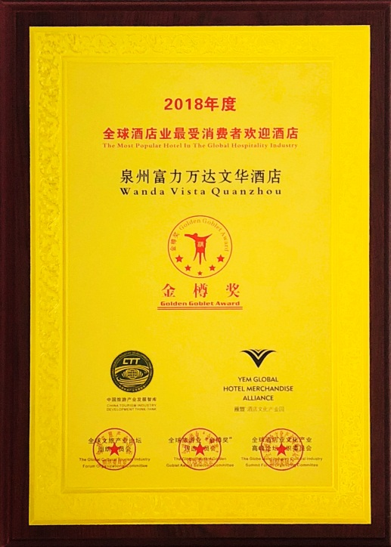
奖项荣誉
Hotel Honor
2018酒店风尚榜 Hotel Fashion List——最佳宾客体验商务酒店|Best Business Hotel for Guest Experience of Hotel Fashion List
第十五届美丽中国金橄榄 Beautiful China Golden Olive Award ——亚洲最佳50家商务酒店、中国家庭出游首选酒店、舌尖上的中国十大推选餐厅
Asia's Best 50 Business Hotel \ China Family Travel Preferred Hotel \ China's Top 10 Elected Restaurant On The Tongue
第五届中国区高端酒店金榜 China High-end Hotel List——最佳婚礼酒店|The Best Wedding Hotel of Hotel Gold List
“会小二”杯 Huixiao-er Cup——年度人气会议酒店、泉州最具人气会议酒店
Annual Popular Conference Hotel \ Quanzhou's Most Popular Conference Hotel
第十届金樽奖 Gold Champion——最受消费者欢迎酒店|Most Popular Hotel of The Globe Hotel Industry Gold Champion
缤客网 Booking.com——好评住宿奖|Guest Review Award of Booking .com
携程旅游口碑榜 C-trip——年度最佳商务酒店奖|The Annual Award for Best Traders Hotel

Slide 23
