Slide 1

呼和浩特会议酒店简介
Brief Introduction of Hohhot Conference Hotel
韵如是 心境自开
Pure Oriental Delight
2021/10

Slide 2
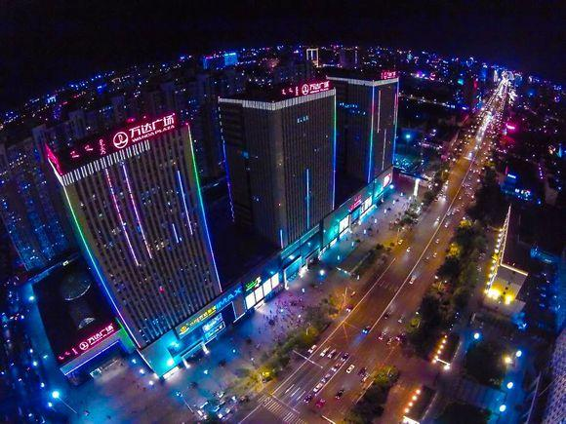
01
目的地介绍
Destination Introduction
呼和浩特 Hohhot
呼和浩特，塞外北疆名城，蒙语意为“青色之城”，因昭庙云集，又称“召城”，是内蒙古自治区政治文化经济中心。呼和浩特具有鲜明的民族特点，丰富的历史文化和得天独厚的自然风光资源，绚丽多彩的蒙古歌舞，精彩纷呈的蒙古摔跤，金碧辉煌的银佛寺大召，中国古代四大美女之墓青冢，气势磅礴的一代天骄成吉思汗陵，浩瀚无垠的响沙湾，天苍苍野茫茫的一望无际的葛根塔拉大草原，这里的一切都是人们远离都市喧嚣，放松心情的天堂净土。
Hohhot is located beyond the Great Wall in Northern China. The city's Mongolian name translates into English as “The Blue City” due to its many luminous temples, making it also known as the “City of Luminous Temples”. The city has a lush history and culture with colourful Mongolian dancing, powerful wrestling shows, magnificent Dazhao temples and Zhaojun Tomb, and outstanding natural landscapes, such as the immense Noisy Sand Bay and the boundless Gegentala Grassland.

Slide 3

02
旅游景点介绍
Tourism Destinations
大召 Dazhao Lamasery
大召蒙古语称“伊克召”， 意为“大庙”，汉语称“无量寺”， 是呼和浩特最早兴建的喇嘛教格鲁派寺院，大召由明代蒙古土默特部落的首领阿拉坦汗于明万历七年（1579年）主持创建，1580年建成，大召注明的艺术三绝是指，银佛，龙雕和壁画，具有极高的工艺水平和文物价值。
The Dazhao in Mongolian called “YeXe Juu” and in Chinese means “ Temple of Boundless Beneficence”, it was the first Shamanism temple in Hohhot. The temple was built in 1579 leading by the Altan Khan, leader of Mongolia Tumote Tribe and completed in 1580 when the emperor WanLi ruled China in Ming Dynasty. The famous three unique arts of Dazhao Temple-silver Buddha, Winding Dragon and Murals with a high level of technology and appreciation value.

Slide 4
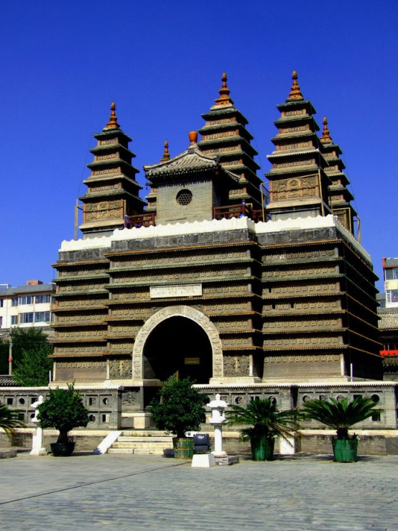
02
旅游景点介绍
Tourism Destinations
五塔寺 Five Pagoda Temple
五塔寺位于呼和浩特玉泉区的五塔寺后街，它以美观的造型和独特的建筑风格，在众多的塔寺中独树一帜。比较特殊的地方是在塔后照壁上嵌有三幅线雕石器刻，正中为须弥山图，西面为六道轮回图，东面为天文图。这是目前全世界仅有的一幅有蒙文标注的石刻天文图，具有重要的历史和科学价值。
The Five Pagoda Temple located at Wuta Backstreet, Yuquan district in Hohhot. It is in beautiful shape and unique architecture comparing with many other pagodas in China. Rather special place on the back of tower embedded with three pieces of carved stone engraved lines, the middle of Sumeru map, west of the six cycle map, east of astronomical figure. This is currently the only one Mongolian stonecutting astronomical figure in the world, which has important historical and scientific value.

Slide 5
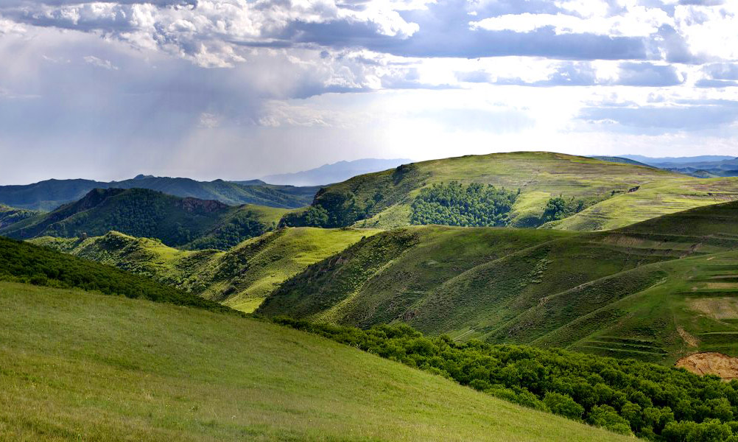
02
旅游景点介绍
Tourism Destinations
大青山生态休闲旅游景区 DaQing Eco-tourism Scenic Area
呼和浩特市大青山旅游度假带东起面铺窑沟，西至黑牛沟，北接武川县，南至山脚，绵亘数百里。这里集中了劈柴沟、白石头沟、喇嘛洞、水磨沟等多个景点。可谓是山山有景，沟沟迷人。
The Daqing Mountain scenic resort band in Hohhot is from Mianpuyaogou in the east to the Heiniugou in the west, adjacent to the Wuchuan country in the north to the foot of a hill in the south, stretching along and unbroken in hundreds miles. Focus here we can enjoy a lot of famous scenic view like Pichagou, Baishitougou, Lamadong and Shuimogou etc. This is called that condensing all essences under the heaven and earth---making every mountain valley has it’s unique view and own attraction.

Slide 6

02
旅游景点介绍
Tourism Destinations
辉腾锡勒黄花沟草原旅游区 Huanghua Ditch Grassland Tourist Area Huitengxile Prairie
辉腾锡勒草原位于乌兰察布市察哈尔右翼中旗西南边际。“辉腾锡勒”在蒙古语里意为“寒冷的高原” 。辉腾锡勒草原海拔1800多米，每当夏秋之际，草原绿草如茵、黄花似锦、湖水如镜、白羊如雪、绿草、鲜花、牛、羊、马、骆驼，慢悠悠的勒勒车和繁星点点的蒙古包，再加上远处起伏的山峦、纵横的沟壑、壁立的悬崖，构成一个童话般的世界。
Huitengxile located in the eastern section of Yin Mountains. “Huitengxile” in the Mongolian word is “cold plateau.” With altitude of over 1800 meters. Today, here are cool enough to be comparable with the Sun and Moon Mountain. In every summer and fall season, prairie mirror and herd of sheep as white as snow, the green grass, flowers, herds of cattle, sheep, horse, camel, leisurely moved Lele cart and yurts embellished with stars then plus the distant hills, the aspect of ravines and sleep cliffs, all of those from a fairy-tale world.

Slide 7

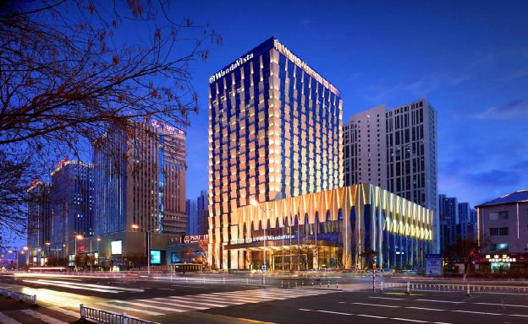
呼和浩特富力万达文华酒店简介
Wanda Vista Hohhot Overview

Slide 8
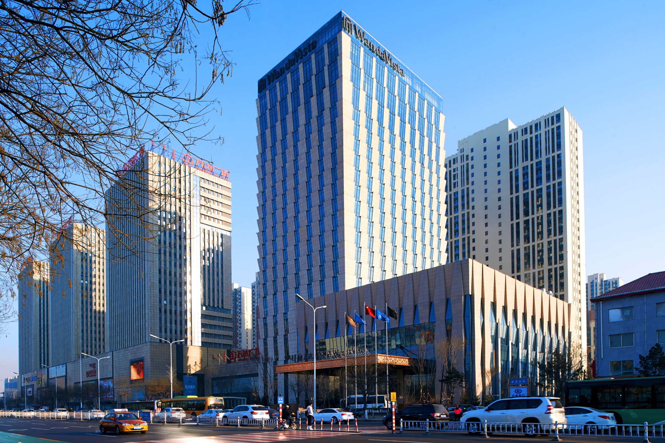
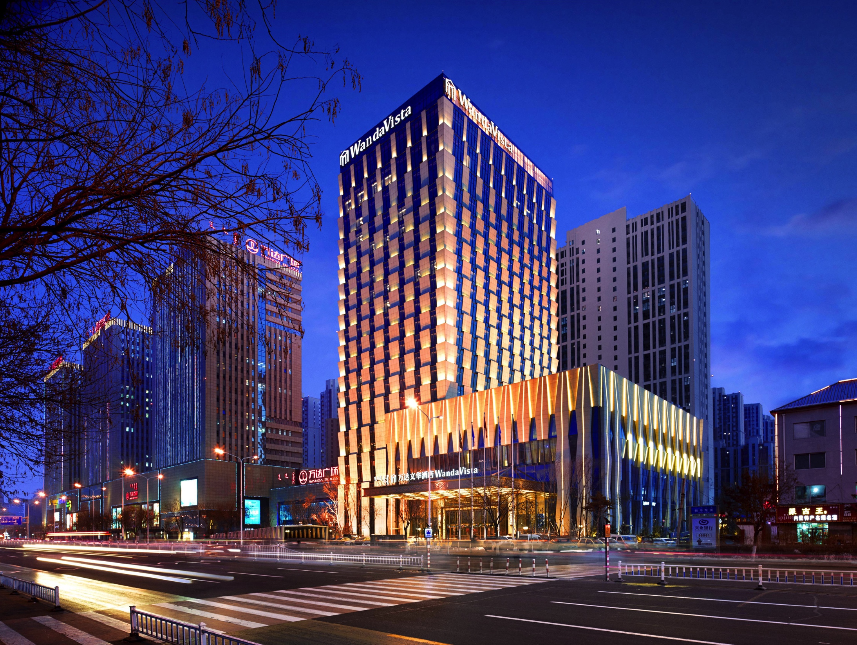
01
酒店介绍-呼和浩特富力万达文华酒店
Hotel Introduction
酒店外观 Hotel Exterior
呼和浩特富力万达文华酒店拥有311间典雅舒适的客房及套房，多家风格各异的餐厅为宾客们提供各种美食珍飨。酒店内设有高端宴会场地、健身中心、恒温泳池，以及齐全的健身设施，并将呈献一系列万达文华酒店特有的品牌特色服务，包括万达迎宾天使、文华之床、茶之旅及“妙梦”助眠产品等。
Hohhot Wanda Vista Hotel 311 luxury rooms and suites offer elegant and artistic ambience, many of them complemented by panoramic view of the nearby Daqing Mountain. Dining options guarantee an unforgettable gourmet experience in Hohhot. The hotel also boasts its well-appointed meeting and events venues, fitness facilities, as well as an indoor heated pool. Wanda Vista's signature services, including Angel's welcome, Bed of Vista, CHA journey and Dream Catcher service, will bring to guests unforgettable experience in Wanda Vista Hohhot.

Slide 9
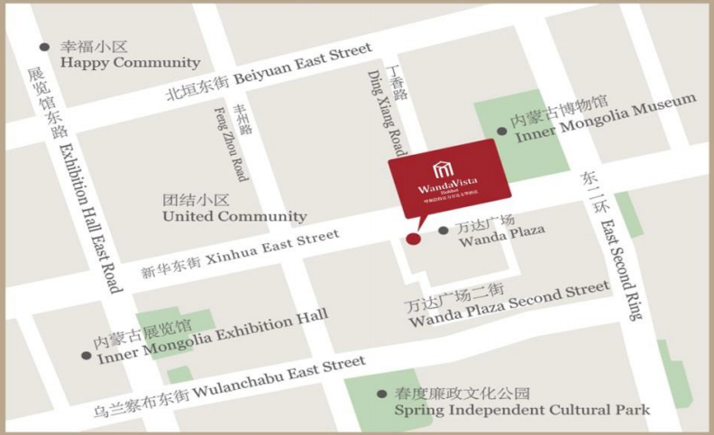
02
酒店介绍-位置
Hotel Introduction
酒店地图 Hotel Map
呼和浩特富力万达文华酒店位于赛罕区中心地带，毗邻万达广场，前往城市主要景点和商圈交通便利，距呼和浩特火车东站仅5分钟车程，距呼和浩特白塔国际机场仅15分钟车程。白塔机场运营航线150条，通航城市77个。Ideally located in Saihan central business district, adjacent to Wanda Plaza, Wanda Vista Hohhot offers easy access to the city’s famous attractions and commercial areas. The hotel is only 5 minutes away from Hohhot East Railway Station or the next Highway access in all directions and 15 minutes’ drive from Baita International Airport. Baita International Airport operate routes 150, navigable city 77.

Slide 10
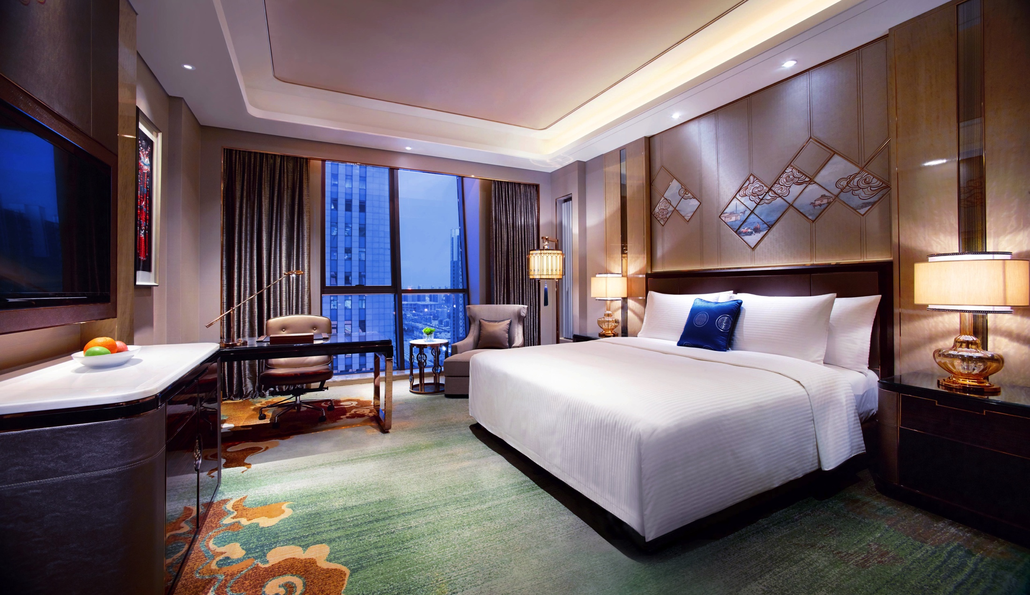
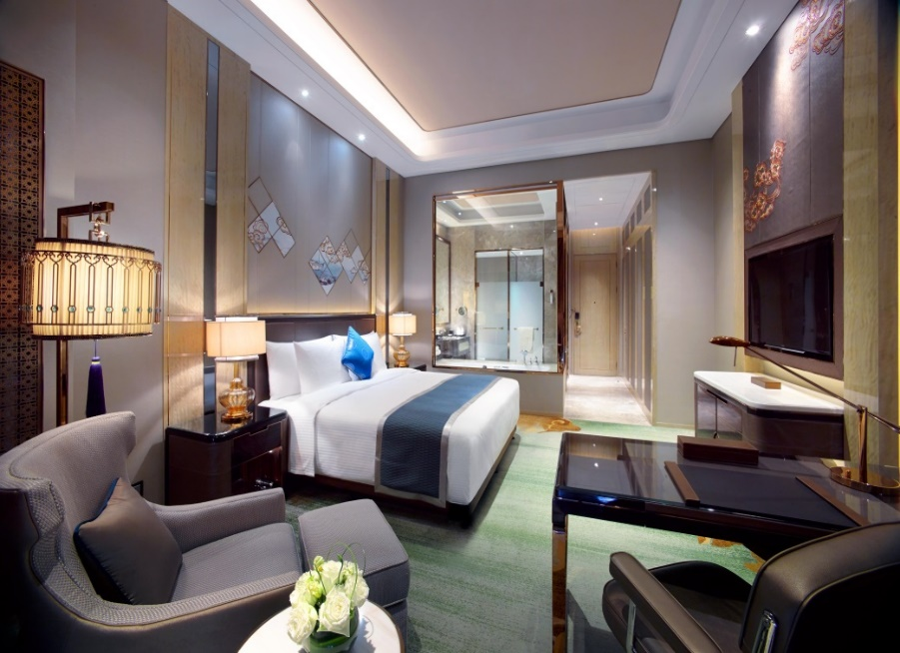
03
酒店介绍-房间
Hotel Introduction
豪华客房 Deluxe Room
行政豪华客房 Executive Deluxe Room
豪华客房装饰以内蒙当地的历史及传统为灵感，营造别具一格、富有艺术特色的住宿空间。设有专属的“万达文华之床”，以高品质的寝具营造如置身云端般的舒适享受，配合品牌独创的“妙梦”助眠产品，陪伴宾客甜睡入梦，畅享优质睡眠体验。宽敞的浴室设有独立式浴缸及步入式淋浴设施，配合优质洗浴用品，打造怡人沐浴享受。豪华客房配备齐全的科技产品，为宾客呈献非比寻常的视听盛宴。房间内的落地玻璃窗打造开阔视野，宾客可将无与伦比的城市风光尽收眼底。
The well-appointed luxurious guest room is artistically decorated, creating an oriental ambience. Bed of Vista and Dream Catcher selections are exclusively customized to ensure a sound sleep during guests' stay in Wanda Vista. Spacious bathroom offers deluxe amenities, separate bath and rainforest shower, all designed to exceptional bathing experience. the Deluxe room guarantees a most state-of-the-art stay. Enjoy stimulating city views from the ceiling-to-floor windows in the room.

Slide 11
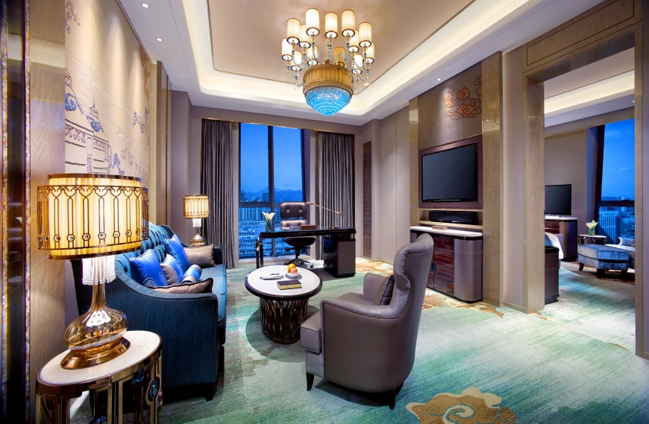
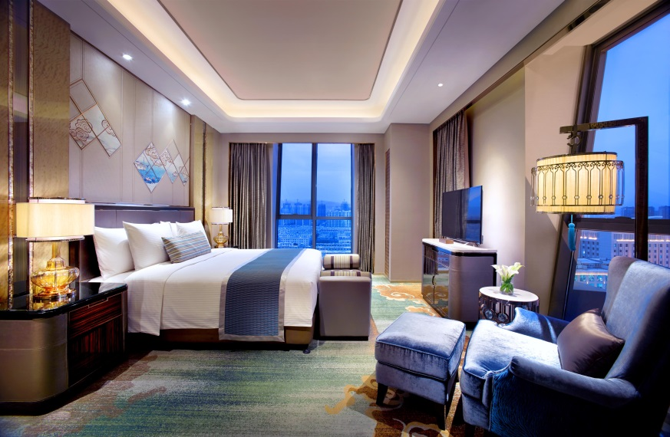
03
酒店介绍-房间
Hotel Introduction
行政套房 Executive Suite
94平米的行政套房豪华舒适，设施齐全。内部装潢别具内蒙特色，打造大气别致的住宿空间。宽敞的浴室，配备热带雨林式沐浴设施及独立浴缸。专属“万达文华之床”打造置身云端般的舒适享受，配合品牌独创的“妙梦”助眠产品，陪伴宾客甜睡入梦，畅享优质睡眠体验。
Executive Suites are luxuriously-appointed suites of 94 square meters designed for an optimal travel experience. The glass-enclosed bathroom in sleek marble lets you savor a soak in the bathtub or revive in the free-standing rainforest shower all while savoring the deluxe bath. Sink into a comfortable sleep every night in the "Bed of Vista" and the service of Wanda Vista’s "Dream Catcher".

Slide 12
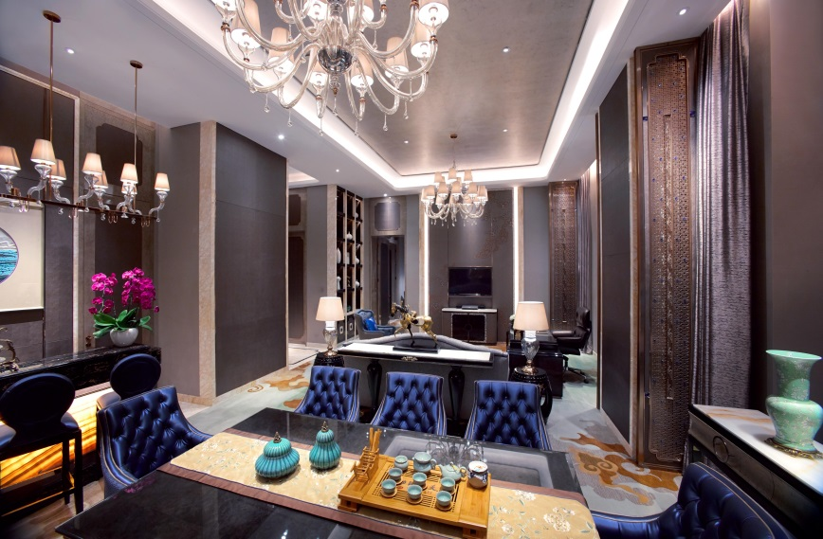
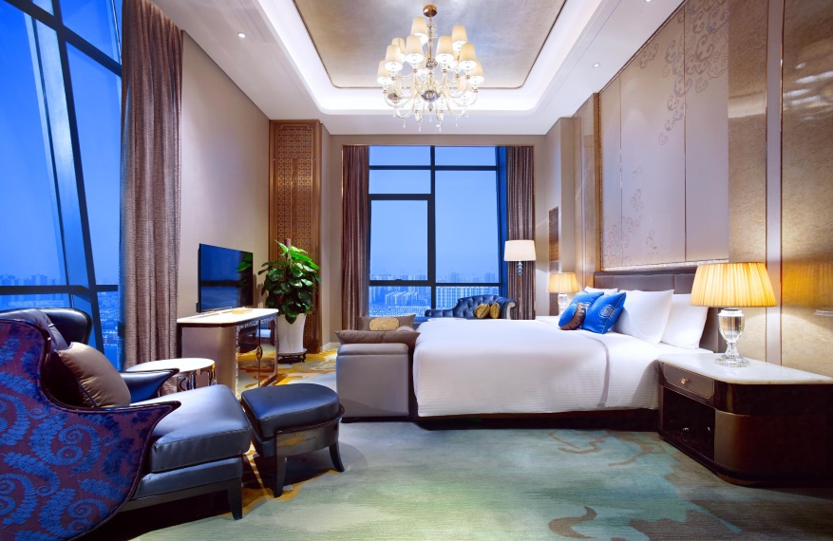
03
酒店介绍-房间
Hotel Introduction
董事套房 Chairman Suite
136平米超大面积的董事套房，配备舒适的起居设施。董事套房提供特大文华床，包括睡枕菜单在内的妙梦助眠系列，高速网络接入等。宽敞的浴室设有独立式浴缸及热带雨林式淋浴设施，配合“欧舒丹”高端护理系列产品，打造舒心的沐浴享受。国际卫星频道、55英寸超大宽屏液晶电视、BOSE高端音响系统等呈现非比寻常的视听盛宴。客人还能够享受到行政酒廊早餐，每日欢乐时光等一系列尊享优惠。
The Chairman Suite is a spacious suite of 136 square meters comprising of a 55-inch LCD TV with International channels and a state-of-the-art BOSE sound system. The suite boasts an super king-size “Bed of Vista”, and Dream Catcher service including a Pillow Menu, as well as complimentary high-speed internet access. Spacious bathroom offers a separate bath, rain-forest shower and deluxe amenity by L'OCCITANE. Chairman Suite guests benefits such as daily breakfast and evening Happy Hour.

Slide 13
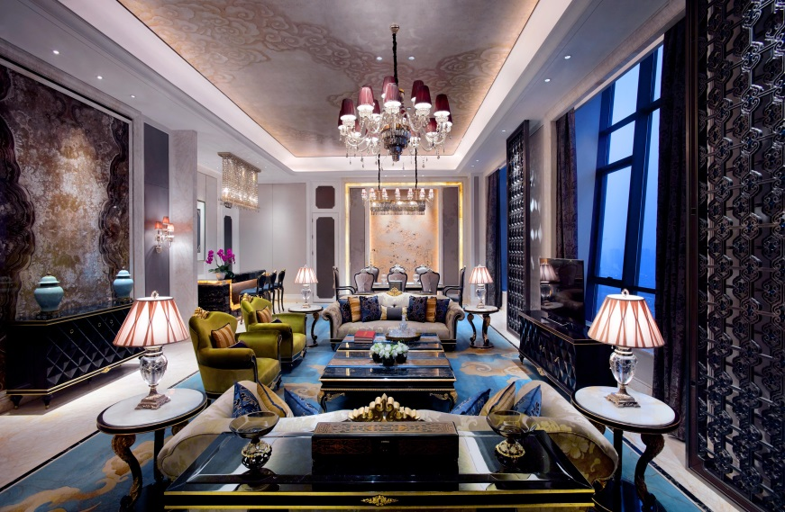
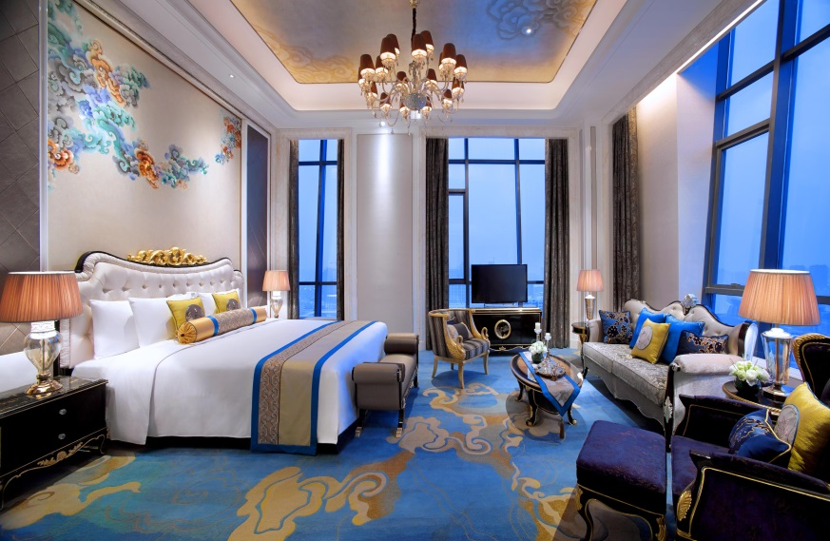
03
酒店介绍-房间
Hotel Introduction
总统套房 Presidential Suite
酒店220平米的总统套房华丽优雅，洋溢着时尚风情和蒙古特色元素。总统套房为成功名仕悉心提供专属服务和艺术氛围。总统套房设有宽敞舒适的客厅、餐厅及办公室。透过落地窗可以欣赏到城市景观。房间配备专属的“万达文华之床”，以高品质的寝具营造如置身云端般的舒适享受，配合品牌独创的“妙梦”助眠产品，陪伴宾客甜睡入梦，畅享优质睡眠体验。
The Presidential Suite is a luxury suite of 220sqms with stunning city views and locally inspired interior designs, ensuring an extravagant experience and spacious living for our most acclaimed guests throughout their stay. With its spacious living room, dinning room and office, this exquisitely designed suite includes a full entertainment system. The suite boasts an super king-size “Bed of Vista”, and Dream Catcher service.

Slide 14
04
酒店介绍-房型
Hotel Introduction
客房房型 Room Type | 客房房型 Room Type | 面积 Square Meter | 房间数量 Room Quantity
Deluxe Room Twin | 豪华双床房 | 42 | 66
Deluxe Holly Wood | 豪华好莱坞房 | 42 | 47
Deluxe Room King | 豪华大床房 | 42 | 39
Grand Deluxe Twin | 高级豪华双床房 | 42 | 36
Grand Deluxe King | 高级豪华大床房 | 42 | 39
Executive Floor Deluxe Twin | 行政豪华双床房 | 42 | 13
Executive Floor Deluxe King | 行政豪华大床房 | 42 | 54
Executive Suite | 行政套房 | 94 | 14
Chairman Suite | 董事套房 | 136 | 2
Presidential Suite | 总统套房 | 220 | 1

Slide 15
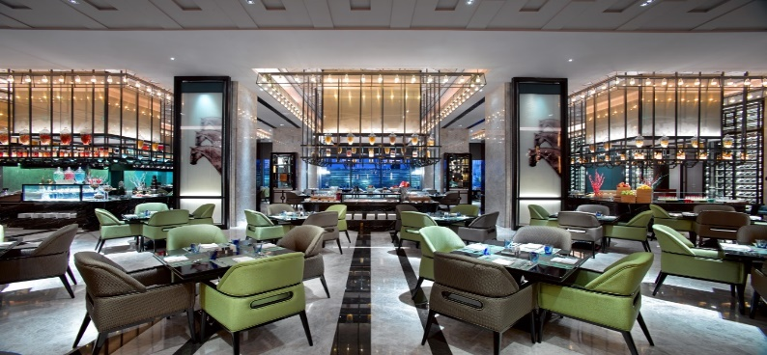
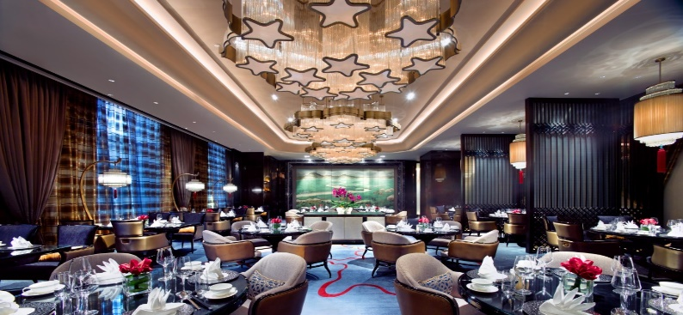
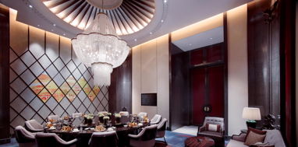
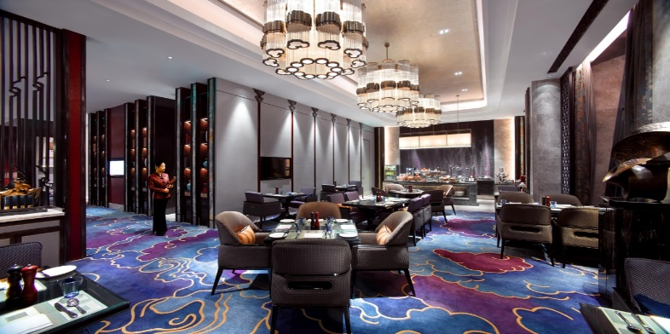
05
酒店介绍-餐厅
Hotel Introduction
美食汇 Café Vista
地点Location：酒店一楼 1F
容纳人数Covers：175
品珍中餐厅 ZHEN Chinese Restaurant
地点Location：酒店二楼 2F
容纳人数Covers：60
西域 West Grate
地点Location：酒店一楼 1F
容纳人数Covers：56
行政酒廊 The Executive Club Lounge
地点Location：酒店21楼 21F
容纳人数Covers：30

Slide 16
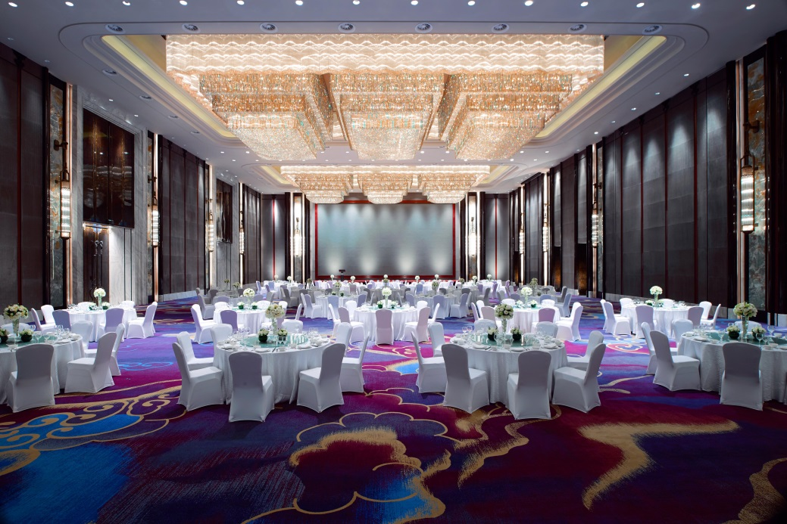
06
酒店介绍-会场
Hotel Introduction
大宴会厅 Grand Ballroom
面积为1,344平方米的无柱式大宴会厅位于酒店3层，配备103平方米LED大屏，可根据您的需求灵活分隔为3个独立空间，是举办各类大型会议和社交宴会的理想选择。
Located on the third floor, the pillar-free grand ballroom measures 1344 square meters. The spacious grand ballroom can be divided into 3 separate parts to cater to guests' different needs. Equipped with a 103 square meters LED screen, the space is a perfect choice for meetings, conferences and social gatherings of various scales.

Slide 17

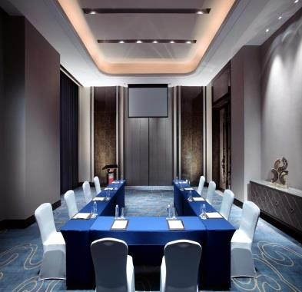
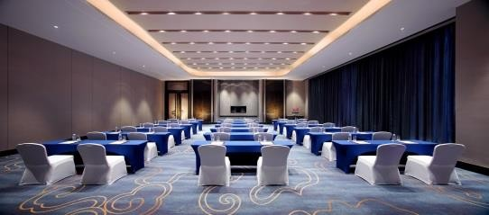
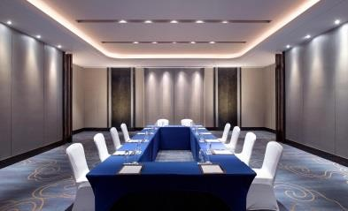
06
酒店介绍-会场
Hotel Introduction

Slide 18
06
酒店介绍-会场
Hotel Introduction
Venue | 场地 | 剧院式 | 课桌式 | 董事会式 | U型 | 宴会式 | 会场长宽高
Grand Banquet Hall | 大宴会厅 | 1300 | 870 | 150 | 150 | 700 | 47.7*28.15*10.7
Banquet Hall 1 | 宴会厅1 | 400 | 200 | 80 | 100 | 200 | 15*28.15*10.7
Banquet Hall 2 | 宴会厅2 | 470 | 230 | 80 | 120 | 240 | 18*28.15*10.7
Banquet Hall 3 | 宴会厅3 | 400 | 180 | 80 | 80 | 200 | 14.5*28.15*10.7
Banquet Hall 1+2 | 宴会厅1+2 | 870 | 500 | 100 | 150 | 420 | 33*28.15*10.7
Banquet Hall 2+3 | 宴会厅2+3 | 900 | 500 | 100 | 150 | 420 | 32.5*28.15*10.7
Inner Mongolia Hall | 内蒙古厅 | 60 | 45 | 26 | 38 | 50 | 13.4*9.55*5
Gansu Hall | 甘肃厅 | 130 | 84 | 42 | 54 | 90 | 16*11.3*5
Ningxia Hall | 宁夏厅 | 50 | 30 | 24 | 20 | 30 | 10.6*9*3.5
Shaanxi Hall | 陕西厅 | 65 | 45 | 36 | 38 | 60 | 13.6*9.5*3.7

Slide 19
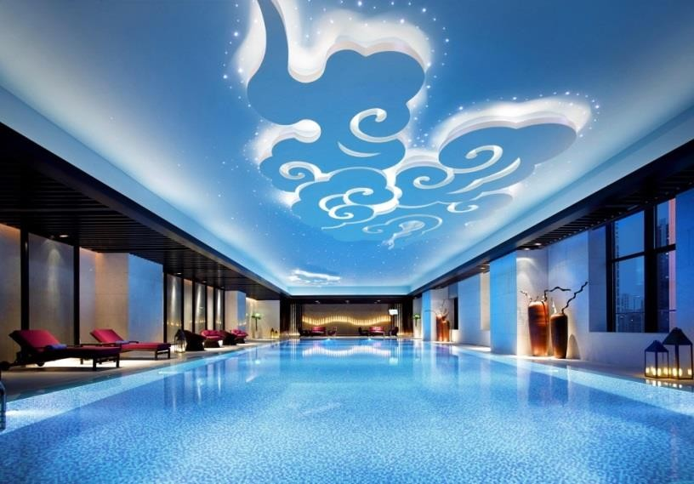
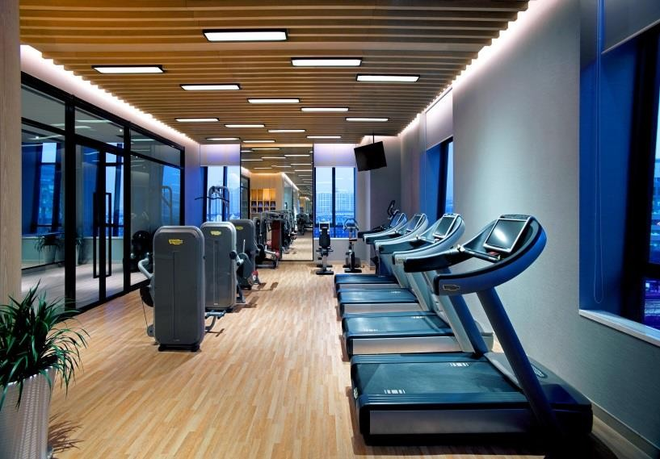
07
酒店介绍-健身中心
Hotel Introduction
健身中心
Health Club
酒店为您提供一系列配套齐全的休闲健身设施，在室内恒温20米的游泳池内畅游或在配备国内先进设施的健身 房中锻炼，都将使您褪去疲惫重焕生机。
Rejuvenate your mind and body while you enjoy your luxurious stay in Wanda Vista Hohhot. Take a refreshing plunge at the 20 meters heated swimming pool, or energize your body with a workout at the state-of-art gymnasium.

Slide 20


谢谢 Thanks!
中国内蒙古呼和浩特市新华东街26号 邮编：010020
26 Xinhua East Street, Hohhot, Inner Mongolia, 010020, P.R.China
全球预订免费电话 Toll Free: 400 088 8899 电话 Tel: (86 471) 518 8888 传真 Fax: (86 471) 516 3333
www.wandahotels.com

