Slide 1
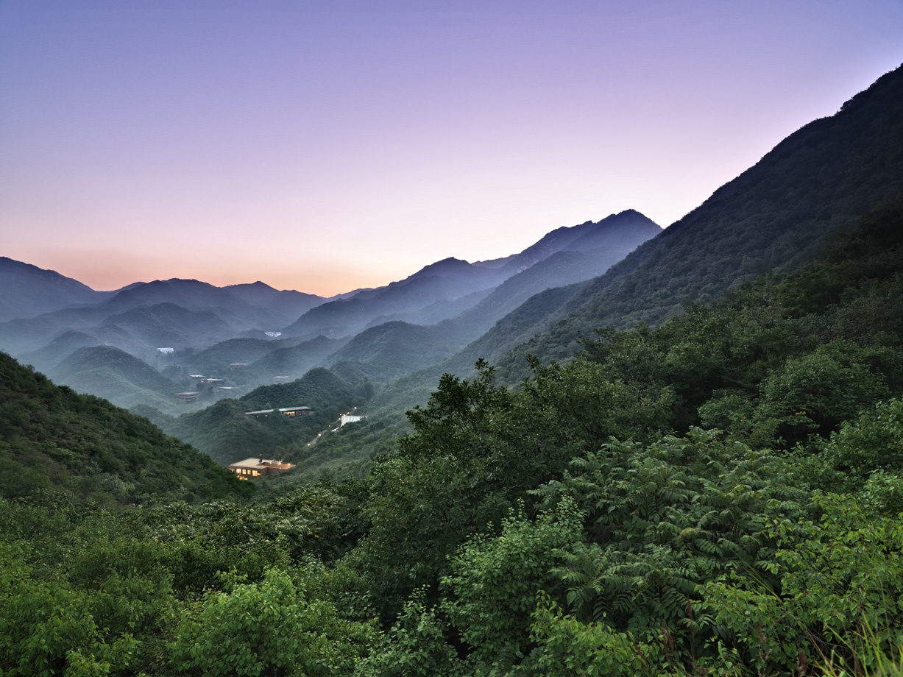
长城脚下的公社，凯悦臻选品牌旗下
Commune by the Great Wall ，In the Unbound Collection by Hyatt
长城脚下的公社，由12名亚洲杰出建筑师设计建造的私人收藏的当代建筑艺术作品，是中国第一个被威尼斯双年展邀请参展并荣获“建筑艺术推动大奖”的建筑作品。2005年被美国《商业周刊》评为“中国10大建筑奇迹”之一。
Commune by the Great Wall is a private collection of contemporary architecture designed by 12 Asian architects. It was exhibited at the 2002 la Biennale di Venezia and bestowed a special prize. In 2005, Commune by the Great Wall was hailed by Business Week as a "New Architectural Wonder of China".

Slide 2

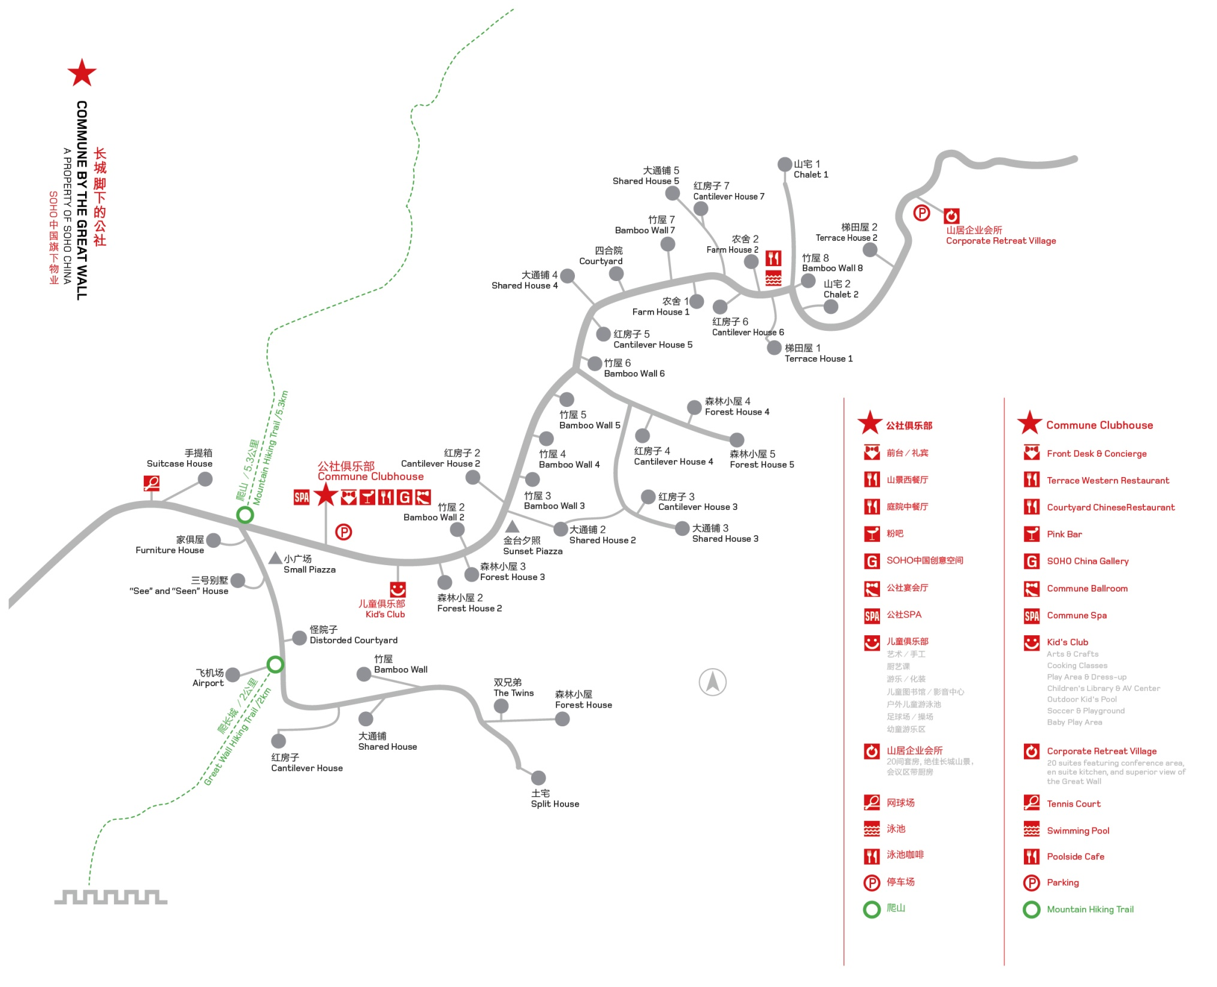
长城脚下的公社别墅分布地图 Commune Inside Floor Plan

Slide 3
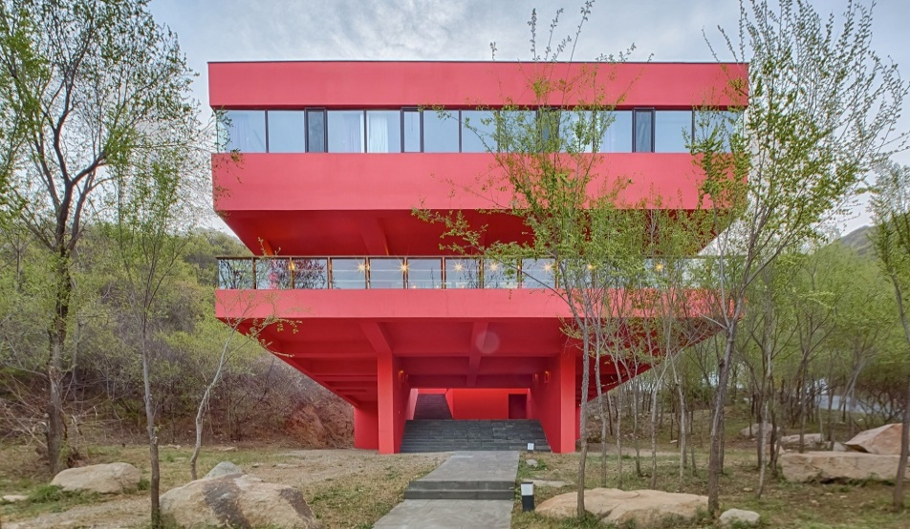
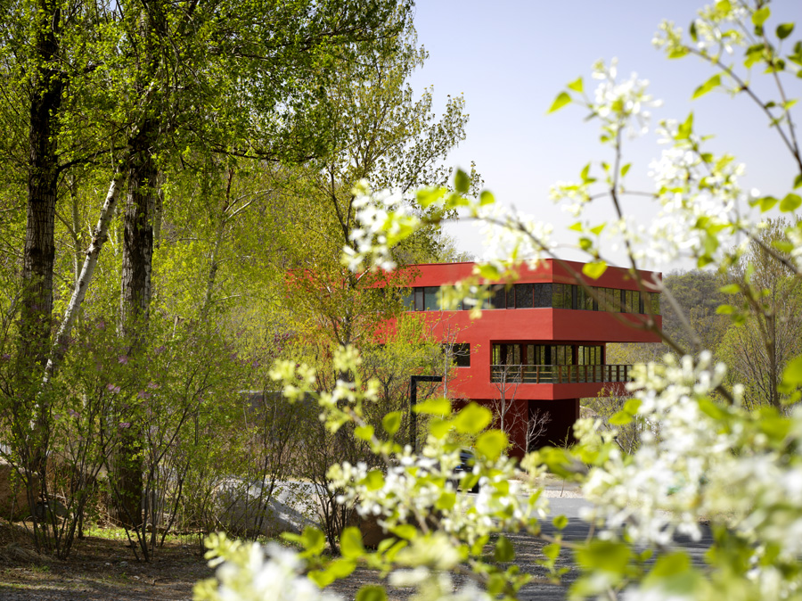
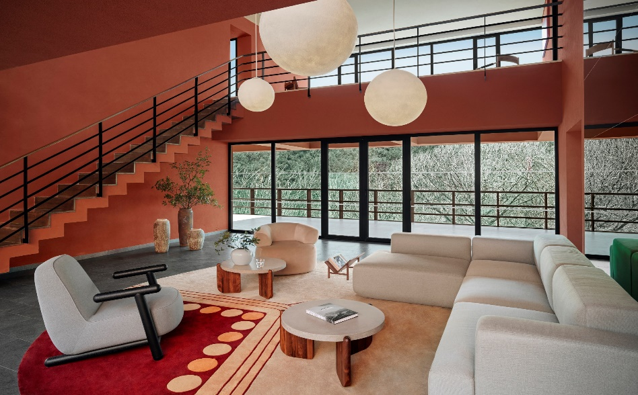
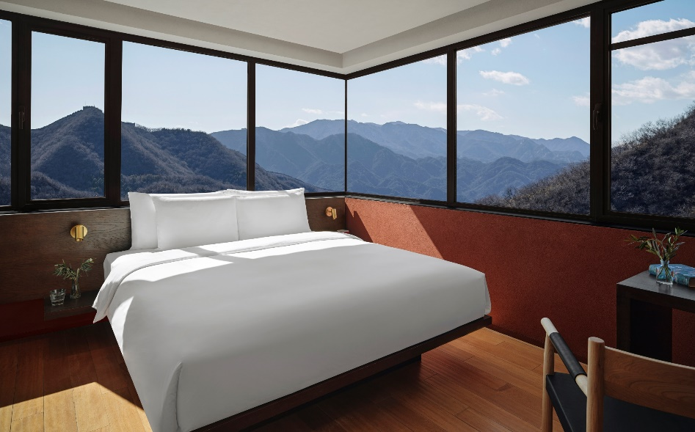
红房子别墅 Cantilever House 设计师：安东 Antonio Ochoa (China)

Slide 4
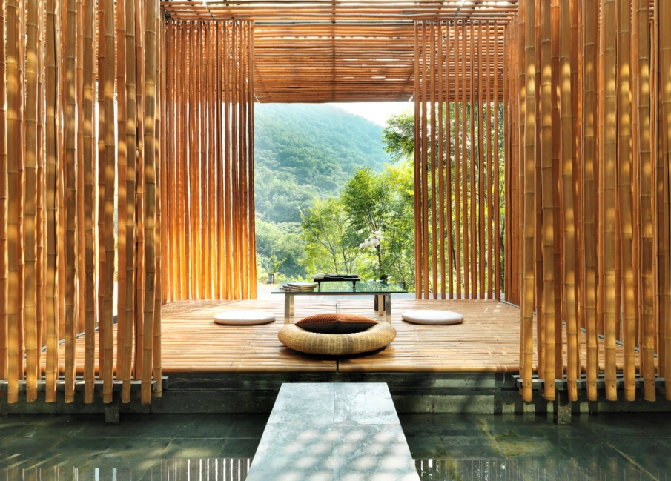
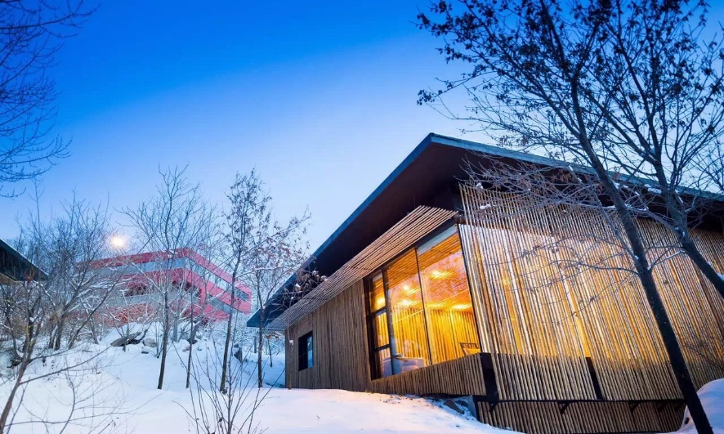
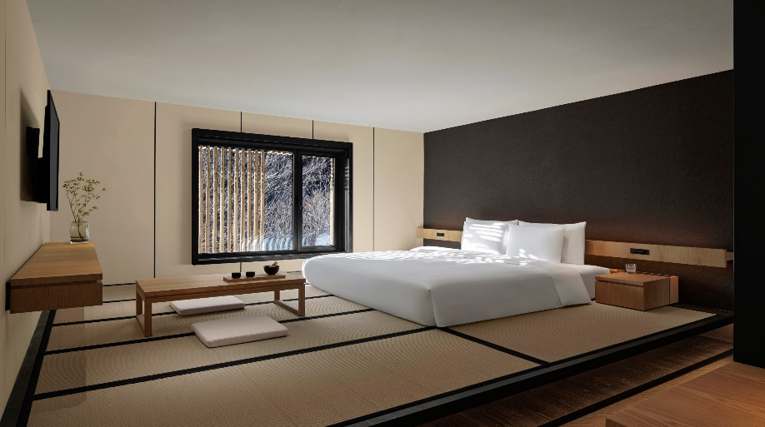
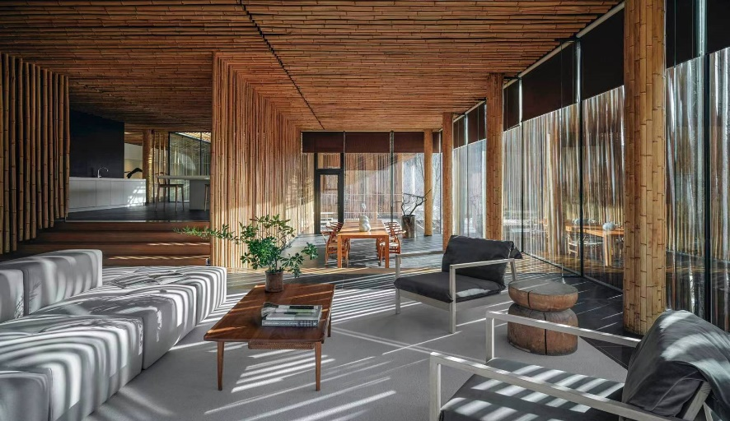
竹屋别墅 Bamboo Wall 设计师：隈严吾Kengo Kuma (Japan)

Slide 5
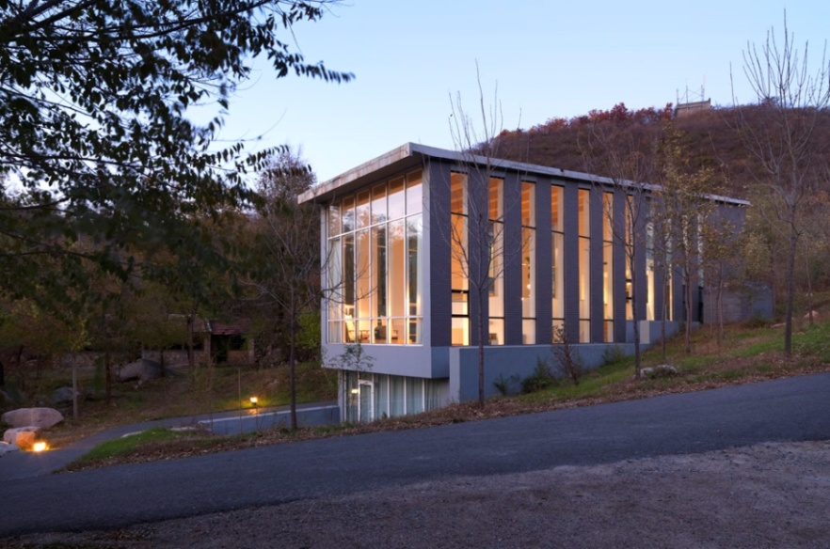
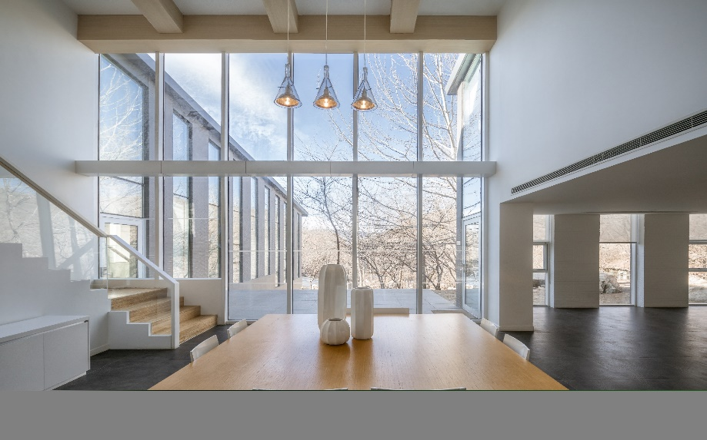
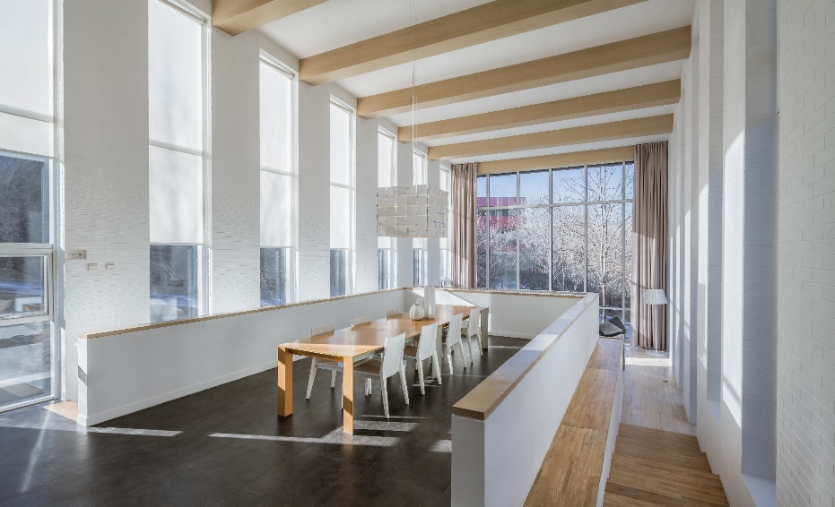
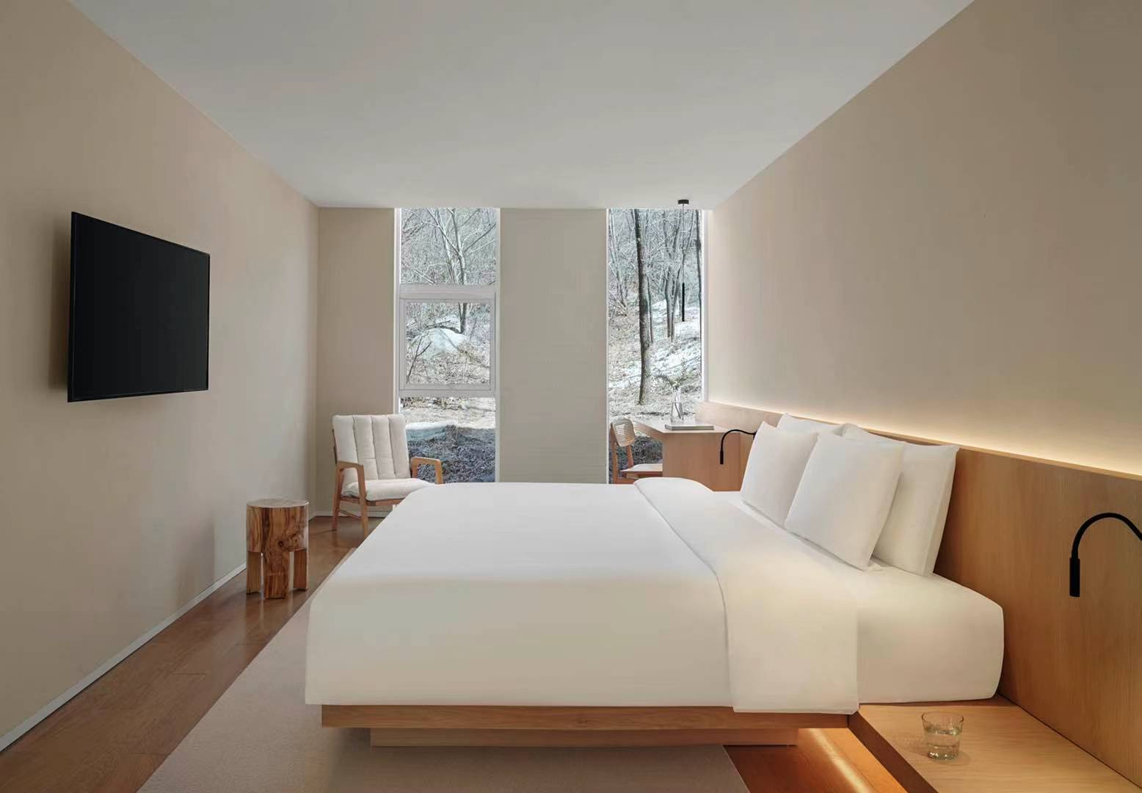
森林小屋别墅 Forest House 设计师：谷古诚章 Nobuaki Furuya (Japan)

Slide 6
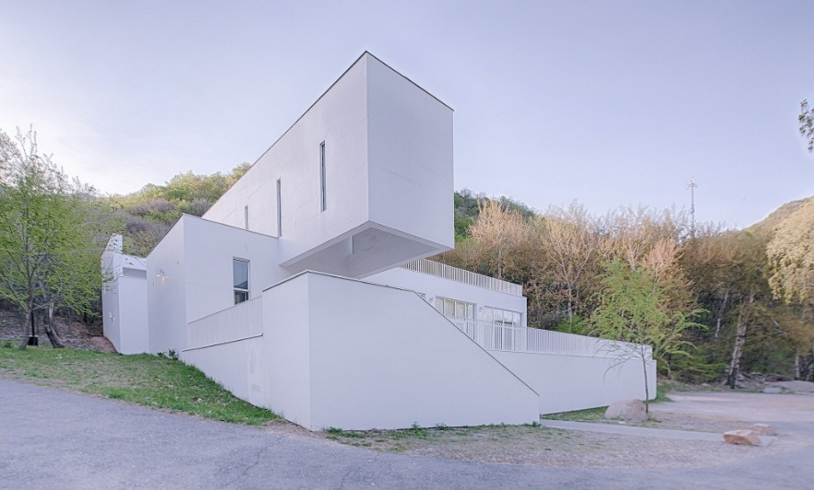
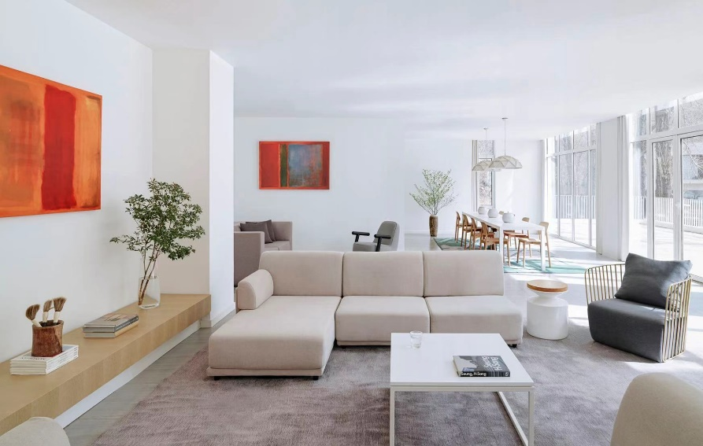
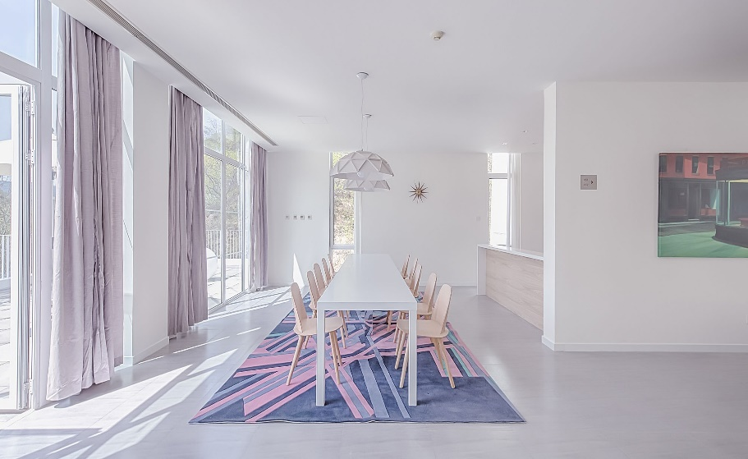
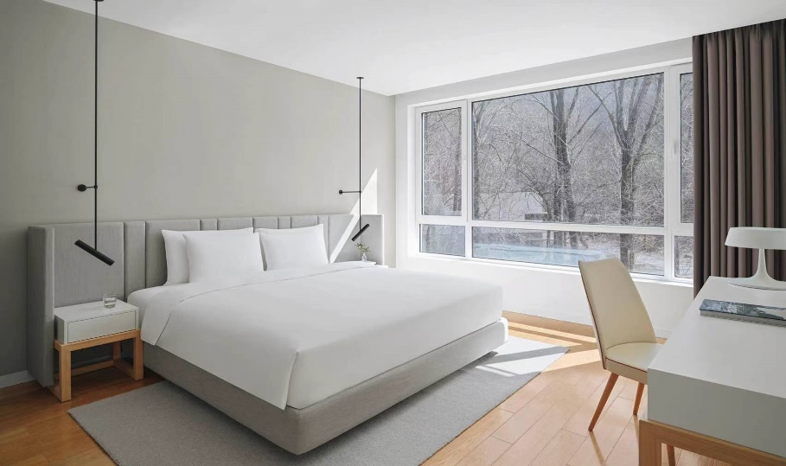
大通铺别墅 Shared House 设计师：堪尼卡Kanika R’kul (Thailand)

Slide 7
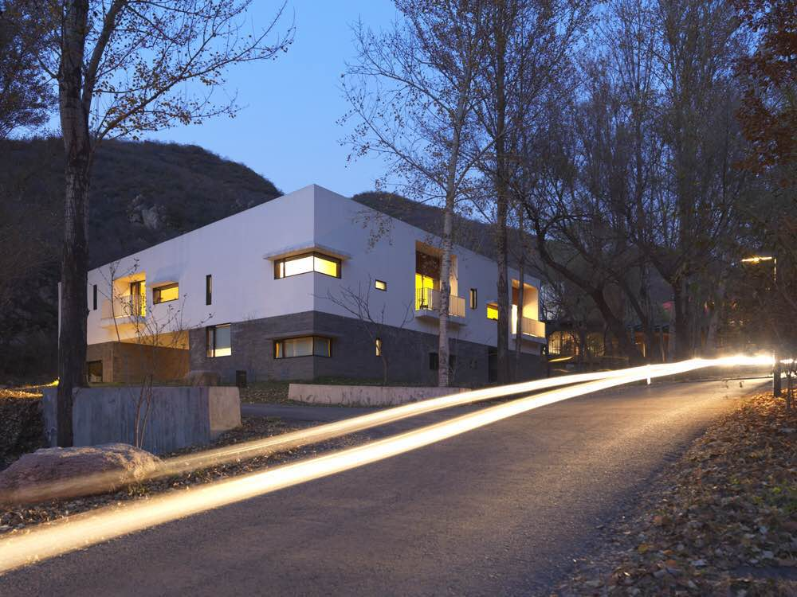
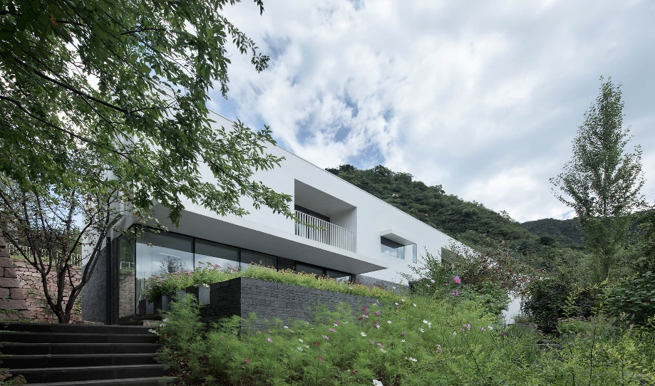
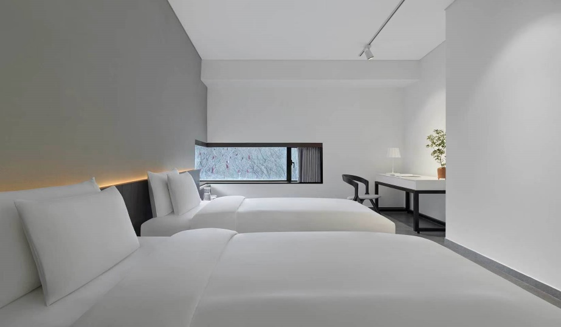
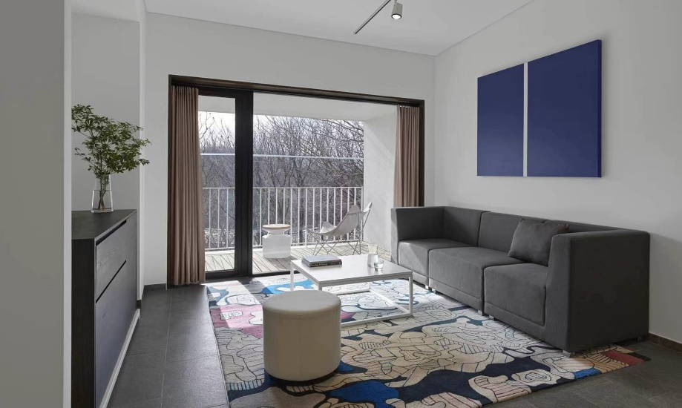
三期别墅 Phase3 Villa 设计师：承孝相 Seung H-Sang (South Korea)

Slide 8

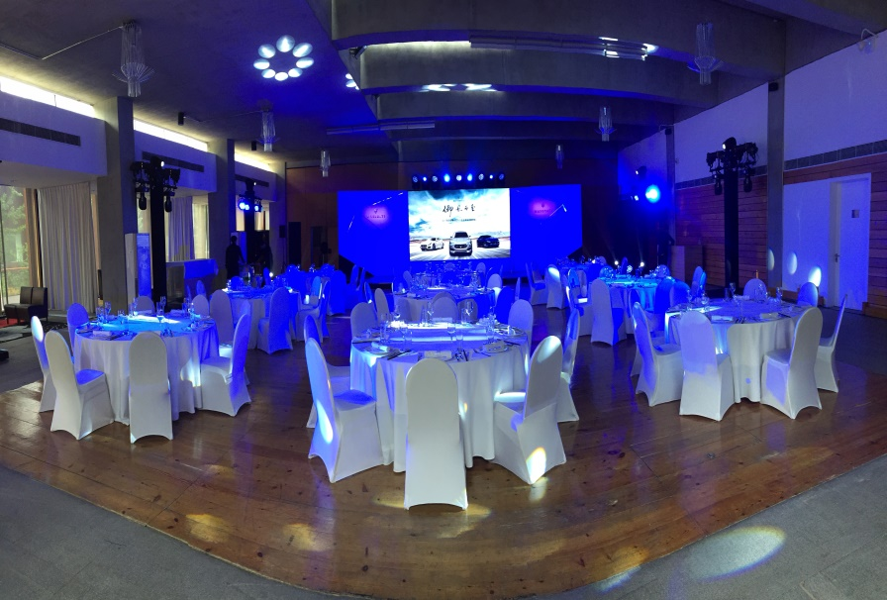
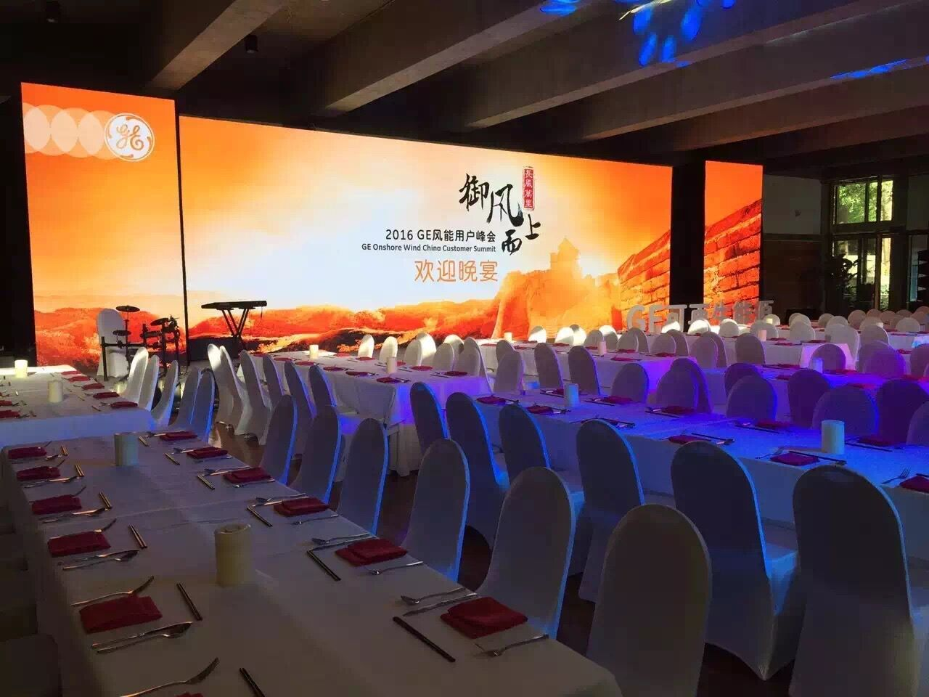
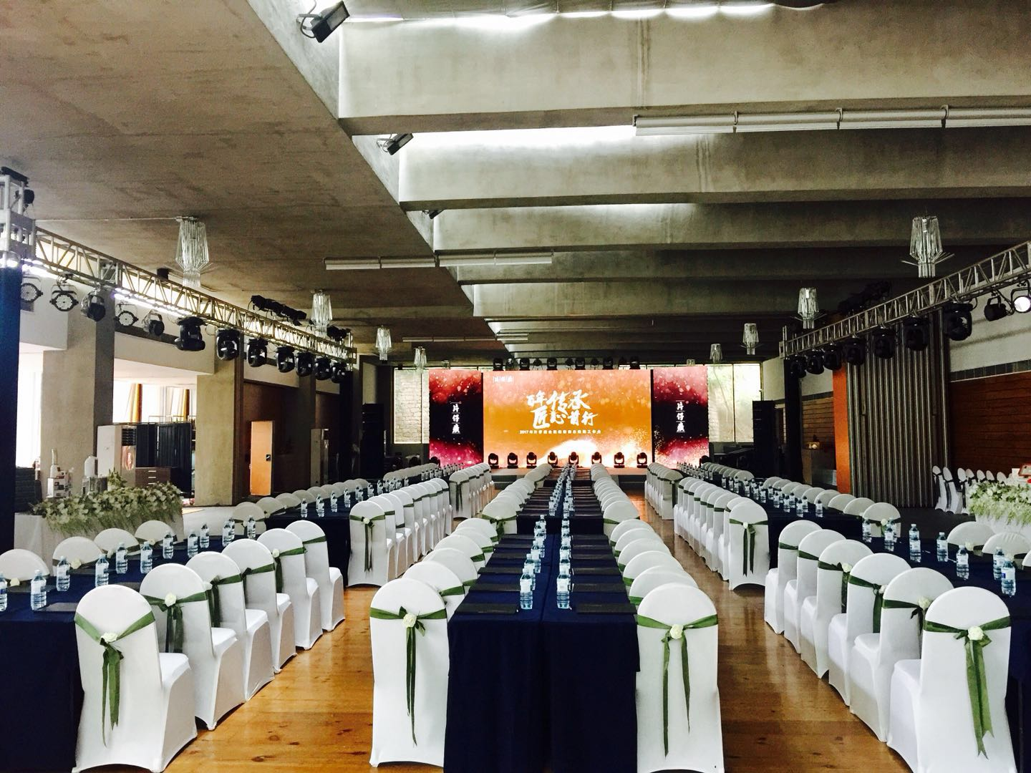
Function Room : It could be divided into two parts by partition wall
Commune Ballroom

Slide 9
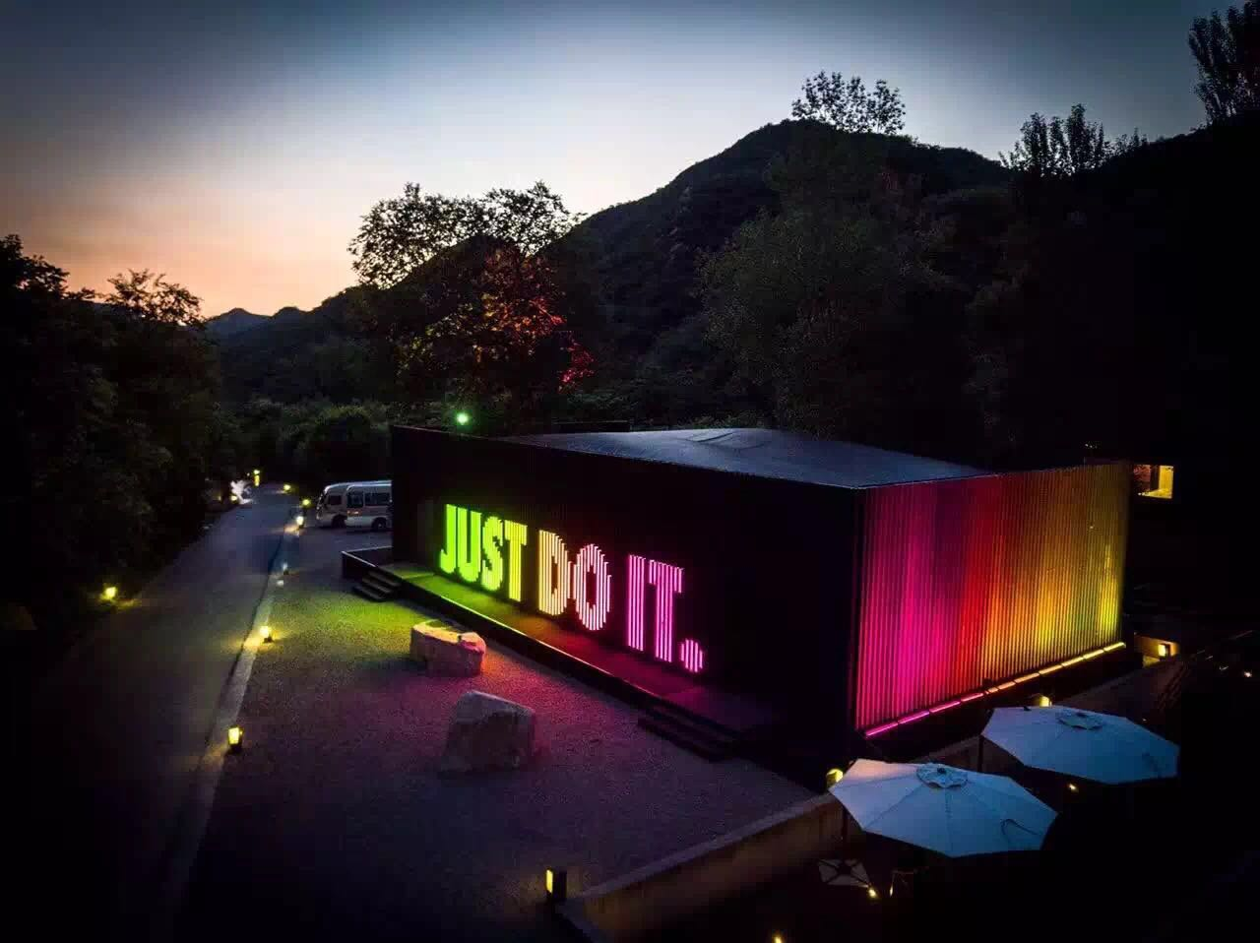
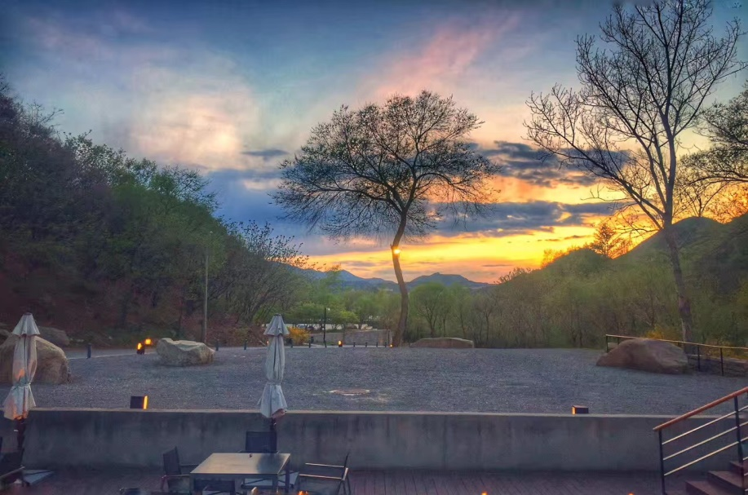
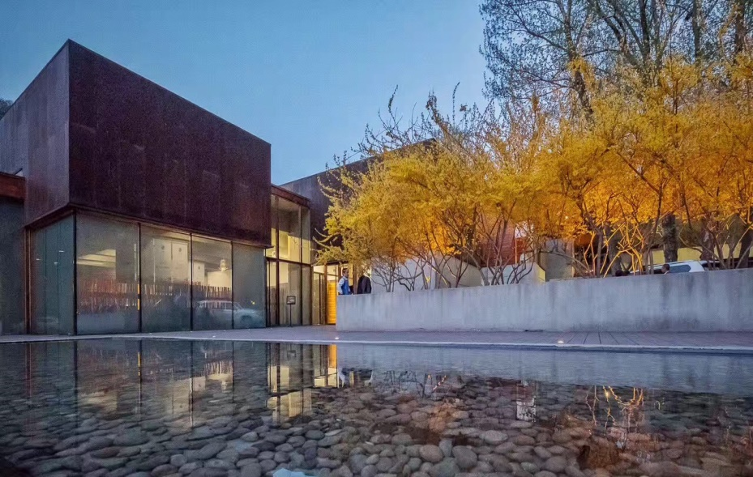
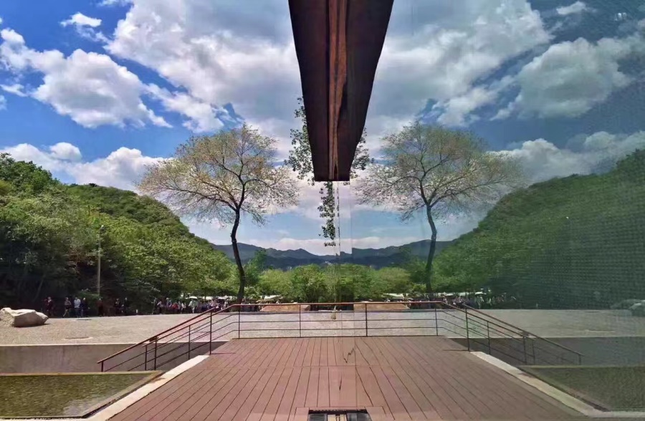
Function Room : It could be divided into two parts by partition wall
Commune Ballroom

Slide 10
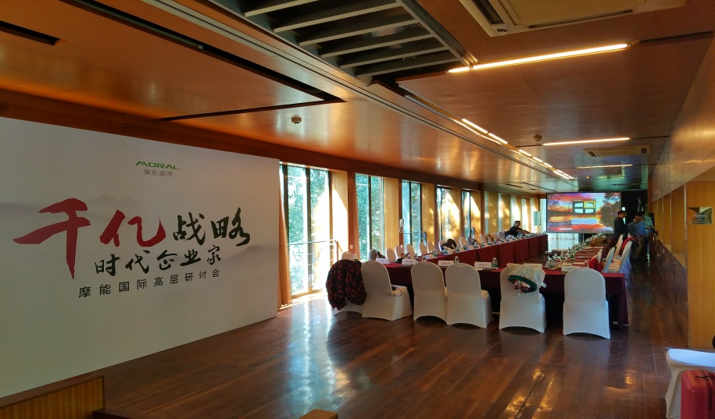
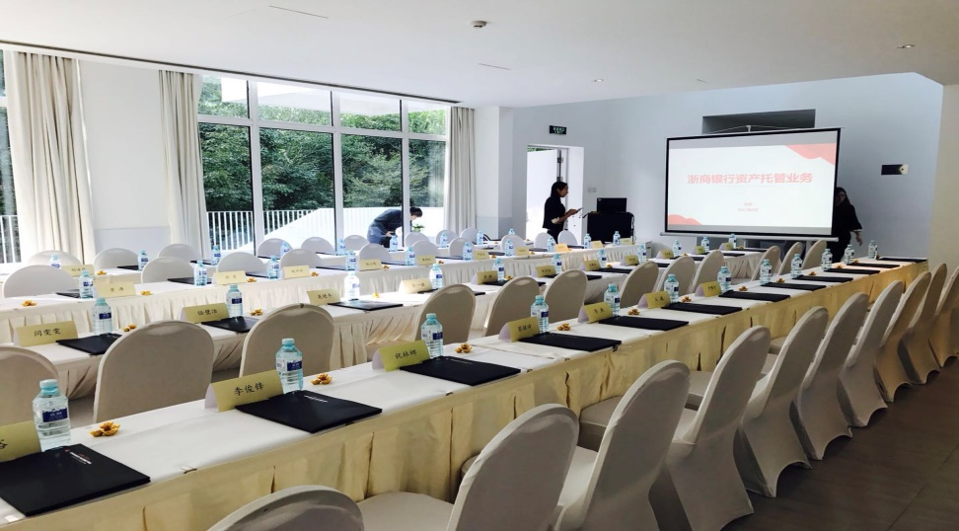
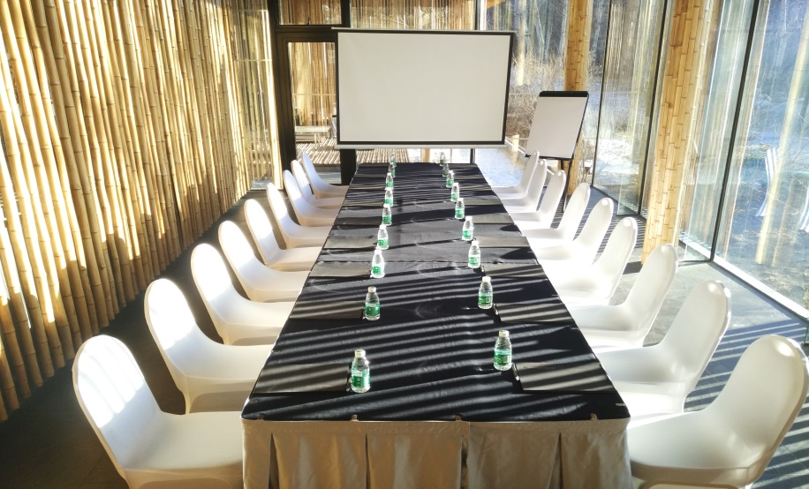
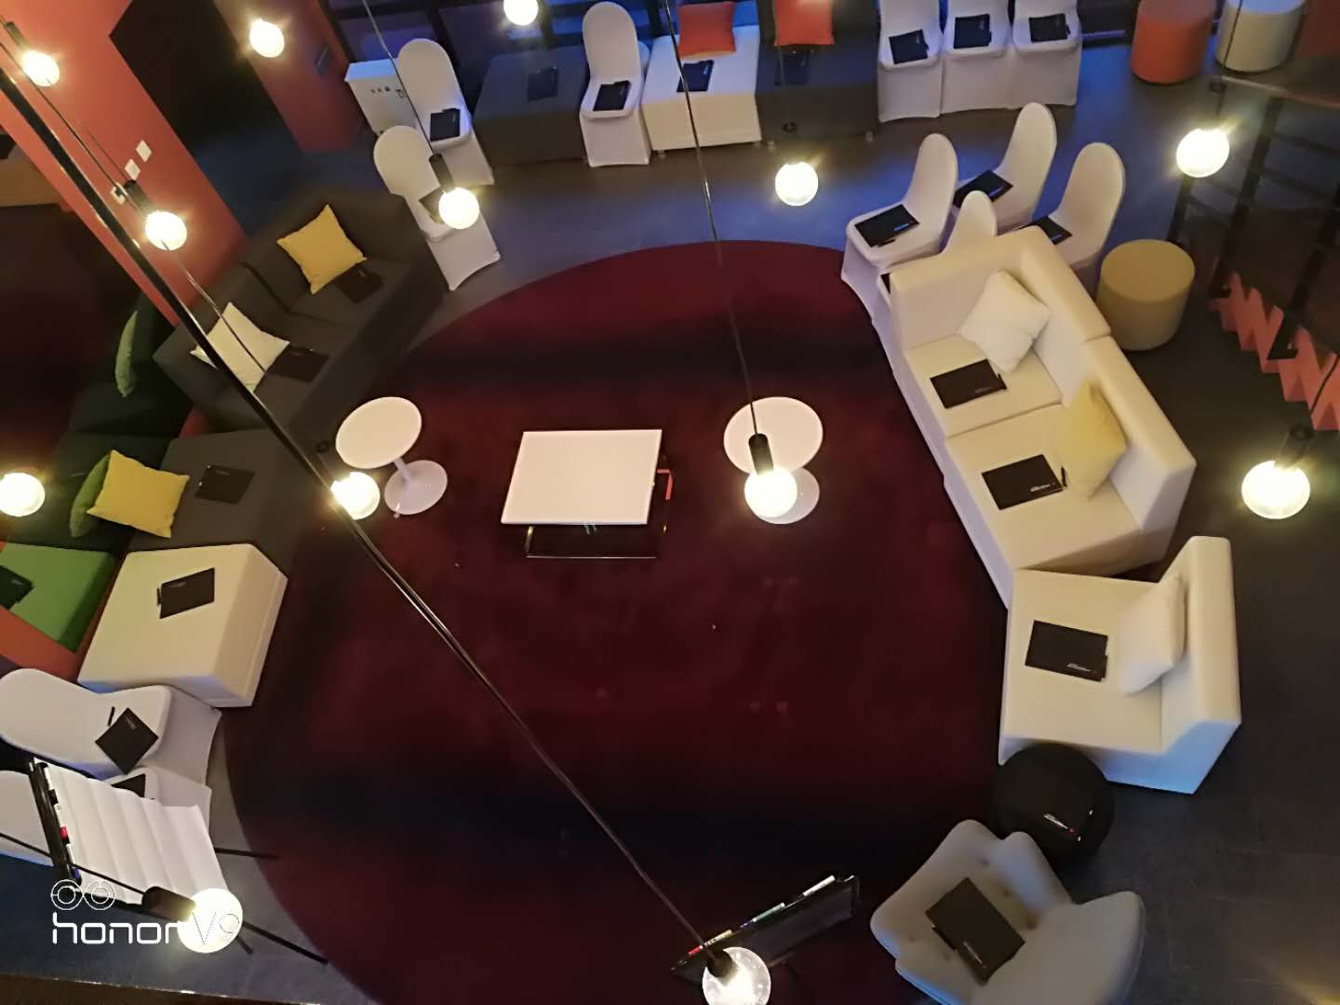
Meeting set up in Villa

Slide 11
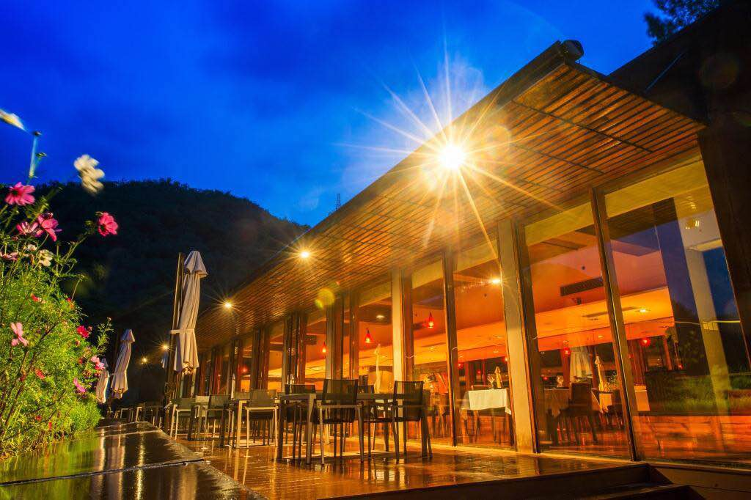
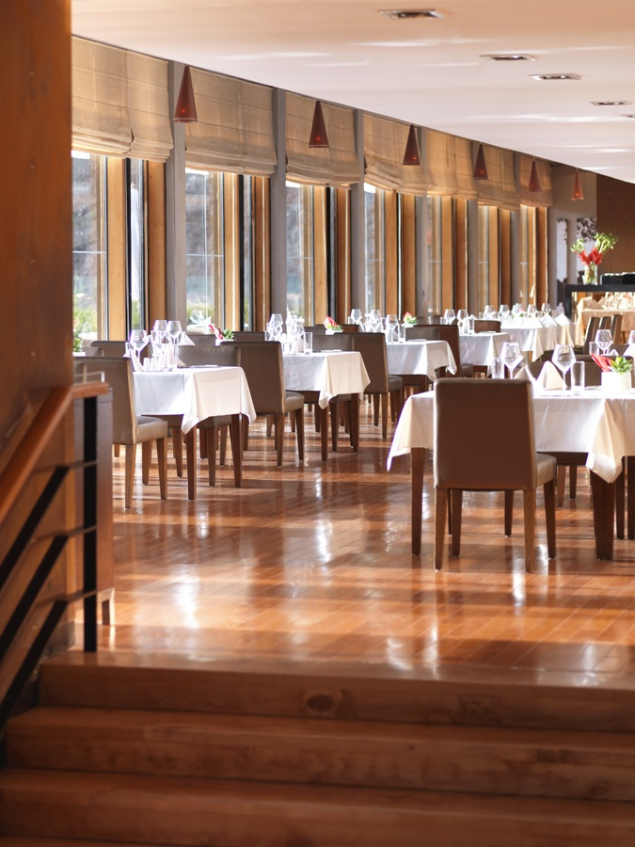
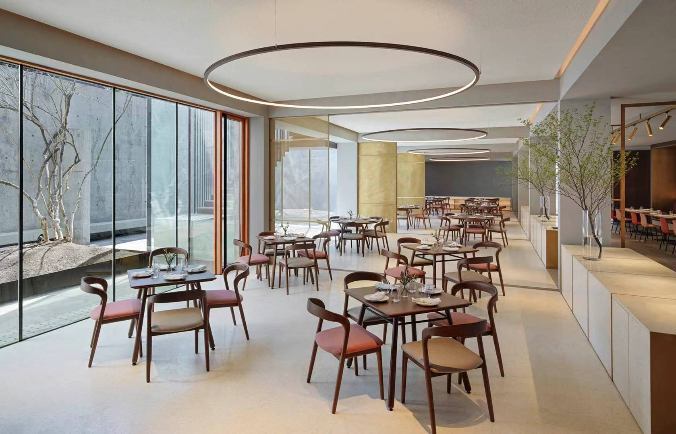
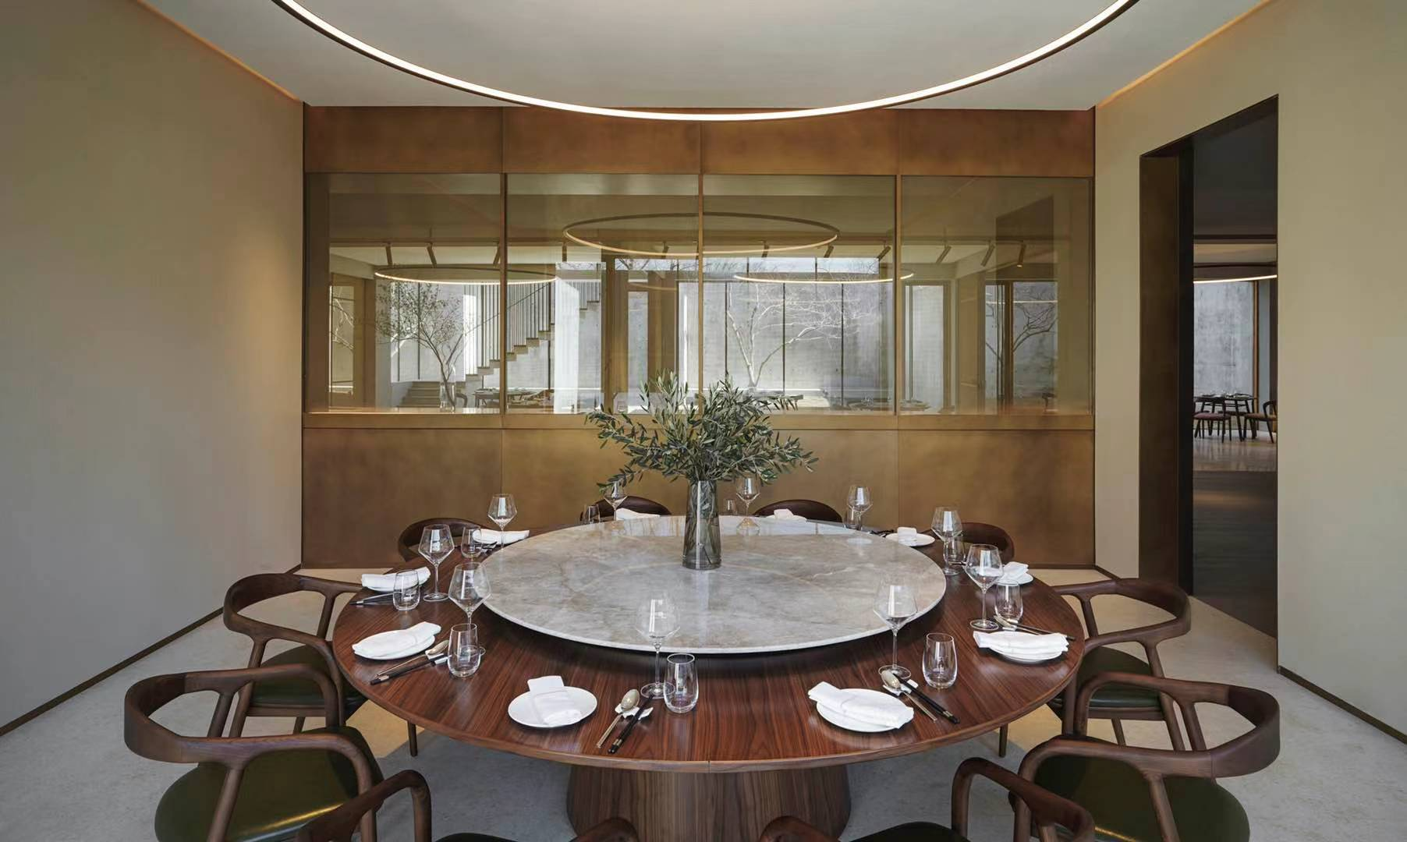
Commune Kitchen

Slide 12
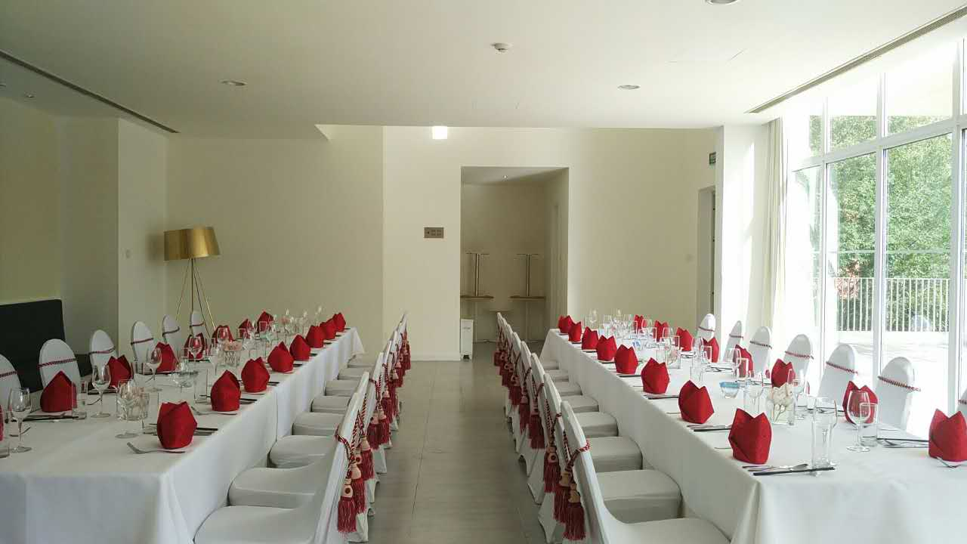
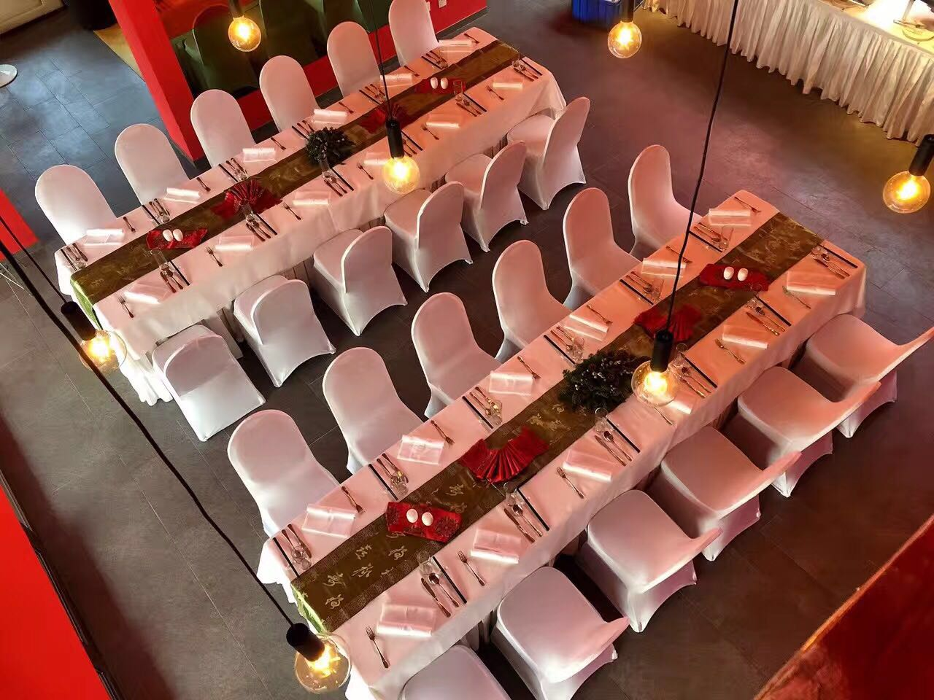
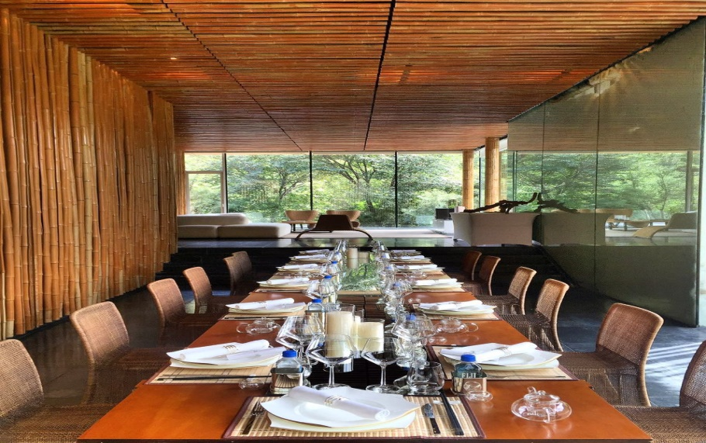
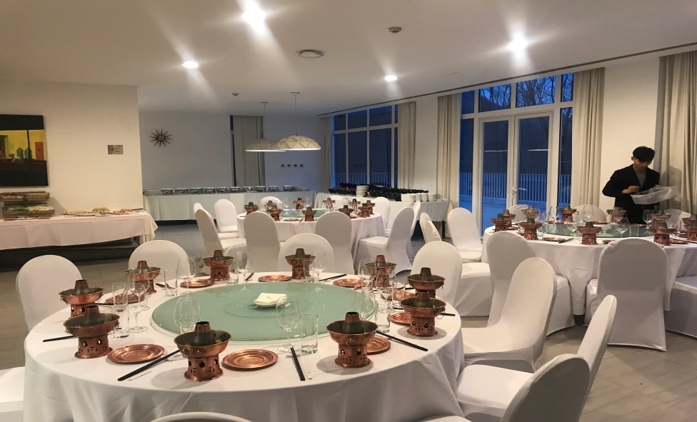
Private dinner or lunch in villa

Slide 13
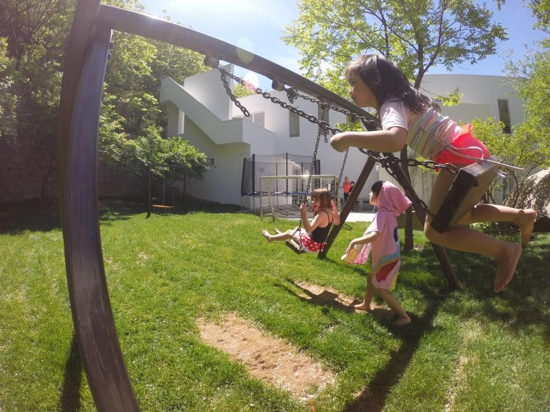



Kid`s Club

Slide 14
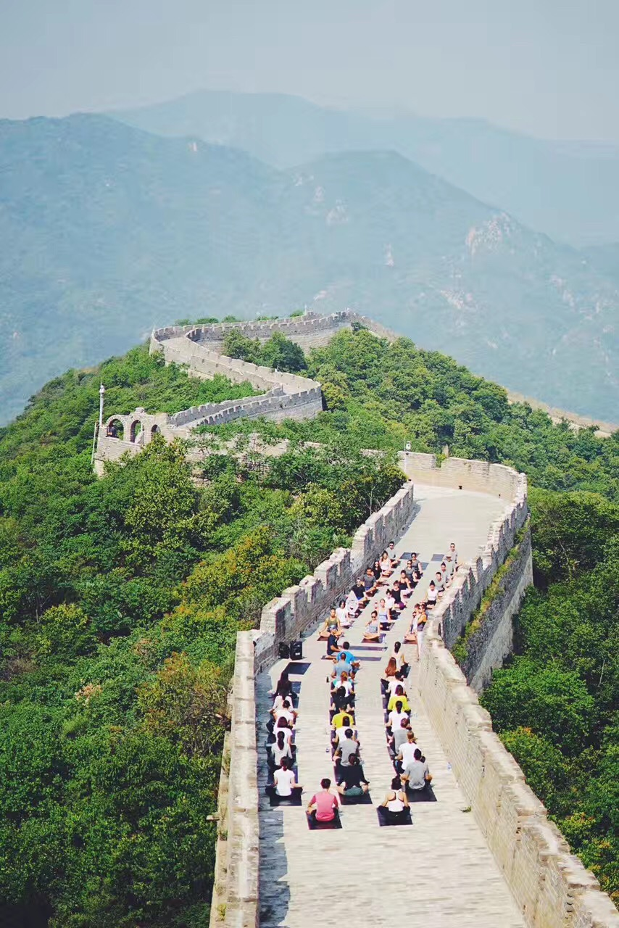
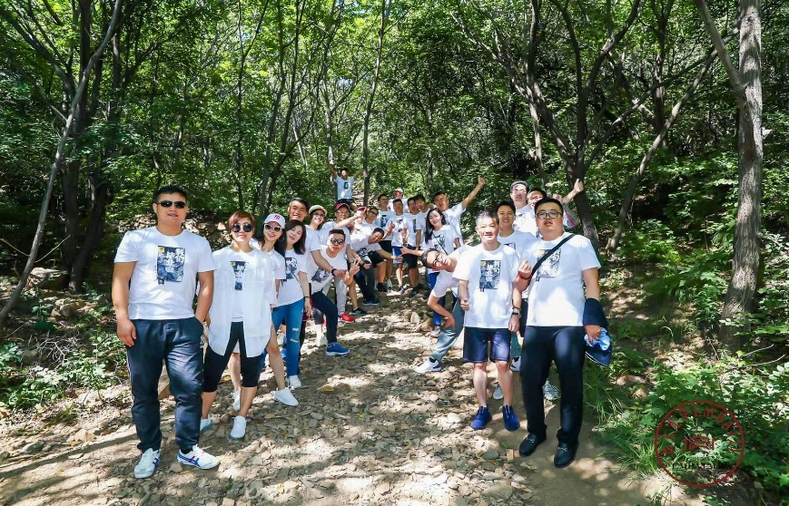

The Great Wall only opens for hotel guests

Slide 15
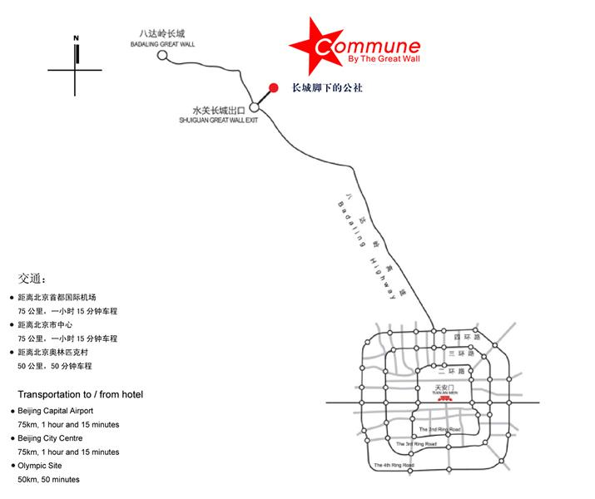
长城脚下的公社行车路线图 Commune drive circuit

Slide 16
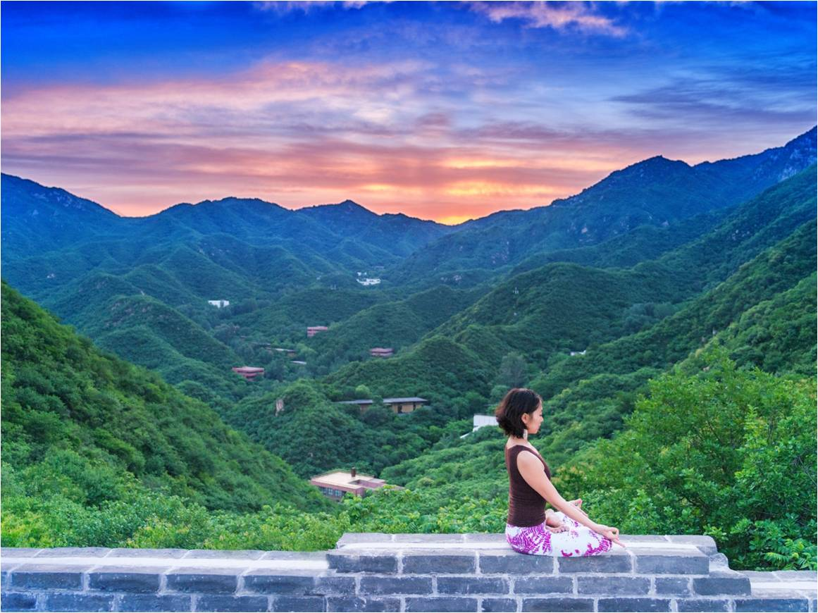
Thank you!

