Slide 1
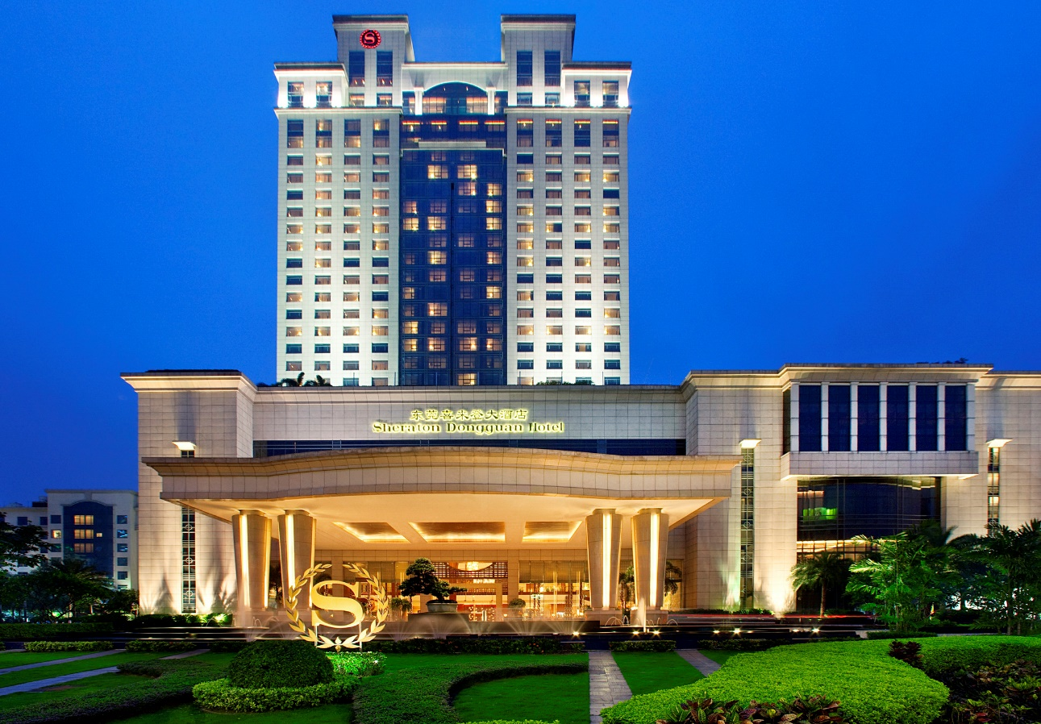

Welcome to
Sheraton Dongguan Hotel
欢迎来到东莞喜来登大酒店

Slide 2
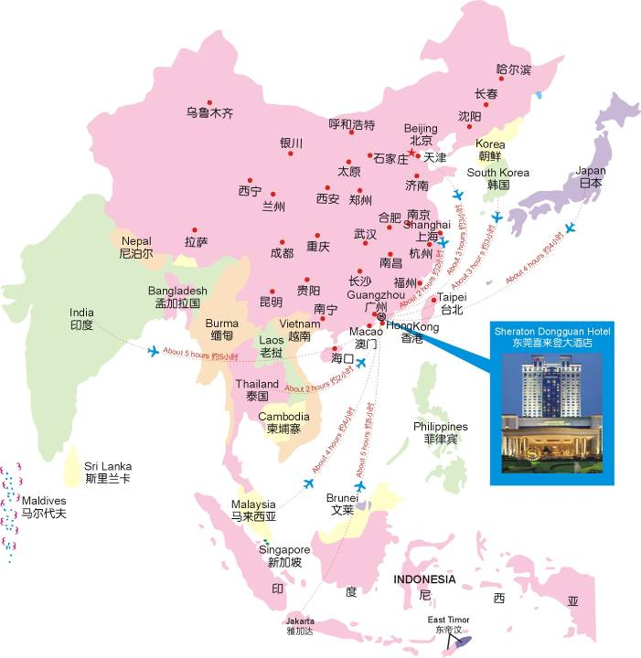
Location
地理位置
International Airport to Sheraton Dongguan Hotel
国际机场到东莞喜来登大酒店
ShenZhen BaoAn International Airport - approx 45mins drive
深圳宝安国际机场大约45分钟车程
Guangzhou BaiYun International Airport - approx 1hour drive
广州白云国际机场大约1 小时车程
Hong Kong International Airport - approx 3hour drive
香港国际机场大约3 小时车程

Slide 3
Convenient Transportation
Sheraton Dongguan Hotel is located in the center of Houjie town, very close to S256, with easy access to Guangzhou, Shenzhen, Hong Kong & Macau.
10 minutes on foot to Wanda Plaza, Ming Fung Plaza, Rainbow Shopping Mall,
Houjie Station, Tesco Super Market;
2 minutes on foot to Kangle Road Commercial Street, China Resource Vanguard, Houjie Government, Houjie Hospital;
5 minutes on foot to Houjie Square;
About 30 minutes by taxi to Dongguan Bus Station about 15 kilometers;
About 4 kilometers to Guangdong Modern International Exhibition Center, takes about 8 minutes by taxi;
About 15 kilometers to Dongguan International Convention and Exhibition Center, takes about 30 minutes by taxi;
About 60 kilometers to Changping Railway Station, takes about 60 minutes by taxi;
About 8 kilometers to Dongguan Nancheng Bus Station, takes about 10 minutes by taxi;
About 78 kilometers to Guangzhou Baiyun airport, takes about 60 minutes by taxi;
About 48 kilometers to Shenzhen Baoan airport, takes about 30 minutes by taxi;
About 2 hours by shuttle bus to Hong Kong downtown,.

Slide 4
便利的交通
便利的交通
酒店位于东莞市繁华的厚街镇中心地带，紧靠S256道，周边配套设施完善，位置优越，来往广州、深圳、港澳交通十分便利。
·至万达广场、明丰购物商场、天虹购物商场、厚街车站、Tesco购物超市步
行10分钟;
·康乐南路购物街、华润万家购物超市、厚街镇政府、厚街医院步行2分钟；
·厚街广场步行5分钟；
·距东莞汽车总站约15公里，乘坐出租车约30分钟；
·广东现代国际展览中心约4公里，乘坐出租车约8分钟；
·东莞国际会展中心约15公里，乘坐出租车约30分钟；
·东莞常平火车站约60公里，乘坐出租车约60分钟；
·东莞南城汽车站约8公里，乘坐出租车约10分钟；
·距离广州白云机场约78公里，乘坐出租车约60分钟； ·距离深圳宝安机场约48公里，乘坐出租车约30分钟；
·距香港市区，乘坐酒店巴士约120分钟。

Slide 5
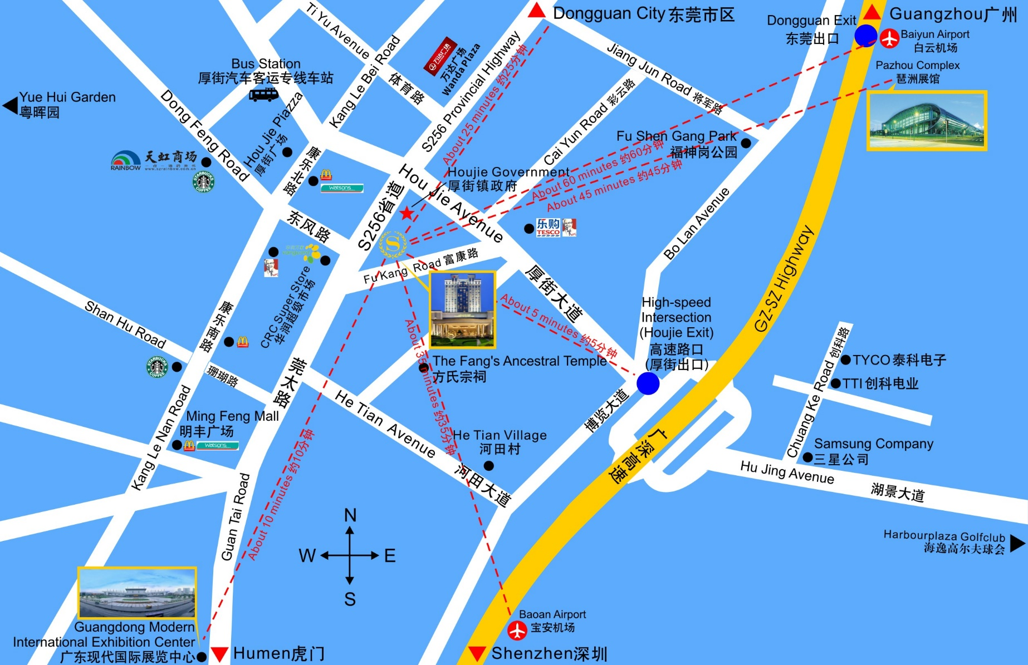

Slide 6
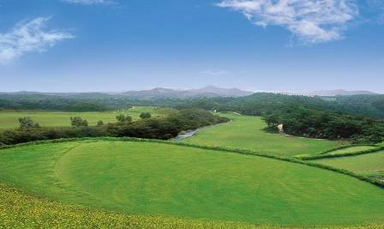
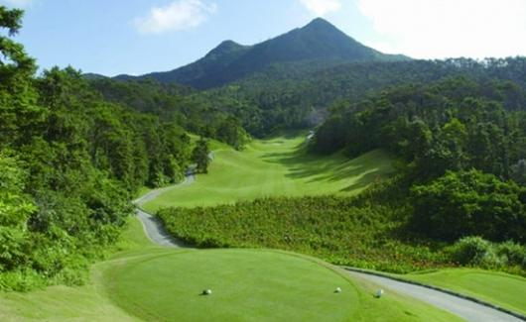
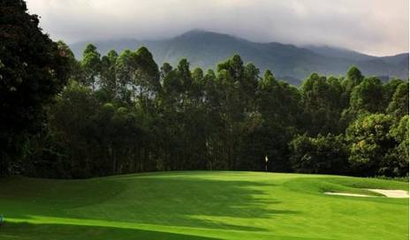
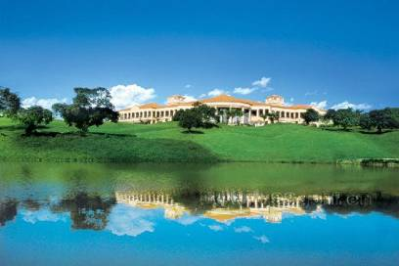
Golf at Dongguan
东莞高尔夫
Mission Hill Golf Club 东莞观澜湖高尔夫球会 （60mins)
Long Island Golf Club 东莞长安高尔夫球会（50mins）
Harbour Plaza Golf Club 东莞海逸高尔夫俱乐部 (20mins)
Hill View Golf Club 东莞峰景高尔夫球会 (30mins)

Slide 7
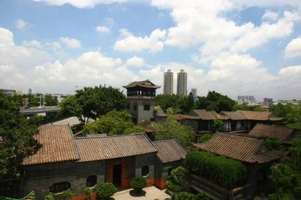
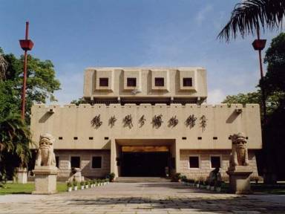
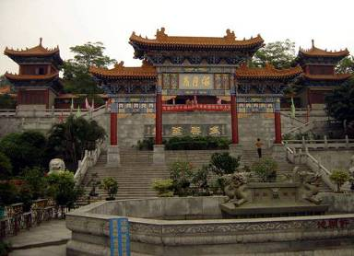
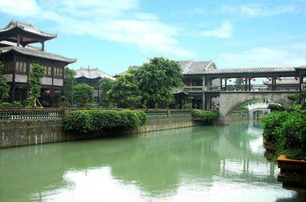
Sightseeing in Dongguan
东莞风光
Keyuan Garden 可园
Opium War Museum 鸦片战争博物馆
Haiyue Rock 海月岩
Yuehui Garden 粤晖园

Slide 8
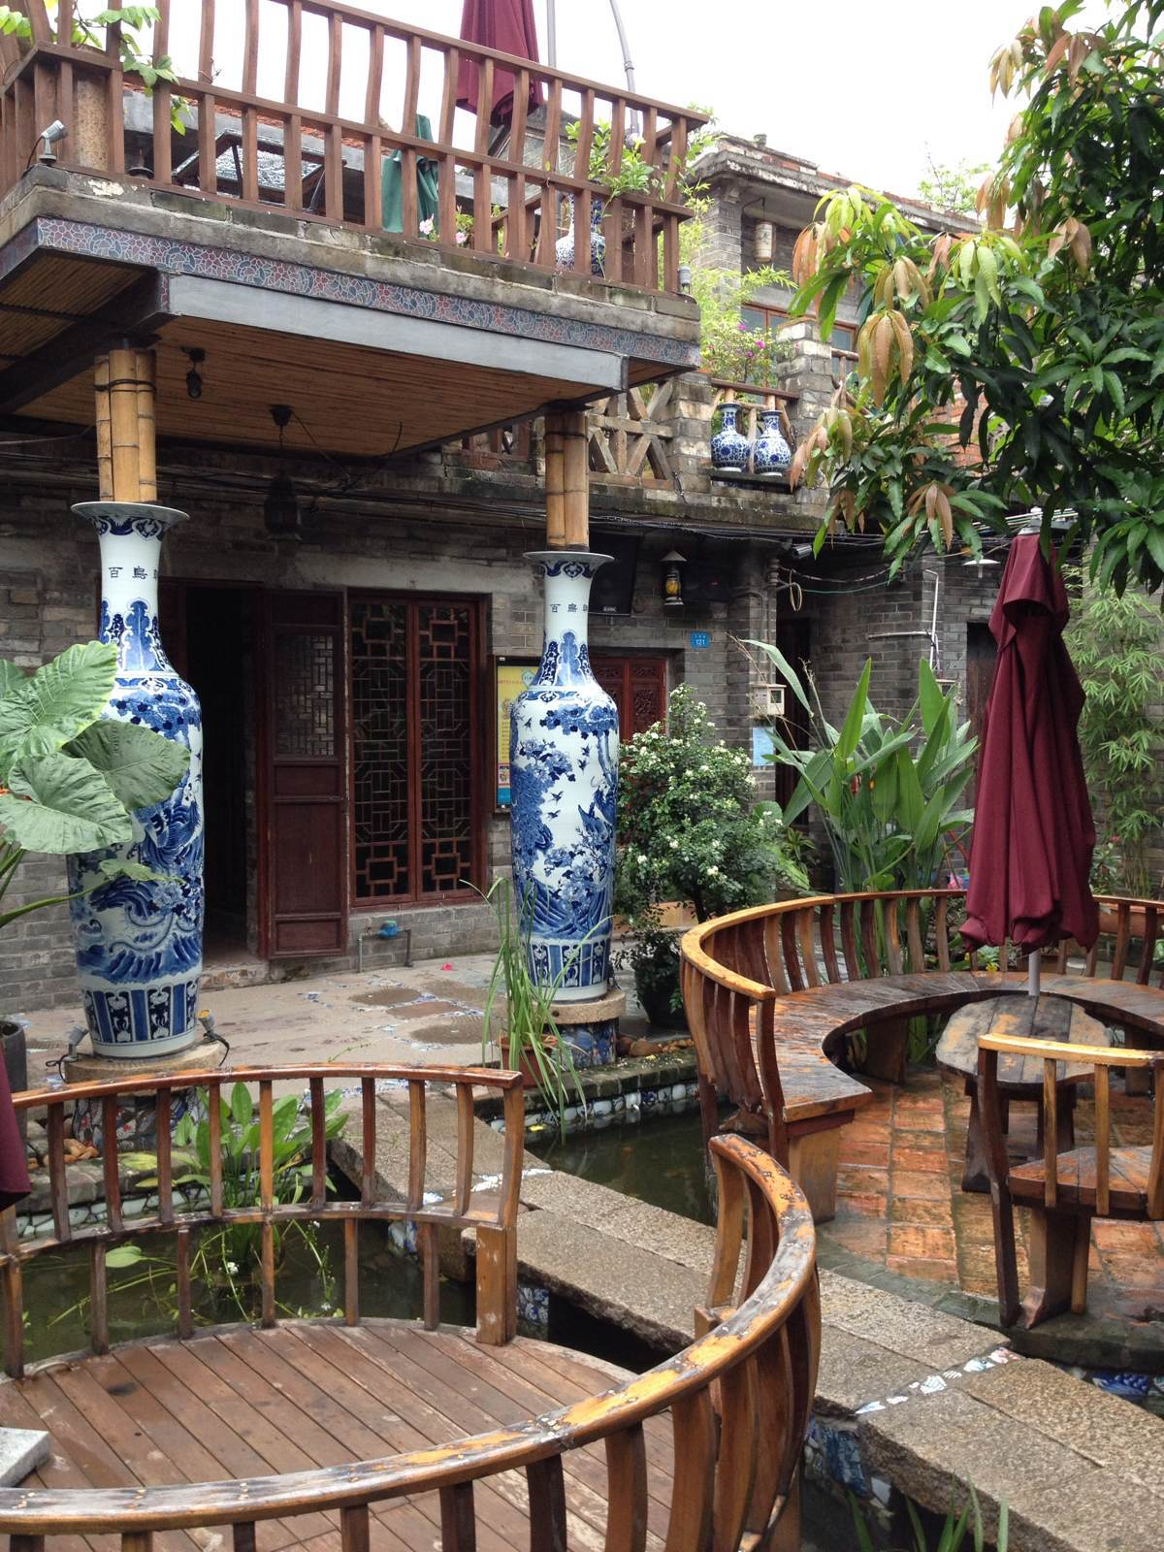
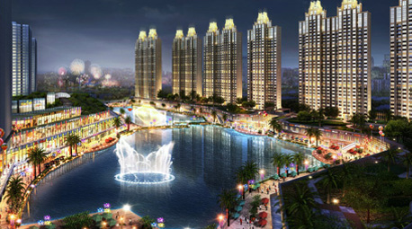
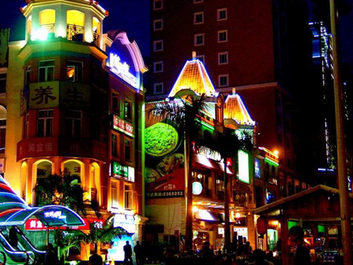
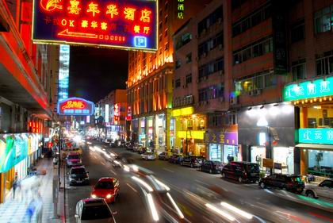
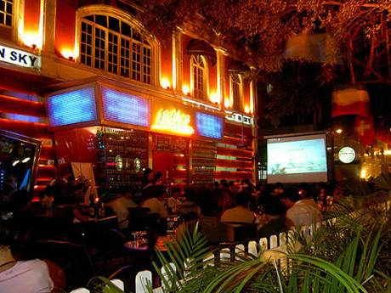
v
Recreation in Dongguan
东莞休闲娱乐活动
Xia Ba Fang 下坝坊
Wanda Plaza 万达广场
Houjie Kangle Road (Bar Street) 厚街康乐路 (酒吧街）
Dongcheng Bar Street 东城酒吧街
Nancheng Walk Street 南城步行街

Slide 9
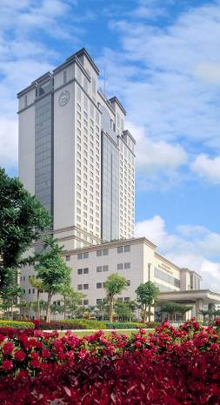
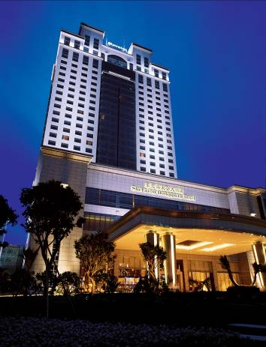
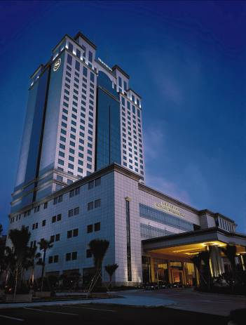
Exterior 外观
Renovation in 2013&2014

Slide 10
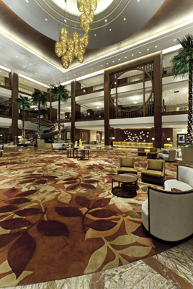
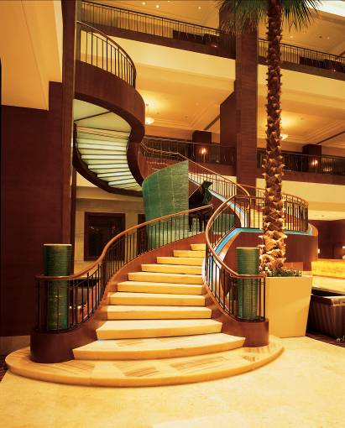
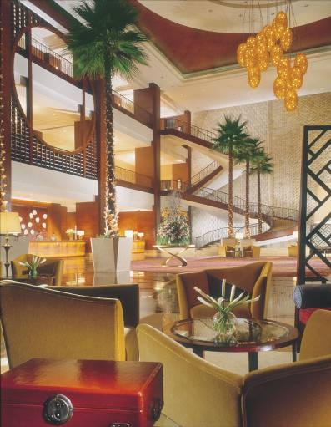

Lobby 大堂

Slide 11
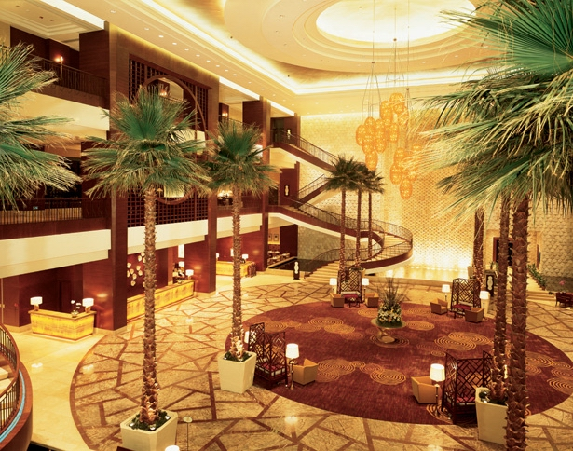

Slide 12
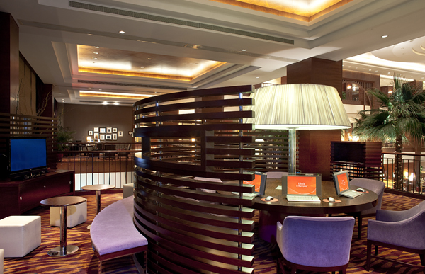

Link@Sheraton
随心连动@喜来登

Slide 13
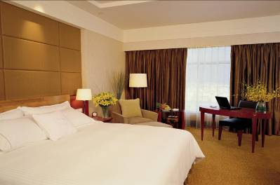
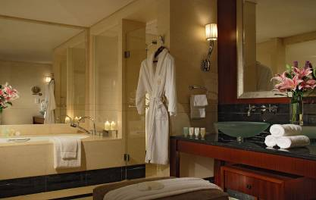
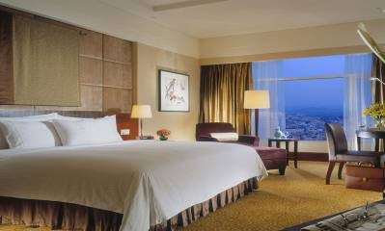
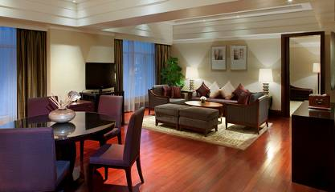

Guest Room 客房

Slide 14
Room Type 房型
Room Category | Twin (2mx1.2m) | King (2mx2m)
Superior Room 42-45sq.m 高级客房 (Total 146 room) | 36 | 110
Deluxe Room 42-45sq.m 豪华客房 (Total 262 room) | 70 | 192
SPG Executive Room 42-45sq.m 行政商务房 (Total 60 room) | 5 | 55
Deluxe Suite 90sq.m 豪华套房 (Total 25 room) | - | 22
Executive Suite 130sq.m 行政套房 (Total 8 room) | - | 9
Presidential Suite 420sq.m 总统套房 (Total 1 room) | - | 1
Total 500 rooms | 111 | 389
Remarks：
· SPG Executive room on 22nd -26th Floor
· Smoking floor 8, 13, 15, 16, 22, 28 floor
· Handicapped room: 1012, 1020, 1112, 1120

Slide 15

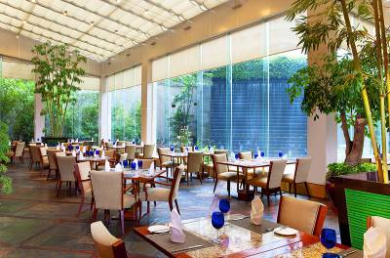
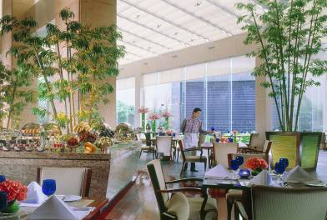
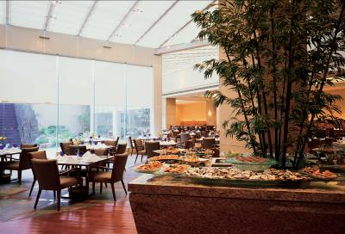
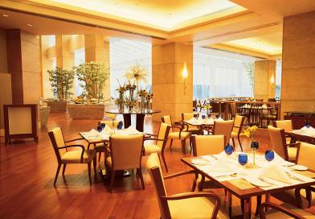

F&B Venues
Botanica Brasserie-All Day Dining 御园西餐厅

Slide 16

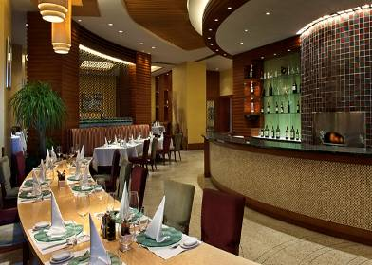
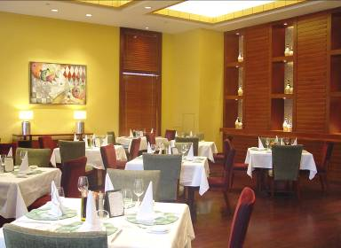
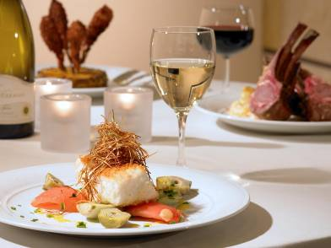
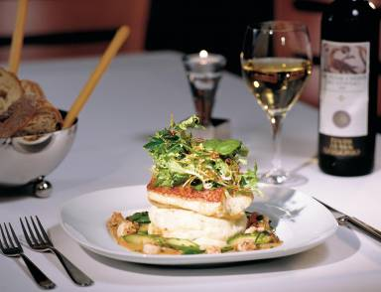
F&B Venues
Luigi Italian Restaurant 意大利餐厅

Slide 17
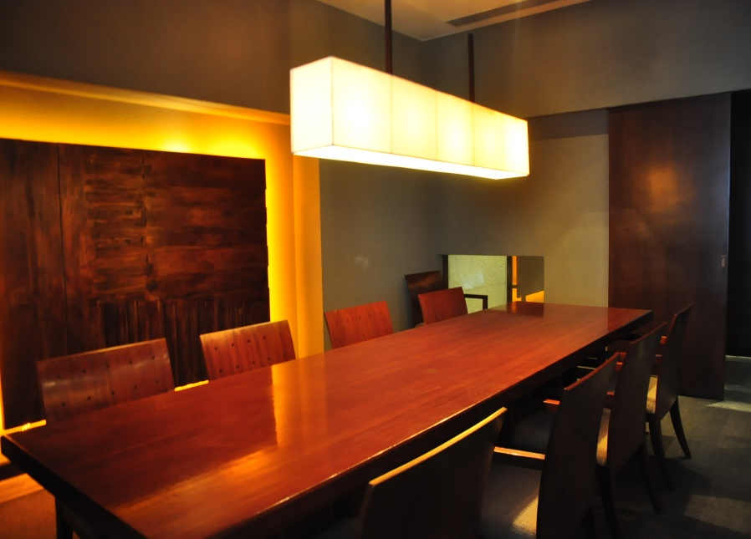
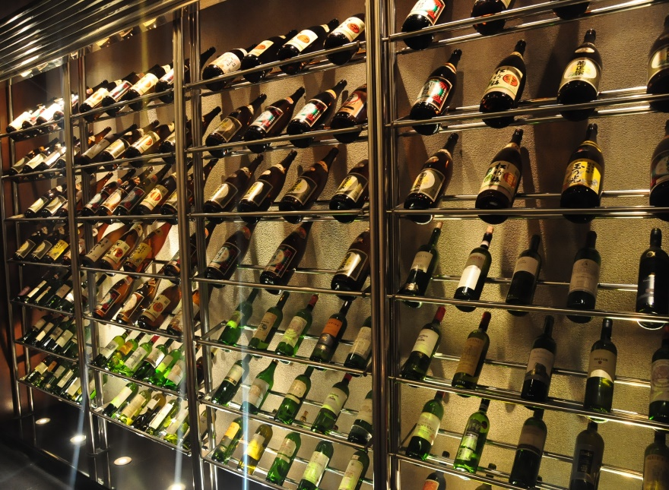
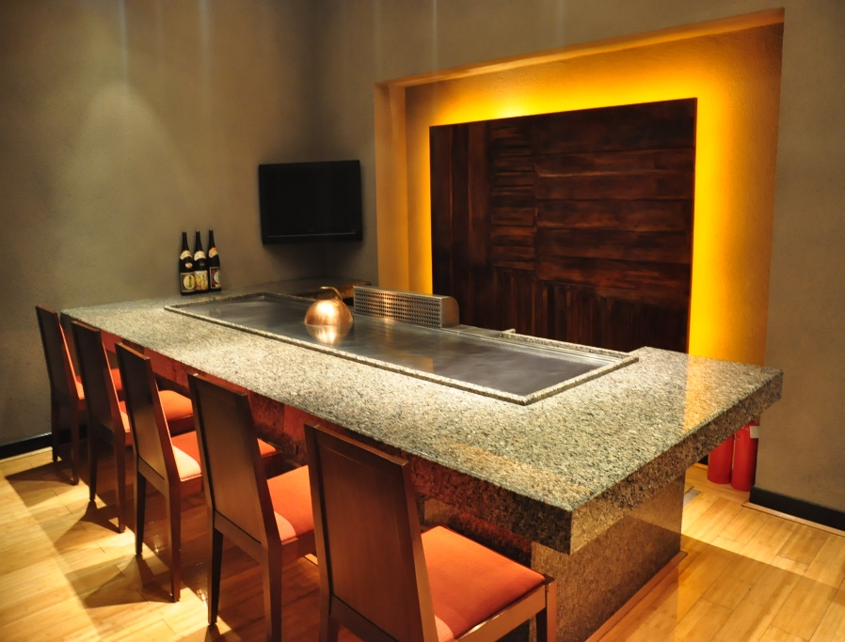
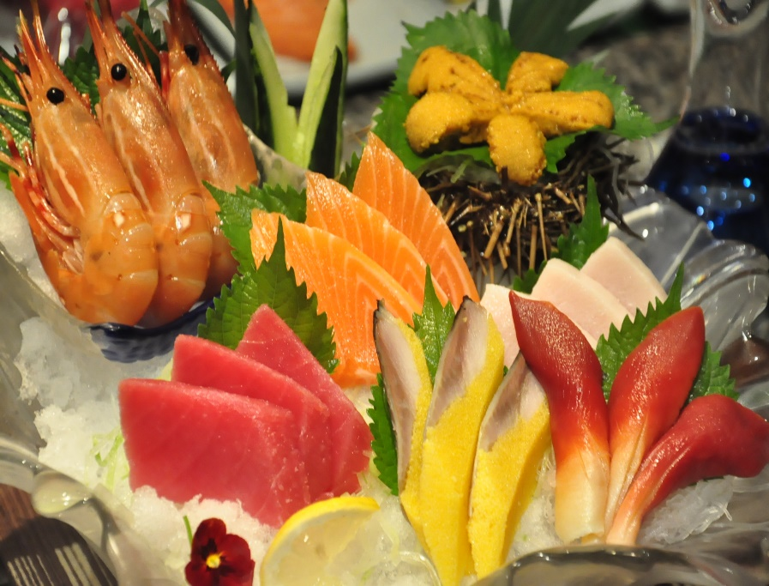
F&B Venues
Sekisai Japanese Restaurant 石彩日餐厅

Slide 18
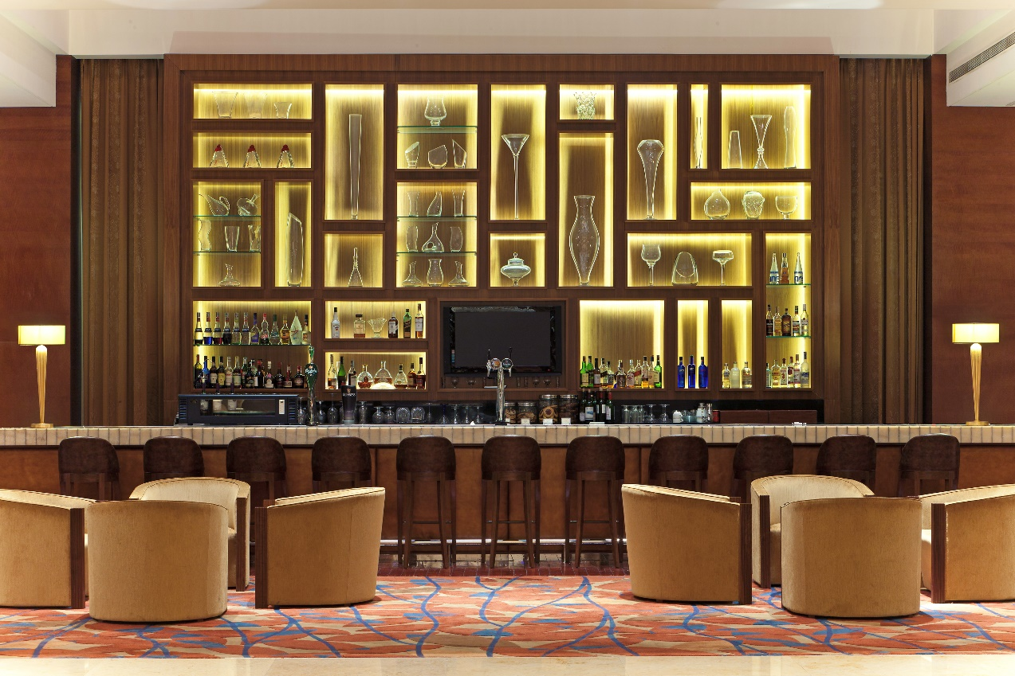
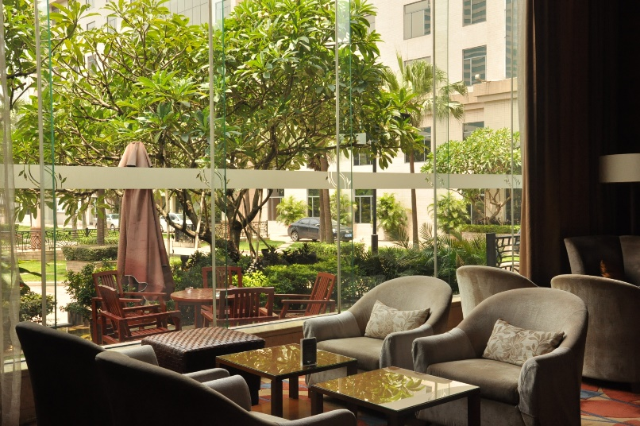
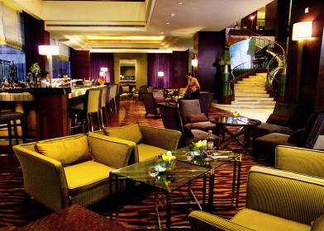
F&B Venues
Renzo Lounge 大堂吧

Slide 19
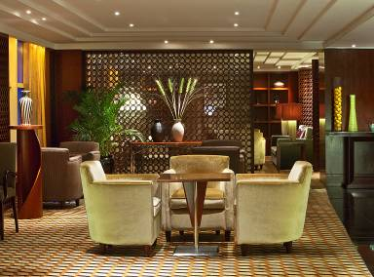
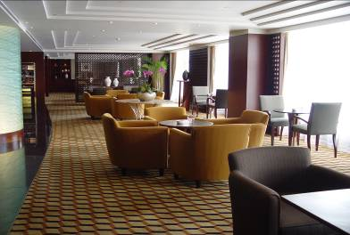
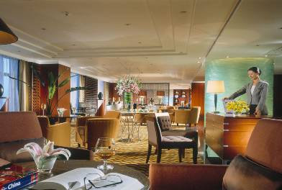
Sheraton Club 行政酒廊

Slide 20

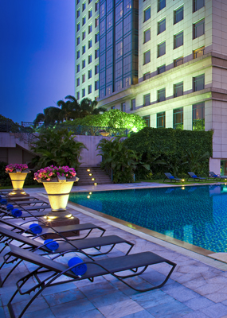
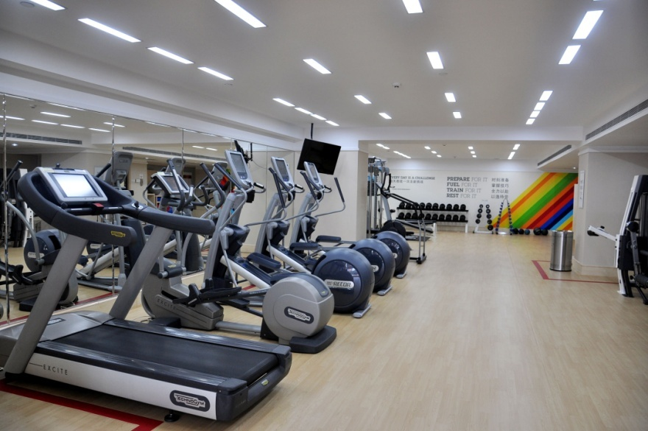
Sheraton Fitness
健身中心

Slide 21
2013 Fully Renovated
2013年全新装修
Multifunction hall with largest ballroom with 1309sqm & 49sqm LED display
1309平方米多功能宴会厅及49平方米LED显示屏
Events Team
宴会团队
Meeting Room | Dimension (Sqm) | Length/ Width (m) | Ceiling (m) | Banquet | Classroom | Theater | Board-room | U-Shape
Sheraton Grand Ballroom | 1309 | 52x 25 | 8 | 800 | 600 | 1200 | - | -
Sheraton Ballroom (1) | 425 | 25 x 17 | 8 | 200 | 150 | 300 | - | -
Sheraton Ballroom (2) | 225 | 25 x 9 | 8 | 120 | 100 | 200 | - | -
Sheraton Ballroom (3) | 425 | 25 x 17 | 8 | 200 | 150 | 300 | - | -
Sheraton Ballroom (5) | 234 | 26 x 9 | 4 | 120 | 100 | 200 | - | -
Meeting Room (1) | 84 | 10 x 8.4 | 4 | 50 | 50 | 60 | 25 | 30
Meeting Room (2) | 67.2 | 8.4 x 8 | 4 | 40 | 35 | 50 | 20 | 24
Meeting Room (3) | 67.2 | 8.4 x 8 | 4 | 40 | 35 | 50 | 20 | 24
Meeting Room (5) | 67.2 | 8.4 x 8 | 3.6 | 40 | 35 | 50 | 20 | 24
Meeting Room (6) | 86.4 | 9.6 x 9 | 3.9 | 50 | 50 | 60 | 25 | 30
Meeting Room (7) | 166 | 19.65 x 8.45 | 3.6 | 100 | 80 | 100 | 40 | 36
Pool Side |  |  |  | 250

Slide 22
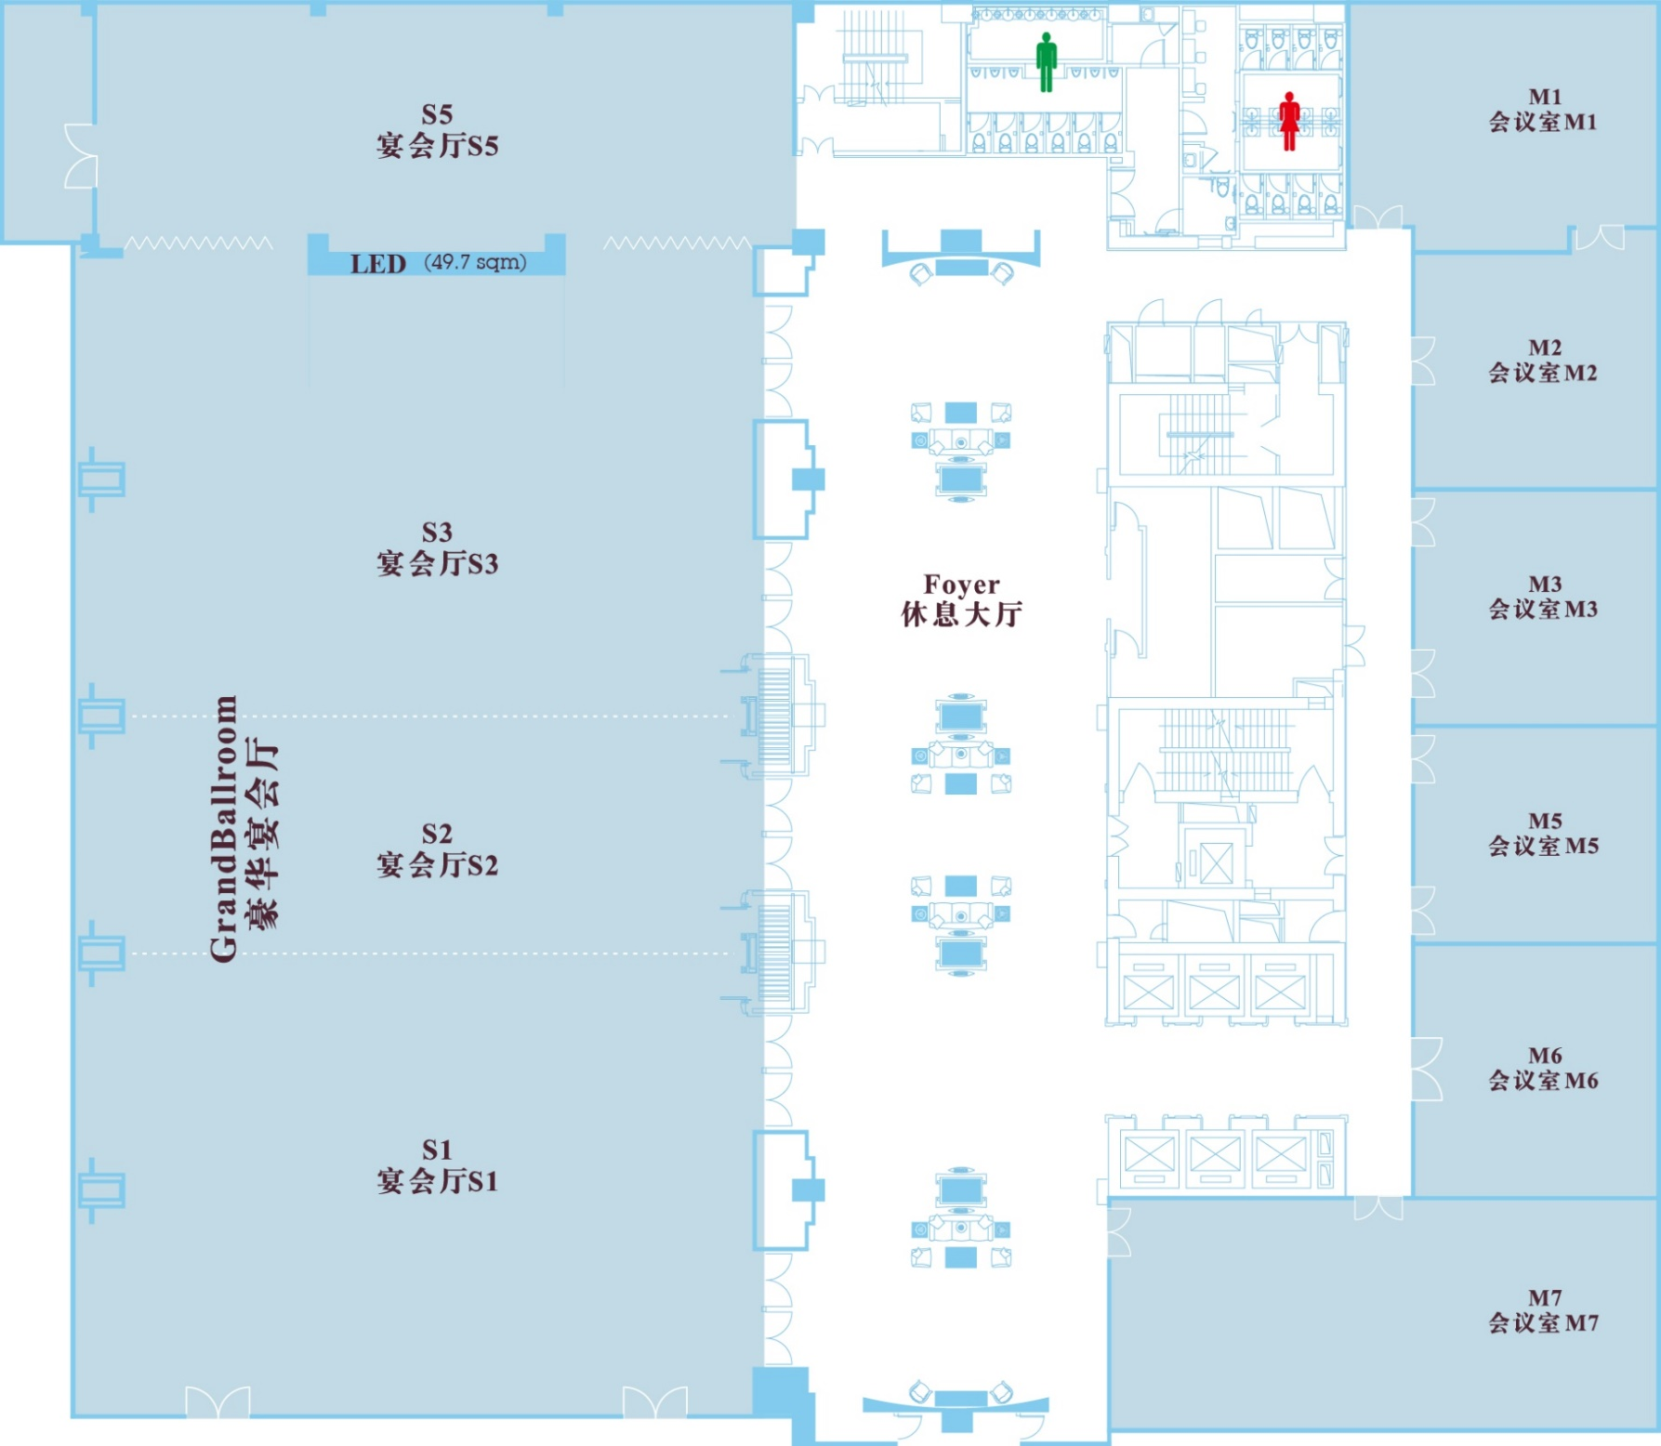
Events Team
宴会团队

Slide 23
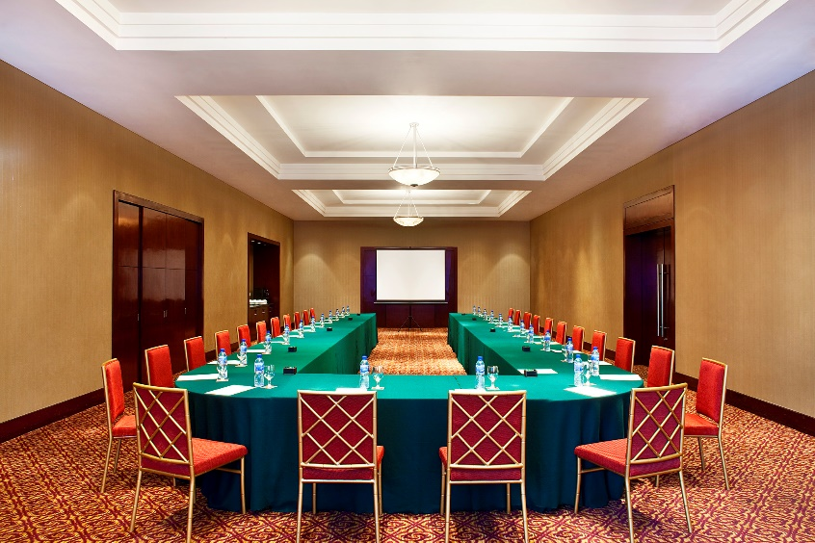



Events
Meeting room 会议室

Slide 24





Past Events
往期宴会

Slide 25




Past Events
往期宴会

Slide 26




Sheraton Weddings & Theme Nights
喜来登婚宴&主题晚宴

Slide 27

Thank you
谢谢
东莞喜来登大酒店
SHERATON DONGGUAN HOTEL
中国广东省，东莞市厚街镇S256省道莞太路段，邮政编码 523962
S256 Provincial Highway, Houjie Town, Dongguan City, Guangdong Province, P.R.China 523962
t —+ 86 769 8598 8888 ext.88861 f —+ 86 769 8599 6616
e – dongguan.sheraton@sheraton.com www.sheraton.com/dongguan

