Slide 1

Insert Hotel
Logo
酒店介绍
Hotel Introduction

Slide 2
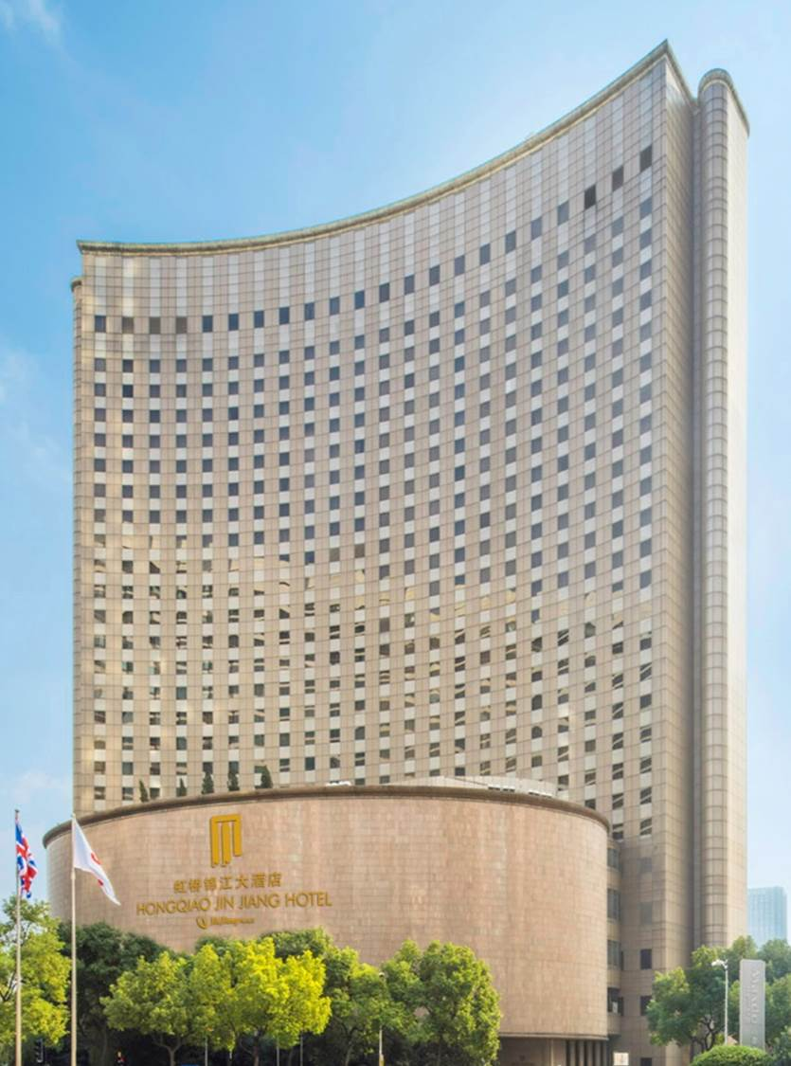
虹桥锦江大酒店（原虹桥喜来登上海太平洋大饭店）坐落于虹桥经济开发区，被数座高档商务大厦、领事馆及大型会展中心：国家会展中心、上海国际贸易中心和上海国际展览中心所围绕，距购物娱乐中心仅一步之遥。其中心的地理位置、便利的交通使您更迅速到达城市的每一处角落。
Located in the prime area in Shanghai – Hongqiao Jin Jiang Hotel (formerly Sheraton Shanghai Hongqiao Hotel) upholds its long tradition of warm hospitality to all its discerning guests in the midst of this amazing city. The surrounding area has its proximity to shopping centers, entertainment spots, restaurants, commercial buildings and consulates, adjacent exhibition centers - NECC, INTEX and Shanghai International Expo Center, making the hotel an excellent address in Shanghai with easy access to major points of the city.

Slide 3
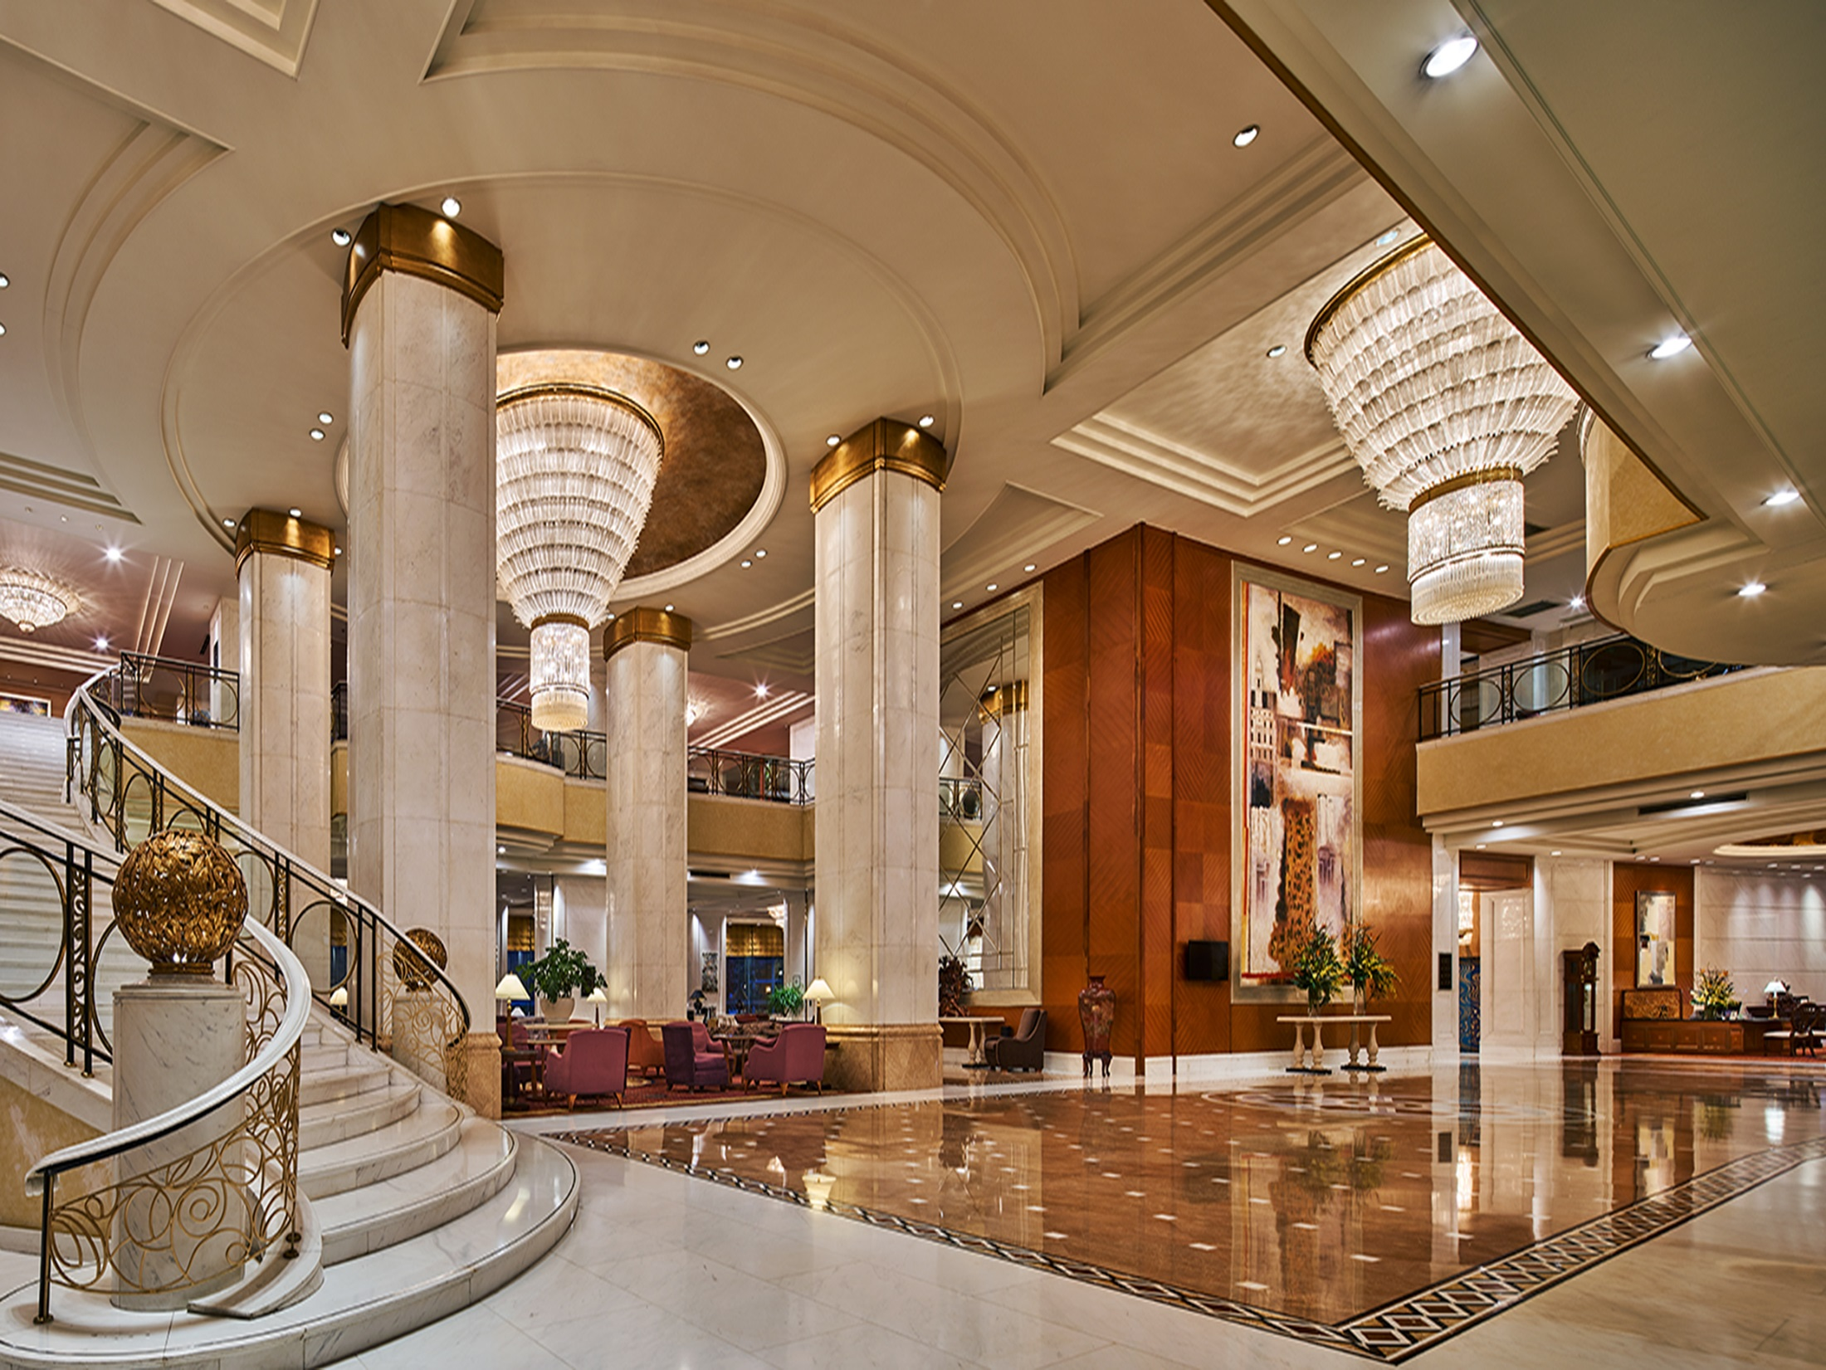
酒店大堂 Hotel Lobby

Slide 4

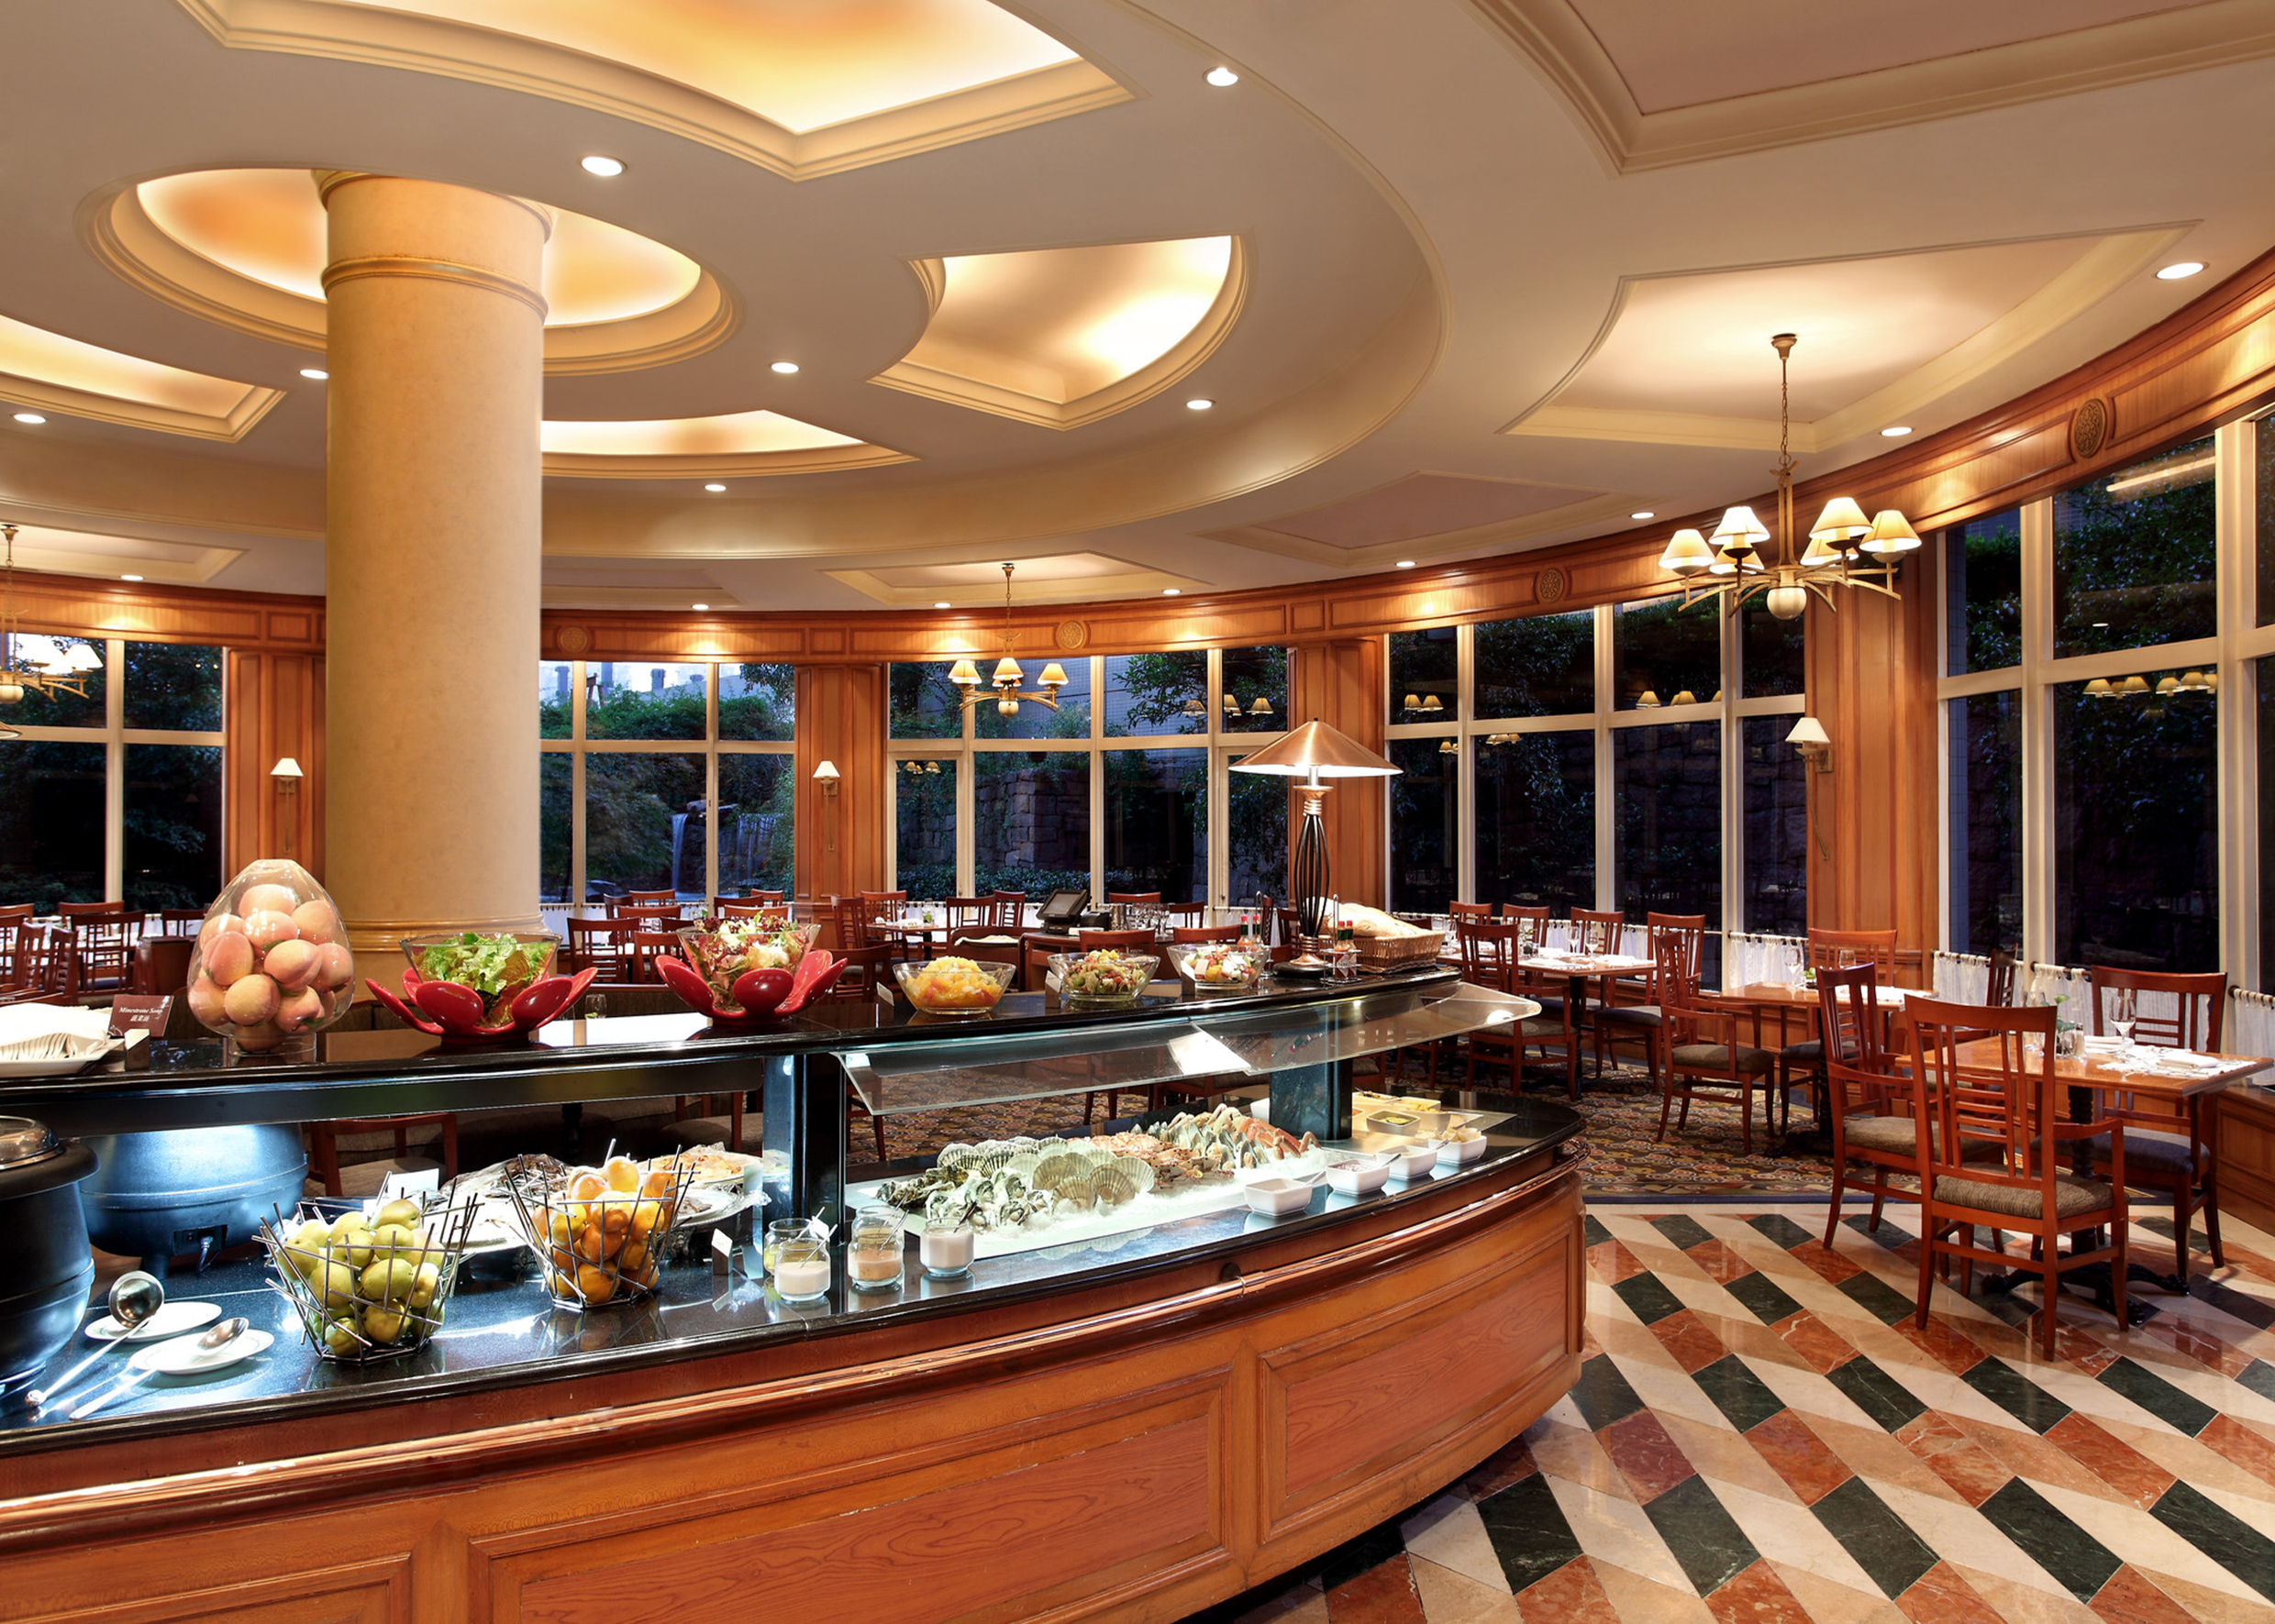
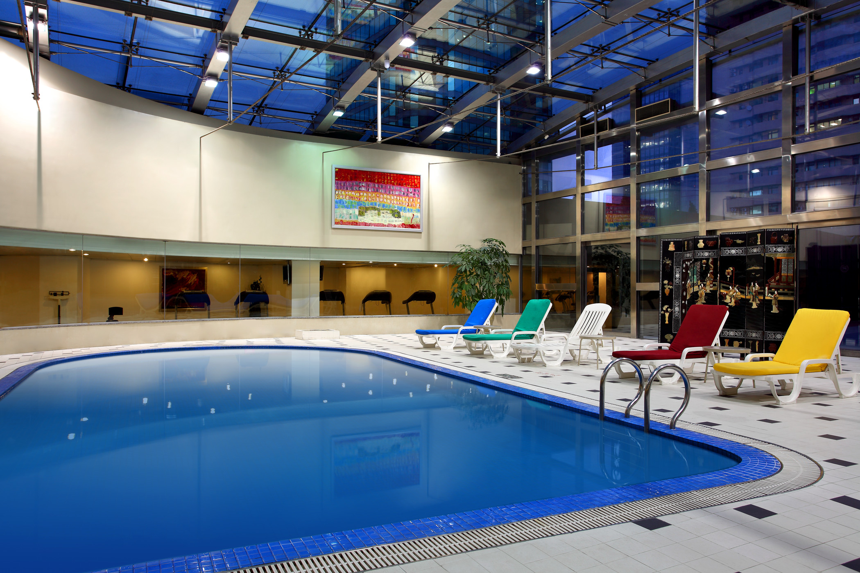
酒店设施 Hotel Facilities
餐饮设施
咖啡亭全日制餐厅
大堂酒廊
吉尔喜酒吧
花野日餐厅
鲜筵餐厅
农夫之家
吉范尼斯意大利餐厅
宾客服务
无线上网
传真/影印/打印
快递
洗衣服务
24小时客房送餐服务
豪华轿车服务
娱乐设施
室内游泳池
健身中心
桑拿
水疗中心
Restaurants & Bars
Cafe Bistro
Lobby Court
Chelsea Bar
Hanano Japanese Restaurant
Xian Yan Restaurant
Bauernstube
Giovanni‘s Italian Restaurant
Guest Service
WiFi
Facsimile/Photo Copying/Printer
Courier Service
Laundry Service
24-hour Room Service
Limousine Service
Recreations
Indoor Swimming Pool
Fitness Center
Sauna
SPA

Slide 5
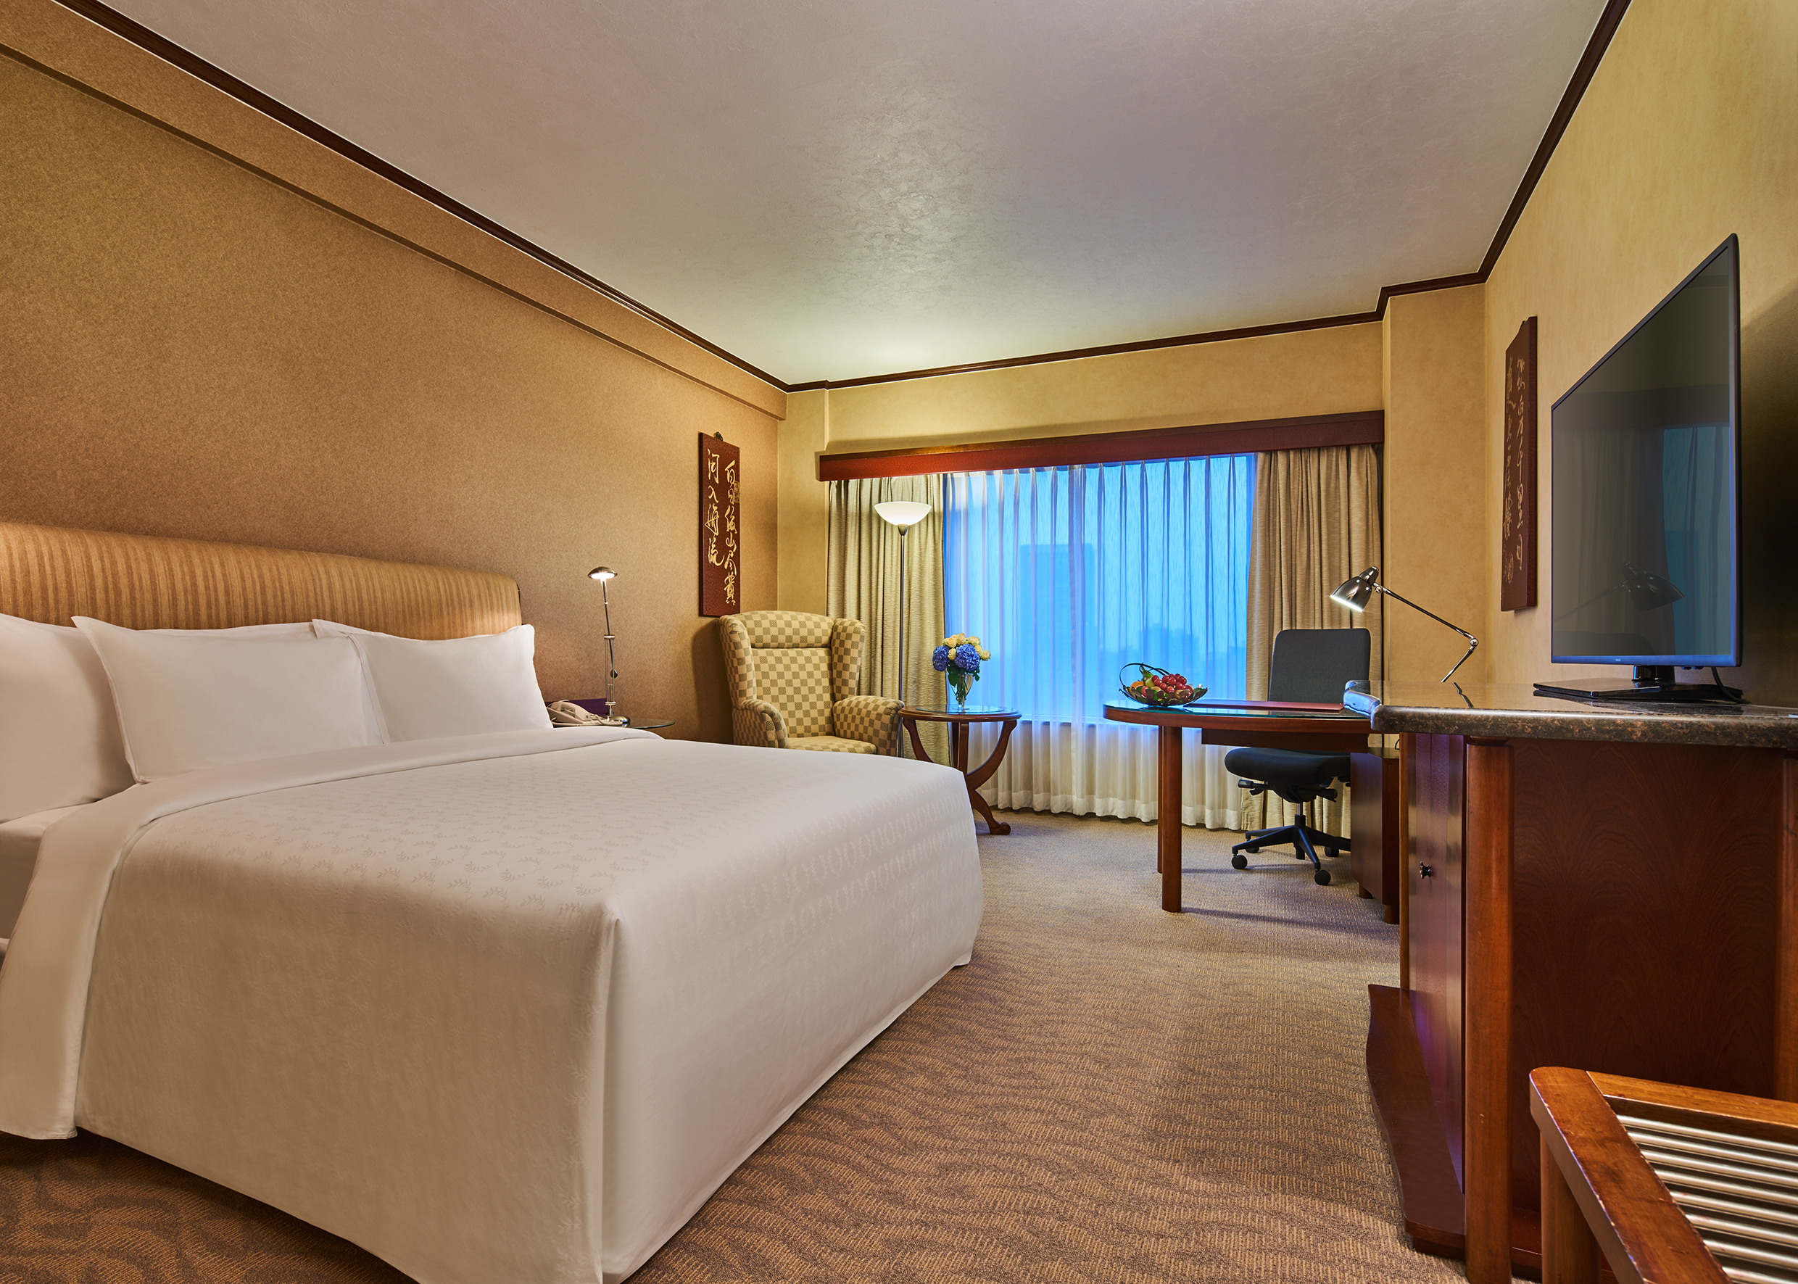
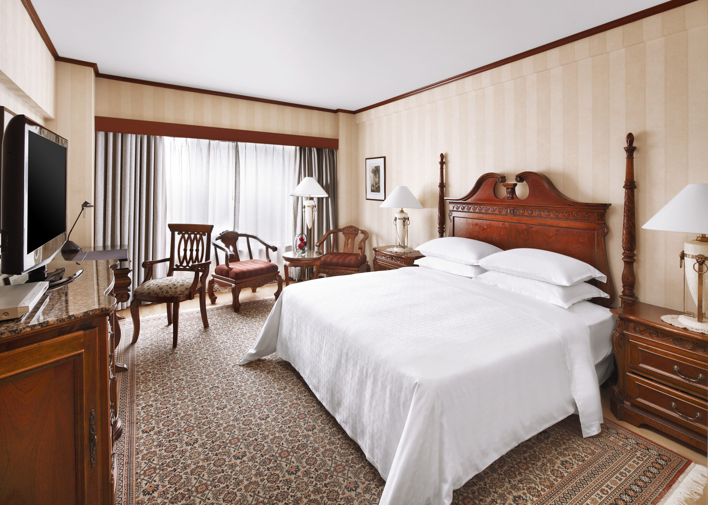
酒店客房 Hotel Accommodation
酒店拥有587间典雅且别致的客房，其中100间为豪华套房, 其艺术化的客房装修及高品质的硬件设施时时为宾客营造舒适温馨的感受。所有房间配备30厘米厚的符合人体工程学的床垫、LED屏幕电视机及高速宽带上网。
The hotel boasts 587 warm and artfully designed guestrooms, including 100 superb suites. All accommodations are equipped with 30cm height ergonomic mattress, LED flat screen televisions and high speed internet.

Slide 6
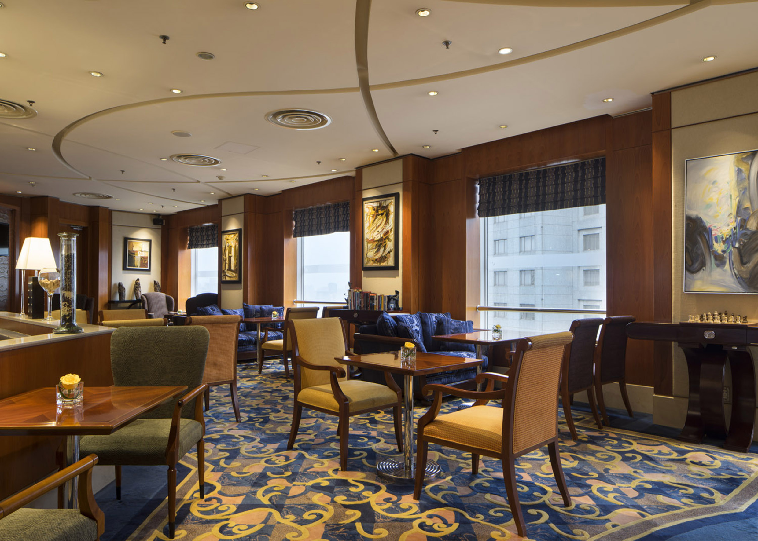
行政酒廊 Executive Lounge
行政酒廊为行政楼层客人提供早餐、全天茶点、午后小吃及多种饮品选择。客人可在氛围私密的行政酒廊与同事、朋友亲密保持联络，或观看最喜爱的电视节目放松身心。
Executive Lounge offers breakfast, refreshments all day, afternoon hors d’oeuvres, and a variety of beverage options. Take advantage of the private Executive Lounge, where you can connect with friends or simply relax by catching your favorite TV show.

Slide 7
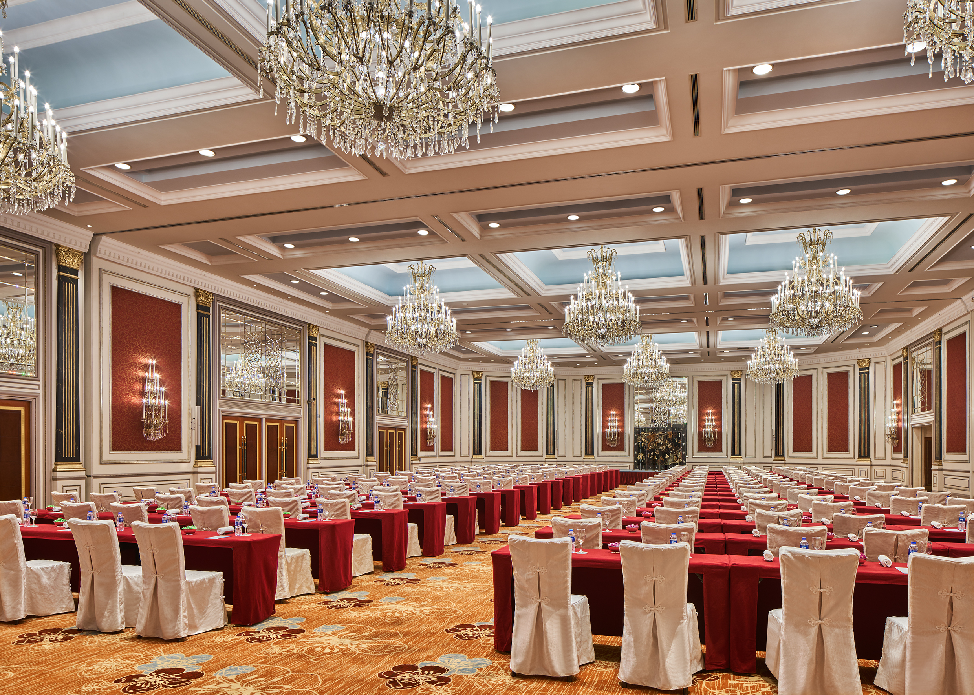
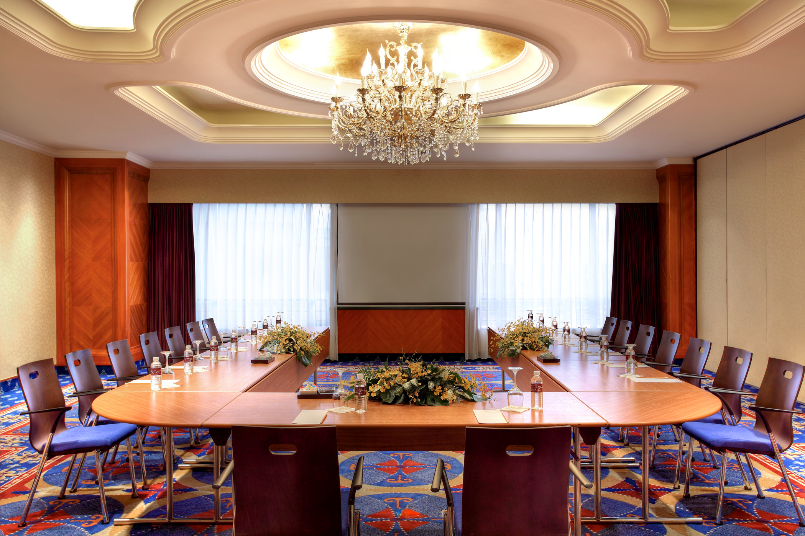
酒店会议 Hotel Meetings
拥有 1900 平米的宴会及会议空间，配备完善齐全的设施，包括一间无立柱宴会厅及10间中小型会议室。830 平米的无柱式宴会厅拥有高达 6.1 米的天花板和流光溢彩的豪华水晶吊灯，可容纳 800 位宾客。
With more than 1,900 square meters of combined banquet and meeting room space, Hongqiao Jin Jiang Hotel provides extensive event facilities. Our 10 state-of-the-art convention facilities include the pillar-less Ballroom and additional small- to medium-size meeting rooms.

Slide 8
会议容量表 Capacity Chart
会议室名称 Meeting Room | 大小（长*宽） Dimension | 面积(平方米) Area (sqm) | 层高 (米) Ceiling (m) | 宴会 Banquet | 剧院 Theatre | 招待会 Reception | 教室 Classroom | U型 U-shaped
大宴会厅 (A+B+C) Ballroom (A+B+C) | 40*21 | 830 | 6.1 | 500 | 800 | 700 | 480 | /
大宴会厅 A 或C Ballroom A or C | 13*21 | 290 | 6.1 | 180 | 250 | 200 | 120 | 70
大宴会厅 B Ballroom B | 13*21 | 250 | 6.1 | 140 | 200 | 200 | 100 | 70
大宴会厅 A+B 或 B+C Ballroom A+B or B+C | 26*21 | 540 | 6.1 | 300 | 400 | 320 | 240 | /
珊瑚厅 Coral Room | 10*8 | 88 | 2.97 | 50 | 70 | 60 | 48 | 24
大西洋厅 Atlantic Room | 20*8 | 160 | 2.97 | 90 | 120 | 100 | 72 | 42
大西洋东厅或西厅 Atlantic East or West | 10*8 | 80 | 2.97 | 40 | 60 | 40 | 30 | 24
南中国海厅 South China Room | 10*8 | 80 | 2.97 | 50 | 60 | 50 | 36 | 24
地中海厅 Mediterranean Room | 20*8 | 160 | 2.97 | 90 | 120 | 100 | 72 | 42
地中海东厅或西厅 Mediterranean East or West | 10*8 | 80 | 2.97 | 40 | 60 | 40 | 30 | 24
太平洋厅 Pacific Room | 160 | 160 | 2.75 | 90 | 120 | 100 | 72 | 42
商务中心会议室 Business Center Meeting Room | 5*10 | 50 | 2.4 | / | / | / | / | /

Slide 9
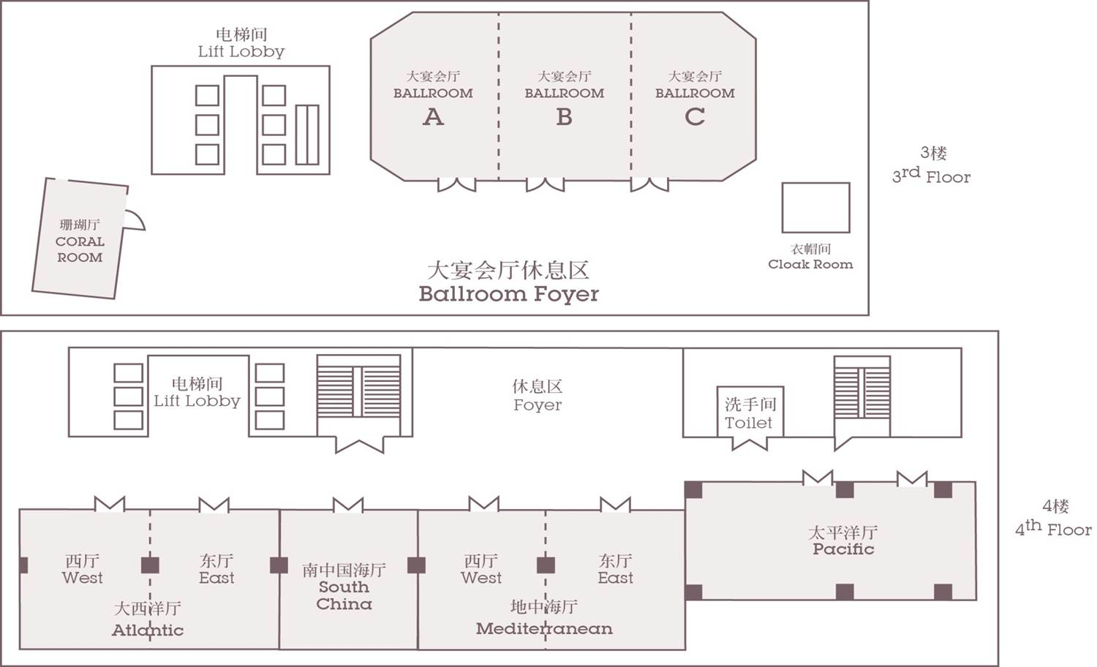
楼层平面图 Floor Plan

Slide 10
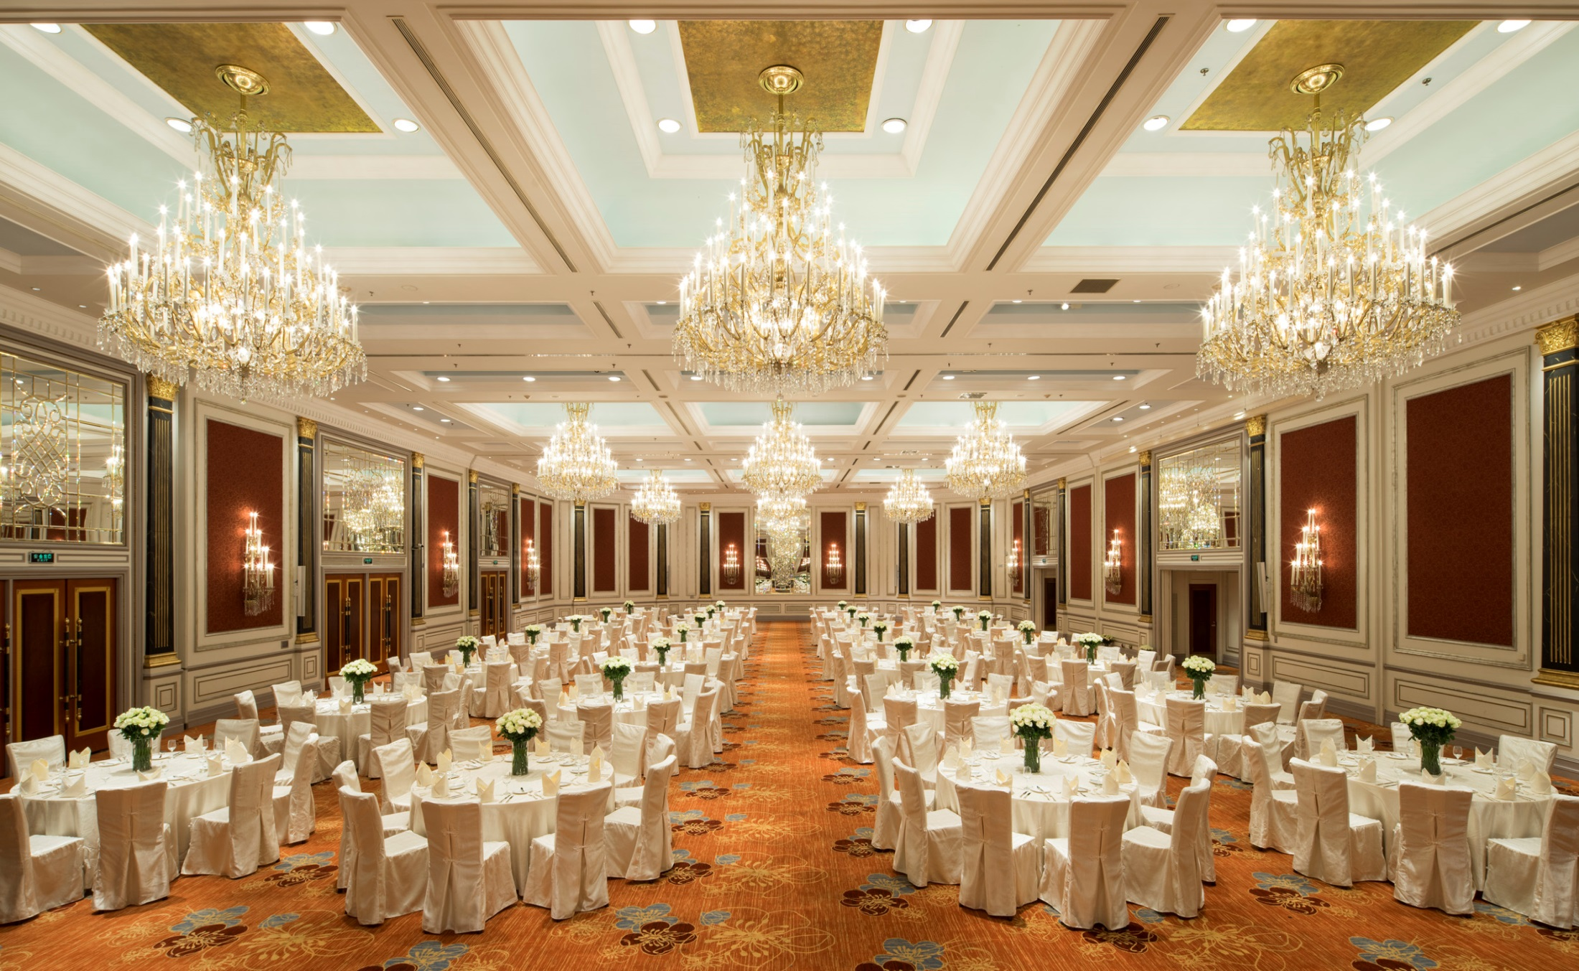
酒店婚宴 Hotel Wedding

Slide 11
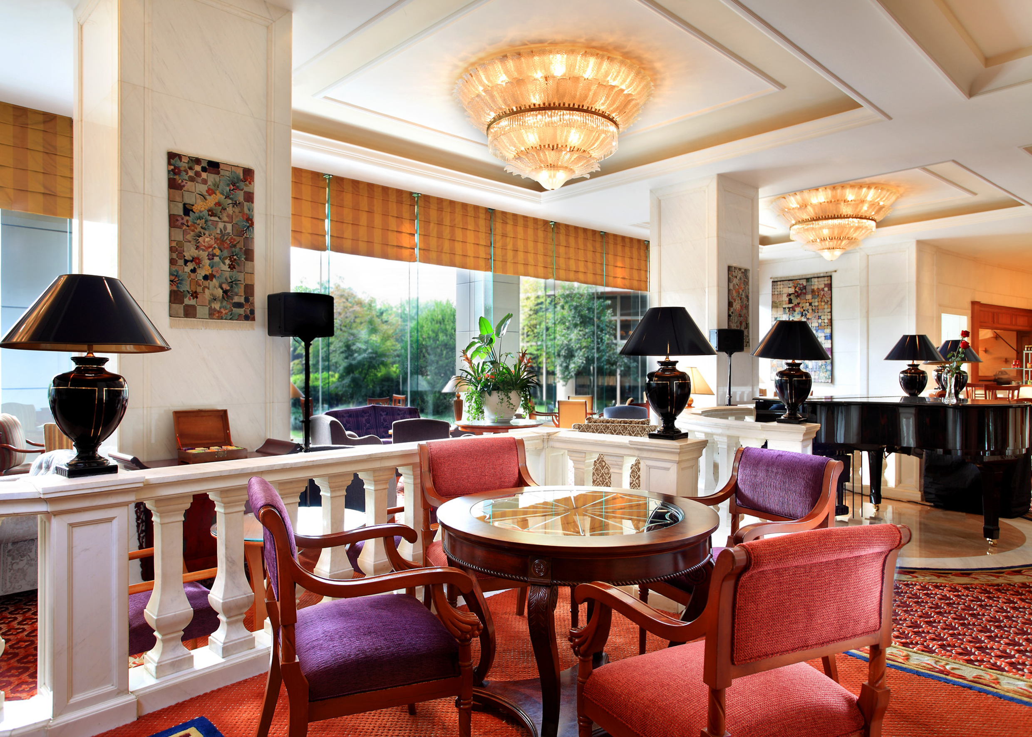
酒店餐饮 Hotel Food and Beverage
丰富多元的餐饮选择，满足客人不同口味。名闻遐迩的吉范尼斯意大利餐厅(Giovanni’s)连续三年获上海时尚生活杂志《尚流Tatler》颁发“最佳餐厅”殊荣；鲜筵餐厅 选用优质原产地新鲜食材，地道特色烹饪手法，原汁原味地呈现食材的极致鲜美；花野日餐(Hanano)主打正宗日式料理。
Hongqiao Jin Jiang Hotel boasts several dining options, each catering to specific palates. Giovanni’s - one of Shanghai’s most renowned fine dining Italian restaurants, was awarded “Best Restaurant” for three consecutive years by Shanghai Tatler Magazine, Xian Yan Restaurant features the freshest seasonal ingredients flown daily from the eastern area, adopting authentic local cooking method without overpowering the original flavor, while Hanano serves authentic Japanese cuisine.

Slide 12
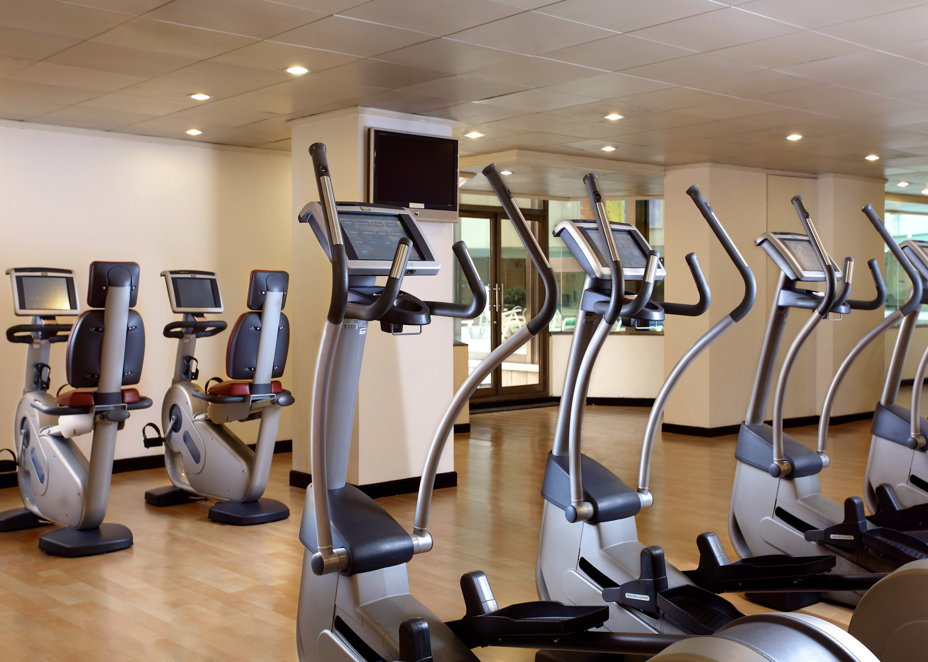
酒店娱乐 Hotel Recreations
酒店的健身中心附设一应俱全的健身器材、室内泳池和桑拿室等先进设施。Touch Spa水疗中心提供美容、保健及按摩项目，是全面放松身心，享受休闲时光的另一理想地点。
Fitness Centre, where guests can make full use of the latest facilities such as a fully-functional gym, an indoor pool and a sauna.

Slide 13
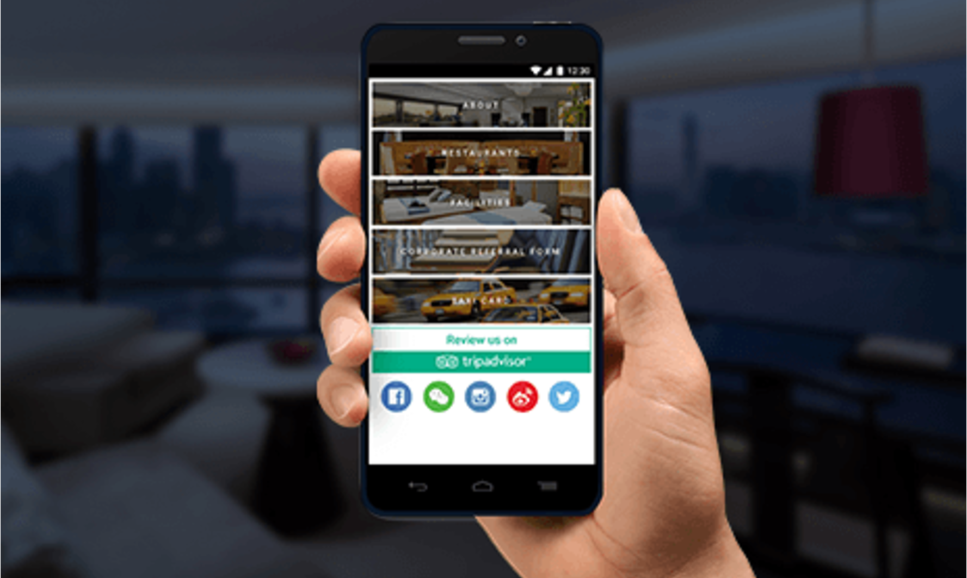
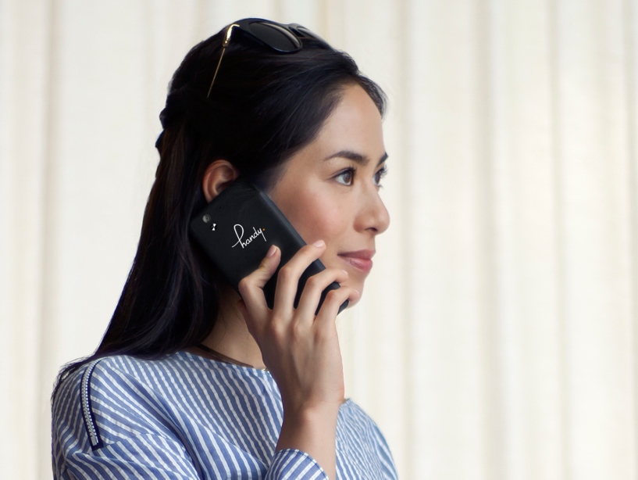
handy是每一位酒店宾客都想要的免费配套
handy is the free amenity every guest desires!
handy is the latest hotel amenity in every guest room. With this handy phone, never worry about roaming charges or getting lost in Shanghai, because we have got you covered. Guests just take it out and enjoy its features and more for FREE during the stay.
Offer versatile APP choices
Unlimited Internet access
Speed dial to Hotel services
Unlimited local & international calls
Latest dining & entertainment info of Shanghai
酒店每间客房都配有handy 手机。handy 手机是一款结合私人旅游指南功能、免费网络、多种应用程序及服务于一体的智能手机。酒店宾客在漫游上海时可以与外界随时保持联络，与家人、朋友以及酒店取得联系，尽情享受旅程。
免费上网
提供功能多样的APP
无限的本地和国际通话
快速接通酒店服务
上海最新生活旅游资讯

Slide 14
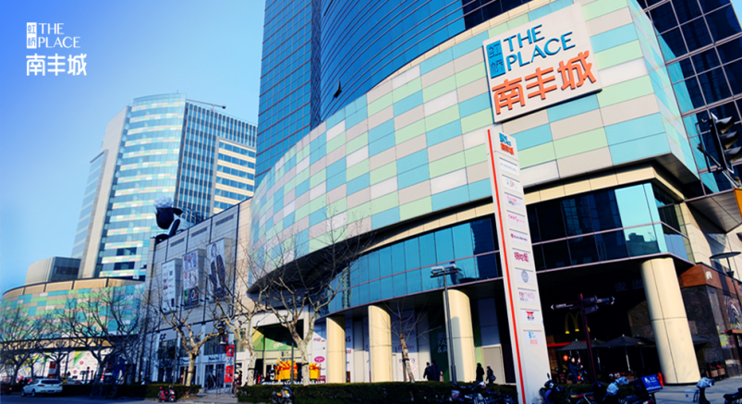
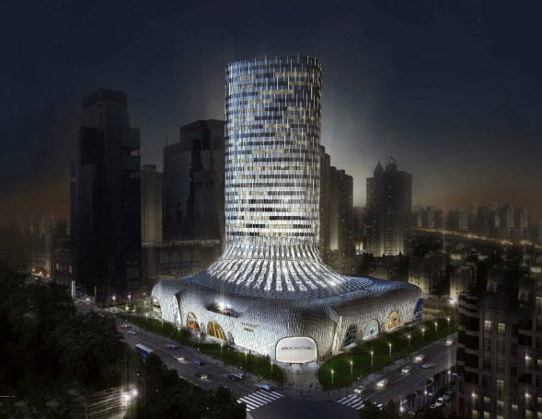
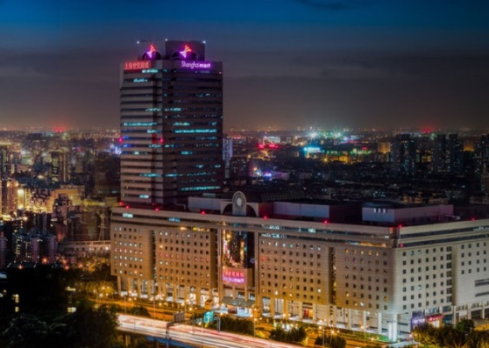
邻近工商行业 Nearby Facilities
国家会展中心 | National Exhibition and Convention Center (NECC) – 15km
上海国际展览中心 | INTEX (Shanghai) – 0.17km
上海商城 | Shanghai Mart - 0.52km
上海跨国采购会展中心 | SHCEC – 2.4km
尚嘉中心 | L’ Avenue Shopping Mall – 0.29km
高岛屋百货 | TAKASHIMAYA – 0.72km
虹桥南丰城 | The Place Shopping Mall – 0.46km

Slide 15
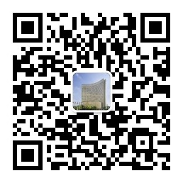
Contact Us
联系我们
虹桥锦江大酒店
HONGQIAO JIN JIANG HOTEL
上海遵义南路5号 / 5 Zunyi Nan Road, Shanghai
电话/Tel: +86 21 6275 8888 传真/Fax: +86 21 6275 5420
网址/Website: www.hongqiaojinjiang.com

