Slide 1
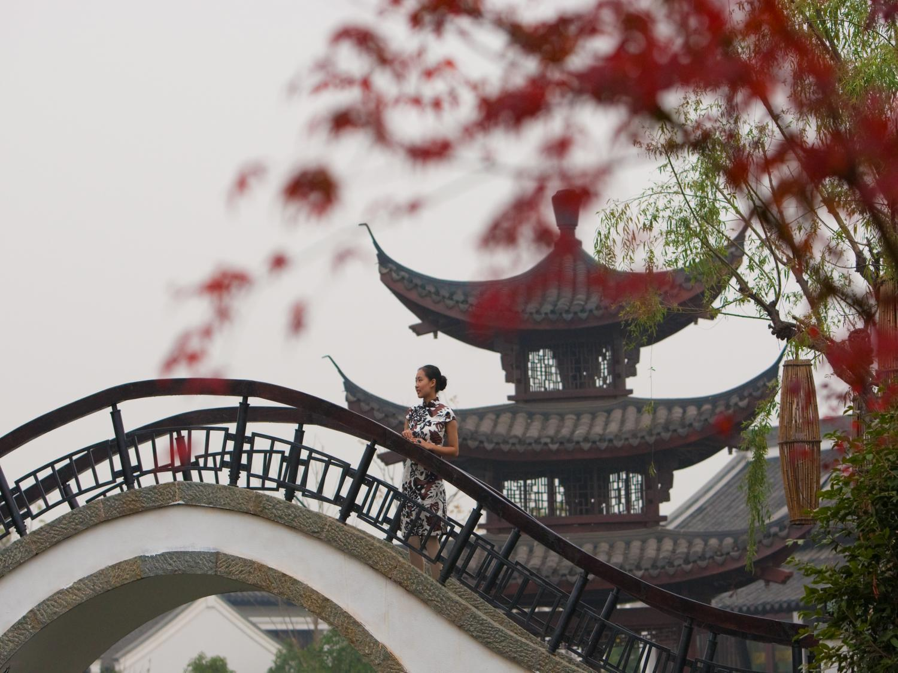
恋上江南 归隐世外 Experience the allure of Jiangnan

Slide 2

杭州 作为浙江省省会城市，具有悠久的历史，是我国七大古都之一，也是最著名的旅游城市之一，曾被十三世纪著名的意大利旅行家马可·波罗誉为“世界上最美丽华贵之城”。 Hangzhou is located on China’s southeast coast at the southern end of the Grand Canal. With a long history, Hangzhou is one of China’s best-known tourist cities and was described by Marco Polo as “the most beautiful and splendid city in the world”.

Slide 3
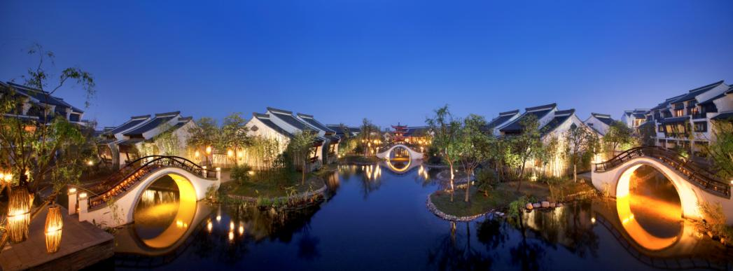

历史悠远的西溪是1465年端午节起源的发祥地，自古就出现于唐代文人的诗文辞章中，其世外桃源般的自然美景历来被竞相传诵。今天，西溪国家湿地公园以其独特的生态、文化和休闲魅力，成为国内外游客推崇的最佳休闲旅游胜地。这是一片最别样的绿洲，融合野趣、静谧、隐匿、清新、舒缓五种风情，是暂别城市喧嚣，寻找世外桃源的最理想之地。 The historic Xixi region in particular was noted for natural beauty in the writings of eminent Tang Dynasty poets, and was also the birthplace of the famed Dragon Boat Festival in 1465. Today, the Xixi National Wetland Park offers a unique retreat to city dwellers from within China as well as to international travellers, with its diverse offerings of ecology, culture and entertainment. A picturesque getaway, the five chords of Xixi – wilderness, silence, solitude, freshness, and relaxation, make it a favoured destination for travellers seeking respite from the hustle and bustle of city life.
杭州西溪湿地国家公园
Xixi National Wetland Park
Banyan Tree
Hangzhou

Slide 4


渔夫之旅是西溪湿地在2006年推出的精品体验游项目。 以景区特色摇橹船为交通工具，每条船乘坐2-5人，先跟随渔夫到菜地采摘湿地的新鲜生态蔬菜，再到河道上亲手捕捞鱼虾。结束之后到餐厅享用自己的劳动成果，酒足饭饱之后乘着余兴继续乘坐电瓶船游览湿地。 Sightseeing: boating in the rivers, you can take beautiful sceneries of Xixi. Experience: different fishing activities at different seasons such as shrimp cage, earth cage, wire mesh, mesh spreading, as well as unique biological funs of the wetland. Gains: to get a lot of fishes, shrimps, turtles, crabs and eels as well as to get close touch with fresh vegetables of Xixi. Enjoy: taste laboring results of yourself and the biological dishes prepared by local farmers.
渔夫之旅 - 深度挖掘农耕、渔耕文化
Journey of Fisherman
Banyan Tree
Hangzhou

Slide 5


暮色西溪悠远迷人，聆听百鸟私语，放眼晚霞斑斓，摇橹欸乃声声中感受大自然的静谧与绿色的生机——“摇橹倚斜阳”的西溪向晚游套餐，让更多人享受到“落霞与孤鹜齐飞”的西溪美景。夕阳西下，红霞满天的黄昏景致；倦鸟归林，虫鸣鸟叫的闲林野趣；静港泛舟，闻香识茶的梵隐意境；农家老灶，土色土香的美食享受；自在逍遥，天人合一的宁静和谐。
向晚游 - 结合生态文化、历史文化
Sundown Ritual
In the distant Xixi twilight it is fascinating to listen to the birds whisper, to admire the gorgeous sunset and to hear the sound of the oars in the water. Feeling quiet and verdantly green and the Xixi evening tour packages allow people to enjoy the sight of "falling clouds and a lonely duck flying across the sky".
Banyan Tree
Hangzhou

Slide 6

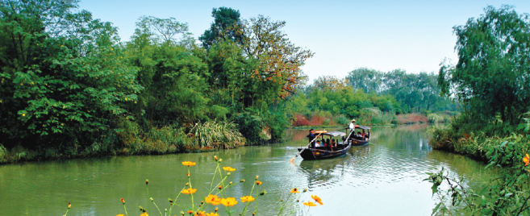
西溪天堂位于杭州西溪湿地国家公园，PM2.5低于0.035毫克，是名副其实的生态天堂。静谧悠然的湿地环境下，空气中含有丰富的负氧离子，有利于人体的身心健康。无论是度假或会议，这里都是真正的绿色天堂。 同时西溪天堂总体定位为杭州最具特色的国际旅游综合体、世界级的城市休闲和度假会议酒店群落，是中国第一个世界级的旅游综合体项目。规划有中国湿地博物馆、国际酒店集群、西溪天堂商业街、国际俱乐部、悦居国际品牌公寓、悦庄产权式酒店以及大型旅游公共服务设施等多元业态，与西溪国家湿地公园一起成为杭州作为世界休闲旅游城市的新平台。
西溪天堂 - 国际旅游综合体 最佳度假目的地
Westbrook Resort
Westbrook Resort, situated in Hangzhou Xixi National Wetland Park, the PM2.5 value is less then 0.035mg - the authentic ecological paradise.
Westbrook Resort is focusing on becoming the featured International Tourist Complex and the world-level urban leisure, resort and conference hotel cluster.
Banyan Tree
Hangzhou

Slide 7
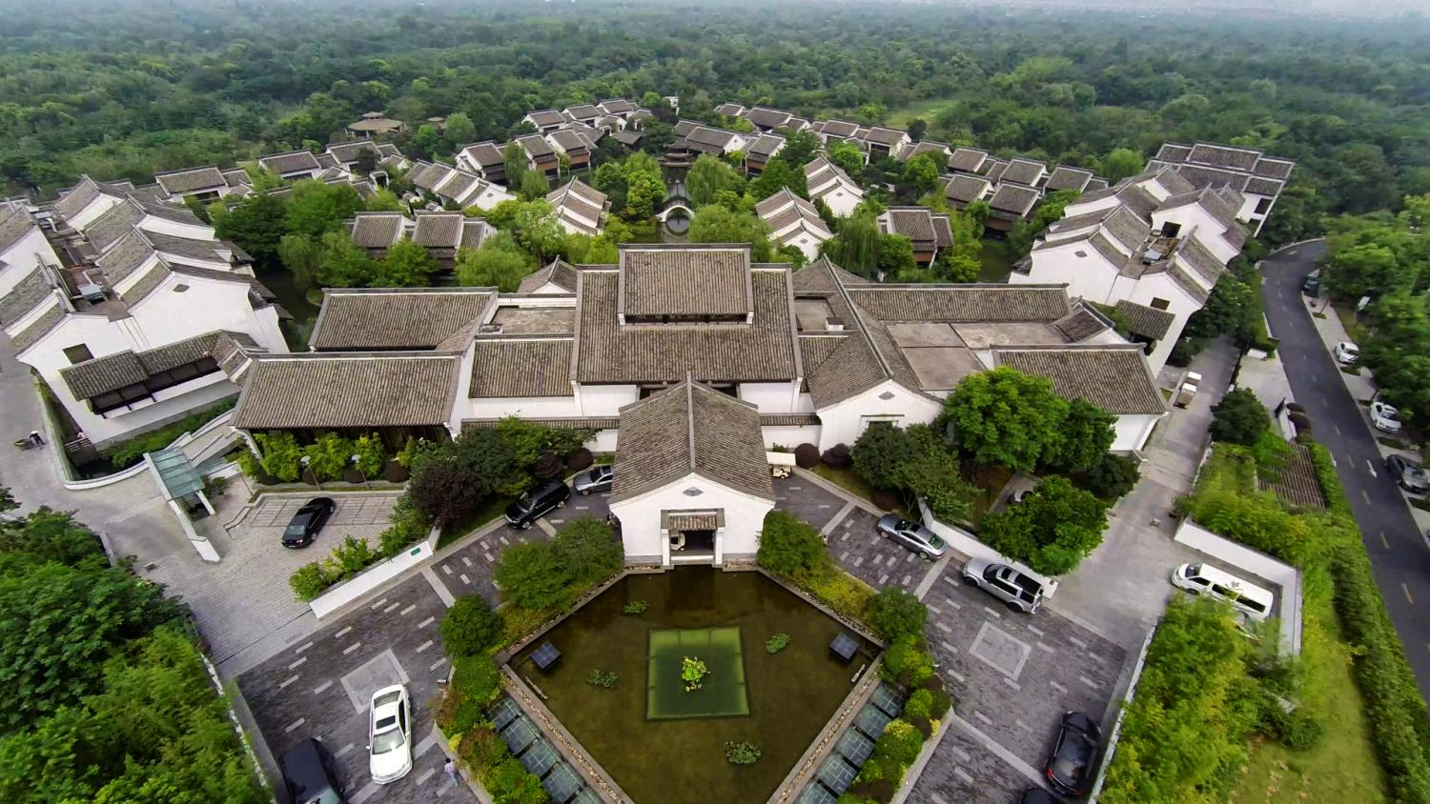
杭州西溪悦榕庄
Banyan Tree Hangzhou

Slide 8
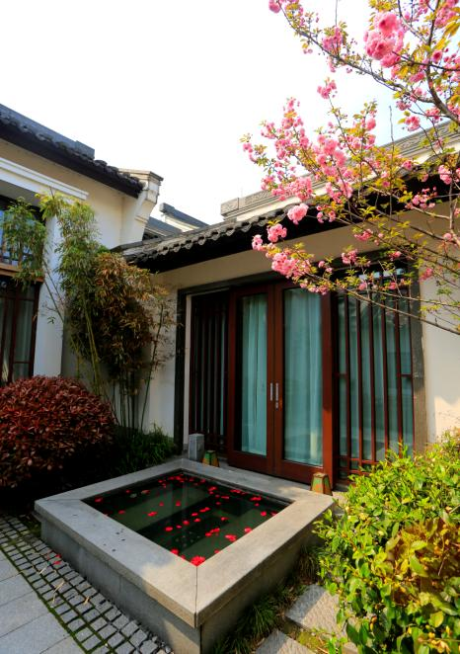
幽雅静谧 低调奢华
Sanctuary for the Senses
房型 Room Category | 房间数量 Number of Rooms | 房间面积 Size sq. m | 房间价格 Room Rate Weekday
水悦阁套房 Water Terrace Suite | 24 | 120 | /
豪华水悦阁套房 Premier Water Terrace Suite | 12 | 120 | /
水悦别墅 Water View Villa | 8 | 130 | /
豪华水悦别墅 Premier Water View Villa | 18 | 130 | /
泉浴按摩池别墅 Spa Jetpool Villa | 7 | 180 | /
双房式泉浴按摩池别墅 Two-Bedroom Jetpool Villa | 3 | 180 | /
总统别墅 Presidential Villa | 1 | 380 | /
总房间数 Total Accomodations | 73 | / | /
Banyan Tree
Hangzhou

Slide 9
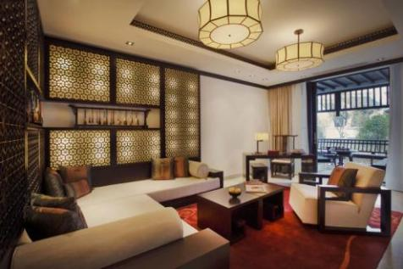
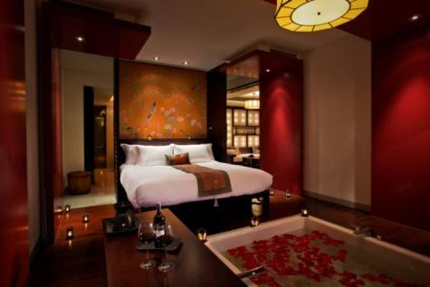
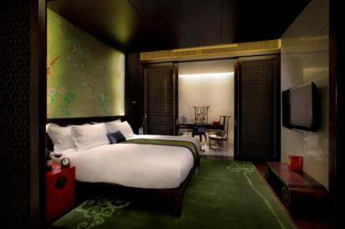
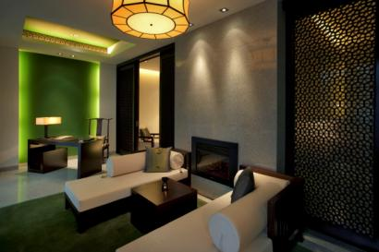
水悦阁位于度假村的主楼两翼，是远离城市喧嚣的世外桃源。24间套房皆配有现代便利设施，高雅的装潢颇具东方神韵。您可以惬意地倚靠在雅致的水悦阁内温暖的壁炉边；抑或泛舟水上，追寻西溪湿地古朴美丽的足迹。12间豪华水悦阁套房卧房亦配有豪华浴池，并附带独立的按摩房，让您纵沉醉在舒适和惬意的氛围中。在领略这座美丽城市的风土人情和热闹繁华之后，不妨舒舒服服地泡在浴缸里放松身心。 Located in the resort’s hotel annexe, the Water Terrace and Premier Water Terrace offer a quiet respite from hectic city life. All 36 suites are fitted with modern amenities and finished with sublime oriental touches. Cosy up next to the warm fireplace in the elegant Water Terrace or steal away on a rustic boat excursion to explore the pristine beauty of Xixi Wetland. The spacious Premier Water Terrace comes with a bathtub – ideal for a relaxing soak after taking in the sights and sounds of this beatiful city.
水悦阁套房/ 豪华水悦阁
Water Terrace Suite/ Premier Water Terrace Suite
Banyan Tree
Hangzhou

Slide 10
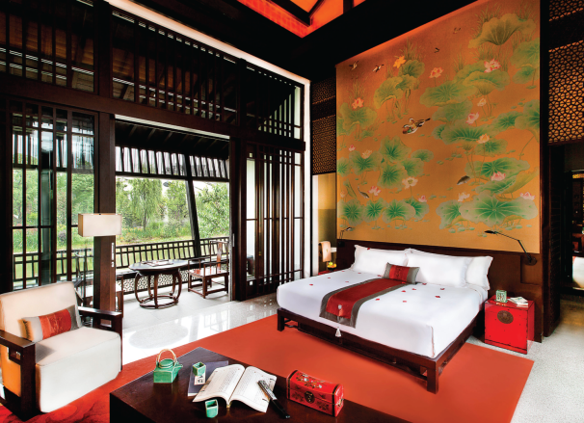
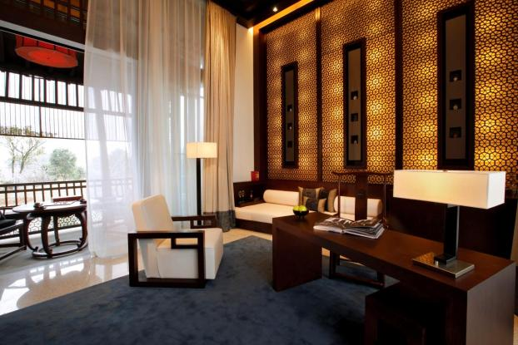
水悦别墅深情俯视着一汪温情脉脉的池塘，是恬静安谧的化身。您可以与最爱的人一起站在阳台上欣赏周围令人心旷神怡的风景。幽静的氛围与别墅风雅考究的装饰、豪迈澎湃的激情及浓重的浪漫主义色彩相映成趣。
水悦别墅/ 豪华水悦别墅
Water View Villa/ Premier Water View Villa
Overlooking a gentle pond, the Water View Villa is the embodiment of serenity. The calm ambience blends harmoniously with the refined sophistication of an immediately decorated villa. Inspiring passion and romance, enjoy the breathtaking surrounding with a loved one at the balcony.
Banyan Tree
Hangzhou

Slide 11
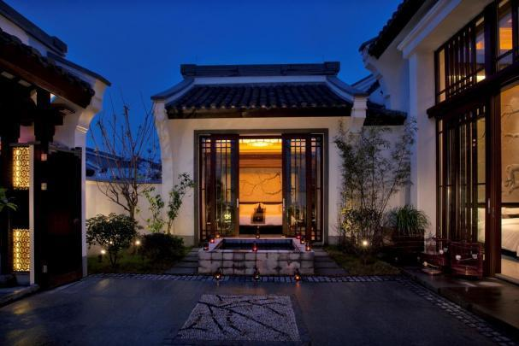
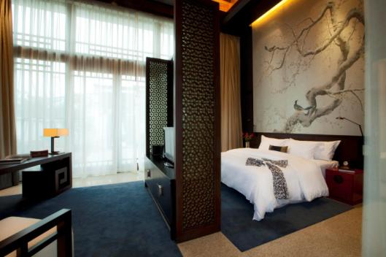
约180平方公尺的泉浴按摩池别墅，坐拥如诗如画的田园仙境，寻求安歇之处的人们能够在这里尽享闲情逸致。高雅精致的装饰风格、华美低调的硬木地板、灿若彩霞的丝绸锦缎，极尽豪华。白天，您可以踏上湿地生态之旅，徜徉于小桥流水、亭台楼榭中，度过充实的一天；晚上，您可以泡在室外按摩池的清爽池水中，或者躲进您的私人Spa护疗室内，让我们专业舒适的按摩帮您驱走疲惫、抚慰您的身心。双房式按摩池别墅所配备的两间卧室适合家庭入住。
泉浴按摩池别墅/ 双房式按摩池别墅
Spa Jetpool Villa/ Two-Bedroom Jetpool Villa
The idyllic setting of the 180 sqm Spa Jetpool Villa promises intimacy for those seeking rest and relaxation. Luxuriate in the comfort of its exquisite décor, resplendent with hard wood textures and plush fabrics. After a fulfilling day of touring the beautiful lakes, terraces and pavilions of the eco-rich wetlands, soak up the reviving waters of the outdoor jet pool for retire to your private spa chamber and be pampered by a sensuous and expertly delivered massage. The spa chamber can be converted into a second bedroom, ideal for families or friends travelling together.
Banyan Tree
Hangzhou

Slide 12
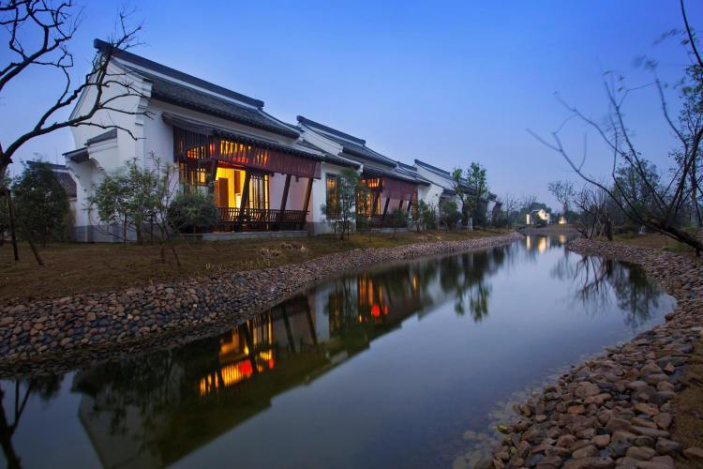
气势恢弘的总统别墅占地超过380平方公尺，到处弥漫着豪华高贵的气息。别墅内部设备完备、装饰华丽，生动明快的花纹为别墅增色不少，环抱在景观庭院中的室外按摩池更是锦上添花。在别墅内享用一桌堪比宫廷御膳的晚宴，为这段绚烂斑斓的邂逅画上浓墨重彩的一笔。 Spanning over 380 sqm, the magnificent Presidential Villa is the epitome of enduring grandeur and exclusivity. The villa is a heaven for respite, with lavishly appointed interiors filled with ornate furnishings and adorned with vibrant textures and an outdoor jet pool held in the embrace of a landscaped courtyard. Complement this enriching encounter with an extravagant in-villa dinner reminiscent of an imperial feast.
总统别墅
Presidential Villa
Banyan Tree
Hangzhou

Slide 13
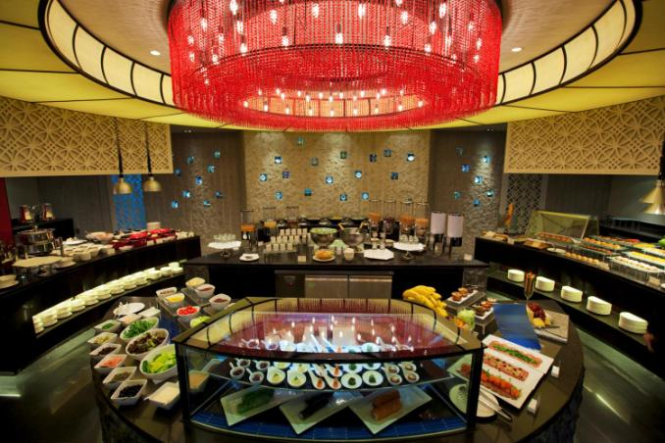
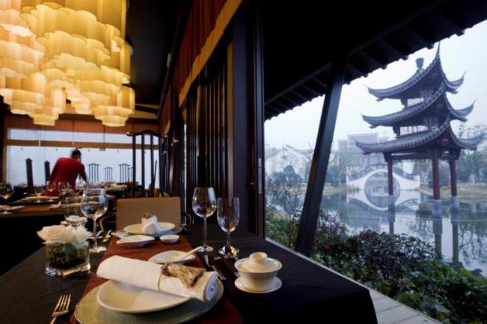
湖光阁：全天为客人提供欧亚风味美食。2间私人包房提供客人更多的私密时光。 Waterlight Court: Enjoy a la carte and buffet delicacies inspired by Europe and Asia; two private dining rooms are available for more intimate gatherings.
探索美味
Delicious Discoveries
白云：提供纯正的中式风味菜肴。以经典的杭帮菜和粤菜为主。 Bai Yun: Banyan Tree’s signature Chinese restaurant specialises in the pure flavours of Hangzhou and Cantonese cuisine.
Banyan Tree
Hangzhou

Slide 14
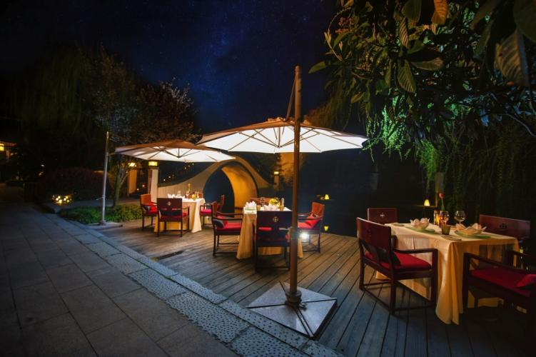
- 每日自助早餐和现场烹饪美食 Daily buffet breakfast with live cooking stations - 提供亚州风味，包括当地特色和国际美食 Serving Asian including local specialties and international favorites - 华丽的周末国际自助餐和平日的全日零点 Sumptuous Weekend Seafood buffet dinner and weekdays a-la-carte - 2间私密的贵宾房 Two private dining rooms - 90个室内餐位和36个室外餐位 90 indoor seating and 36 alfresco dining at the water edge
探索美味 - 湖光阁
Waterlight Court
Banyan Tree
Hangzhou

Slide 15
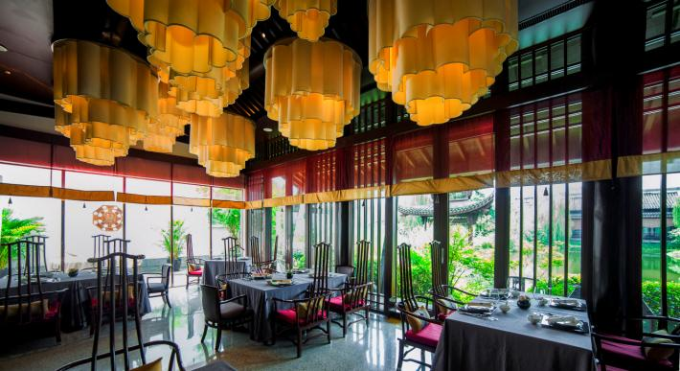
- 提供纯正的中式菜肴，以经典的杭帮菜为主 Authentic Chinese and Hangzhounese cuisine - 包括10人品茶区，品茗多种传统当地茶 Featuring a Tea Lounge, offering the finest teas in town - 远眺小桥流水的内景 Overlooking the stunning courtyard and waterways - 室内24个餐位，室外20个餐位 Seats 24 persons in the main hall and 20 persons at the outdoor terrace - 2个包厢为聚会提供私密处所 With two private rooms for intimate dining experience
探索美味 - 白云
Bai Yun
Banyan Tree
Hangzhou

Slide 16
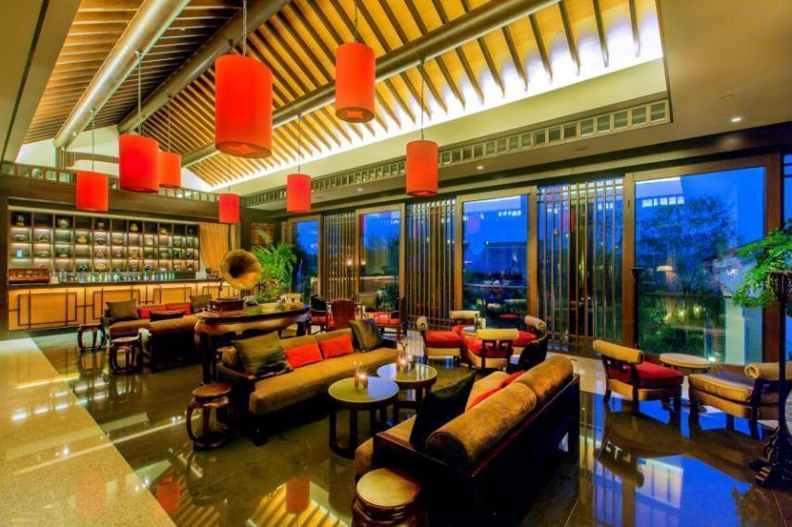
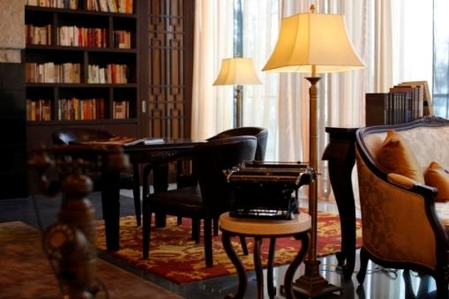
酒仙：为宾客提供种类丰富的咖啡和鸡尾酒饮品。与酒仙大堂酒吧相连的图书馆，让您在闲暇之余上网，阅览，松懈身心。 Specialised cocktails and other non-alcoholic beverages await guests in the lobby lounge. Its adjacent library offers books, magazines and newspapers as well as board games.
探索美味 - 酒仙
Jiu Xian
Banyan Tree
Hangzhou

Slide 17

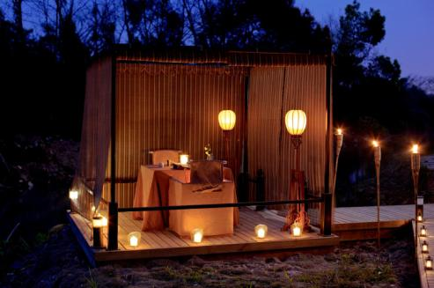
爱之船 与柳月佳人沉醉于巧舟之上，欣赏江南水乡湖光雅黛 体验水中美宴，独到之选，只羡鸳鸯影成双 Experience our unique dining sensation in our exclusive Banyan Tree Love Boat. Dine on the waterways amidst the natural beauty of the surroundings and rediscover the true meaning of romance.
探索美味 - 目的地餐饮
Destination Dining
湖畔柔情 执手挚爱，感受临湖而栖的静谧
珍藏每段只言片语，只应此刻因你不
Along the lakeside, enjoy precious and unforgettable moments with your loved one.
A unique dining experience to cherish for a lifetime.
Banyan Tree
Hangzhou

Slide 18
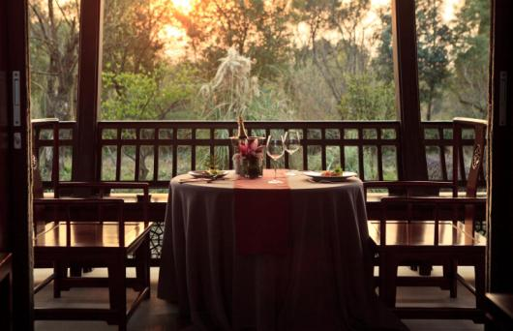
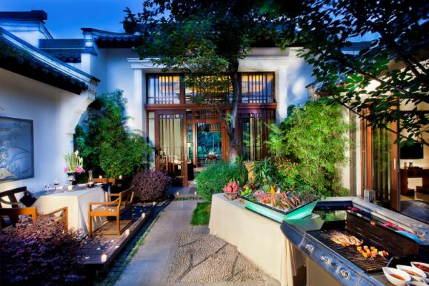
亲密露台 让自然美景与饕餮珍味浑然天成 传递爱侣间的柔情蜜意，挑逗舌尖，拨动情弦 Intimate moments start here. In the privacy of your suite or villa, take in the beauty of nature and savour delectable cuisine especially prepared by our culinary hosts.
探索美味 - 目的地餐饮
Destination Dining
别墅内烧烤 多汁的烤肉，美味的海鲜
只在您私属的别墅内现场烹制，纵情享受美食体验
Succulent meat and mouth-watering seafood to delight your senses. BBQ dining and wining in the privacy of your own Villa especially prepared by our Chef.
Banyan Tree
Hangzhou

Slide 19


湿地泛舟下午茶 乘坐水乡韵味的传统摇橹船，泛舟湿地水域 沿途赏水墨江南的意境，耳畔闻莺声之呖呖 四周植被繁盛，碧水涟漪；品上一杯香茗，聆听大自然之音 在幽静的下午，感受专属的“江南礼遇” 逃逸尘嚣，放松身心，品味难得的闲适时光
探索美味 - 目的地餐饮
Destination Dining
Intimate Afternoon Tea on Boat Surprising relaxation. Relish scrumptious savouries and sweets, complemented by fragrant Chinese tea and cruise along the pastoral Xixi wetlands on a traditional “Jiang Nan” scull boat.
Fill your senses with melodic sounds from tweeting birds, the rhythmic ripples of the marshland waters and the flourishing greens surrounding this idyllic setting.
Banyan Tree
Hangzhou

Slide 20
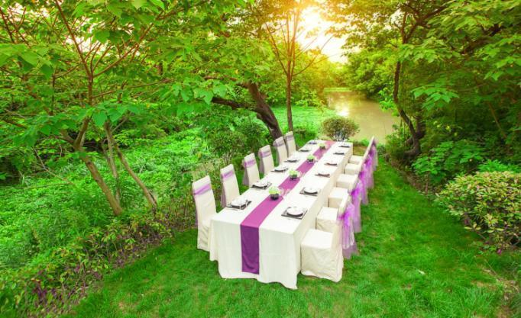

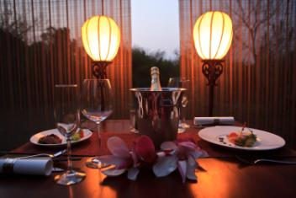
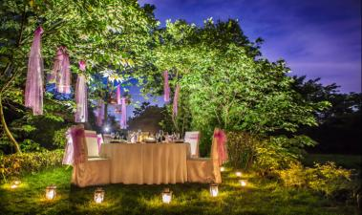

浓情时刻 钟爱杭州西溪悦榕庄 融合中西美食情调 倾听诗意浪漫乐章 More memorable moments only at Banyan Tree Hangzhou Fusing the elements of Chinese ethnicity gastronomy and romance
探索美味 - 目的地餐饮
Destination Dining
Banyan Tree
Hangzhou

Slide 21
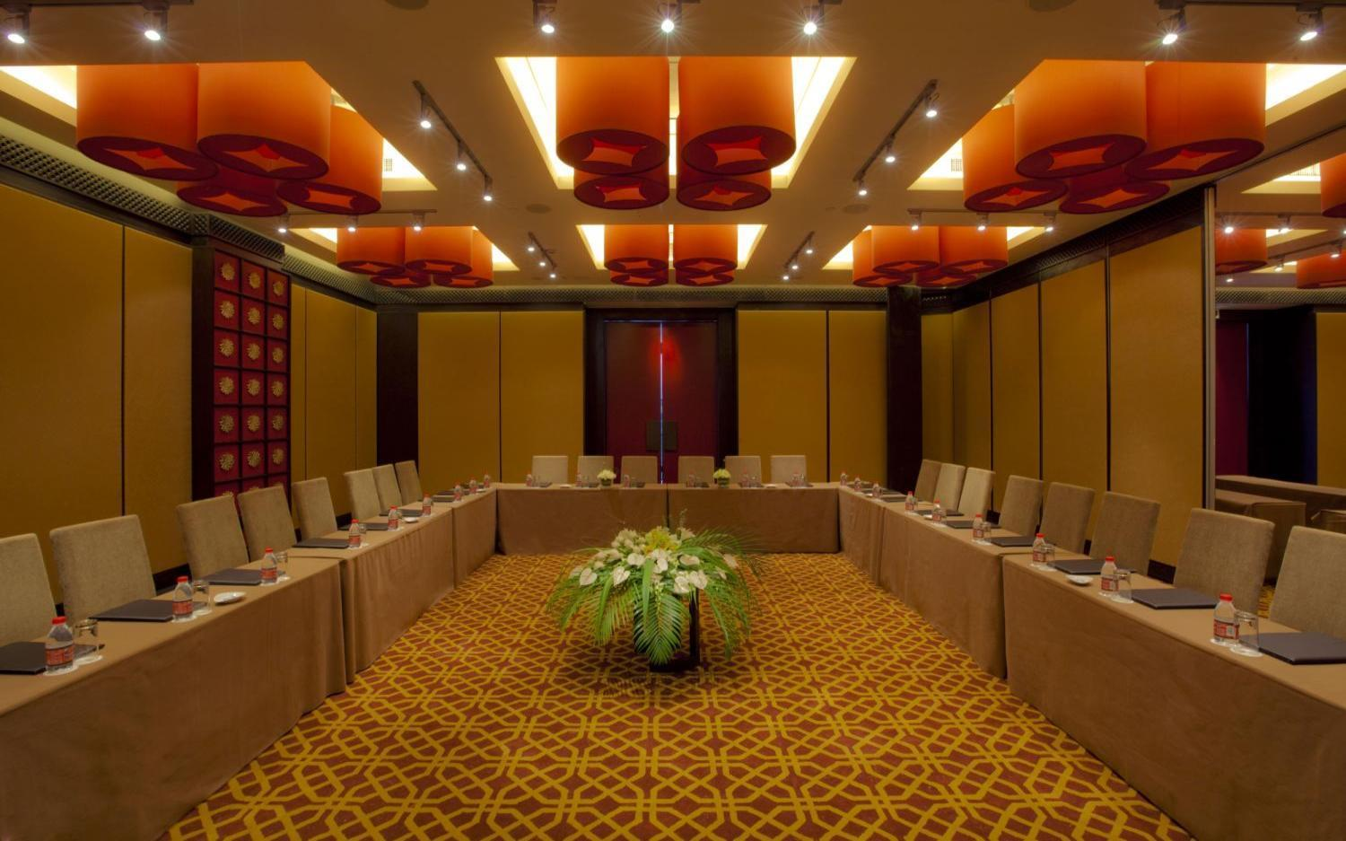
会议设施
Intellectual Stimulation
宴会厅名 Event Room | 尺度 Dimension |  |  |  | 可容纳人数 Capacity
 | 面积 Area (M²) | 层高 Ceiling Height (M) | 长 Length (M) | 宽 Width (M) | 鸡尾酒会 Cocktail | 剧院式 Theatre | 课桌式 Classroom | 中式 Rounds | 长桌 Boardroom | U型 U-shape
大宴会厅 Ballroom | 200 | 3.8 | 17 | 11.8 | 100 | 150 | 100 | 100 | 60 | 60
宴会厅1 Ballroom 1 | 100 | 3.8 | 11.8 | 8.5 | 40 | 80 | 50 | 50 | 30 | 30
宴会厅2 Ballroom 2 | 100 | 3.8 | 11.8 | 8.5 | 40 | 80 | 50 | 50 | 30 | 30
会议室 Boardroom | 30 | 3.8 | 7.6 | 4 | n/a | n/a | n/a | n/a | 14 | n/a
图书馆 Library | 70 | 3.8 | 9 | 7.8 | 30 | n/a | n/a | n/a | n/a | n/a

Slide 22
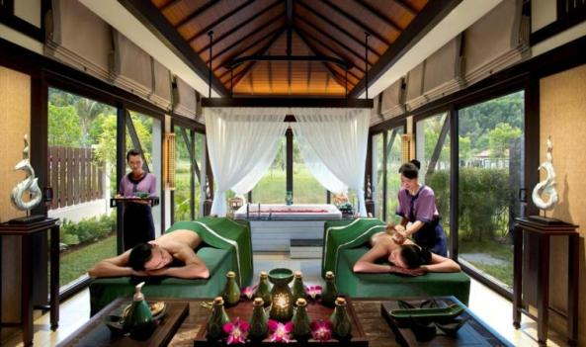
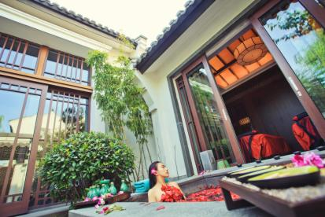
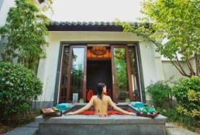


悦榕Spa以全方位的特色护理，为您呈现非凡的Spa体验，令身、心、灵获得彻底的新生。 Banyan Tree Spa presents the ultimate spa experience with The Banyan Indulgences featuring holistic signature treatments for complete physical, mental and spiritual renewal.
悦榕Spa
Banyan Tree Spa
万千宠爱于悦榕（皇家悦榕 / 协调悦榕）
中式传统（阴-淑女挚爱 / 阳-绅士之选）
阴阳雨淋（阴雨淋 / 阳雨淋）
经典再现（金-净化 / 木-新生 / 水-纾解 / 火-鲜活 / 土-平衡）
按摩方式随心选
巴厘按摩/热桂石按摩/地表精华按摩/Lomi Lomi按摩/东方按摩/运动按摩/瑞典式按摩/柔情触感/泰式经典按摩/瑜伽按摩/汉方足疗/东方背部按摩
五行面部护理（金/木/水/火/土）、美容护理（悦榕手部和足部护理）
秀发水疗（悦榕秀发护理 / 悦榕美发护理）、蜜蜡脱毛
东方泉浴体验
Banyan Tree
Hangzhou

Slide 23




汇集来自全球民间能工巧匠精心制作的手工艺品，感受悦榕的生活艺术化体验。 A lifestyle gallery showcasing indigenous art and craft from community projects worldwide. * 悦榕Spa - 经典亚式Spa疗法由专业培训的护疗师展现，10间室内护疗亭提供多款Spa疗程。Spa区域亦配备一公共泳池、美容沙龙、亚式热水浴、健身房、瑜伽室以及休息室。 Experience Asian-inspired spa therapies by professionally trained therapists. The spa features 10 indoor treatment rooms and other facilities include a swimming pool, beauty salon, oriental bath facilities, gymnasium, yoga studio and spa lounge.
悦榕阁
Banyan Tree Gallery
Banyan Tree
Hangzhou

Slide 24
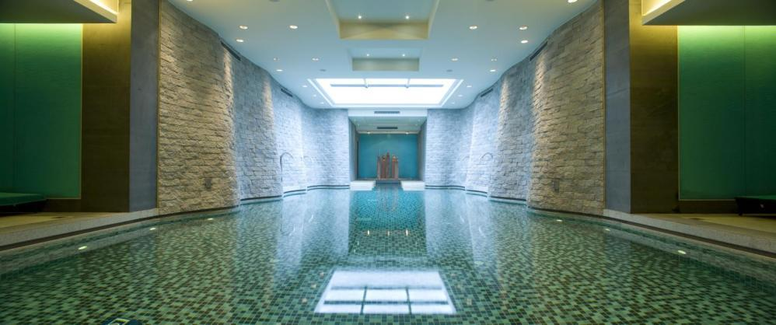
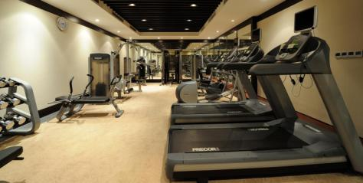
游泳池、健身房
Swimming Pool / Fitness Centre
室内游泳池
- 长度: 8米
深度: 1.2米
阔度: 5米 - 泳池温度: 26-28°C
8 x 5-metre temperature-controlled indoor swimming pool
Sauna, whirlpools, steam rooms and a fully equipped gymnasium
Banyan Tree
Hangzhou

Slide 25

无论温馨浪漫，亦或盛大典雅，杭州西溪悦榕庄为幸福喜悦的新人打造与众不同的婚礼。 We make your romantic interlude and wedding day a unique affair by offering a personal commitment to be with you from the first moment you make your wedding plans until you start your life… 宴会厅 Ballrom 每桌人民币8,688元加15%服务费起 CNY8,688 plus 15% service charge per table 草坪(仪式) Garden 人民币20,000元/半天 CNY20,000 per half day 详情垂询请致电 For more information please call +86 571 8586 0000 转7031
悦榕婚典
Wedding - A Hidden Paradise

Slide 26
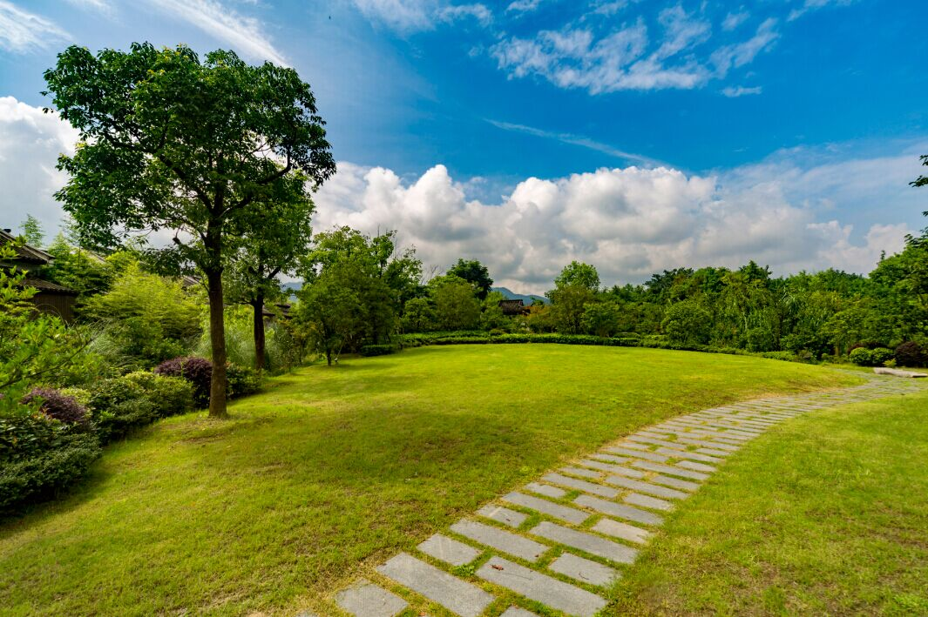
绿茵碧水环绕，户外花园处处流露着西溪湿地独有的旖旎风光。和谐美满的爱情生活从这里自然绵延，韵味丛生。在大自然的臂弯下，新人乘着祝福的微风，用爱远航。 Image taking your vows outdoors by our significant garden.
户外花园 - 幸福起航
Garden
Banyan Tree
Hangzhou

Slide 27
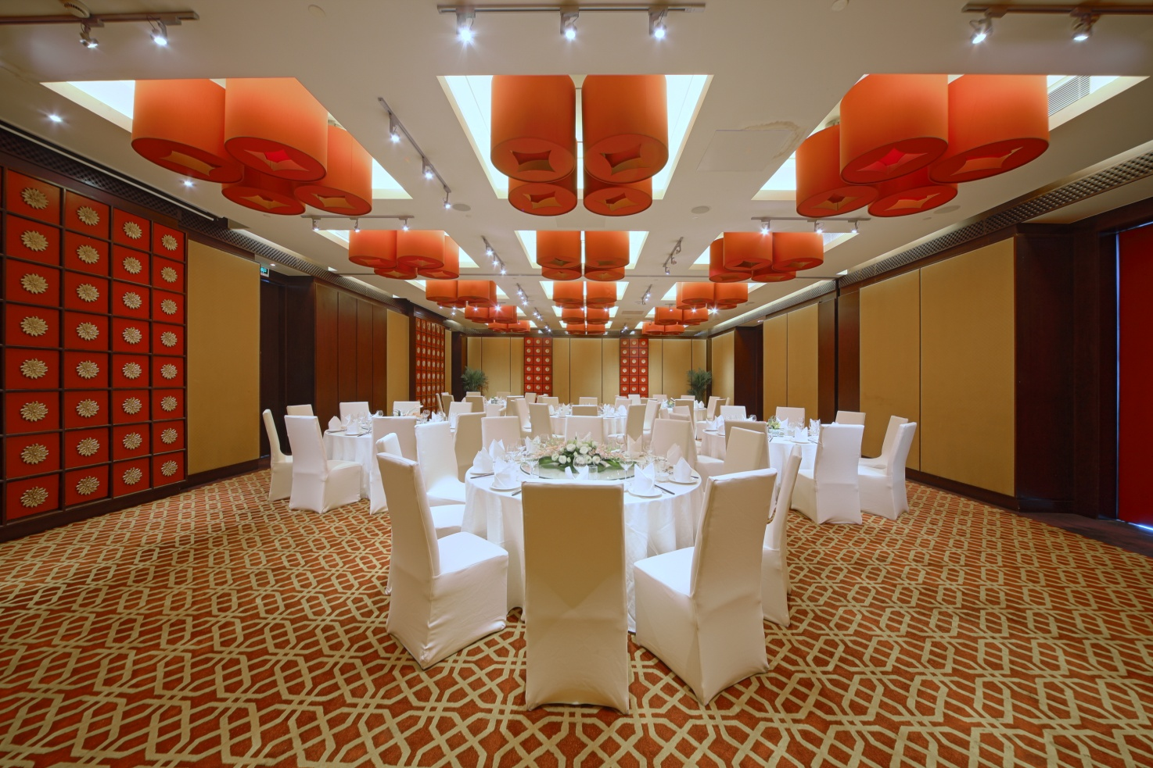
200平方米的宴会厅 柔美的灯光照佛，愈渐浓郁的浪漫柔情在礼堂内升温。 Image taking your vows in a stunning Ballroom.
宴会厅 - 温馨爱意
Ballroom
Banyan Tree
Hangzhou

Slide 28

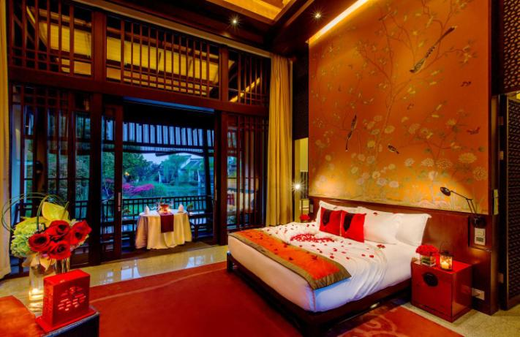
亲密时光 - 婚房
Wedding Room
Banyan Tree
Hangzhou

Slide 29
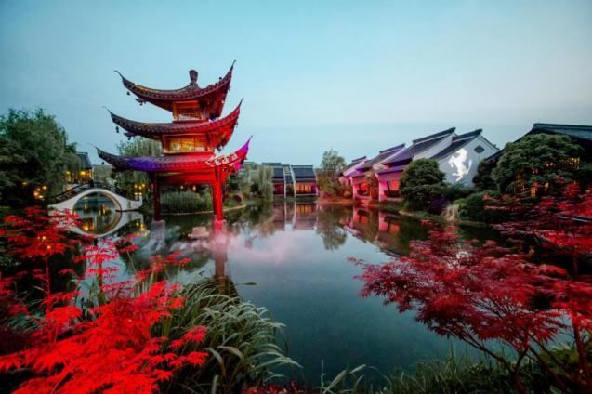

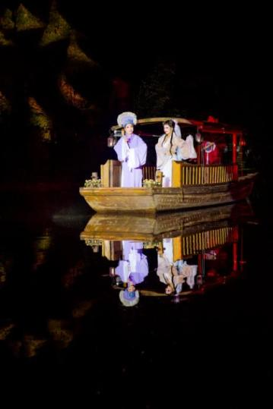
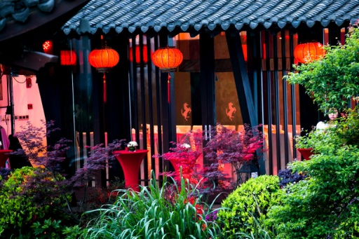
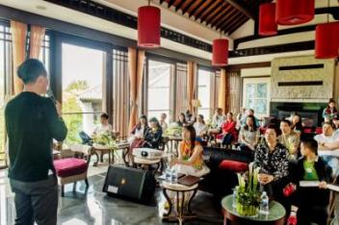

案例分享 - 法拉利
Ferrari Event
礼致中华
Tribute to Chinese Culture
Banyan Tree
Hangzhou

Slide 30
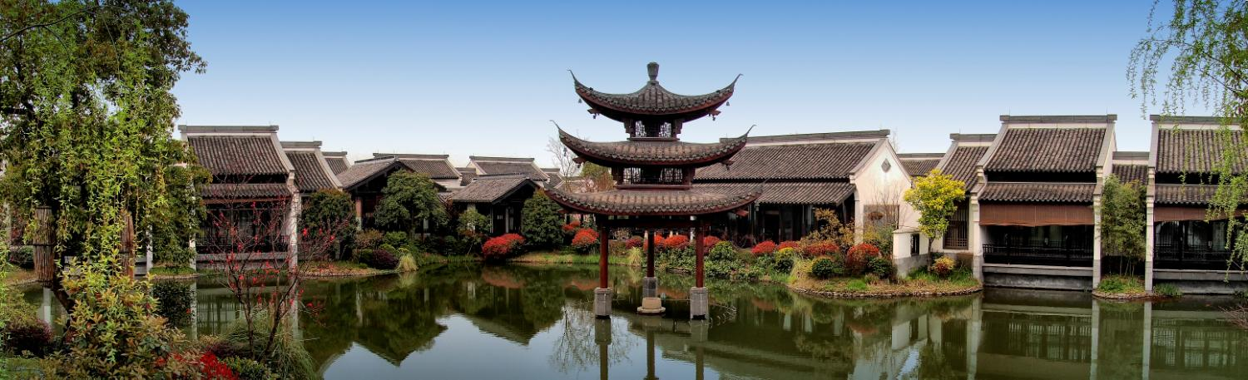
杭州西溪悦榕庄是由悦榕集团和杭州西溪投资发展有限公司共同合作的项目，由悦榕集团负责管理72间套房和别墅的度假村。从杭州萧山国际机场架车前往只需50分钟，离杭州市区及著名的西湖景区仅15分钟车程。 Banyan Tree has partnered with Hangzhou Westbrook Investment Co., Ltd to manage Banyan Tree Hangzhou, which comprises 72 water terraces and villas. The development is within a 50-minute drive from Hangzhou Xiaoshan International Airport, and 15-minute drive from downtown Hangzhou and the famed West Lake.
联系我们
Contact us
中国浙江省杭州市西湖区紫金港路西溪天堂国际旅游综合体2号 邮编: 310030 2 Westbrook Resort, Zijingang Road, Hangzhou, Zhejiang Province, People’s Republic of China 310030 电话Tel: +86 571 8586 0000 传真Fax: +86 571 8897 6535 邮件Email: sales-hangzhou@banyantree.com http://www.banyantree.com/zh/cn-china-hangzhou

