Slide 1
Artyzen Habitat Hengqin Zhuhai 珠海横琴雅辰悦居酒店

Slide 2
目 录 Contents
01
Hengqin Guangdong-Macao
In-Depth Cooperation Zone
横琴粤澳深度合作区
02
ARTYZEN HOSPITALITY GROUP (AHG) INTRODUCTION
雅辰酒店集团介绍
03
OUR BRAND PORTFOLIO
我们的品牌
04
HOTEL INTRODUCTION
酒店简介

Slide 3
Hengqin Guangdong-Macao In-Depth Cooperation Zone
横琴粤澳深度合作区
1

Slide 4
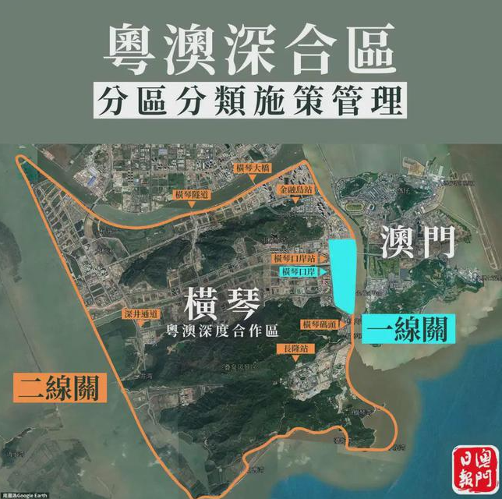
横琴粤澳深度合作区范围
Hengqin Checkpoint of the Cooperation Zone
横琴粤澳深度合作区实施范围为横琴岛“一线”和“二线”之间的海关监管区域，总面积约106平方公里。横琴与澳门特别行政区之间设为“一线”，横琴与中华人民共和国海关境内其他地区之间设为“二线”，根据横琴全岛客观现实情况对合作区进行分区施策管理。
The cooperation zone covering a customs-supervised area between the "first line" and "second line" of Hengqin Island. The "first-line" refers to Hengqin Island and Macao, while the "second-line" refers to the area between Hengqin Island and other Chinese customs. Future will implement "first-line" release and "second-line" control of goods.
到2035年，“一国两制”强大生命力和优越性全面彰显，合作区经济实力和科技竞争力大幅提升，公共服务和社会保障体系高效运转，琴澳一体化发展机制更加完善，促进澳门经济适度多元发展的目标基本实现。
By 2035, the zone's economic strength and technological competence will be greatly enhanced with an efficient public service and social security system and better collaboration mechanism between Hengqin and Macao.

Slide 5
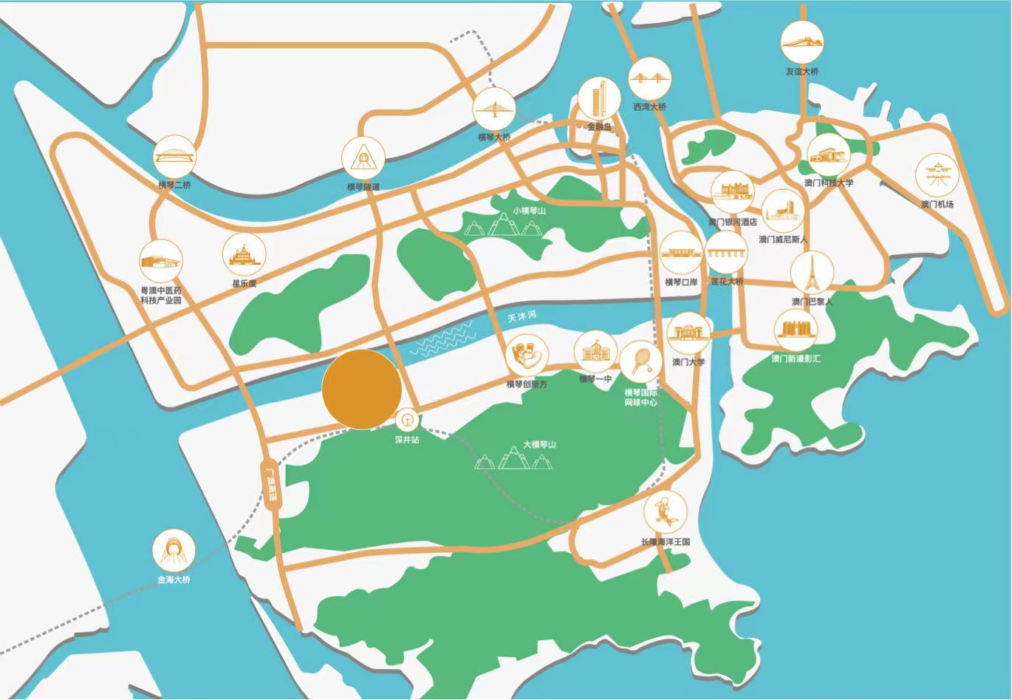

横琴粤澳深度合作区范围
Hengqin Checkpoint of the Cooperation Zone
珠海横琴雅辰悦居酒店位于粤澳深度合作区横琴的中心地带，毗邻横琴口岸和横琴高铁站，咫尺珠海长隆景区，与澳门氹仔隔海相望。
Artyzen Habitat Hengqin Zhuhai is situated at the heart of Hengqin, the Guangdong-Macao In-Depth Cooperation Zone, adjacent to Hengqin Port and Hengqin Railway Station, within easy reach of the Zhuhai Chimelong Scenic Area and facing Macao Taipa each other across the sea.
横琴粤澳深度合作区
Hengqin Guangdong-Macao In-Depth Cooperation Zone

Slide 6
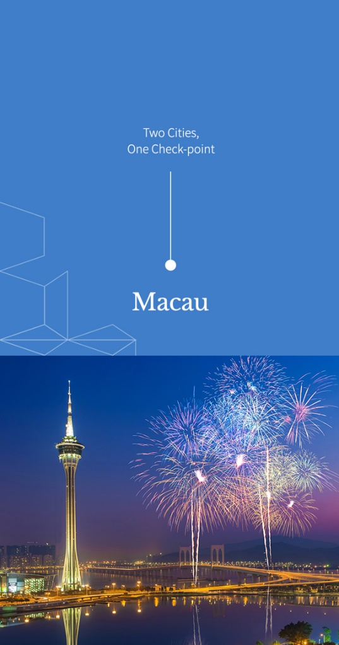

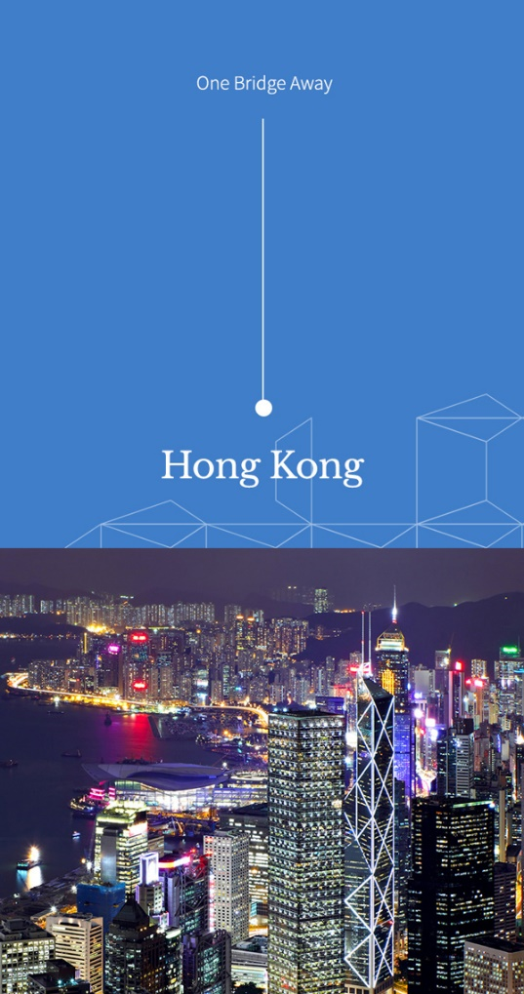
琴港澳一小时生活圈
Guangdong-HongKong-Macau, the one-hour living circle
一 桥 连 通
一 站 直 抵
两 地 一 检
澳 门
长 隆
香 港

Slide 7
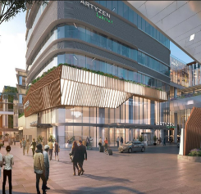
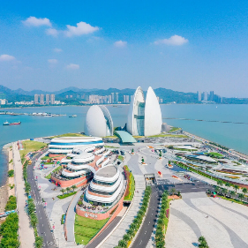
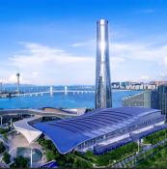






轻松娱乐 休闲配套 一应俱全 近在咫尺
Leisure and Entertainment Attractions within Your Reach
珠海大剧院
ZHUHAI GRAND THEATER
23KM, 45mins driving
珠海国际会展中心
ZHUHAI INTERNATIONAL CONVENTION&EXHIBITION CENTER
7.5KM, 15mins driving
长隆海洋王国
CHIMELONG OCEAN KINGDOM
5KM, 10mins driving
东方高尔夫球场
ORIENT GOLF
8KM, 15mins driving
珠海渔女
ZHUHAI FISHING GIRL STATUE
25KM, 40mins driving
国际网球中心
INTERNATIONAL TENNIS CENTER
3KM, 7mins driving
珠海航展
ZHUHAI AIRSHOW
38KM, 45mins driving

Slide 8
雅辰酒店集团介绍
ARTYZEN HOSPITALITY GROUP (AHG) INTRODUCTION
2

Slide 9
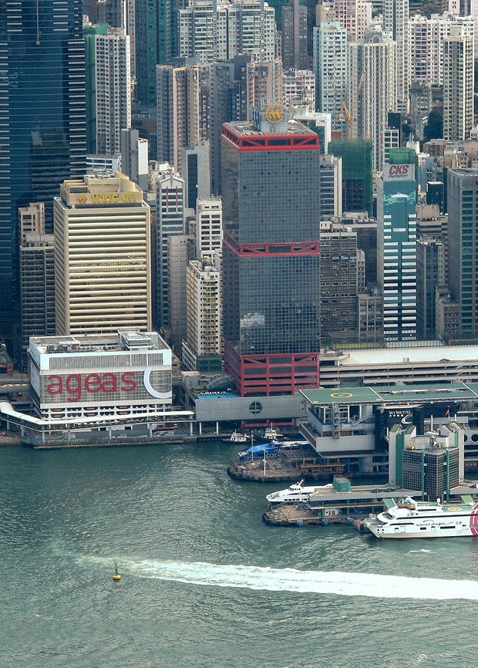
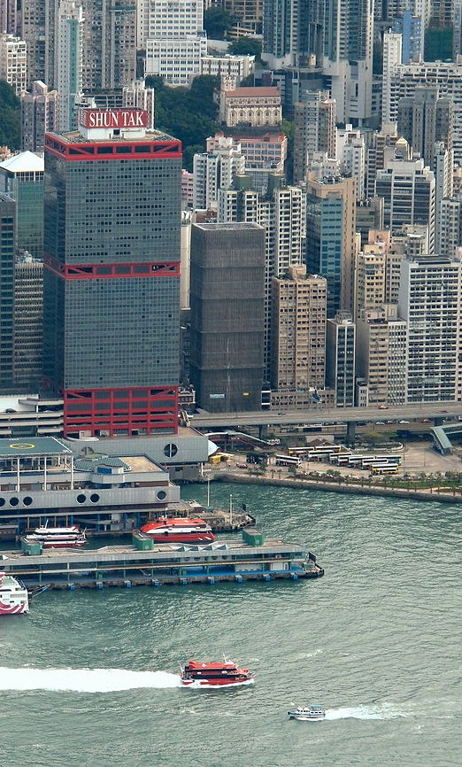

HOSPITALIT Y, TRANSPO RTATION, REAL ESTATE & INVESTMENTS
Artyzen Hospitality Group is part of Shun Tak Holdings, Ltd.
Established in 1972, Shun Tak is a leading conglomerate in Hong Kong with core businesses in transportation, property, hospitality and investments. Shun Tak has been listed on the Hong Kong Stock Exchange since 1973 and is currently a constituent stock in the MSCI Hong Kong (Small Cap) Index and the Hang Seng HK MidCap Index.
酒店、旅游会展、运输、地产与其他投资
雅辰酒店集团隶属于信德集团有限公司。
信德集团有限公司成立于1972年,是具领导地位的香港大型综合企业。 旗下核心业务包括运输、地产、酒店及娱乐与投资。信德集团于1973年在香港联合交易所上市并且现时为MSCI香港(小型股)指数及恒生香港中型股指数的成分股。

Slide 10

International Hotel Management Company 一家国际酒店管理公司

Slide 11

ORIGIN OF THE NAME “ARTYZEN” 「雅辰」名字的由來
The very name of our Group, “Artyzen”, speaks directly to our admiration for Arts – the expression of which is greatly influenced by culture. “雅辰”这个名字直接反映出我们对艺术的嚮往, 以及文化对我们所产生的深远影响。
We do believe that “art” provides a window into the soul of a culture. So, you will find “art” in all of our hotels. 通过艺术这扇门，我们相信可以更真切地接触到每一种文化的灵魂。因此，在我们旗下的酒店，你会发现不同形式的艺术。

Slide 12
Our Brand Portfolio 我们的品牌
3

Slide 13


Slide 14
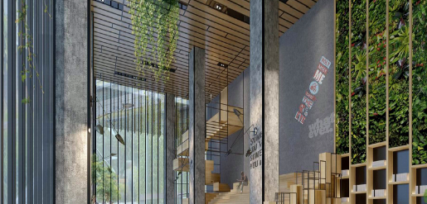
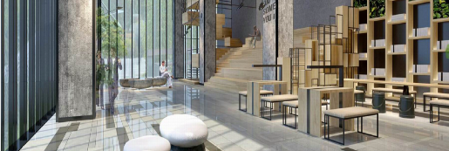

SIGNATURE EXPERIENCE
品牌体验
VIBRANT SOCIAL SPACES
引人入胜的社交空间
To Connect, work and play.
一个集居住，工作，休憩的社交空间，让你享受自由，分享所有。
RESIDENTIAL INSPIRED DESIGN
设计灵感由家开始
Creating your home away from home.
将多功能房间与舒适融为一体，让你可乐在其务，务有所乐。
COMMUNITY COLLABORATIONS
社区共创
A dynamic hub that connects people and ideas.
融入你的栖居地，遇上所爱，爱上所遇。

Slide 15
Hotel Introduction 酒店简介
4

Slide 16
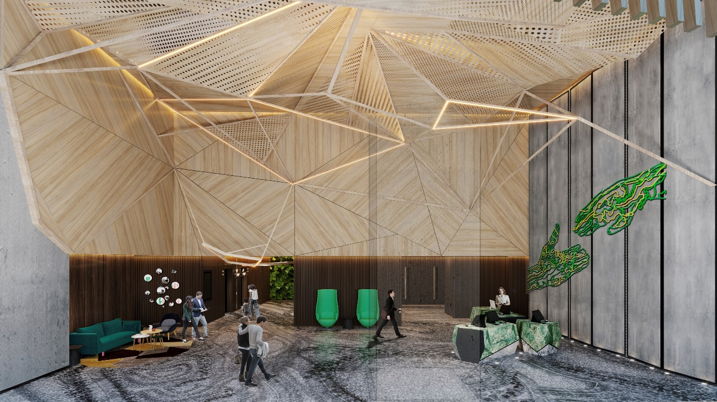
珠海横琴雅辰悦居酒店
酒店位于粤澳深度合作区横琴的中心地带，毗邻横琴口岸和横琴高铁站，连接整个大湾区交通圈，咫尺珠海长隆景区。酒店设有230间功能性客房和一系列多功能会议室，是信德集团横琴综合体的重要部分。酒店将呈现独具品牌特色的共享社交空间“思方汇”，并提供全天候美食。酒店还配备24小时健身中心和自助洗衣间，满足住客“人在旅途身在家”的日常所需。
Artyzen Habitat Hengqin Zhuhai
Artyzen Habitat Zhuhai Hengqin is situated at the heart of Hengqin, the Guangdong-Macao In-Depth Cooperation Zone, adjacent to Hengqin Port, Hengqin Railway Station and within easy reach of the Zhuhai Chimelong Scenic Area. The location provides swift access to the entire Greater Bay Area transportation network.
The hotel offers 230 highly-functional guest rooms with an array of flexible meeting rooms and is part of the Hengqin integrated development complex by Shun Tak Holdings. It houses Artyzen Habitat’s unique gem, the 'Townsquare', which is a vibrant social commune-meets-lifestyle hub. The 'Townsquare' serves all-day dining. The hotel is also equipped with a 24-hour workout area, laundromat, and conducive workspaces for guests maximized convenience during a stay.

Slide 17
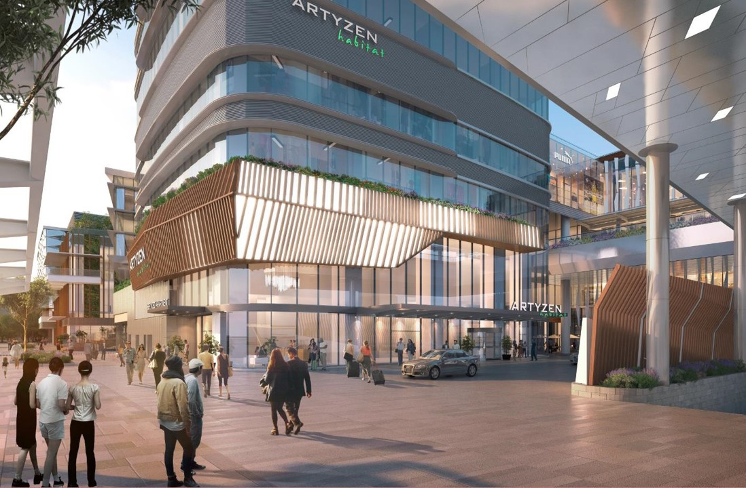
位置： | 珠海市横琴新区
客房数： | 230间房
会议设施： | 5个多功能会议室，共215平
酒店设施： | 24小时健身中心 、思方汇餐厅 、24小时自助洗衣服务
餐饮设施名称： | 思方汇餐厅
标准客房尺寸： | 28平方米
主要交通枢纽距离 | 横琴码头 4.1公里 澳门机场 8.4公里 珠海机场 43公里

Slide 18
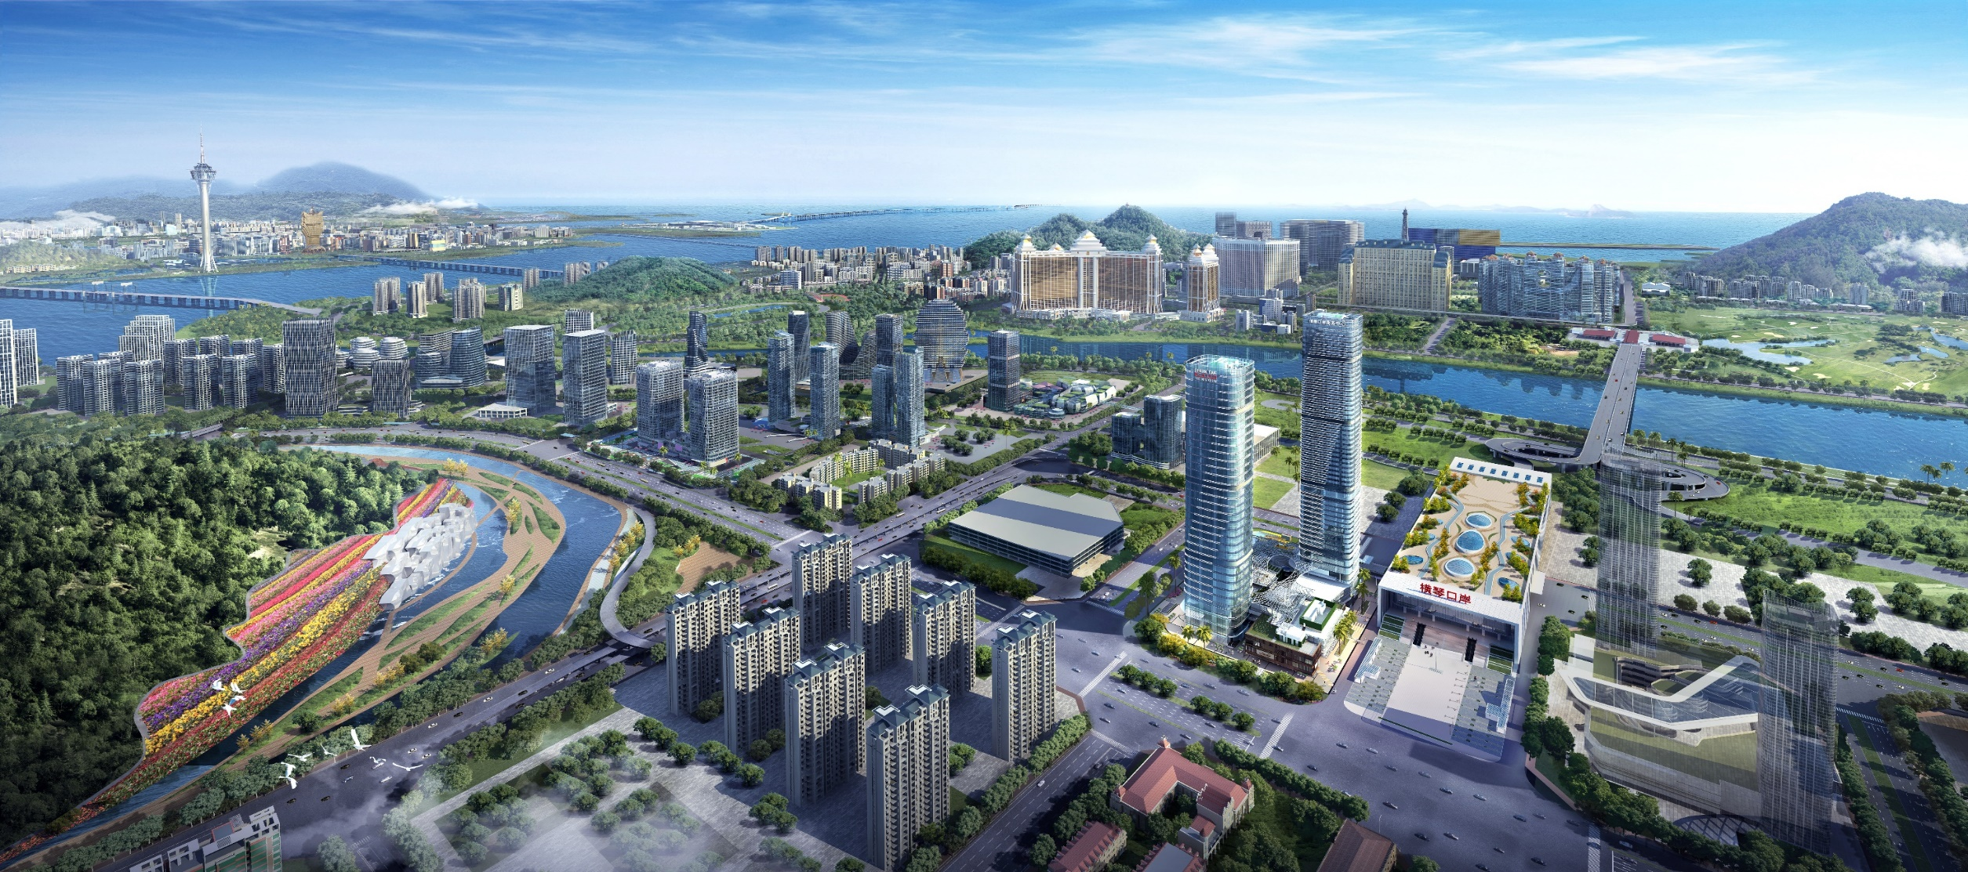

Hotel location 酒店位置
澳门半岛
MACAU
澳门氹仔
TAIPA
横琴口岸
HENGQIN PORT
信德口岸商务中心
SHUN TAK HENGQIN PORT COMMERCIAL CENTRE

Slide 19
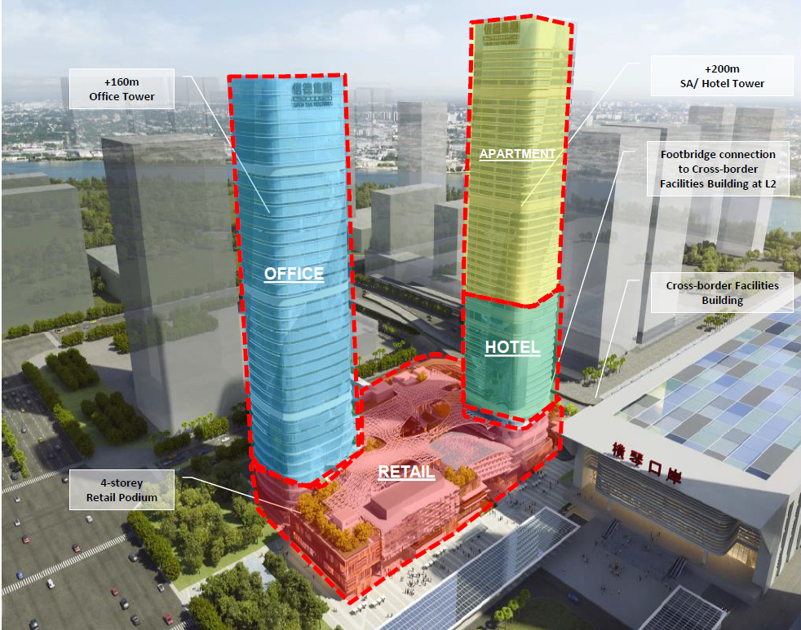
Notes:
Let’s see the progress development of Hengqin, last 7 years

Slide 20
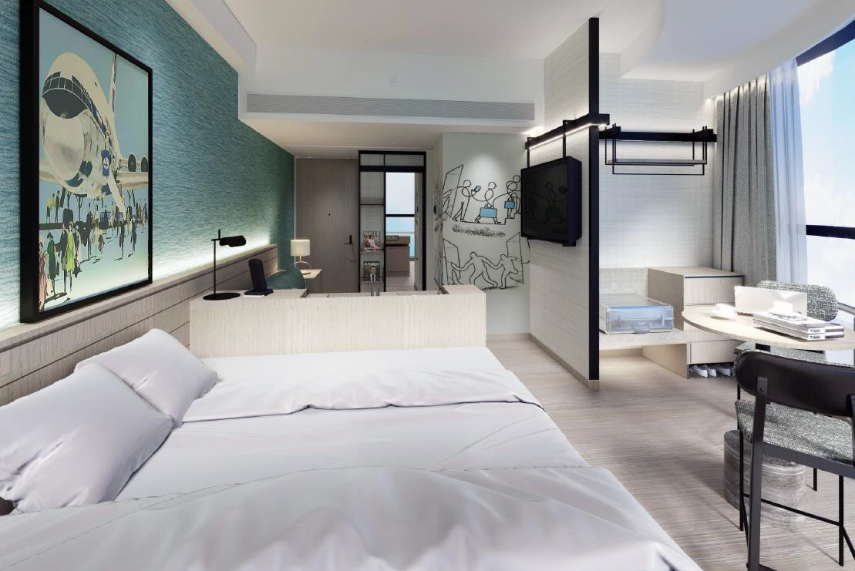
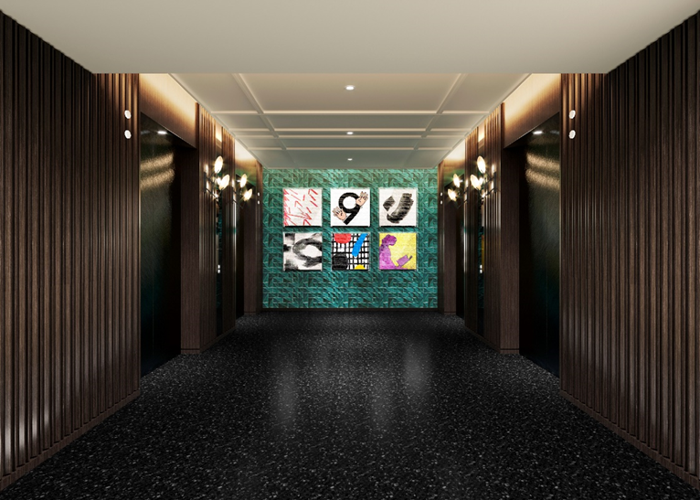
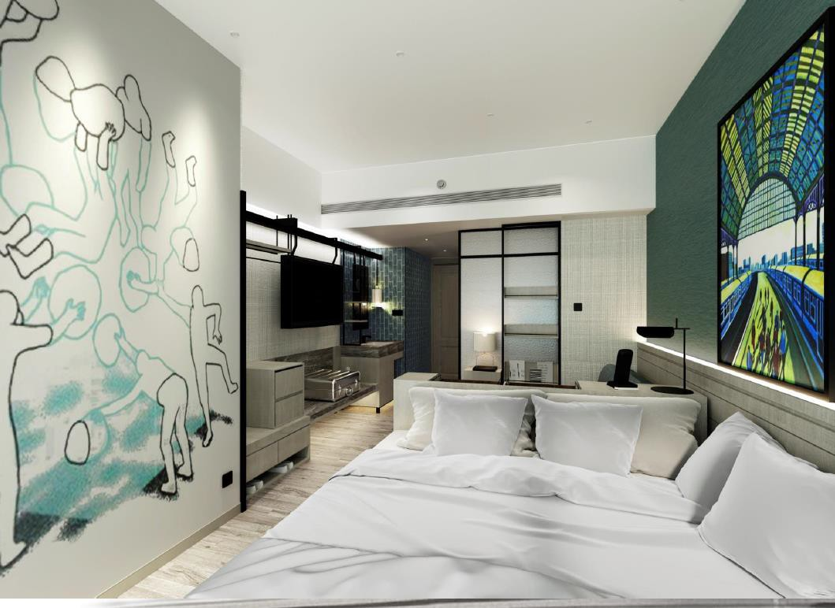
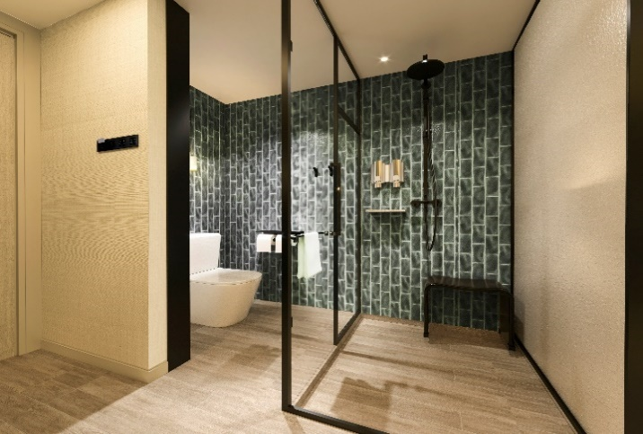
Guest room 客房
雅 辰 悦 居
愉悦你的居旅
文 化 艺 术
Culture & Art
230间客房
230 KEYS
澳 门 景 观Macau View
230间客房
230 Keys
澳 门 景 观Macau View

Slide 21

LEVEL 1 HOTEL OUTLOOK
Notes:
Let’s see the progress development of Hengqin, last 7 years

Slide 22
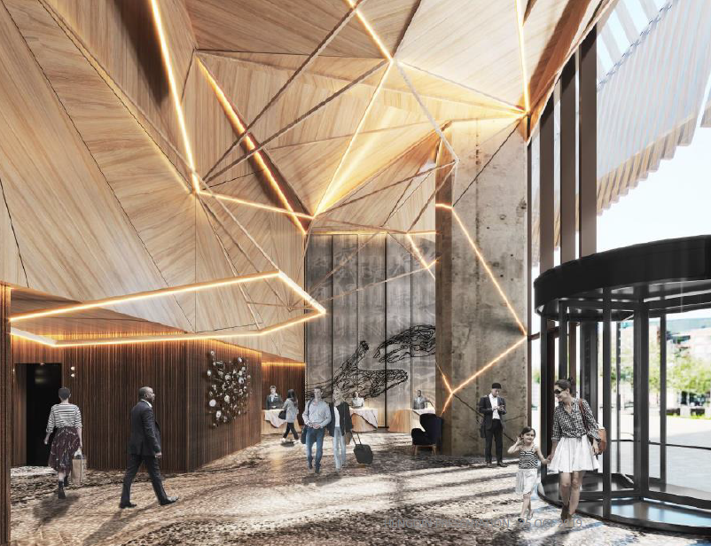
LEVEL 1 – HOTEL LOBBY
Notes:
Let’s see the progress development of Hengqin, last 7 years

Slide 23
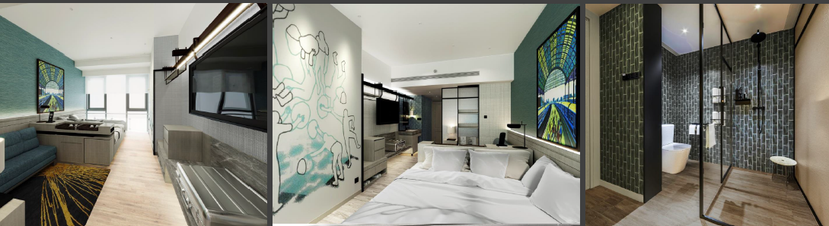
LEVEL 8-17 – MOKE UP ROOM TYPE A
Notes:
Let’s see the progress development of Hengqin, last 7 years

Slide 24
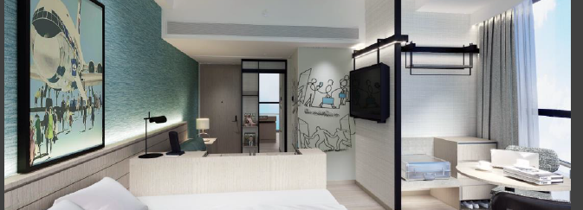
LEVEL 8-17 – MOKE UP ROOM TYPE B
Notes:
Let’s see the progress development of Hengqin, last 7 years

Slide 25
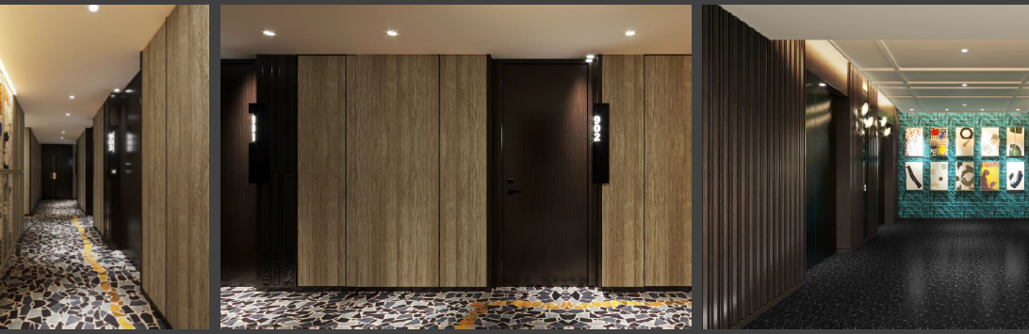
LEVEL 8-17 – PUBLIC CORRIDOR & LIFT LOBBY
Notes:
Let’s see the progress development of Hengqin, last 7 years

Slide 26
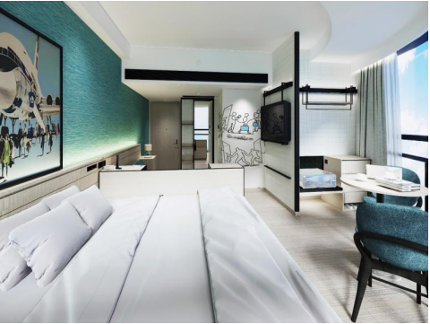
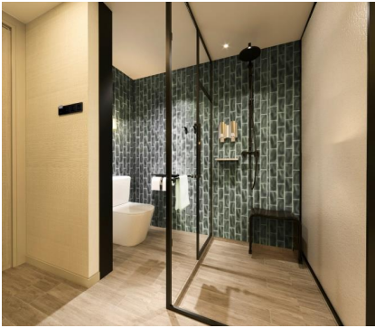
房型 | 数量 | 面积
悦居豪华房 Habitat Deluxe Room 104 28-31
悦居澳门景观房 Habitat Macau View Room 48 28-31
悦居尊贵房 Habitat Premium Room 17 35-38
悦居尊贵澳门景观房 Habitat Premium Macau View Room 15 35-38
悦居行政房 Habitat Club Room 38 28-31
悦居尊贵行政房 Habitat Premium Club Room 8 35-38
总计 230 /

Slide 27
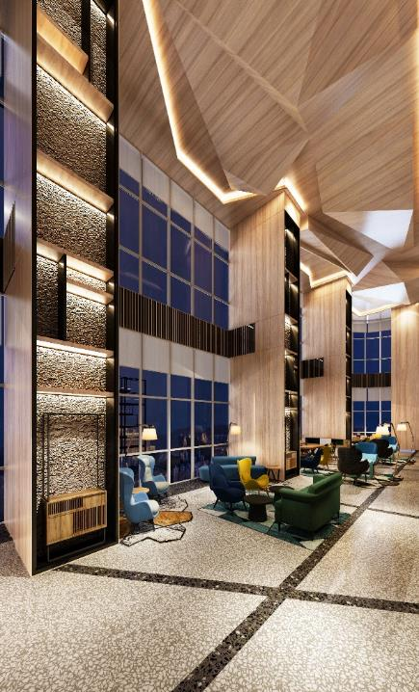
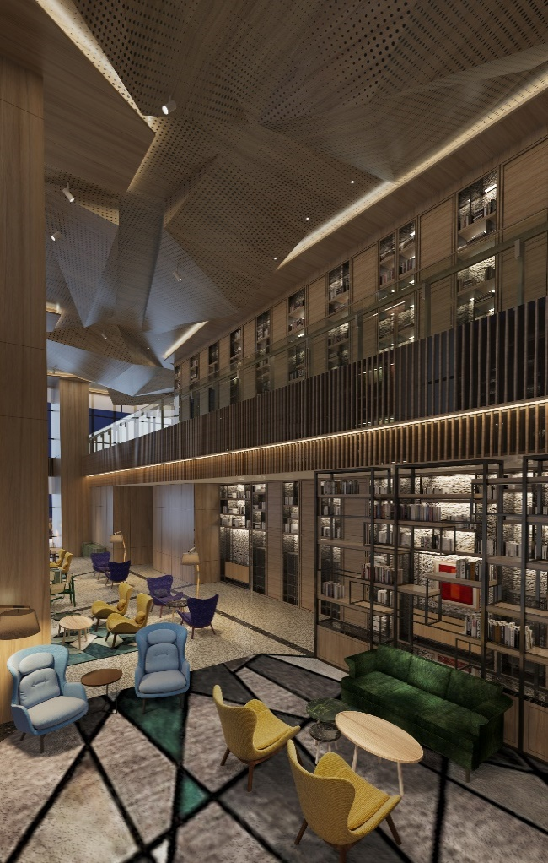
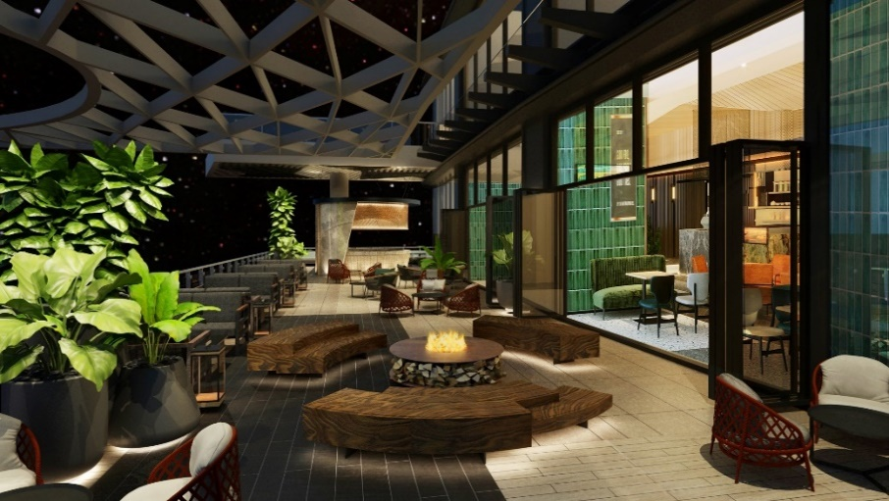

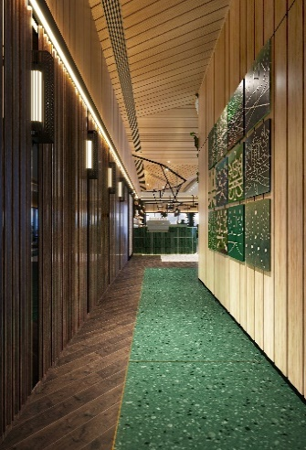
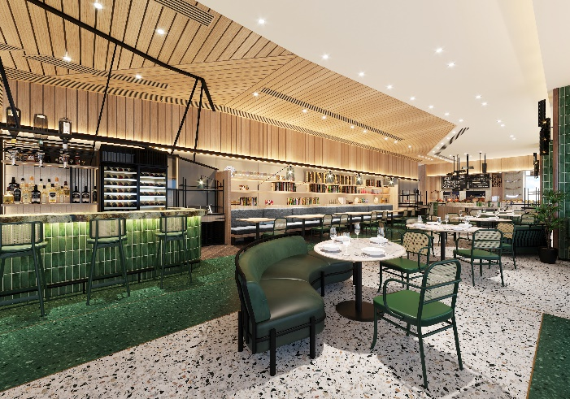
RESTAURANT - TOWNSQUARE 餐厅 - 思 方 汇
思方汇是一个独特的室内外相结合的餐厅, 260个餐位，提供全天候美食。独有的户外露台，是用餐与社交的「氧气」空间，让你在商务工作之余，身心得以休憩和放松。
Townsquare is a unique “indoor-outdoor” interactive guest space with 260 seats. Creating a community focused food and beverage operation that is casual and relaxed whilst delivering high quality product with engaged service style that exceeds guest needs.

Slide 28
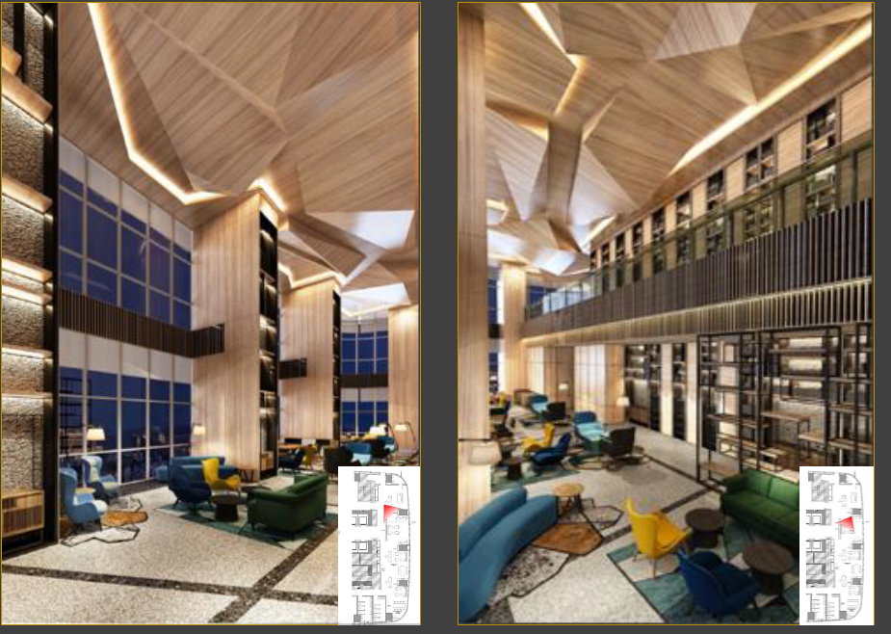
LEVEL 5 – LOUNGE AREA
Notes:
Let’s see the progress development of Hengqin, last 7 years

Slide 29
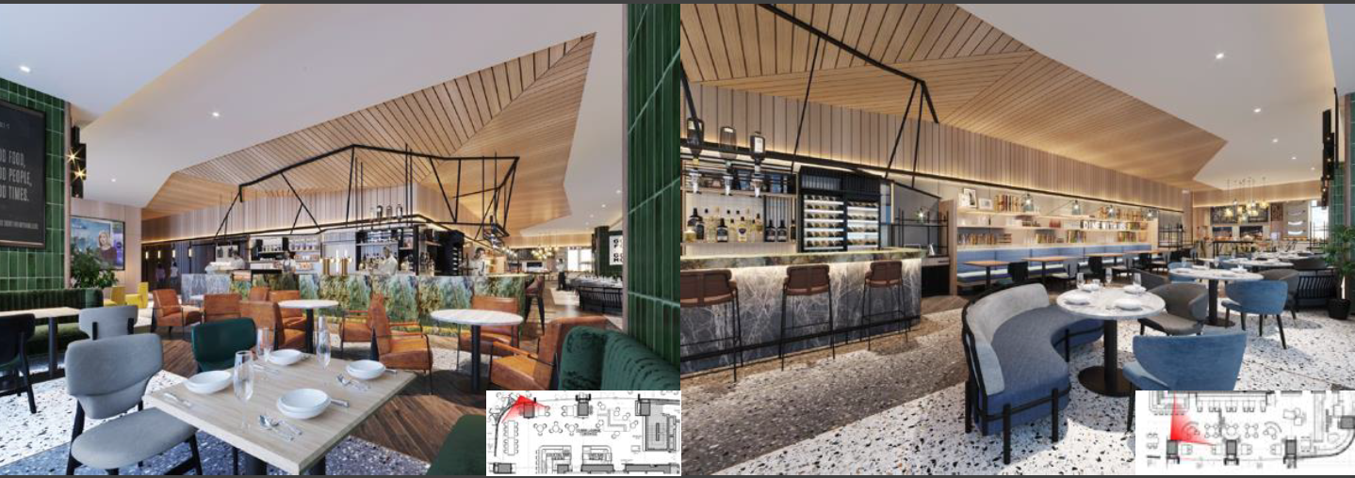
LEVEL 5 – TOWNSQUARE CAFÉ & BAR
Notes:
Let’s see the progress development of Hengqin, last 7 years

Slide 30
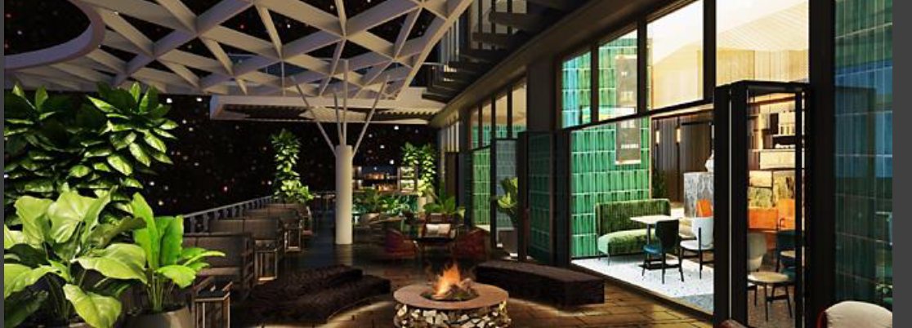
LEVEL 5 – OUTDOOR TERRACE & BAR
Notes:
Let’s see the progress development of Hengqin, last 7 years

Slide 31

Townsquare basic information 思方汇基本信息
Location 位置: 5th Floor
Capacity 座位: 260 Seats
Operation Hours 运营时间: 6:30 – 22:30
Breakfast 早餐: 6:30-10:30
Lunch 午餐: 11:30-14:30
Afternoon tea 下午茶: 15:00-17:00
Dinner 晚餐: 18:00-22:00

Slide 32
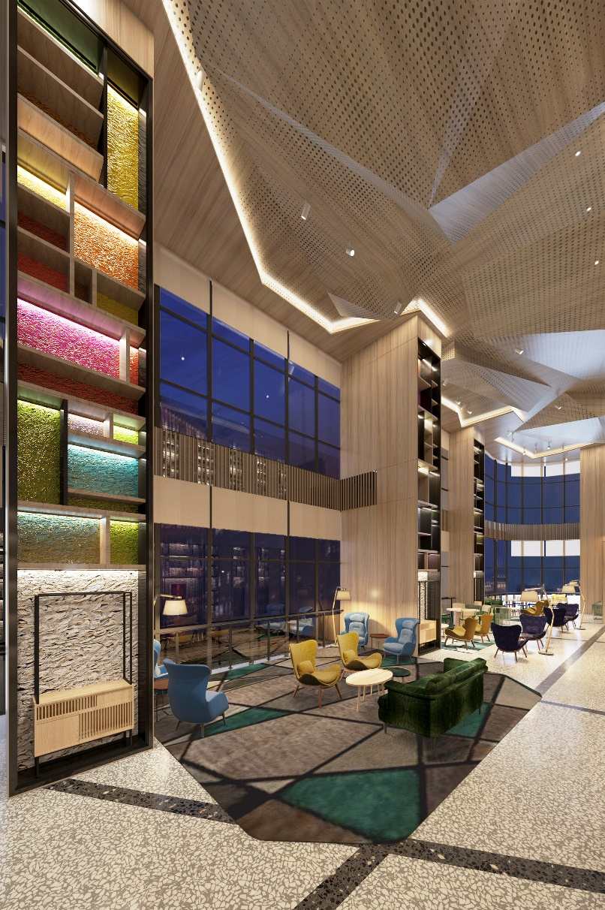
Townsquare concept 思方汇经营理念
Level 5 of Artyzen Habitat Hengqin is a unique “indoor-outdoor” interactive guest space. Creating a community focused food and beverage operation that is casual and relaxed whilst delivering high quality product with engaged service style that exceeds guest needs.
横琴雅辰悦居五层是一个独特的室内外共享空间。它创建了一个以社区为中心的独特餐饮运营，休闲与放松的同时提供高质量的产品和超越客人需求的敬业服务风格。
The flexible multi-use F&B and event spaces provide guests with an oasis in the middle of the busy modern metropolis hub. The offerings here will allow guests to drop in for a quick coffee, semi buffet breakfast, light lunch, relaxing dinner and home catering options.
灵活的多功能餐饮和活动空间，为客人提供了一个在繁忙现代都市中的绿洲。在这里，客人可以放松的来一杯咖啡，我们还提供全日早餐、轻午餐、晚餐和家庭餐饮的更多选择。

Slide 33
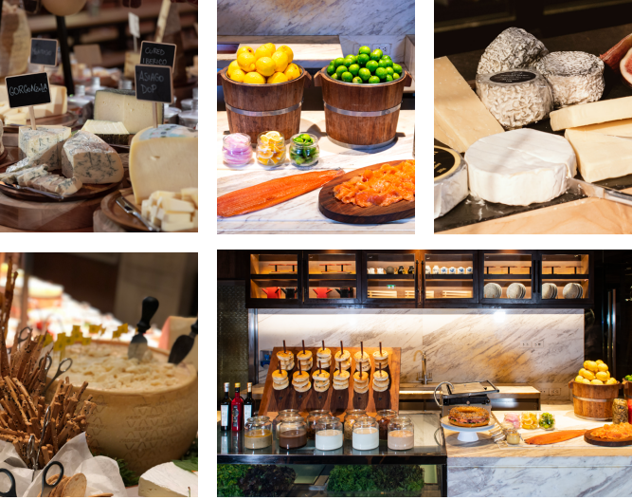
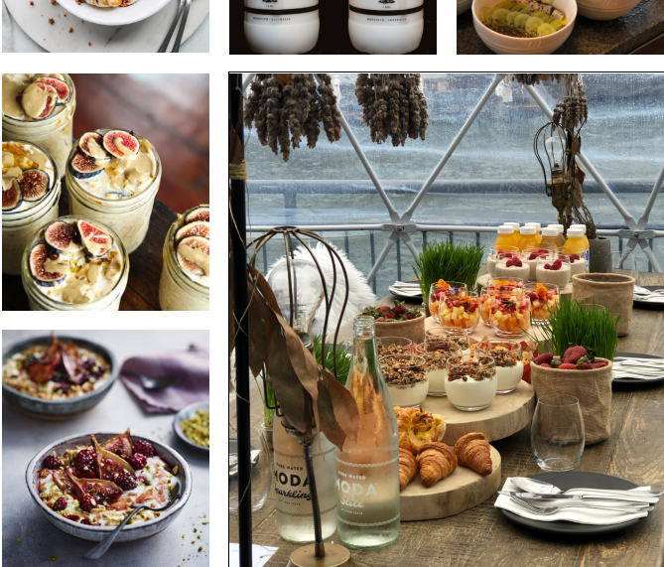
Townsquare Menu concept & unique selling point 思方汇菜单理念及独特卖点
Breakfast Semi-buffet 早餐半自助餐
Green and healthy customized 绿色健康的定制早餐
Local seasonal ingredients are used to reflect regional representativeness 选用当地季节食材，展现地区代表性
Open kitchen live cooking style 开放式厨房现场烹饪
Live cooking eggs station, more types of eggs selection.现场制作的鸡蛋档口，提供多样鸡蛋选择。

Slide 34
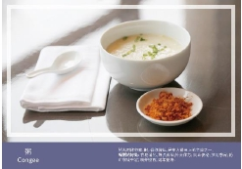
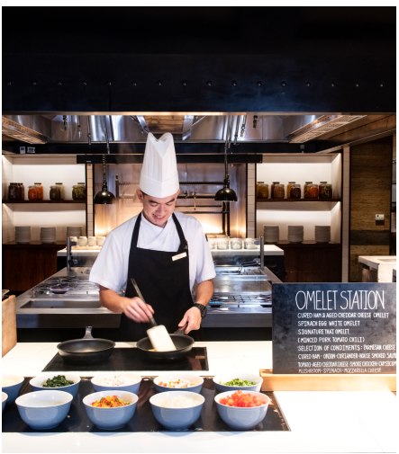
Townsquare Menu concept & unique selling point 思方汇菜单理念及独特卖点
Breakfast Semi-buffet 早餐半自助餐
Local speciality congee, choose Guangdong Luodin rice and use soup instead of water for porridge. The combination of cooking soup culture and congee culture in Guangdong. 特色粥品，选用广东罗定大米，用靓汤取代水煲粥。把广东的煲汤文化与粥文化相结合。
Freshly baked croissant or special egg tart pass around to the guests. 每日新鲜出炉的牛角包或者特别的蛋挞会派送给客人。
Seasonal fresh fruit & fresh squeezed juice 选用当地当季的水果和精心配比的鲜榨蔬果汁。

Slide 35
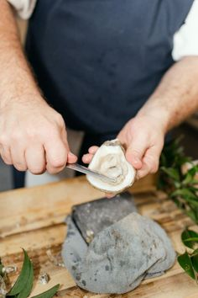
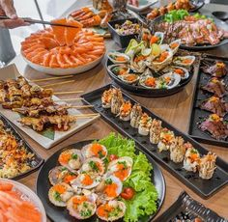
Townsquare Menu concept & unique selling point 思方汇菜单理念及独特卖点
LUNCH & Dinner 午餐 & 晚餐
Lunch and dinner with a la carte style. Western food with a focus on Mediterranean cuisine, It also combines some of the characteristics of Portuguese food and local ingredients, including Portuguese sausage, grilled sardines, Portuguese salted cod, grilled Hengqin oysters, etc. It also makes full use of the open kitchen, and its unique rotisserie, pizza oven. Live cooking.
In addition to the original menu, we will also introduce seasonal and festive special menus to provide guests with more choices.
思方汇午晚餐，以零点形式呈现。提供以地中海风味为主的西餐，还结合了葡萄牙饮食的一些特色及本地特有食材，包括有：葡萄牙香肠，烤沙丁鱼，葡式腌鳕鱼等。横琴毗邻南海，菜单中也有丰富的海鲜选择，烤横琴生蚝，地中海风味焗海鲜，乌鱼子意大利面，都是我们的特色。同时还有充分利用开放厨房，以及独有的烤肉炉，披萨炉。现场制作，增加与客人的互动。
在固有菜单的同时，我们还会推出应季和节日的特别菜单，供给客人更多的选择。

Slide 36
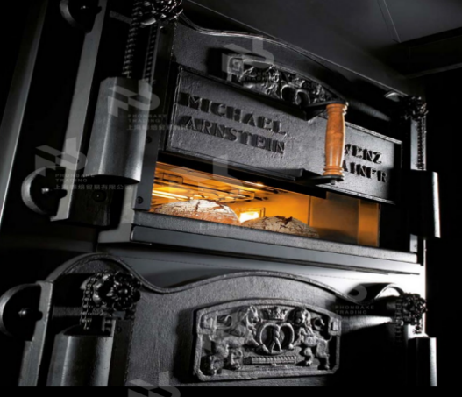
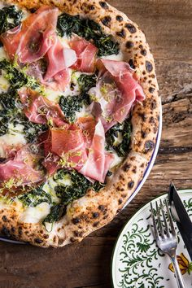
Townsquare Menu concept & unique selling point 思方汇菜单理念及独特卖点
Pizza oven 披萨炉
It's a busy day in the pizza oven. We have food baked from the oven in the morning, in the middle of the evening, fresh baked bread, egg tarts for breakfast. For lunch and dinner, we introduce the classic Neapolitan pizza, the original Italian pizza, we use Neapolitan certified flour, with a traditional recipe, to recreate the classic. In addition, we have introduced a healthy pizza base in order to make pizza more healthy because it is high in salt. Adding vegetable juice to the base of the pie reduces the salt content of the pizza while preserving tradition, making this traditional dish more special and healthy. The pizza oven is versatile, and we have a secret roast of East China Sea large yellow croaker, which is cultivated in the best waters of Fujian province and semi-wild. It's very delicious.
披萨炉一天都会很忙碌，早中晚我们都会有从里面烤制的食物，早餐会有现烤出炉的面包，蛋挞。午晚餐我们推出经典的那不勒斯披萨，那不勒斯披萨是意大利披萨的始祖，我们选用了那不勒斯认证的面粉，用传统的配方，再现经典。此外我们为了披萨这个高盐食物更健康，我们推出了一款健康披萨饼底，在饼底中加入蔬菜汁，能保留传统的同时，降低了披萨的含盐量，让这个传统美食更特别，更健康。披萨炉是多用途的，我们还有一道秘烤东海大黄鱼，选用了福建最优质海域养殖，半野生状态下的大黄鱼，非常鲜美。

Slide 37
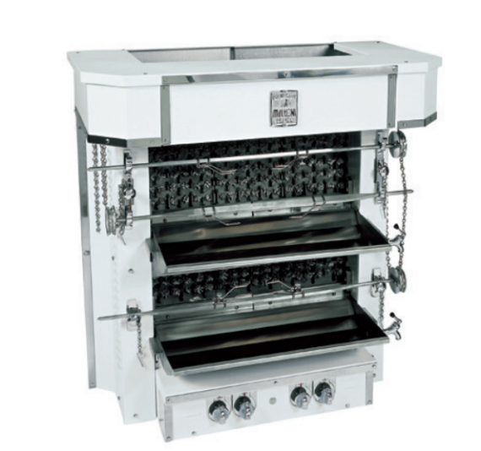
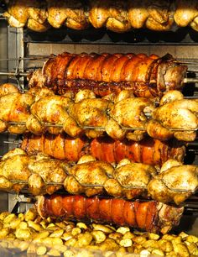
Townsquare Menu concept & unique selling point 思方汇菜单理念及独特卖点
Rotisserie 烤肉炉
Rotisserie furnace, is one of the unique selling point Townsquare, we have a special menu, barbecue furnace for guests to choose from, there are two special grilled chicken, a brittle spring chicken is a combination of Chinese and western characteristics, one is made of African bird's eye chilies homemade peri sauce grilled chicken, and barbecue flavor, such as Turkey flavor roast Angus beef ribs, Brazil flavor roast Iberian black pigs, For family gatherings, order a flavor roast New Zealand leg of lamb. There will also be special seasonal menus based on seasonal changes. We also accept take-out food reservations.
烤肉炉，是思方汇的独特卖点之一，我们有一份特别的烤肉炉菜单，供客人选择，有两种特别的烤鸡，一个是中西结合的特色脆皮春鸡，一个是用非洲鸟眼辣椒自制辣酱做的烤鸡，还有各国风味烤肉，如土耳其风味烤安格斯牛肋排，巴西风味烤伊比利亚黑毛猪，如果家庭聚会还可以预定一个风味烤新西兰羊腿。另外还会根据季节变化推出应季的特别菜单。我们还接受外带食品预定。

Slide 38

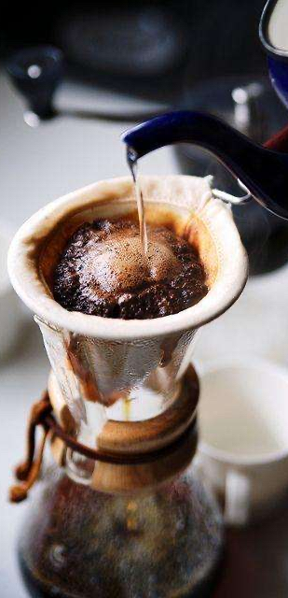
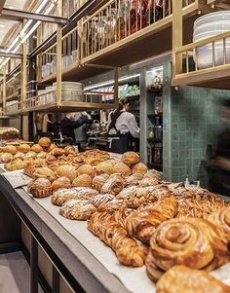

Townsquare beverage concept 思方汇酒水理念
Coffee bar 咖啡吧
All types of coffee 各种经典咖啡
Cold brew & pour-over coffee 冷萃及手冲咖啡
Selected Western teas
精选西式茶
Freshly baked breads and desserts 新鲜出炉的面包及可口的甜品

Slide 39



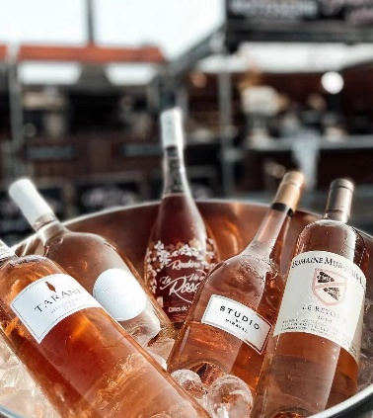
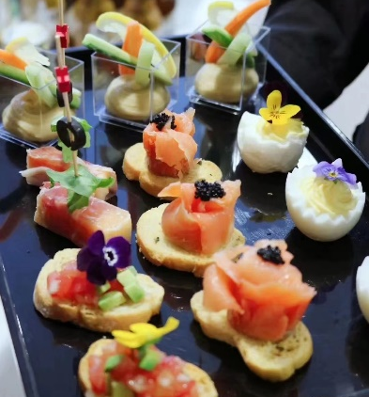

Townsquare beverage concept 思方汇酒水理念
Bar on the terrace 户外露台吧
Freshly squeezed juice 鲜榨蔬果汁
Health milkshake 健康奶昔
Cold fruit wine 冷水果酒
Champagne & sparkling wine on the ice 冰镇的香槟及起泡酒
Delicate and delicious bites 精致美味的配酒小吃
Great live performance 精彩的现场表演

Slide 40
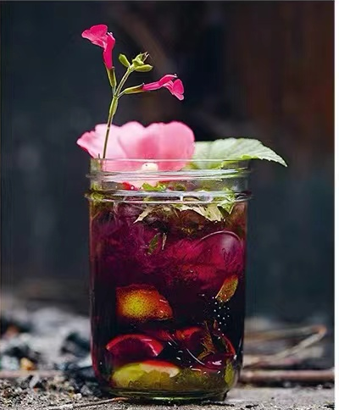


Townsquare beverage concept 思方汇酒水理念
Cocktail bar 鸡尾酒吧
Variety of classic cocktails 各种经典鸡尾酒
Selection of Mocktails 精选无酒精饮料
Creative unique cocktails with local culture, stories and art 有创意的，独特的鸡尾酒，富有本地文化，有故事，有艺术气息

Slide 41
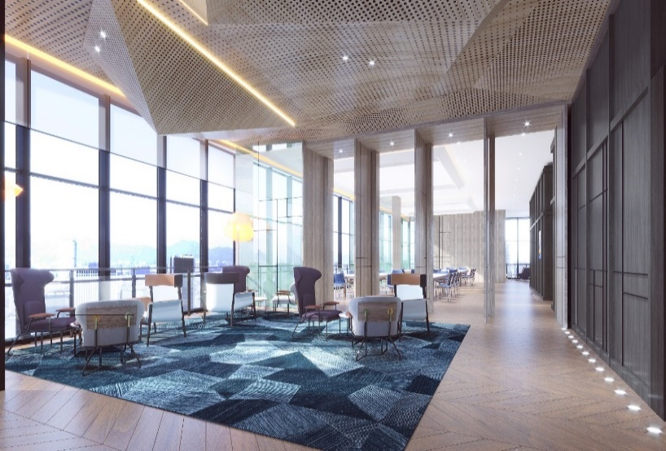


MEETINGS & EVENTS、RECREATION 会议与宴会、娱乐活动场所
多功能厅
Multi-function Rooms
休息室
Break-Out Lounge
健身房
Gym
酒店有多个多功能厅，配备了先进的多媒体技术，可举办灵活性的中小型会议、网络会议、发布会及高端私人派对等各种活动，满足宾客的多样需求。
Hotel offers multi-function rooms that can be adapted for your needs. Equipped with multimedia capabilities of state–of-art technology, these rooms are available to accommodate up variety of requirement, such as middle scale meetings/events that require flexibility, organized networking sessions, product launching press conference and high-level private event..
酒店健身房配置最新的健身器材，24小时免费开放。
Hotel Gym Room equipped with the state-of-art equipment, with 24H access.

Slide 42



WORKSHOP BASIC INFORMATION 会议空间基本信息
L6 Workshop space
位于酒店6楼

Slide 43

LEVEL 6 – MULTI FUNCTION AREA AND BREAKOUT AREA
Notes:
Let’s see the progress development of Hengqin, last 7 years

Slide 44
WORKSHOP floorplan 会议空间平面图
WORKSHOP 5 - 26㎡
L5 Workshop space
WORKSHOP 4 - 26㎡
WORKSHOP 3 - 72㎡
PANTRY- 33㎡
WORKSHOP 2 - 43㎡
WORKSHOP 2 - 48㎡

Slide 45
WORKSHOP capacity chart 会议空间容量表
Workshop Capacity | Size | Theatre | Classroom | Boardroom | U-shape | Round table
Workshop 1 | 48 | 18 | 12 | 12 | 15 | 20
Workshop 2 | 43 | 18 | 12 | 12 | 15 | 20
Workshop 1+2 | 90 | - | - | - | - | 40
Workshop 3 | 72 | 24 | 18 | 12 | 18 | 30
Workshop 4 | 26 | 12 | - | 10 | - | -
Workshop 5 | 26 | 12 | - | 10 | - | -
Breakout pantry | 33

