Slide 1
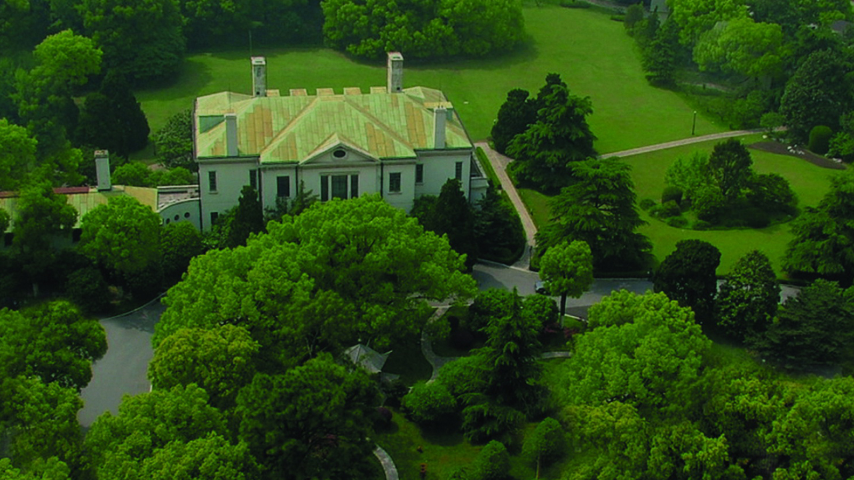


Slide 2


上海兴国宾馆丽笙精选
Radisson Collection Hotel, Xing Guo Shanghai

Slide 3


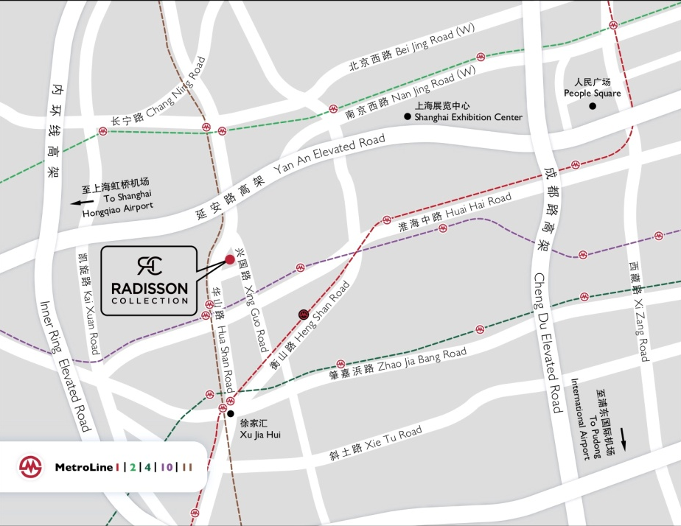

地理位置 Location
位于上海市中心兴国路、华山路和江苏路的交汇处
毗邻市中心领馆区，距商业中心仅五分钟车程
步行至地铁1、2、10、11号线仅需十分钟
距离上海虹桥机场仅15分钟车程
距离浦东国际机场45分钟车程
延安路高架近在咫尺
出行、就餐、购物、娱乐极为便利
Junction of Xing Guo, Hua Shan and Jiang Su Roads
5 minutes from the central business district
10 minutes from the Metro Line 1, Line 2, Line 10 and Line 11
15 minutes from Shanghai Hongqiao Airport (SHA)
45 minutes from Pudong International Airport (PVG)
Easily accessible from the Yan An elevated highway
Within close proximity to restaurants, shopping and entertainment areas.

Slide 4
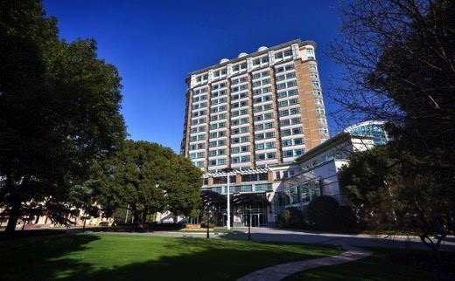
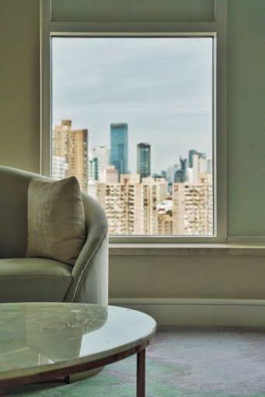
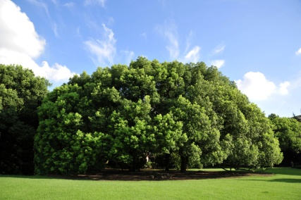
绿色花园酒店 Unique Garden Hotel
上海兴国宾馆丽笙精选位于领馆区高雅地段，坐拥市中心七万平米大花园，拥有多栋建于上世纪二三十年代的欧美历史老别墅，静谧优雅、鸟语花香，被誉为“绿色花园酒店”。
The Radisson Collection Hotel, Xing Guo Shanghai, is a deluxe boutique hotel located within seven hectares of historic gardens. The Hotel overlooks beautiful gardens and historic villas from the 1930's, providing a tranquil and welcoming oasis for guests in this urban retreat.

Slide 5
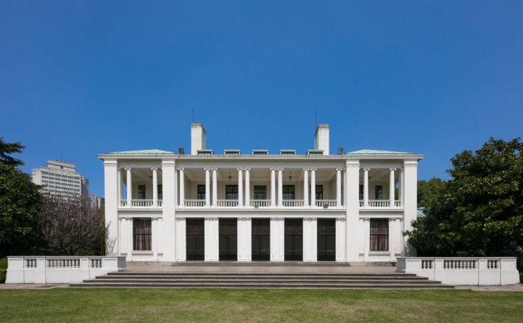
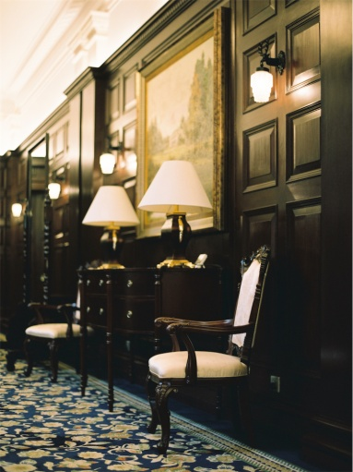
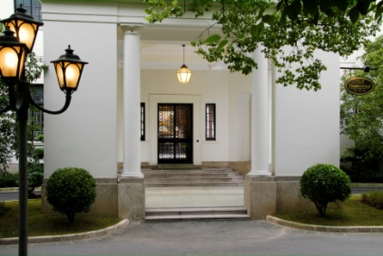
历史老别墅：一号楼 Villa One
一号楼以前是英商太古洋行大班的住宅，建于1934年，原名“赫世屋”，也被称作“小白宫”，是上海新古典主义建筑的杰出代表，建筑面积为1,647平方米，两层砖混结构，其充满着浓郁的文艺复兴风格，运用柱式手法表现建筑的严谨、端庄、气派。
Villa One was built in 1934 and intended as a residence for the Taipan of Butterfield & Swire. Now it is also known as the small white house. It is representative of Shanghai Neo-Classicism architecture, a two-story brick building with a floor area of 1,647 square meters.

Slide 6
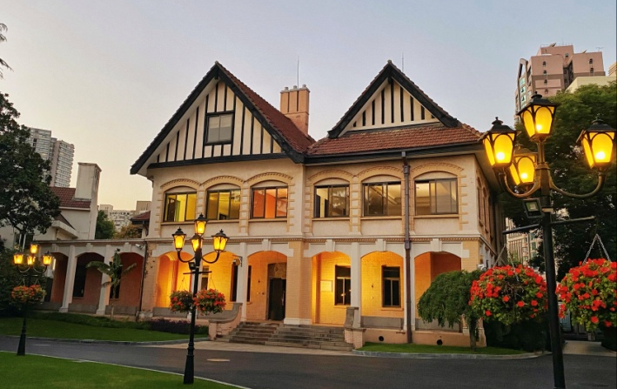
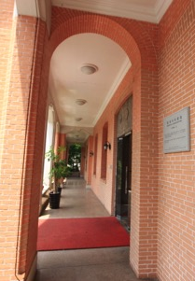
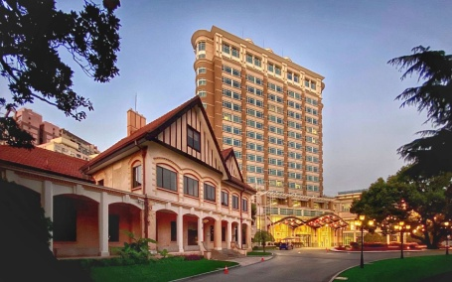
历史老别墅：二号楼 Villa Two
二号楼是一幢英国乡村式假三层砖木结构的花园住宅，建造于20世纪20年代。这是一座自然环境与建筑艺术完美结合的作品。它坐落在宾馆的草坪和树木丛中，保存依然完好。
Villa Two, a three-storied brick and timber garden residence, was built in 1930s. It is a building that perfectly combines nature with the art. Situated among the trees and lawns of Xing Guo Hotel, the villa was kept pretty well.

Slide 7
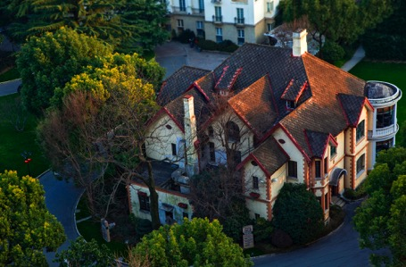
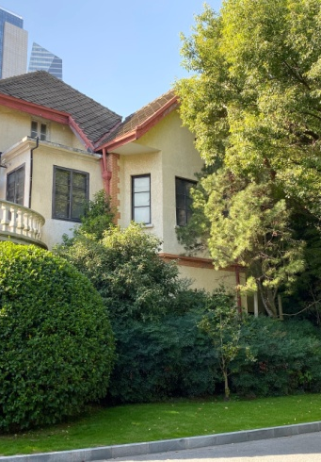
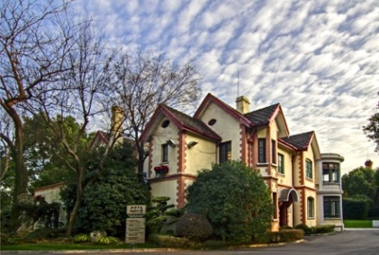
历史老别墅：六号楼 Villa Six
六号楼是一幢砖木结构假三层的法国民居建筑，于1922年建立，而又在1935年扩建，使其面积达到846平方米。法式建筑一向追求精致的细节，强调色彩与内在的联系，将高贵、优雅和浪漫交织在一起，升华了建筑的诗意、诗境，营造出不落窠臼的经典气质。
Villa Six is a three-storied French-style residence of brick and timber. In the French architectural style, house are set in nature, emphasizing the color and the inner connection more than the size to create the feeling of being spacious. Another trait of the French building is the strict standard about the building as a whole and expert in working on the details.

Slide 8
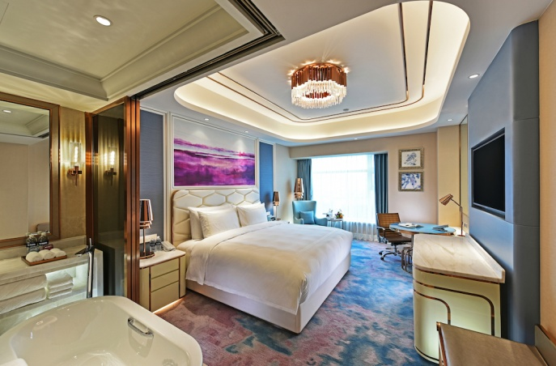
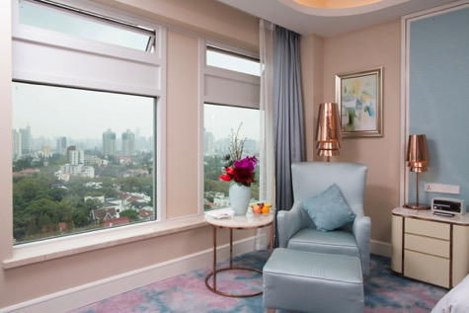
经典园景客房 Collection Superior Garden View Room
35m²
入住典雅舒适的经典园景客房，窗外七万平米的花园景致一览无余，一栋栋建于上世纪二三十年代的欧美历史老别墅错落有致，交相辉映。
Guests staying in the room with garden view, will enjoy beautiful gardens and historic villas from the 1930's.

Slide 9
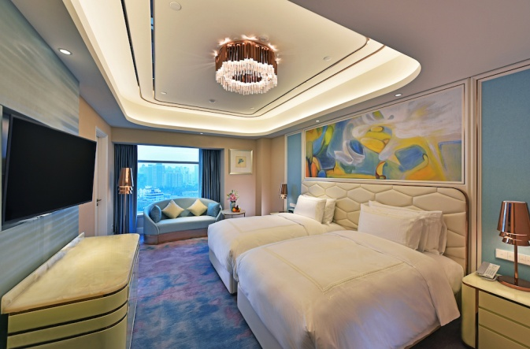
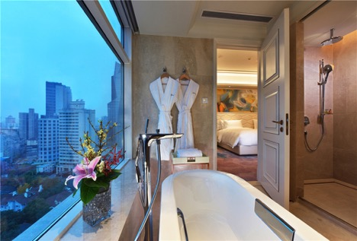
豪华商务客房 Collection Business Class Room
42m²
豪华商务客房宽敞气派，有大床及双床可任您选择，客房内配备了高科技的客控系统及特别定制的智能互动电视系统，美国丝涟床垫为您营造优质舒适的睡眠享受。
With a choice of either a king bed or two twin beds, the Collection Business Class Room has the latest in technology, from room sensors, upgraded air conditioning systems, interactive television, along with a whole new bedding, guests are treated to layers of pure comfort that add up to an exceptional sleep experience.

Slide 10
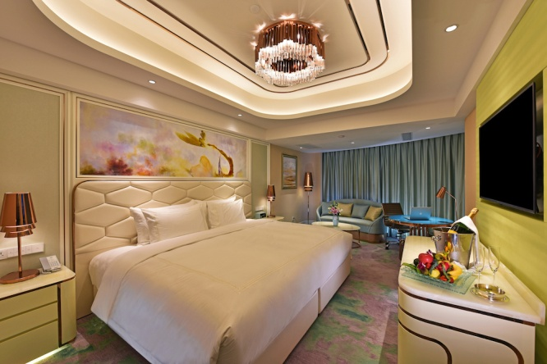
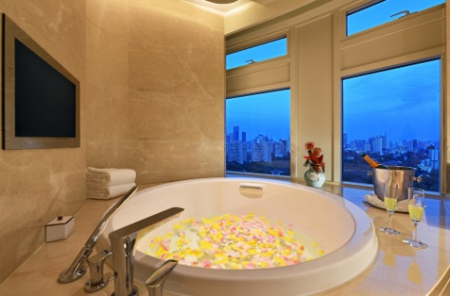
豪华全景客房 Collection Panorama Room
45m²
豪华全景房设计独特，优雅浪漫，拥有特别的景致。宽敞的卫生间设有独立分隔的双人台盆，超大圆形泡泡浴缸，可让您一边享受舒适的泡泡浴，一边欣赏液晶电视或窗外的花园美景忘却一天的疲惫，尽享精致优雅的入住体验。
The Collection Panorama Rooms are unique, blending modern flair with ample bathroom space, which includes two separate basins and a round whirlpool bathtubs. Spoil yourself in an elegant and spacious room where you can relax after a busy day in Shanghai.

Slide 11
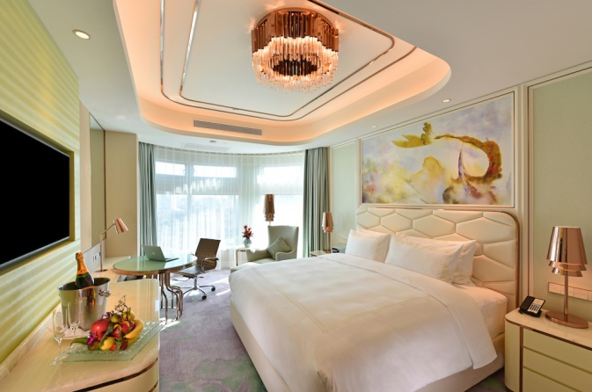
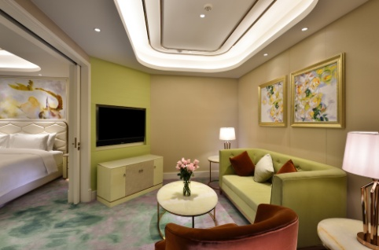
豪华行政套房 Collection Executive Suite
58m²
豪华行政套房内设有独立的客厅、卧室与卫浴间，为您带来无比舒适的入住空间。尊贵典雅的设计风格，每一处细节都融入了“智慧酒店”的精髓及元素，以满足各种宾客的需求。
The Collection Executive Suites are spacious, offering a separate lounge, bedroom and bathroom. The room showcases refined taste and creates a Smart Hotel experience for sophisticated travelers.

Slide 12
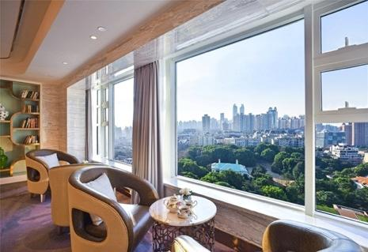
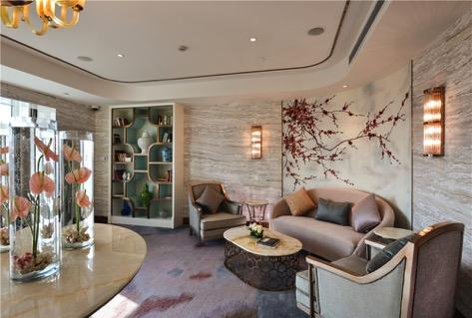
丽嘉楼层 Madam Li Floor
位于酒店12层的丽嘉楼层(Madam Li)，以时尚优雅的粉色为主色调，为高端商务女性打造专属的入住区域。匠心设计的丽嘉休息区，静谧优雅，在此可体验名媛社交的尊贵之感。
Madam Li level is located on 12th floor of the hotel, and delivers high quality services especially for our discerning female guests. Guests will enjoy the pampered lifestyle that accompanies being a celebrity at the Radisson Collection Hotel, Xing Guo Shanghai.

Slide 13
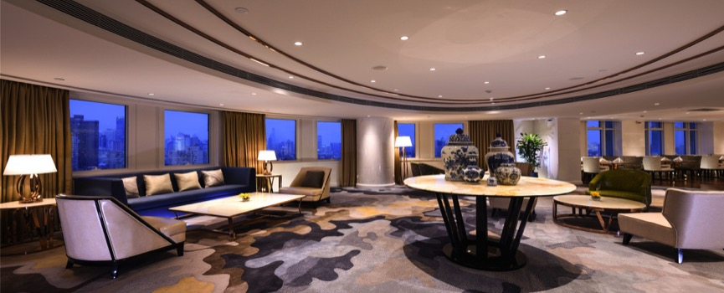
行政酒廊 Executive Lounge
行政酒廊位于酒店15层，拥有绝佳的观景视角，在此美食与美景交相辉映，入住行政楼层的客人们可免费体验全天候贵宾式服务，品尝高品质的早餐、下午茶及欢乐时光。
Located at the 15th Floor, the Executive Lounge with the stunning view, is a nice place for the guest staying in the upgraded Collection Business Class Rooms, guests can enjoy complimentary breakfast, afternoon tea and happy hour.

Slide 14
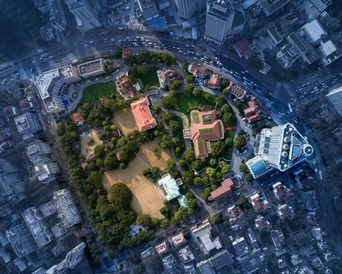
酒店俯视图 Top View

Slide 15
酒店信息 Hotel Information
上海兴国宾馆丽笙精选
Radisson Collection Hotel, Xing Guo Shanghai
中国上海市长宁区兴国路78号
78 Xing Guo Road Shanghai, 200052, China
电话T: +86 21-6212-9998 传真F: +86 21-6212-9996
sales@radissoncollection-xingguo.com
radissoncollection.com

Slide 16


