Slide 1


2015年8月盛大开业
Grand Opening in August 2015

Slide 2

市场定位及品牌特征 | Positioning & Brand Feature
为商务人士创造温馨 、惬意的居停感受。
万达嘉华承诺：美妙的睡眠体验、独特的东方美食，定会令各方宾客难以忘怀。
As a warm and comfortable resting place for business travelers, Wanda Realm offers its guests an unforgettable journey and unique Oriental cuisine.
自然 | Warm 舒适 | Comfortable 高效 | Efficient

Slide 3
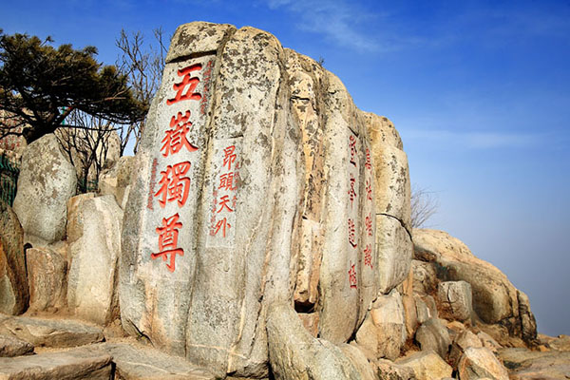
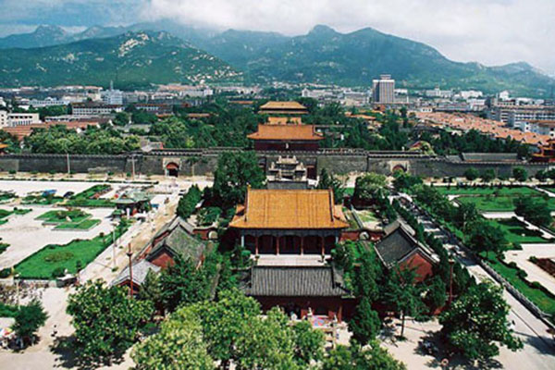
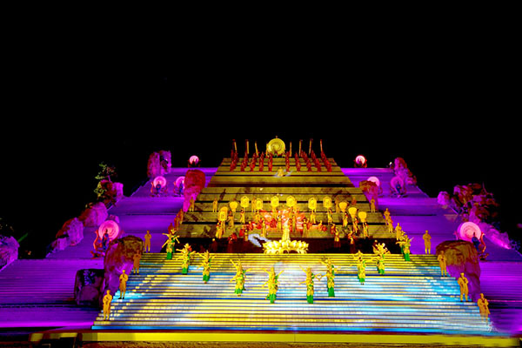
泰安旅游景点 | Taian Tourist Attractions
泰山风景区
Mt Tai Scenic Area
岱庙景区
Dai Temple Scenic Area
封禅大典实景演出
Grand Worship of Heaven and Earth about Mt Tai

Slide 4
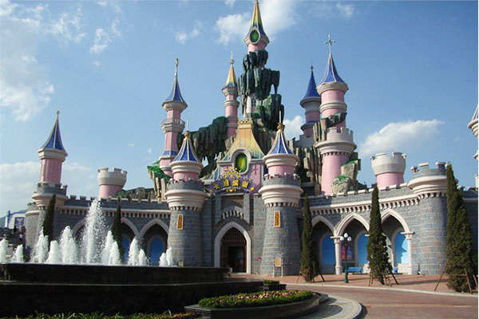

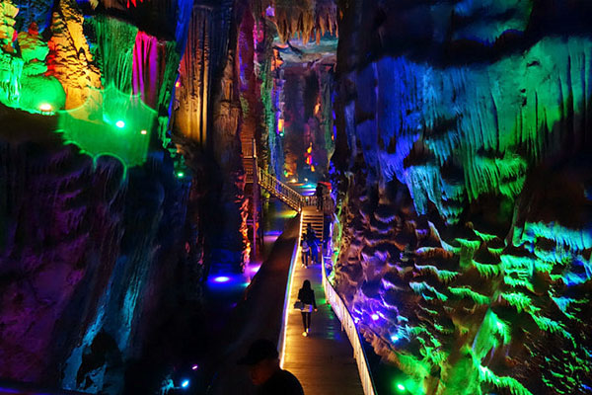
泰安旅游景点 | Taian Tourist Attractions
方特欢乐世界
Fanta Wild Adventure
太阳部落
The Sun Tribal
地下大裂谷
Underground Rift Valley

Slide 5
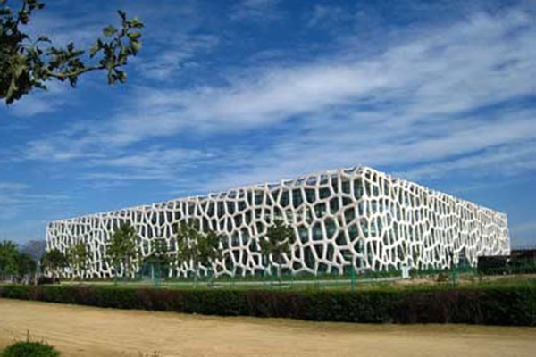


泰安旅游景点 | Taian Tourist Attractions
花样年华
Flowers Scenic Area
腊山国家森林公园
Mountain La National
Forest Park
六工山水浒大寨
Mountain Liugong Water Margin Landscape

Slide 6
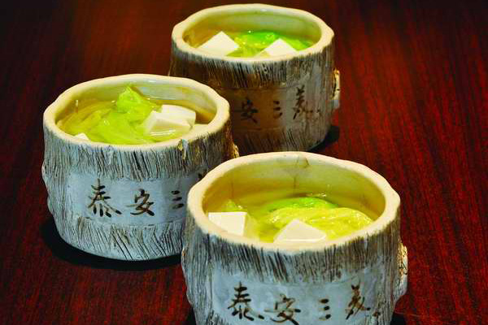
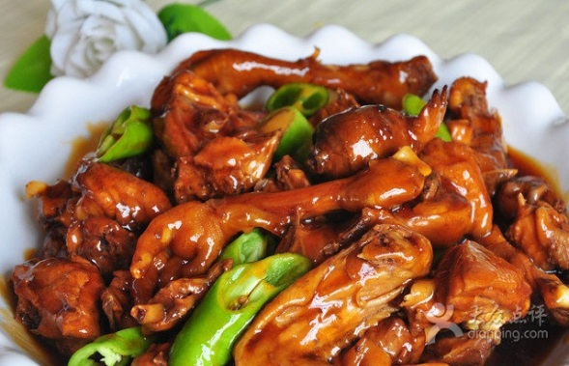
泰安特色美食 | Taian Local Cuisines
泰安三美
Three Delicious @ Taian
白菜，豆腐和水
Chinese Cabbage, Bean Curd & Brook Water
泰安炒鸡
Fried Chicken with Taian Style

Slide 7
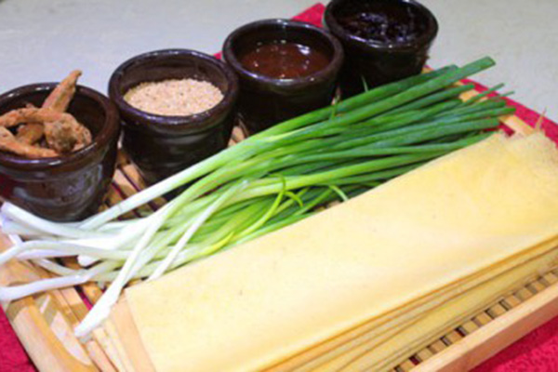
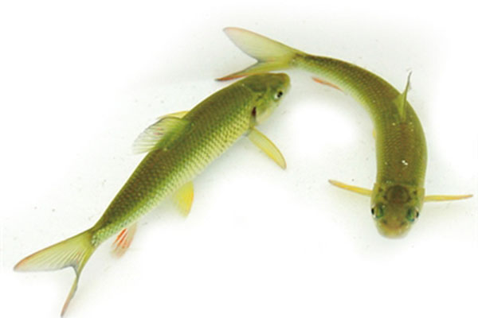
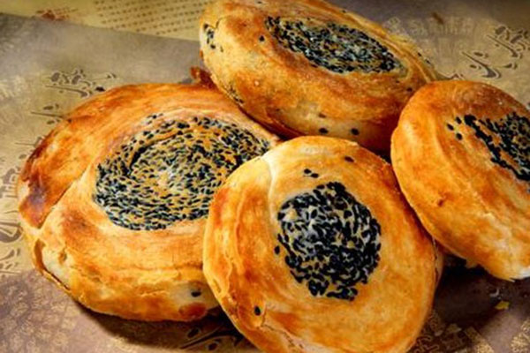
泰安特色美食 | Taian Local Cuisines
煎饼卷大葱
Corn Pan-cake wrapped
with Shallot
赤鳞鱼
Brook Mini Fish
驴油火烧
Baked Donkey Oil Pan-cake

Slide 8

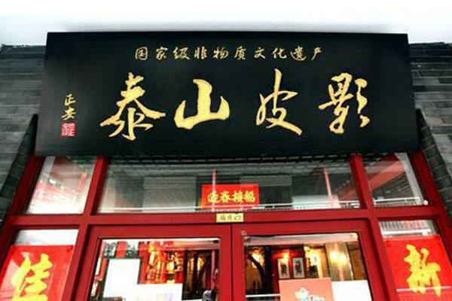

泰安特产 | Taian Specialties
泰山石敢当
Mt Tai Tablets
泰山皮影
Shadow Puppet
泰山虫草
Cordyceps Taishanensis

Slide 9



泰安特产 | Taian Specialties
泰山核桃
Taishan Walnut
泰山板栗
Taishan Chestnut
泰山四叶参
Codonopsis Lanceolata

Slide 10
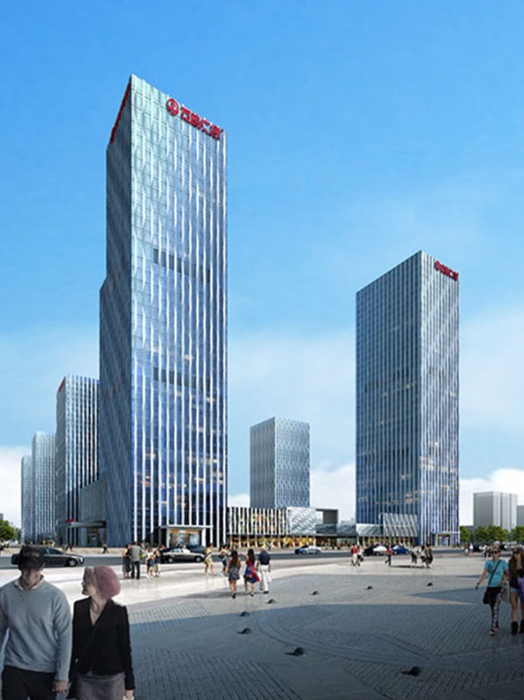
酒店介绍 | Hotel Introduction
泰安万达嘉华酒店坐落于泰安核心商圈——万达广场城市综合体内，驱车10分钟即可抵达泰安高铁站、泰山火车站及泰山进山口。位于酒店25至37层的283间时尚雅致的客房可俯瞰泰安城区景色，精选山景房更将泰山美景尽收眼底。四间风格各异的餐厅及酒吧，荟萃来自世界各地的美肴飨馔。城中最大的1,200平米的无柱大宴会厅和7间可灵活分隔的多功能会议厅，是您商务洽谈、社交活动的理想之选。
Wanda Realm Taian is conveniently located in the CBD of Taian and part of the multiuse Wanda Plaza Complex, the first of its kind in Taian. The Hotel is located both 10 minutes from either train station as well as to the entrance of Mt Tai. Our modern and stylish rooms are located between floors 25– 37, all offering views of Taian city. Selected rooms offer uninterrupted views of Mt Tai. Treat yourself to a world of culinary delights in the hotels chic and welcoming restaurants and lounges. The 1,200 sqm Grand Ballroom is the largest pillar free Ballroom in the city, 7 flexible meeting rooms ensure Wanda Realm Taian is the perfect meeting and social venue in the city.

Slide 11
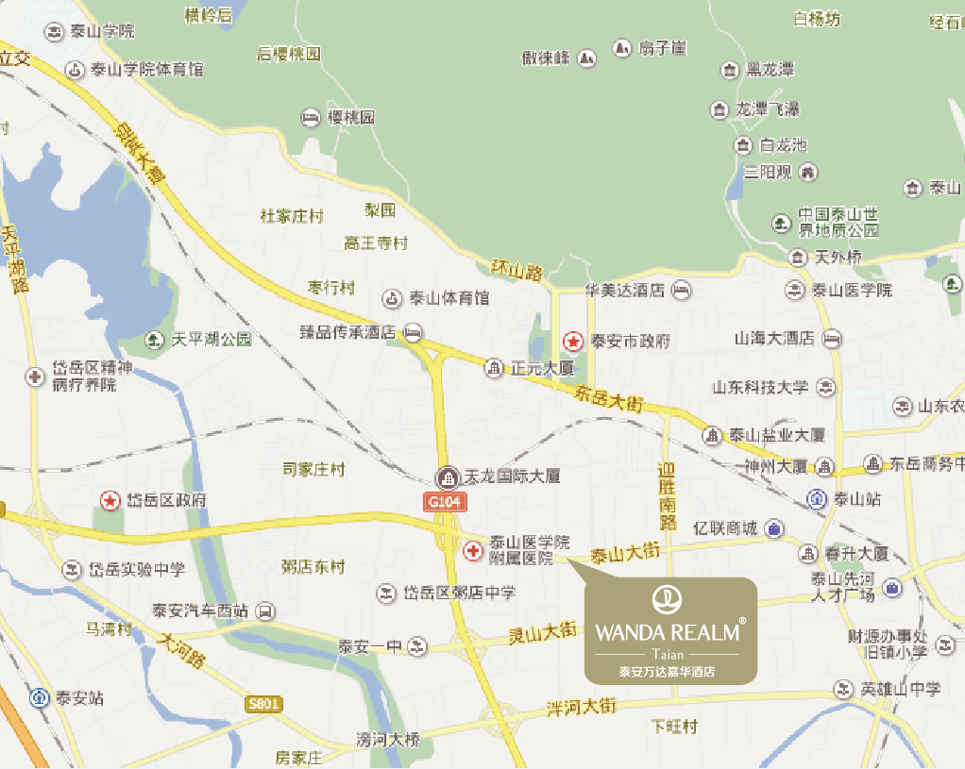
优越的地理位置 | Ideal Location
距泰安高铁站：10分钟车程
From/To Taian Railway Station : 10min
距泰山火车站：10分钟车程
From/To Taishan Railway Station : 10min
距泰山进山口：10分钟车程
From/To entrance of Mt Tai : 10min
距泰山汽车站：10分钟车程
From/To Taishan Bus Station : 10min
距济南遥墙国际机场：1.5小时车程
From/To Jinan airport: 1.5 hour

Slide 12

周边配套| Surrounding Facilities
坐拥万达广场，优质品牌一网打尽。
Located in Wanda Plaza, bring you more quality brands.

Slide 13

周边配套| Surrounding Facilities
餐饮主力店云集，总有一款适合您的口味。
Gathering all kinds of restaurants, any choices will satisfied with you.

Slide 14
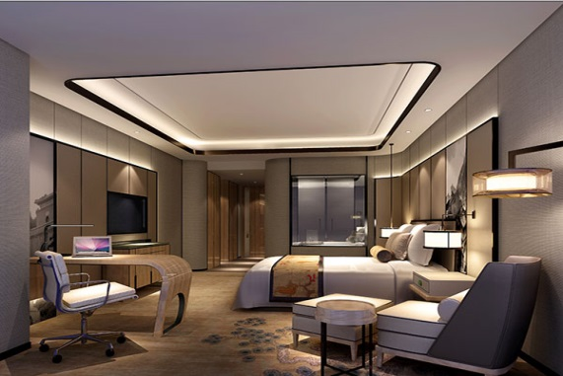
酒店客房 | Guest Rooms
酒店拥有283间客房及套房，设计时尚而雅致，每间客房均配备温馨舒适的“万达嘉华之床”及“妙梦”助眠系列，同时设有独立浴缸与热带雨林式淋浴设施的盥洗室。高楼层景观房可以俯瞰整个泰安城区，山景房也将五岳之首——泰山美景尽收眼底。
The 283 spacious guestrooms and suites combine elegant decor with the finest in facilities and amenities, including our signature “Bed of Realm” and “Dream Catcher”, as well as an opulent bathroom with a rainforest shower and separate bathtub. A number of scenery rooms also offer panoramic views of the city and the picturesque Mountain Tai.

Slide 15
酒店客房 | Guest Rooms
房型 Room type 数量 Quantity
豪华大床房 Deluxe King Room 132
豪华双床房 Deluxe Twin Room 93
好莱坞双人房 Hollywood Twin Room 40
残疾人房 Disable King Room 2
豪华套房 Deluxe Suite 10
行政套房 Executive Suite 3
行政部长套房 Executive Master Suite 2
总统套房 Presidential Suite 1
总计 Total 283

Slide 16
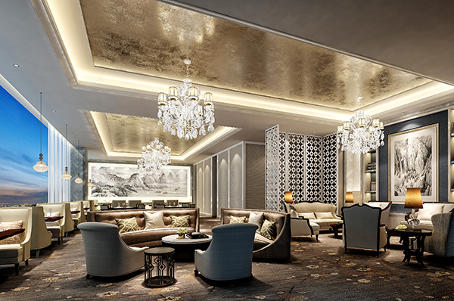
行政酒廊 | Executive Lounge
位于酒店36层的装修时尚高雅的行政酒廊是为入住行政楼层的宾客提供的专属礼遇，超高楼层的绝佳位置及全景落地窗，确保您在享用行政早餐、免费茶点及晚间鸡尾酒的同时可将泰山美景尽收眼底。同时，温馨舒适的行政酒廊也是您工作之余进行商务洽谈的理想之所。
Our comfortable and stylish Executive Lounge is exclusive to guests staying in our suites and executive floor rooms. Located on the 36th floor offering panoramic views of Mt Tai ensures this is a truly special and unique venue to enjoy morning breakfast, complimentary snacks and refreshments during the day completed with evening cocktails. The Executive Lounge is also the ideal place to catch up on work our conduct a business meeting during your stay.
营业时间 Operation Hours: 06:30-23:00
座位Capacity: 42
楼层Location: 36F

Slide 17

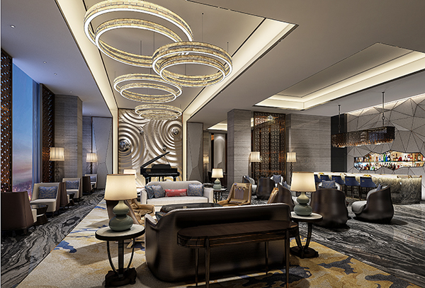
大堂酒廊 | Lobby Lounge
大堂酒廊悠闲舒适的气氛和亲切贴心的服务，让您可以在这儿度过写意愉快的时光，享用一杯香浓的咖啡、清新茗茶、啤酒、特色鸡尾酒以至精选红酒及香槟，佐以精美小点，无论独自小酌或与三五知己谈天说地，同样怡然自得，定能尽享惬意。
Lobby Lounge offers a comfortable environment with attentive staff at your service. An extensive drink list is served with delectable choices of snacks and desserts. The perfect venue to relax and unwind over a cup of coffee, tea, or refreshing beverage, alone or with your friends at leisure.
营业时间 Operation Hours: 08:30-23:30
座位Capacity: 38
楼层Location: 1F

Slide 18

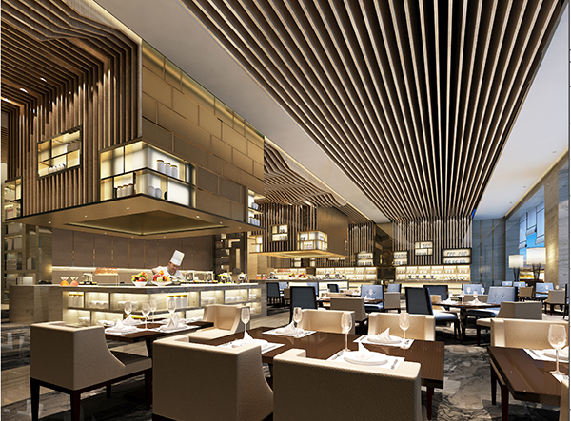
美食汇 | Café Realm
美食汇全日餐厅全新定义了国际酒店不可或缺的全日餐厅；为您贴心准备“外带早餐”，让您在高效工作之余感受家的温暖；“24小时环球精选”令您始终品尝心仪美味；汇聚各国佳肴的自助大餐以及别有情调的招牌零点，更是让您的午间聚会和晚间盛宴惊喜不断！
Café Realm redefines the standard of all-day dining service at international hotels. Busy hotel guests can enjoy the convenient and delicious “Takeaway Breakfast”. What’s more, the Café Realm also serves sumptuous international buffets and a fabulous a la carte menu. All in all, you’re pampered with delicious surprises at Café Realm, day or night.
营业时间 Operation Hours: 06:30–22:30
早餐Breakfast: 06:30–10:00 (周一至周五 Monday–Friday)
06:30–10:30 (周六至周日 Saturday–Sunday)
午餐Lunch: 11:30–14:00
晚餐Dinner: 17:30–21:30
座位Capacity: 142
位置Location: 1F

Slide 19

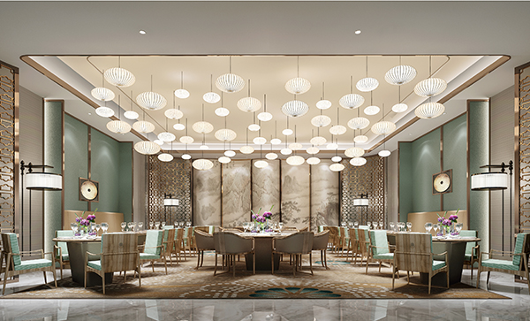
品珍 | ZHEN
品珍中餐厅以本地特色菜为主，搭配精美粤菜及高档海鲜，专注于原汁原味以及均衡营养。美食佳酿的精致感受、匠心独具的奢华氛围以及温情倍至的周到服务，令您忘返于独具东方特色的美食文化。
Zhen Chinese Restaurant specializes in local specialties, exquisite Cantonese and high-end Seafood. While presenting colorful dishes in their authentic flavor, special attention is paid to offer balanced nutrition. Take delight in the Oriental culinary tradition that combines superb wine and dine, regal dining ambience and impeccable service.
营业时间 Operation Hours:
午餐Lunch: 11:30–14:00
晚餐Dinner: 17:30–21:30
座位Capacity: 142
楼层Location: 2F

Slide 20

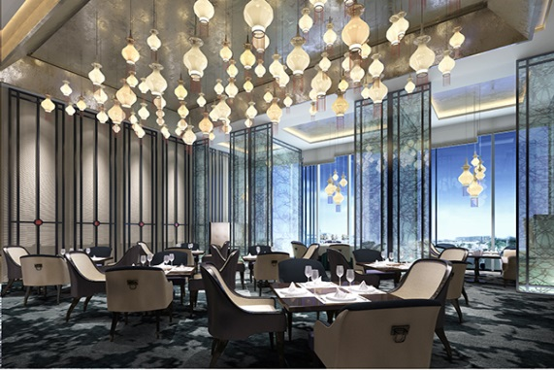
辣道 | Chili & Pepper
辣道荟萃川湘及世界各地以麻辣为特色的各式美肴，辅以精致传统的佐酒小食，带给您全新独特的“辣式体验”。畅享香鲜诱惑的环球辣味美食，辣道定是您的不二之选。
Chili & Pepper combines a unique variety of local, national and international dishes that are famous for using either pepper or chili as one of its key ingredients. Not all is hot, but if you truly enjoy authentic hot and spicy dishes Chili & Pepper is a must do experience.
营业时间 Operation Hours:
午餐Lunch: 11:30–14:00
晚餐Dinner: 17:30–21:30
座位Capacity: 66
楼层Location: 1F

Slide 21
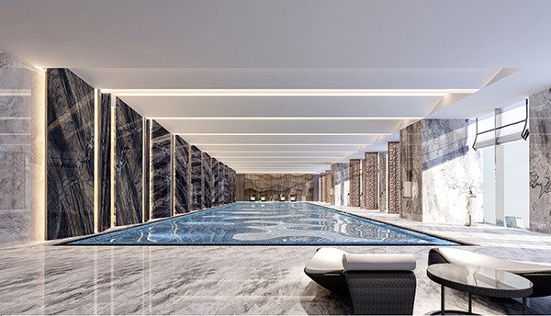
健身中心 | Health Club
25米室内恒温游泳池
25 meters indoor heated swimming pool
先进齐全的健身设施
Health Club with state-of-the-art facilities
瑜伽室及桑拿蒸汽房
Yoga, Steam Room and Sauna Room
美发沙龙
Hair Salon
营业时间 Operation Hours:
健身中心Health Club: 06:00–23:00
美发沙龙Hair Salon: 10:00–20:00
楼层Location: 5F

Slide 22
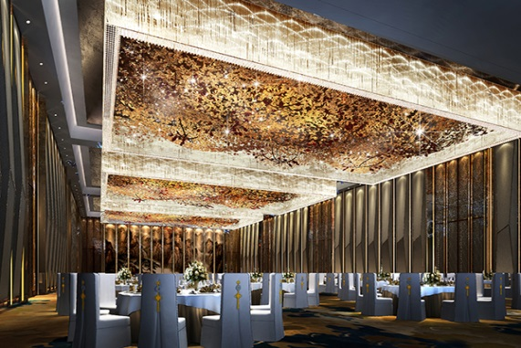
会议与宴会 | Meeting and Banquet
每场活动都有独特的需要与要求，泰安万达嘉华酒店拥有多种活动场地供您选择，所有场地均设备完善，配备最先进的视听与多媒体设施，以及免费高速上网服务。同时，筹办活动是一项既费神又费时的任务，我们独特的“专属会议管家”一站式服务将为您倾心服务，让您高枕无忧。无论活动规模大小，性质如何，我们训练有素的专业活动策划团队将为您提供全程协助与指导，力求一切完美无瑕。
Every event has its own unique needs and requirements, that’s why Wanda Realm Taian offers you a selection of event venues, each of them fully-equipped with the latest audio-visual and multimedia technology, as well as complimentary high-speed Internet access. Organising an event can be a complex and time-consuming process, that’s why we take pride in offering you the one-stop convenience of our signature “Exclusive Meeting Director” service. Whether your event is large or small, business or social, our dedicated team of event organisers is here to provide the support and guidance you need to host a truly successful occasion.

Slide 23
会议与宴会 | Meeting and Banquet
场地 Venue | 剧院式Theatre | 课桌式Class-room | 鸡尾酒会式Cocktail | 董事会式Room | U型U-shape | 宴会式Banquet | 面积 (㎡) | 尺寸（米）Dimensions (m) | 楼层高度(m)
大宴会厅 Grand Ballroom | 900 | 600 | 900 | — | — | 600 | 1,200 | 46*26 | 9
宴会厅 1 Ballroom 1 | 300 | 200 | 300 | 120 | 120 | 200 | 400 | 15*26 | 9
宴会厅 2 Ballroom 2 | 300 | 200 | 300 | 120 | 120 | 200 | 400 | 15*26 | 9
宴会厅 3 Ballroom 3 | 300 | 200 | 300 | 120 | 120 | 200 | 400 | 15*26 | 9
宴会厅-前厅 Ballroom Foyer | — | — | 300 | — | — | 200 | 350 | 50*7 | 9
多功能厅1 Function Room 1 | 60 | 42 | 50 | 26 | 36 | 60 | 105 | 16*6.5 | 3.5
多功能厅2 Function Room 2 | 60 | 42 | 50 | 26 | 36 | 60 | 105 | 16*6.5 | 3.5
多功能厅3 Function Room 3 | 60 | 42 | 50 | 26 | 36 | 60 | 105 | 16*6.5 | 3.5
多功能厅5 Function Room 5 | 130 | 88 | 100 | 42 | 42 | 120 | 230 | 35*6.5 | 3.5
贵宾室 VIP Room | — | — | — | 20 | — | — | 100 | 15*6.5 | 4.5
董事会议室 Board Room | — | — | — | 20 | — | — | 100 | 15*4.5 | 4.5

Slide 24
浪漫婚典| Romance Wedding Ceremony
泰安万达嘉华酒店的厨师团队久负盛名，深谙环球美食之精粹，从传统鲁菜到精致粤菜，无所不精。厨师团队将为您精心设计婚宴菜单，满足您的一切细致需求，为您打造一场饕餮盛宴，宾主尽欢。
At Wanda Realm Taian, you can enjoy the services of renowned chefs who are highly skilled in a wide range of cuisines, from the local Shandong cuisine to exquisite Cantonese dining. This team of talented chefs is here to create a banquet menu that meets all your requirements, delighting you and your guests with a dining experience of pure finesse.
大宴会厅：容纳60桌 Grand Ballroom: 60 tables
宴会厅 1+2/2+3 ：容纳38桌 Ballroom 1+2/2+3: 38 tables
宴会厅 1/2/3 ：容纳18桌 Ballroom 1/2/3: 18 tables

Slide 25

万悦会 | Wanda Club
万悦会会议奖励计划适用于在万悦会所有加盟酒店组织会议者，是一个独立的奖励计划。会议组织者可通过万悦会网站或万悦会会员服务中心申请，获取会议奖励计划账户，并可享有：
· 积分永久 · 积分称心兑换
· 积分自由购买 · 尊享预定通道
· 个性化积分转赠 · 享受办理入住手续优先权
The Wanda Club Meeting Rewards Program is available for meeting planner individuals only. The program is independent of the Wanda Hotels & Resorts rewards program. Wanda Club Meeting Rewards membership may be applied for via the Wanda Club website or Wanda Club Service Center. Upon membership approval by Wanda Hotels & Resorts, a Meeting Reward Program member will enjoy:
·Non-expiration of points · Points redemption
· Points purchases ·Dedicated reservation channel
· Points transfers
· Exclusive staying at Wanda Club Floor Priority check-in

Slide 26


万优会 | Club One
万优会是万达酒店及度假村管理有限公司的餐饮常客计划，作为万优会的成员，您可以享受独一无二的专属优惠，包括：
在参与活动的餐厅内享受无限次数的餐饮折扣
10次最优惠房价八折的住宿礼遇
在当地酒店享受一系列额外优惠，如免费住宿，免费自助餐，现金抵用券以及更多超乎预期的优惠。
Club One is paid membership that offers discount privileges for food and beverage. As a member of Club One, you will enjoy exclusive privileges including:
Unlimited dining discounts at participating
restaurants and bars.
10 times of special 20% off Best Available Rate.
A range of amazing bonus benefits such as free accommodation, complimentary buffet, cash vouchers and many more that exceed your expectation at your host hotel.

Slide 27


万达儿童基金会 | Wanda Children’s Foundation
万达儿童基金是由万达酒店及度假村管理有限公司创立，与中华慈善总会合作，面向全球推出的针对儿童的专项公益慈善项目。万达酒店及度假村旗下各酒店邀请每位住店客人每次入住捐助人民币5元以及酒店员工的义卖捐款，汇聚点滴爱心，帮助需要帮助的儿童。
Established by Wanda Hotels & Resorts and in collaboration with the China Charity Federation, Wanda Children’s Foundation is developed as a special charity programme for children across the world. All of our hotels are helping children in need by encouraging every guest to donate RMB 5 during each stay. Hotel associates also donate their time in hosting a charity sale.

Slide 28

筹备办公室: 中国山东省泰安市财源街道中七里社区中兴大厦5楼
Pre-opening Office: 5th floor, Zhongxing Building, Qili Community, Caiyuan Subdistrict, Taian, Shandong Province 271000, P.R. China
电话/Tel: +86 (0)538 878 0080 www.wandahotels.com

