Slide 1

Kempinski Hotel Guiyang 贵阳凯宾斯基大酒店 A stage to experience luxury meetings and events 奢华会议，荣耀呈现

Slide 2
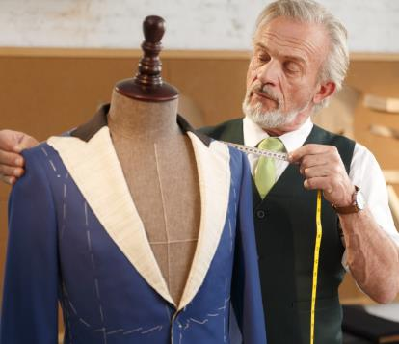
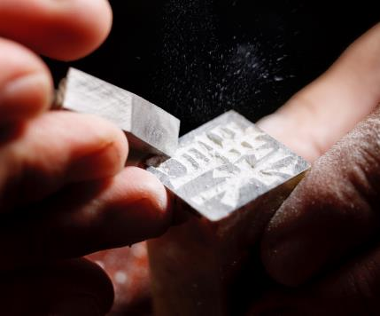

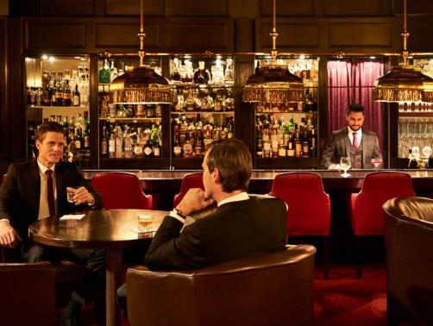


CULTURAL
EMPATHY
REMARKABLE EUROPEAN FLAIR
TIMELESS ELEGANCE
At Kempinski, We Believe In…
AUTHENTIC DESTINATION
TRAVELLING
IN
STYLE
SMALL
IS BEAUTIFUL
Notes:
2

Slide 3
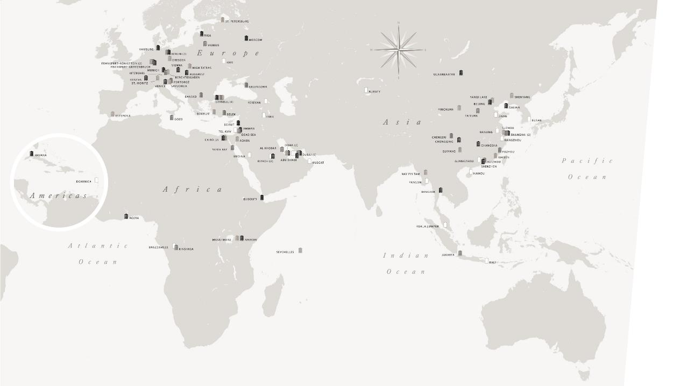

KEMPINSKI TODAY

Slide 4

“Exceptional Meeting Experience with Exclusive Privileges.”
“为您打造无与伦比的会议体验”
Enchanting hospitality in the heart of Guiyang

Slide 5
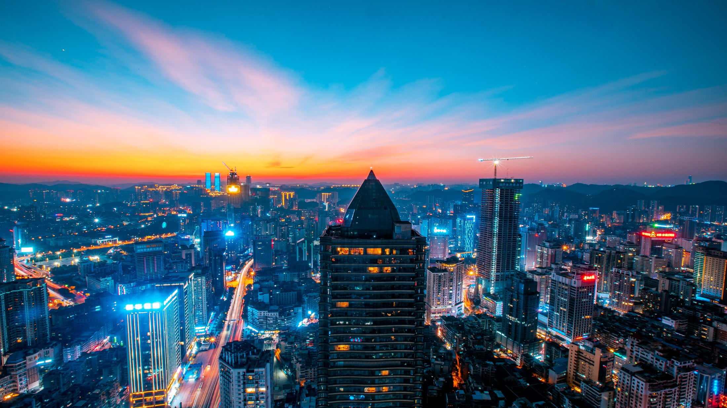
Kempinski Hotel Guiyang
贵阳凯宾斯基大酒店
Notes:
5

Slide 6
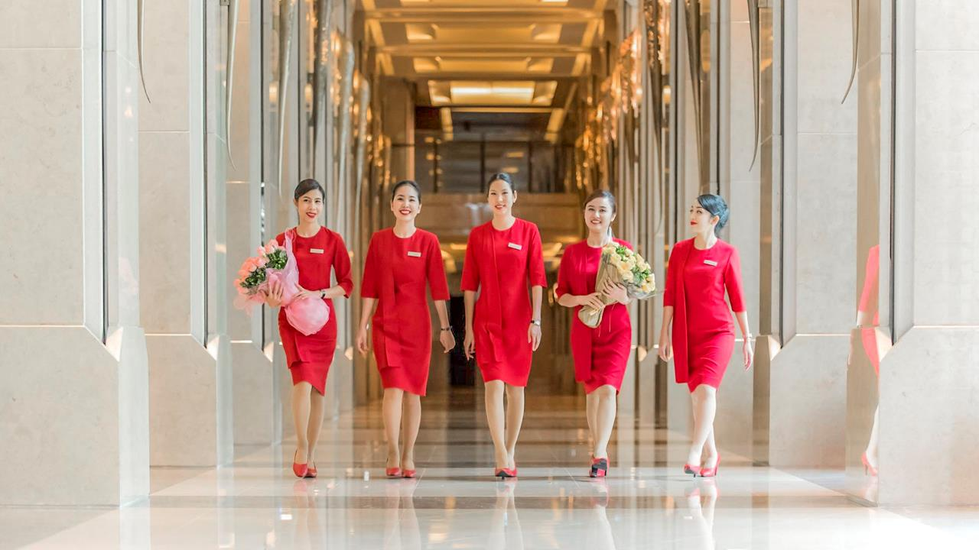
Lady in Red
红衣女郎
“The Brand Ambassador of Kempinski, the Reinterpretation of the Traditional Concierge ”
红衣女郎为凯宾斯基酒店独有。作为形象大使，她们出现在每座凯宾斯基酒店的大堂，为您提供向导服务并记录您的需求和期盼。
Notes:
6

Slide 7
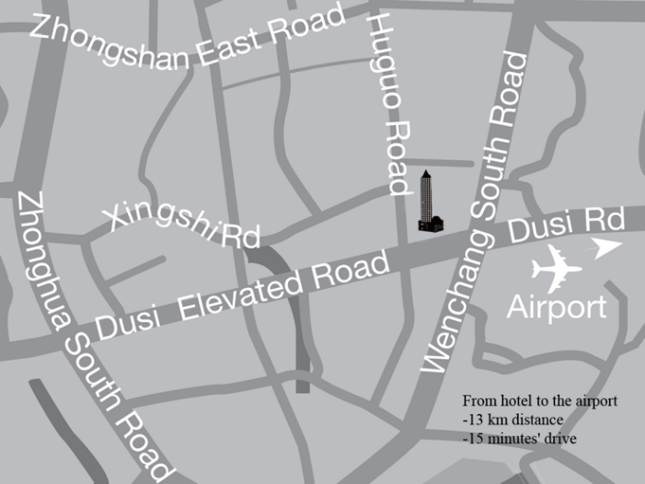
Location Map 地图位置
仅需15分钟车程可到达贵阳龙洞堡国际机场
15-min by car from Guiyang Longdongbao International Airport
5分钟车程便可抵达火车站
5-min by car from Train Station
紧邻亨特城市广场和家乐福大超市
Hunter City Mall and Carrefour Supermarket is nearby
步行5分钟可到达贵阳最繁华的商业区小十字
5-min walking distance to the city center Xiaoshizi.
步行10分钟可到达最大商业中心喷水池
10-min walking distance to Penshuichi shopping area

Slide 8
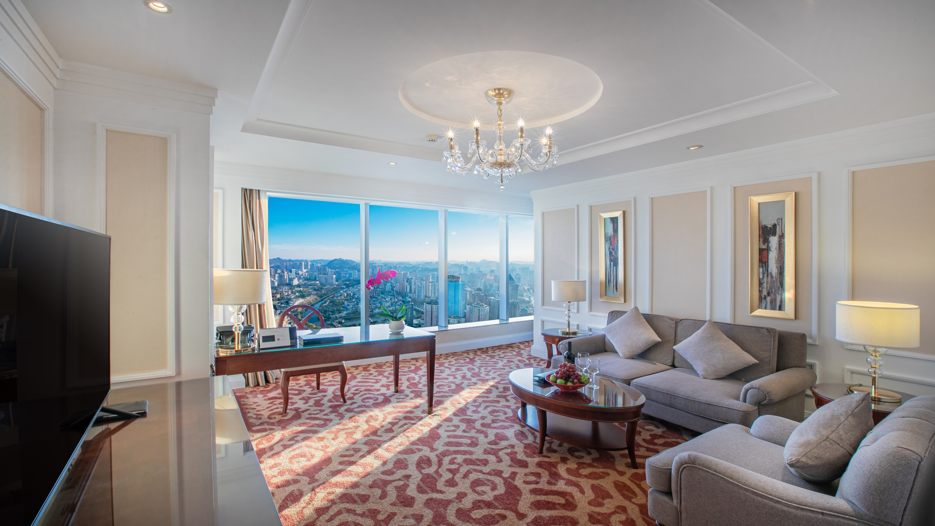
“The magnificent five-star property features 366 elegantly furnished guestrooms and suites, offering refined luxury and exceptional space, complemented with innovative amenities and Kempinski’s legendary service and poise.”
酒店拥有366间优雅的客房及套房，提供精致奢华的入住体验，辅以创新的设施，提供给您无与伦比的欧式奢华服务。
Luxurious Accommodation
奢华入住体验

Slide 9
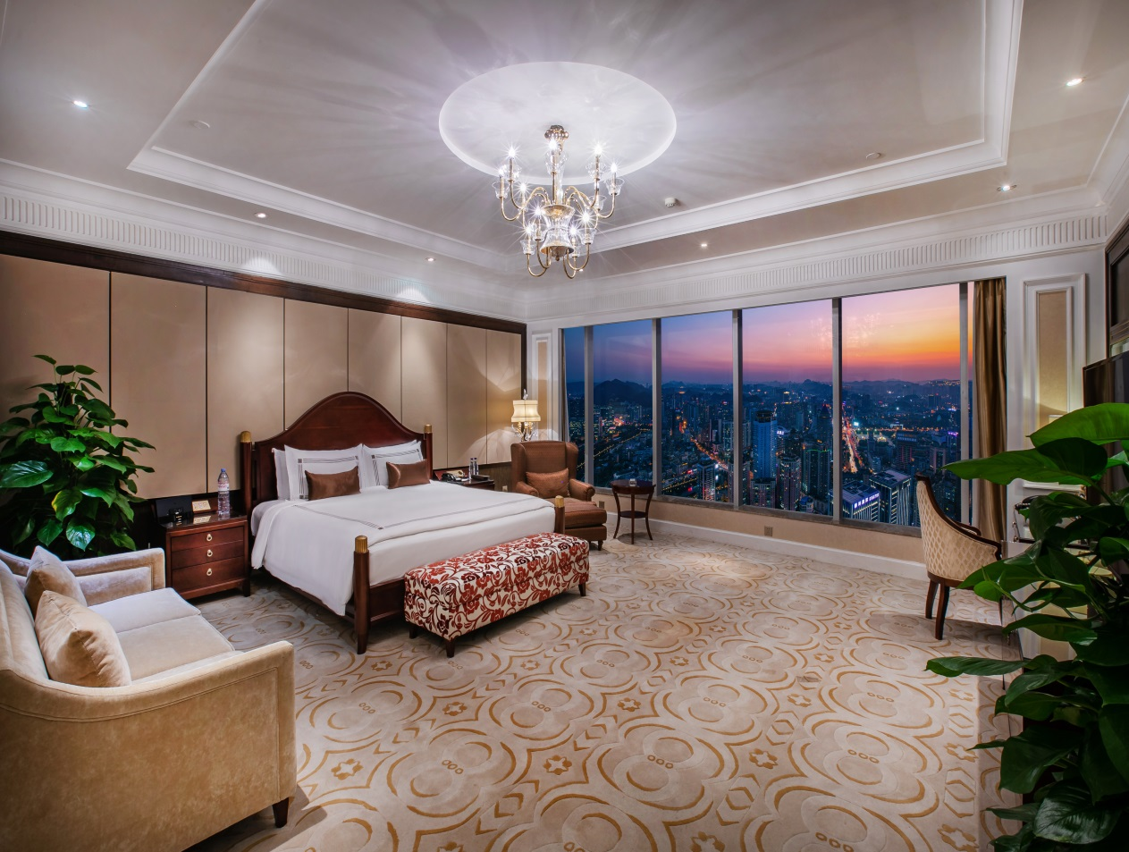

Room Category 房间类型
豪华单间 48
Deluxe King Room
豪华标间 71
Deluxe Twin Room
全景豪华标间 35
Panorama Deluxe Twin Room
全景豪华单间 70
Panorama Deluxe King Room
行政豪华客房 50
Executive Deluxe
行政全景豪华客房 24
Executive Panorama Deluxe
行政套房 29
Executive Suite
行政全景套房 23
Executive Panorama Suite
大使套房 1
Diplomatic Suite
总统套房 1
Presidential Suite

Slide 10
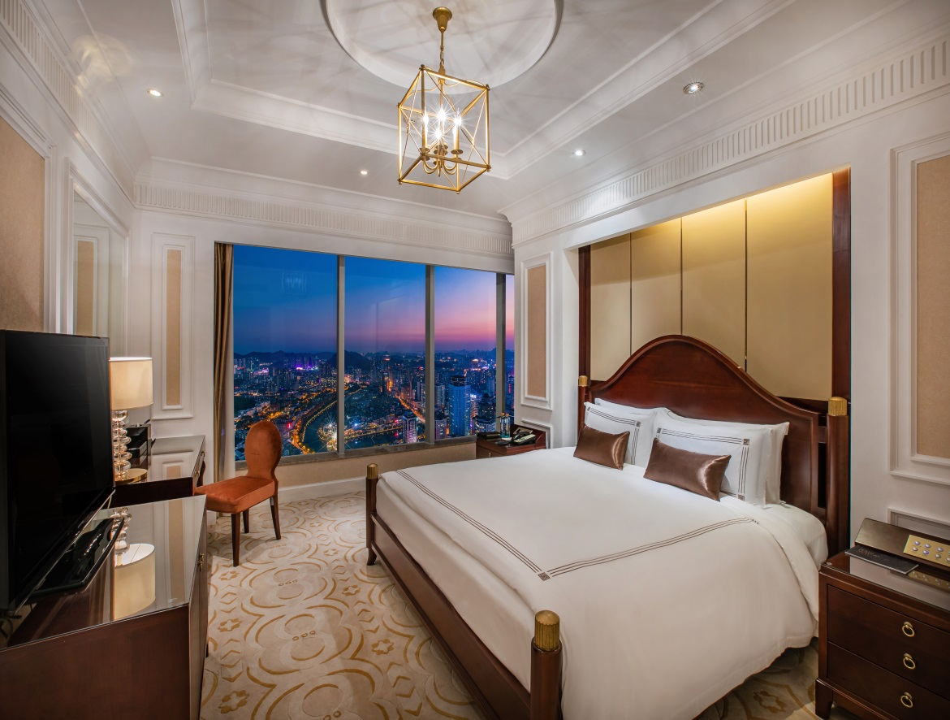
Rooms Features 房间特色
自助窗帘和电源开关
State-of-the-art technologies: curtains and lighting controls
独立的淋浴及浴缸
Separate standing shower and bathtub
部分客房拥有连通门
Some rooms with connecting doors
宽带和无线网网络
Internet and Wi-Fi
全景落地窗
Floor-to-ceiling window

Slide 11
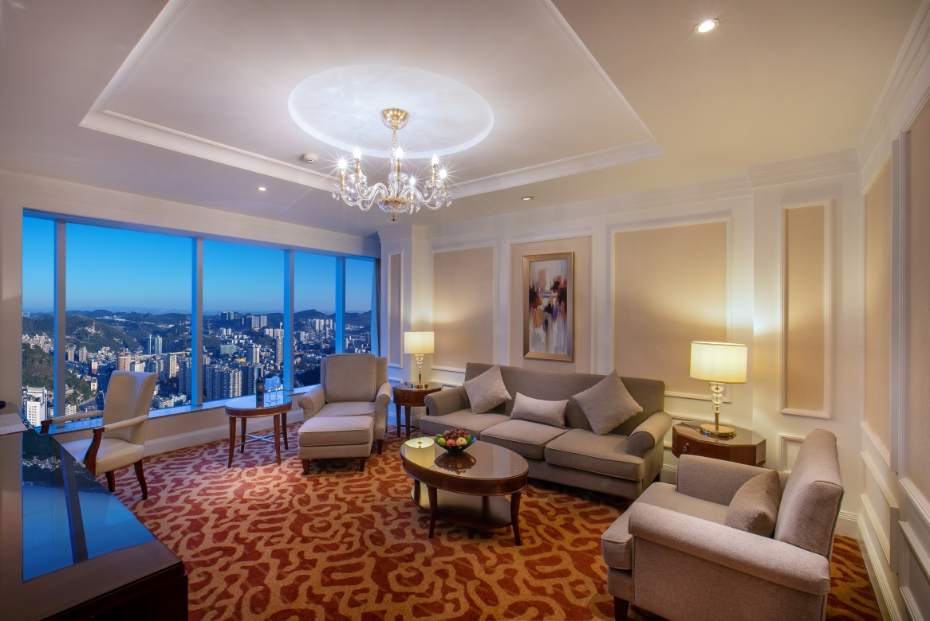
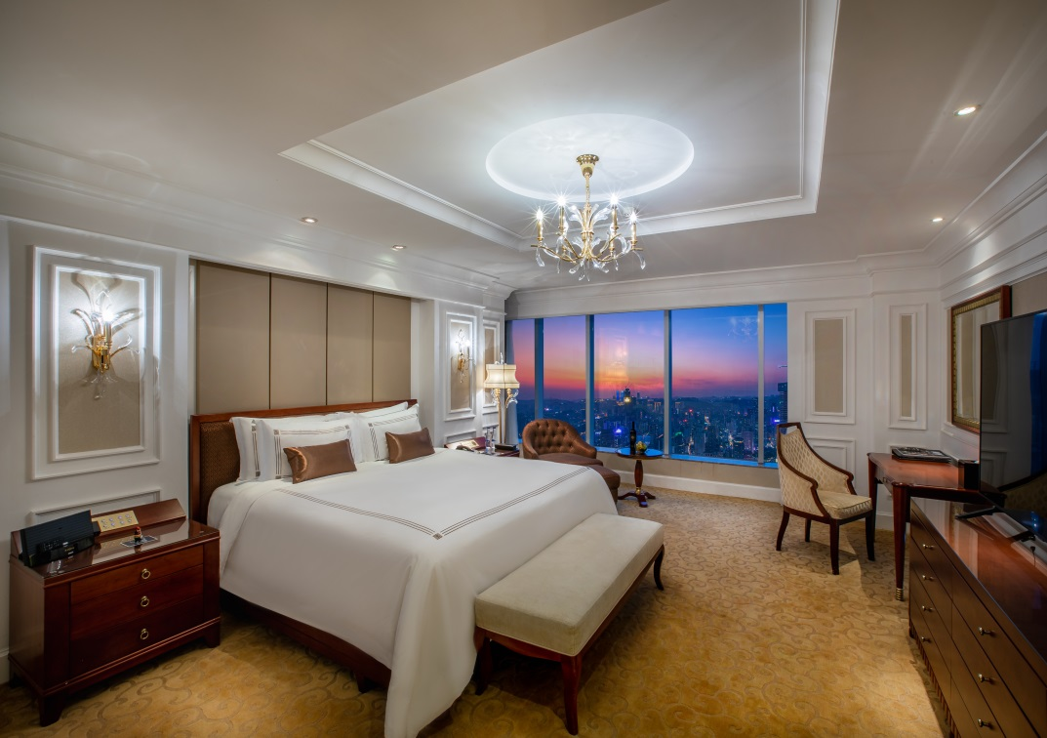
Executive Panoramic Deluxe Suite 行政全景套房
“Elegant, Spacious and Comfortable, For A Truly Royal Stay ”

Slide 12
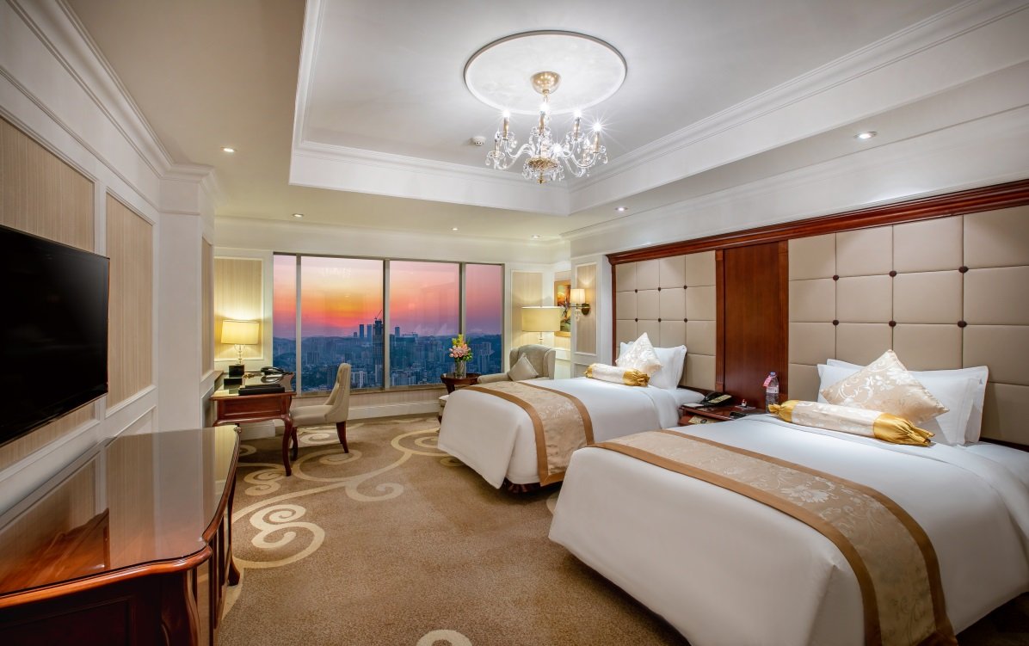
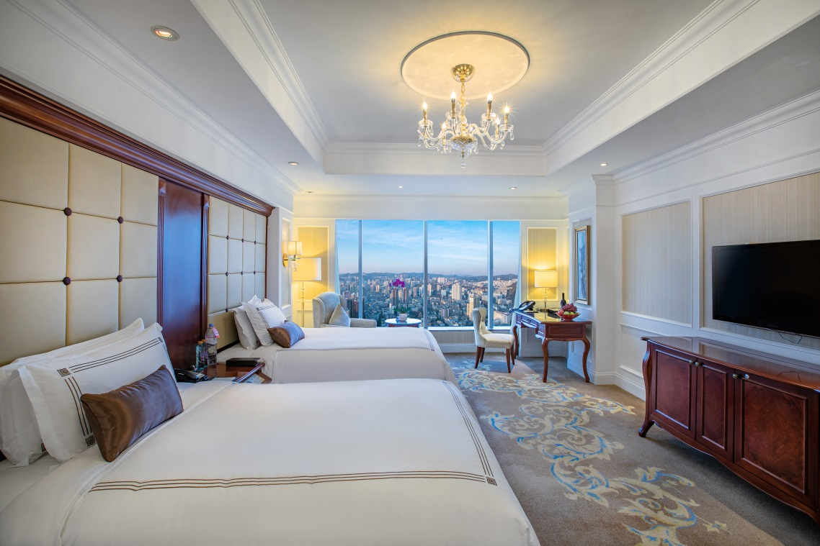
Twin Bed Room 标间
“Spacious with state of the art features and perfect for a good night after an intense meeting”

Slide 13
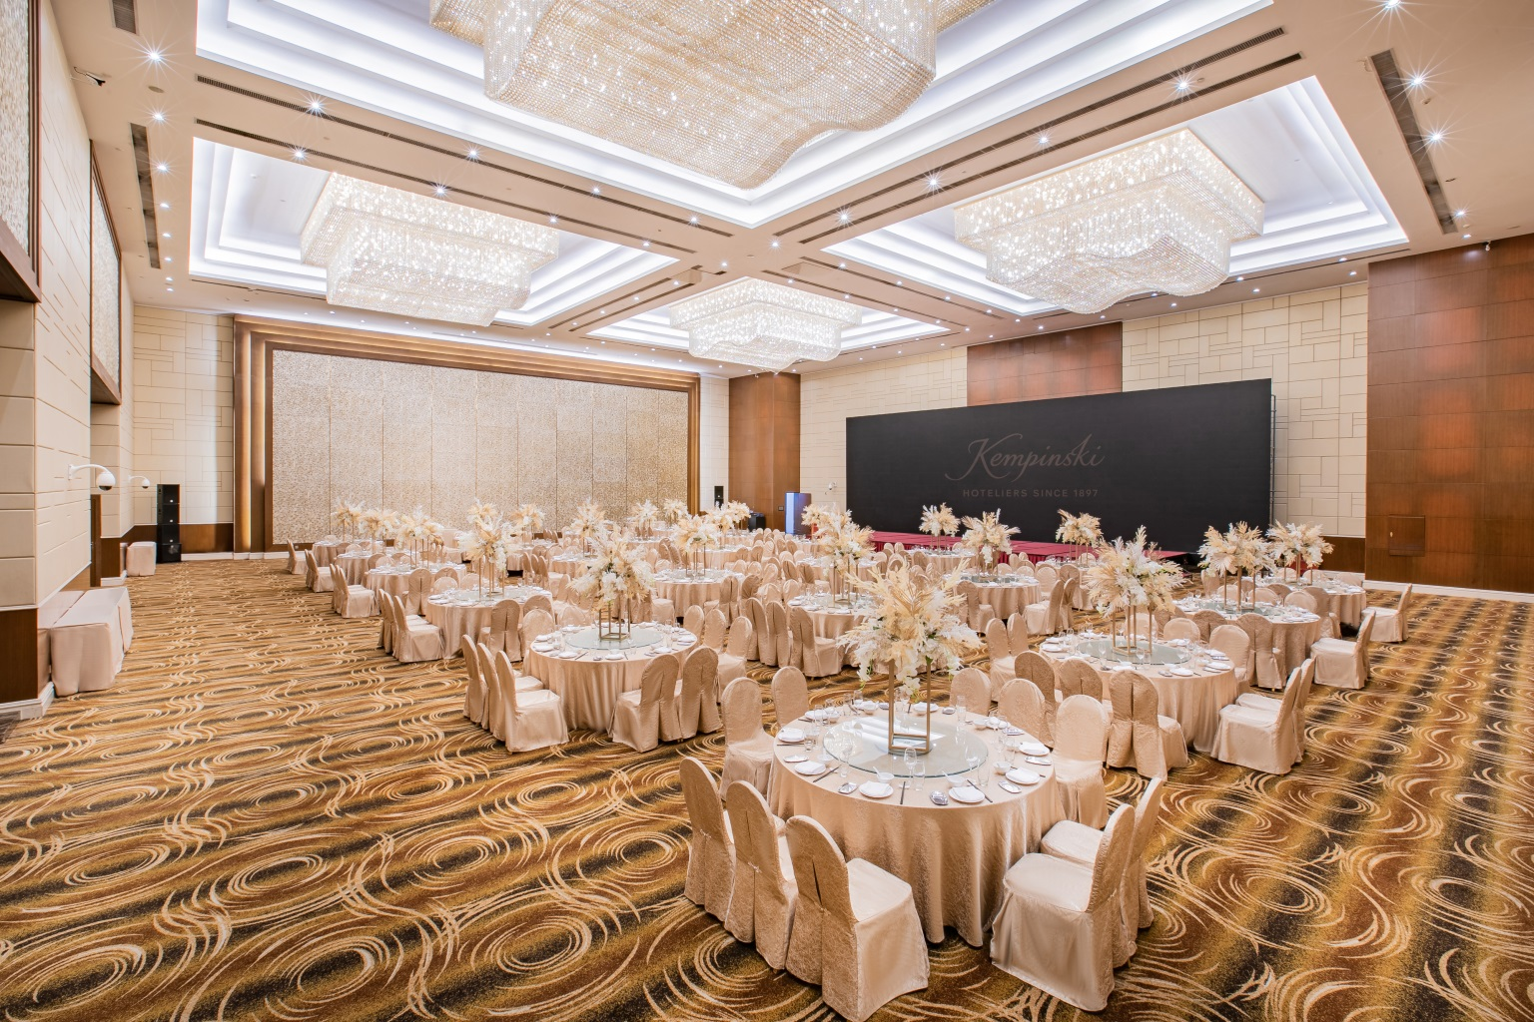
Kempinski Grand Ballroom 凯宾斯基大宴会厅
Banquet Set-up
宴会式摆台

Slide 14
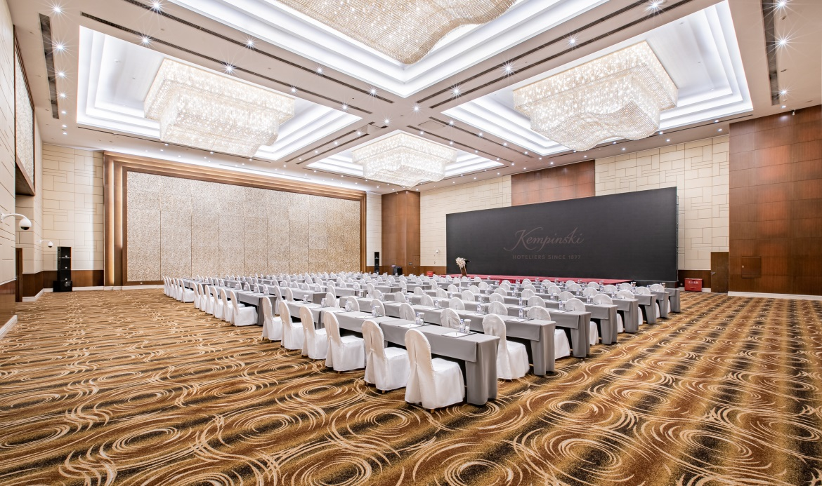
Kempinski Grand Ballroom
凯宾斯基大宴会厅
Area: 770 sqm
面积：770平方米
Theater Set-up: 600 persons
戏院式摆台：600人
Classroom Set-up: 390 persons
教课桌式摆台：390人
Banquet Set-up: 400 persons
宴会式摆台：400人
Classroom Set-up
课桌式摆台

Slide 15
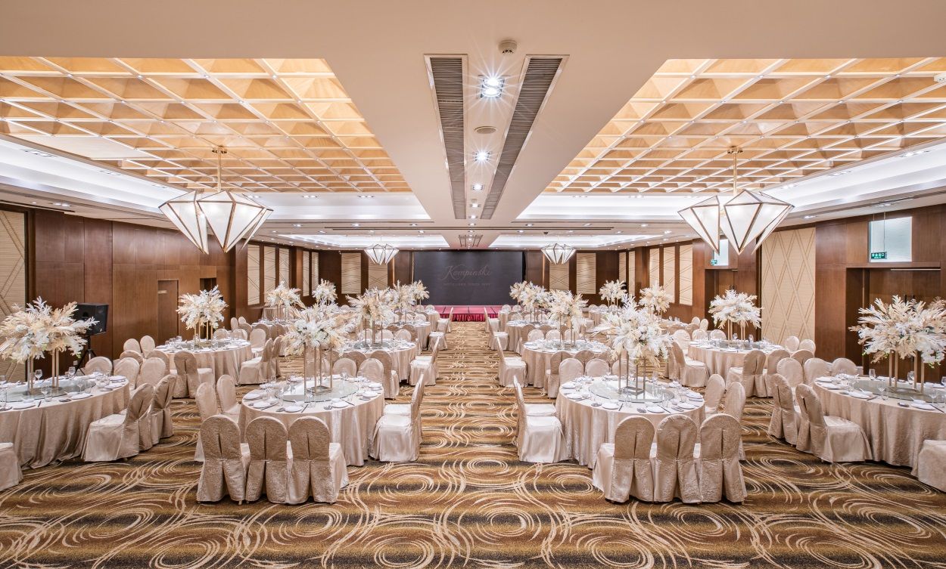
Guiyang Ballroom
贵阳宴会厅
Area: 504 sqm
面积：504平方米
Theater Set-up: 400 persons
戏院式摆台：400人
Classroom Set-up: 220 persons
教课桌式摆台：220人
Banquet Set-up: 260 persons
宴会式摆台：260人
Round Set-up
圆桌摆台

Slide 16
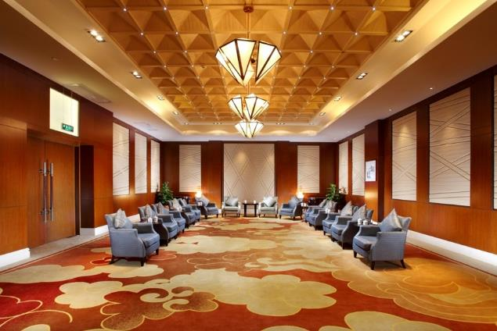
Wen Yuan Ge
文渊阁
Area: 98 sqm
面积：98平方米
Theater Set-up: 70 persons
戏院式摆台：70人
Classroom Set-up: 45 persons
教课桌式摆台：45人
Banquet Set-up: 60 persons
宴会式摆台：60人
U-shape Set-up: 30 persons
U型摆台：30人
Board Meeting Set-up: 30 persons
董事会摆台：30人
VIP Set-up
VIP摆台

Slide 17
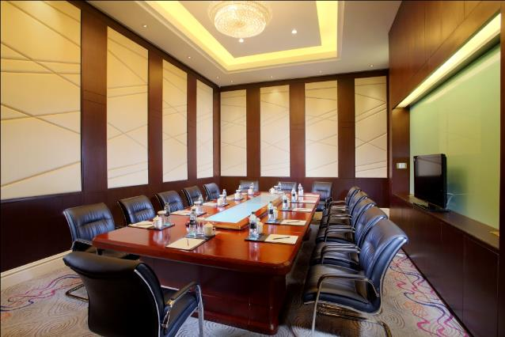
Frankfurt Meeting Room
法兰克福会议室
Area: 40 sqm
面积：40平方米
Board Meeting Set-up: 12 persons
董事会摆台：12人
Board Meeting Set-up
董事会摆台

Slide 18
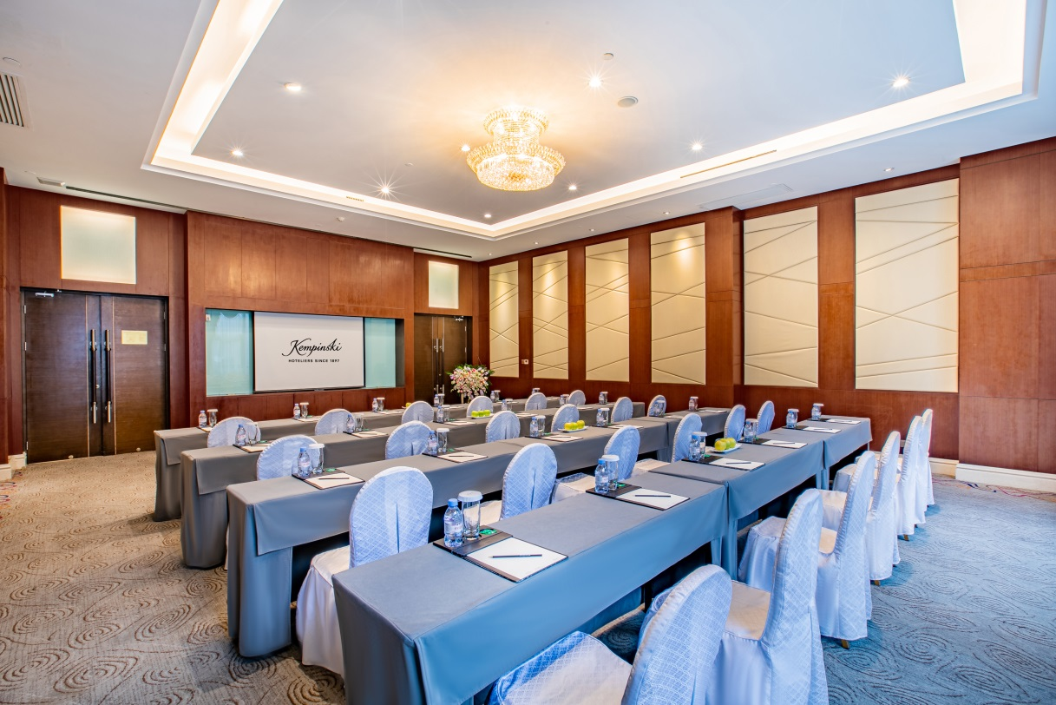
Istanbul Meeting Room
伊斯坦布尔会议室
Area: 88 sqm
面积：88平方米
Theater Set-up: 70 persons
戏院式摆台：70人
Classroom Set-up: 45 persons
教课桌式摆台：45人
Banquet Set-up: 50 persons
宴会式摆台：50人
U-shape Set-up: 40 persons
U型摆台：40人
Board Meeting Set-up: 43 persons
董事会摆台：43人
Cocktail Set-up: 70 persons
鸡尾酒会：70人
Classroom Set-up
课桌式摆台

Slide 19
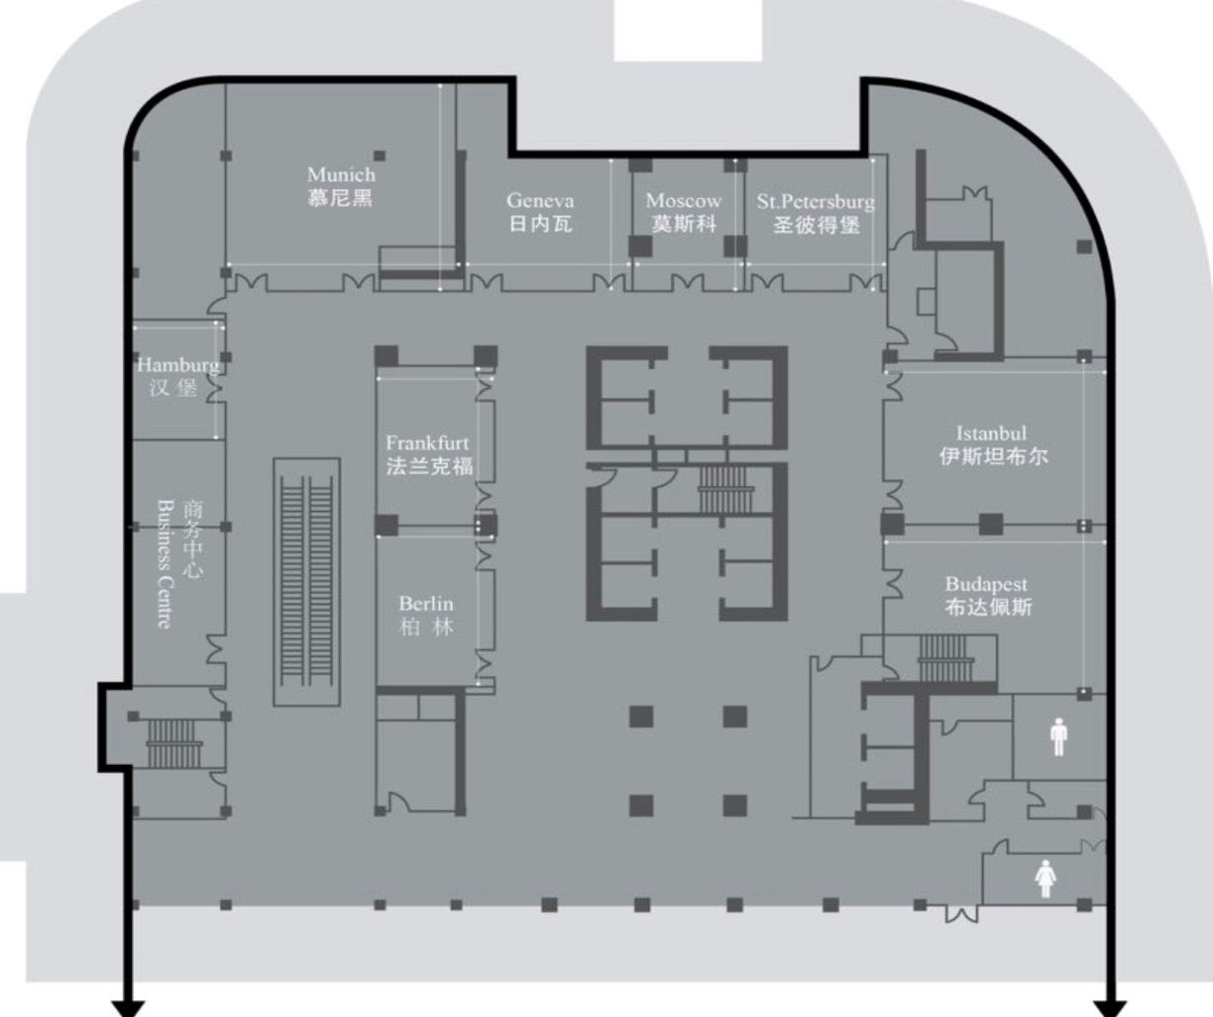
Floor 2 Plan
二楼平面图
会议室 | 长X宽X高 | 平方米
Rooms | L*W*H (m) | M²
柏林 | 8x5x4 | 40
Berlin
法兰克福 | 8x5x4 | 40
Frankfurt
慕尼黑 | 10x11x4 | 110
Munich
伊斯坦布尔 | 11x8x4 | 88
Istanbul

Slide 20
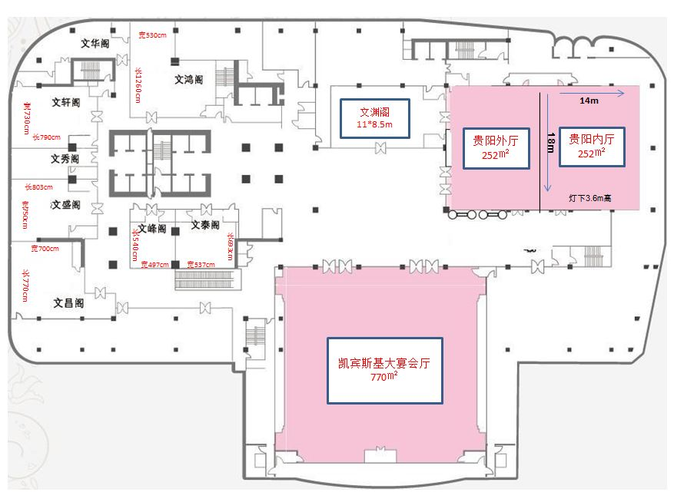
Floor 3 Plan
三楼平面图
酒店拥有完善的会议设施，770平米及504平米的两个无柱式宴会大厅是大型会议、展览、婚礼的首选之地；9间多功能厅，为宾客提供多种选择。专业的宴会服务团队，可根据宾客的需求，为其量身设计主题宴会，提供高端定制服务。
The hotel offers two grand ballrooms and nine function rooms, fully equipped with banqueting and conference facilities. Our professional catering and banquet team is dedicated to providing you with high-quality and tailor-made banquet services.

Slide 21
TESTIMONIALS
2017
Travel & Leisure Magazine
Best Business Hotels
旅游休闲杂志
2017年度最佳商务酒店大奖
2016 - 2017
China MAG Travel Awards
The MICE Hotel of Year 2016
中国誌旅游业大奖
2016年度MICE酒店大奖
2016
HURUN Presidential Awards
Best Executive Suite in Guiyang
胡润总统奖
2016胡润最热门酒店奖·贵阳最佳行政套房大奖

Slide 22
Tourist Attractions 旅游景点

Slide 23
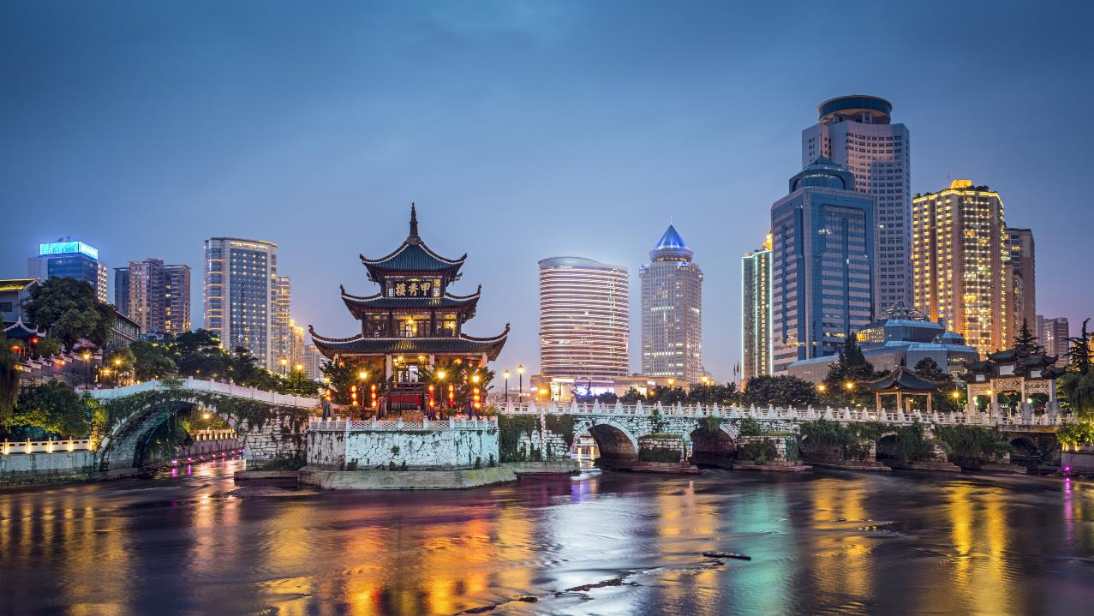
Guiyang, Guizhou Province
贵州省贵阳市
贵阳市是贵州省的省会，是一座“山中有城，城中有山，绿带环绕，森林围城，城在林中，林在城中”的现代化城市，享有“森林之城，避暑之都”的美名。
Guiyang is the capital of Guizhou Province. It is a modern city with unique scene of “interwoven mountains and city circled by green forest belt”. It is also acclaimed as the “City of Forest and the Capital of Summer Resorts”.
Notes:
23

Slide 24
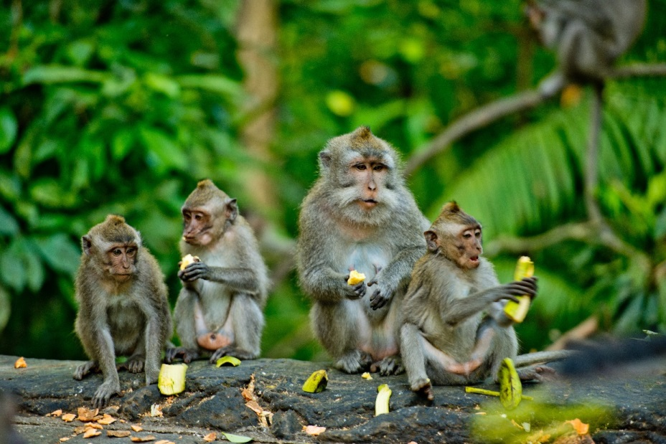

Qianling Park
黔灵公园
Huangguoshu Waterfall
黄果树瀑布
城市公园之一黔灵公园是位于贵阳市西北角，因素有“黔南第一山”之称的黔灵山而得名。公园里清泉怪石，随处可见，有成群的灵猴和鸟类在此栖息，是国内为数不多的大型综合性。
Qianling Park, located in the northwest corner of Guiyang. The Park got its name from the Qianling Mountain. Clear springs and peculiar stones can be seen everywhere. Groups of clever monkeys and birds are living here.
位于贵州省安顺市镇宁县，距离贵阳市区137公里，是贵州第一胜景，也被称为“亚洲第一大瀑布”。黄果树瀑布已连同附近的白水河瀑布群等景点被整合开发为“黄果树瀑布景区”，2007年成为首批国家5A级旅游景区之一。
One of the largest waterfalls in China and East Asia, and is located on the Baihe River in Anshun, Guizhou. This is one of the most popular tourism attractions in China , in 2007, it was named one of the first “National 5A-level Scenic Areas”.

Slide 25
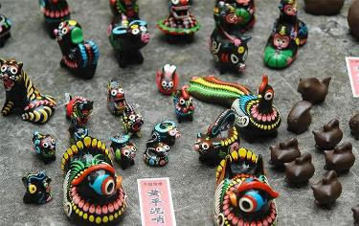
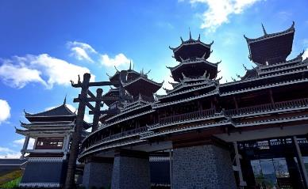
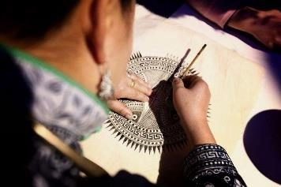
KEMPINSKI DISCOVERY
凯宾斯基探索之旅
Loyalty Program
Huang Ping Mud Whistle
黄平泥哨
Our team member will escort you to visit and experience the cultural history behind these amazing mud whistles.
我们将为您介绍黄平泥哨的非物质文化遗产传承人，让您充分体验和了解背后的故事。
A Journey of the Colorful Guizhou City
观光多彩贵州城
The Guizhou exhibition hall will embark you in the history and understanding of the local ethnic minority culture.
贵州非物质文化遗产的展馆将成为你了解当地少数民族文化最值得体验的场所。
Discovery of Miao Batik
探索蜡染工艺
We will make you discover the traditional Miao Batik artist where you will be able to make your own batik.
我们将为您介绍传统苗族蜡染的艺术家，在她的指导下，您可以尝试并制作属于您自己的蜡染。

Slide 26
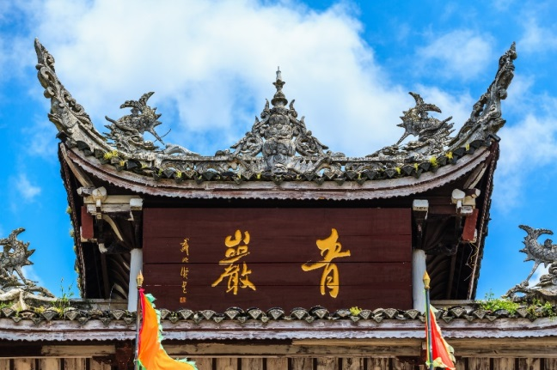
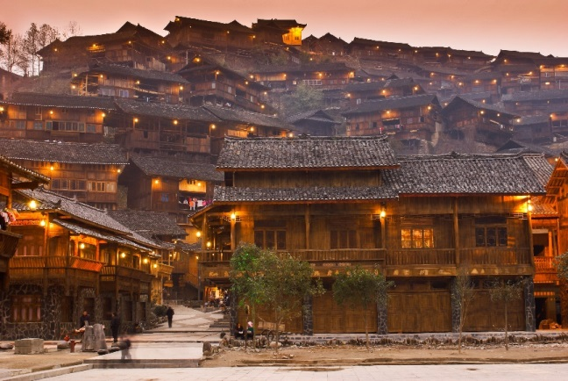

Qingyan Ancient Town
青岩古镇
青岩古镇位于贵阳市的南郊，始建于明朝。是贵州非常著名的文化古镇之一，镇容布局沿袭明、清格局，朝门、腰门以及陈旧古老的石柜台和木柜台仍然较完整地保留着。交错密布多座明清古建筑，以及城门、城墙、炮台等军事遗迹。
Qingyan Ancient Town, founded in 1378 during the Ming Dynasty, is located in the southern suburb of Guiyang. As Guizhou Province’s historical and cultural ancient town, Qinyan Ancient Town retains a lot of its original layout, as well as ancient buildings from the Ming and Qing dynasties
Xijiang Miao Village
西江千户苗寨
西江千户苗寨位于贵州黔东南雷山县，由十余个依山而建的自然村寨相连成片，是世界上最大的苗族聚居村寨。西江是一个保存苗族“原始生态”文化完整的地方，是领略和认识中国苗族漫长历史与发展的首选之地。
Located in the high mountains of Leishan County and known as the largest Miao ethnic village in the world,. The Xijiang Miao Village is composed of 12 natural villages and 1,200 families lives in this famous historical-cultural ancient town.
Wanfenglin
Wanfenglin
万峰林
万峰林是国家地质公园和国家AAA级旅游区，是中国西南三大喀斯特地貌之一，堪称中国锥状喀斯特博物馆，被誉为“天下奇观”。登山而览，山峰如春笋般拔地而起，连绵不断。下瞰平畴，万倾如锦，一湾清流由南而西，有十数布衣村寨依水而立。
Welcome to Wanfenglin! Be surrounded by mountains, lakes, rivers and fields, enjoy the splendid landscapes. You will be able to explore this region with the numerous activities offered: hiking, rafting, fishing, mountain climbing, bicycling and rock climbing…or just relax and take a bowl of fresh air. Whichever you like, you will find the activities of your taste.

Slide 27
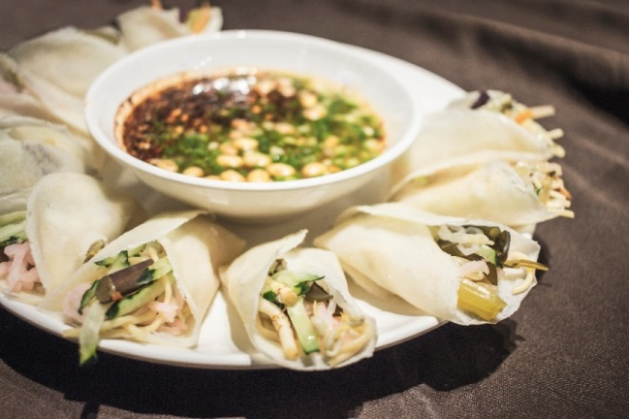
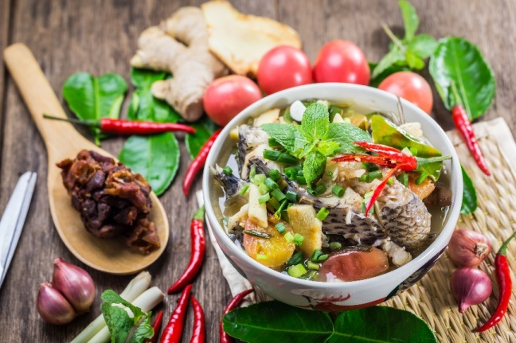
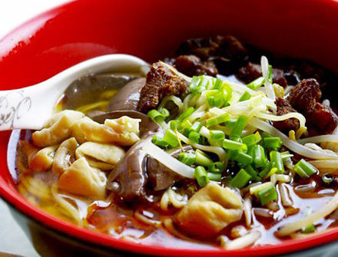
Si Wa Wa
丝娃娃
“丝娃娃”是因为一张小薄皮面饼包了很多“丝”而得名。先用直径两寸左右的薄皮面饼，然后由食者亲自动手，依次放上少量切成丝的蔬菜，再将小面饼卷成筒状，加上特制的蘸水，一个"丝娃娃"就做成了，放入口中，脆生生、凉悠悠、酸溜溜、辣呼呼、味道十分诱人。
Si Wa Wa is named as it has a lot of vegetable inside. It is the name of this small wrap. Put the vegetables on the small wrapper and roll it, then add some special seasoning. It is delicious!
Fish in sour soup
酸汤鱼
到贵州，不得不吃酸汤鱼。贵州苗族人爱吃酸，苗族独有的食品，入口酸味鲜美，辣劲十足，令人胃口大开。
You should taste the fish sour soup while you arrived in Guizhou. Guizhou Miao nationals love the fish sour soup very much. It’s a traditional soup.
Wanfenglin
Changwang Noodle
肠旺面
贵阳肠旺面是贵州贵阳市极负盛名的一种风味小吃。以色、香、味“三绝”而著称，具有血嫩、面脆、辣香、汤鲜的风味和口感，以及红而不辣、油而不腻、脆而不生的特点。
Changwang Noodle is very famous in Guiyang. It’s famous because of color, aroma and taste. Its relish and flavour is memorable very much.

Slide 28
DOSM Lee Jiang
Lee.Jiang@Kempinski.com
No.68 Huguo Road, Guiyang, Guizhou 550002, China
Tel: +86 851 8599 9999
Kempinski.com/guiyang

Slide 29
THANK YOU

