Slide 1

武汉富力万达嘉华酒店简介 The Introduction of Wanda Realm Wuhan
Notes:
封面

Slide 2

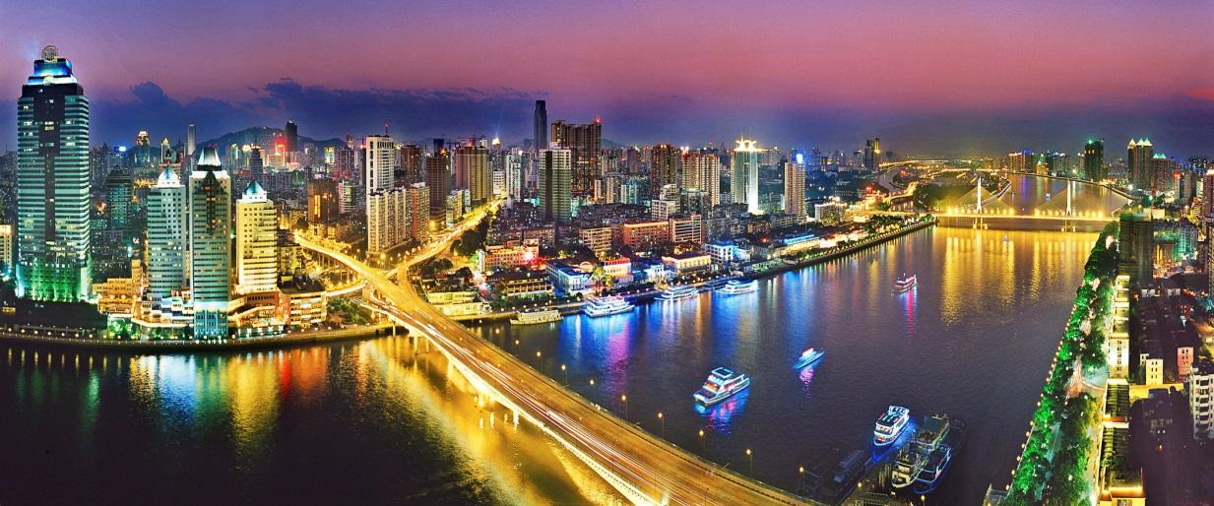
武汉富力万达嘉华酒店 Wanda Realm Wuhan
区域介绍 Hotel Area
武 汉
Wuhan
武汉是中国中部地区最大的都市及唯一的副省级城市，也是中国内陆地区最繁华及国家的区域中心城市；是全球城区面积最为广阔无垠的特大城市之一。世界第三大河——长江及其最长支流汉江横贯市区，它拥有中国内陆最大的水陆空交通枢纽，成为内陆地区金融、商业、贸易、物流、文化中心，正由于武汉承东启西、接南转北、吸引四面、辐射八方的区位优势，它拥有“东方芝加哥”的美誉。
Wuhan is central largest city and the only sub-provincial city in China, is also the most prosperous inland areas and the countries of the regional center of the city; is one of the most vast expanse of mega-cities of the global urban area. The world’s third longest river, the Yangtze River and its longest tributary of the Han River running through the city, it has the largest inland water, land and airline transportation hub, become the center of finance, commerce, trade, logistics, culture, precisely because of Wuhan connect East, West, South and North, it has the " Chicago of the East " in the world.
Notes:
目录

Slide 3
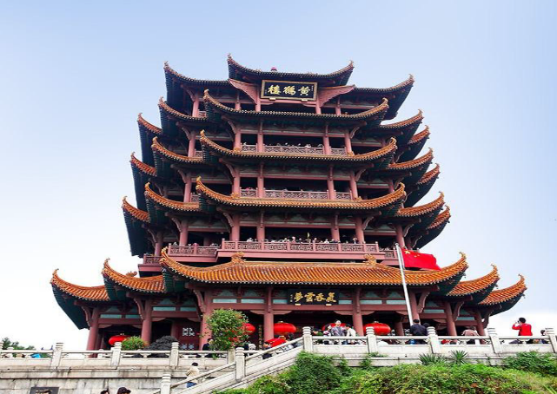
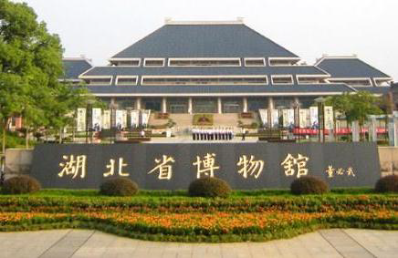

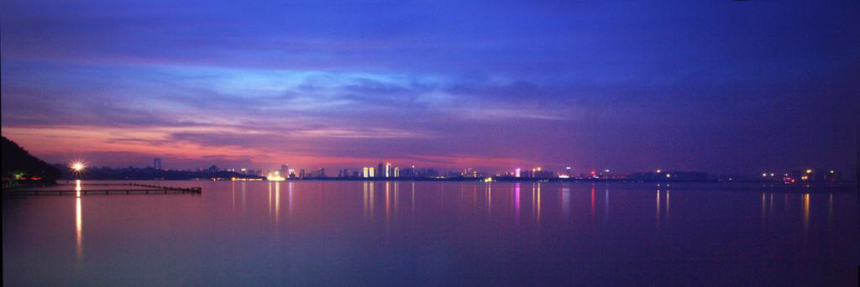
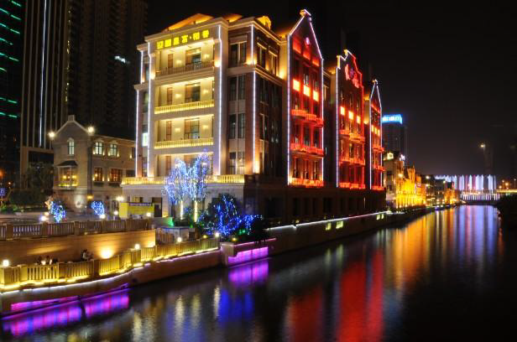

武汉富力万达嘉华酒店 Wanda Realm Wuhan
黄鹤楼
Yellow Crane Tower
湖北省博物馆
Hubei Provincial Museum
归元寺
Guiyuan Temple
东湖风景区 East Lake
楚河汉街 Han Street
户部巷 Hubu Lane
Notes:
目录

Slide 4
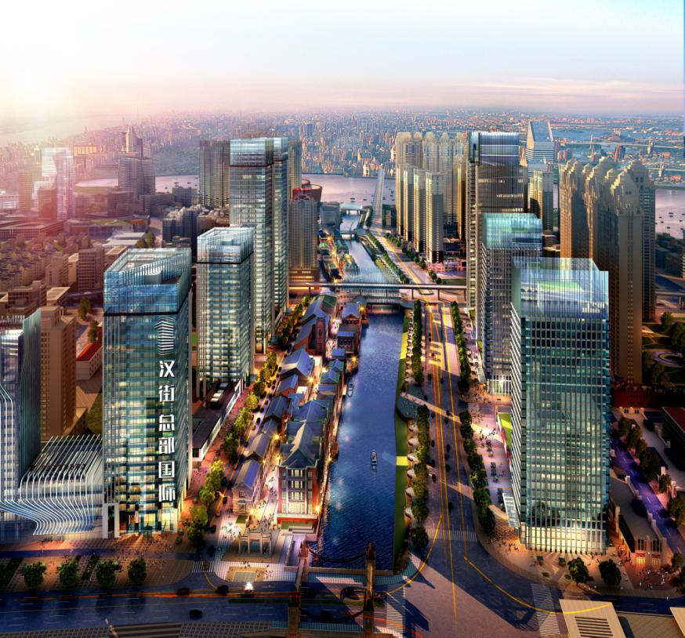
武汉富力万达嘉华酒店 Wanda Realm Wuhan
周边配套
Hotel Surroundings
楚河汉街
Han Street
武汉中央文化区
The Wuhan Central Cultural District
汉街购物、高级住宅
Han Street & Building
汉秀、杜莎夫人蜡像馆
Han Show & Madame Tussaud's
Notes:
目录

Slide 5
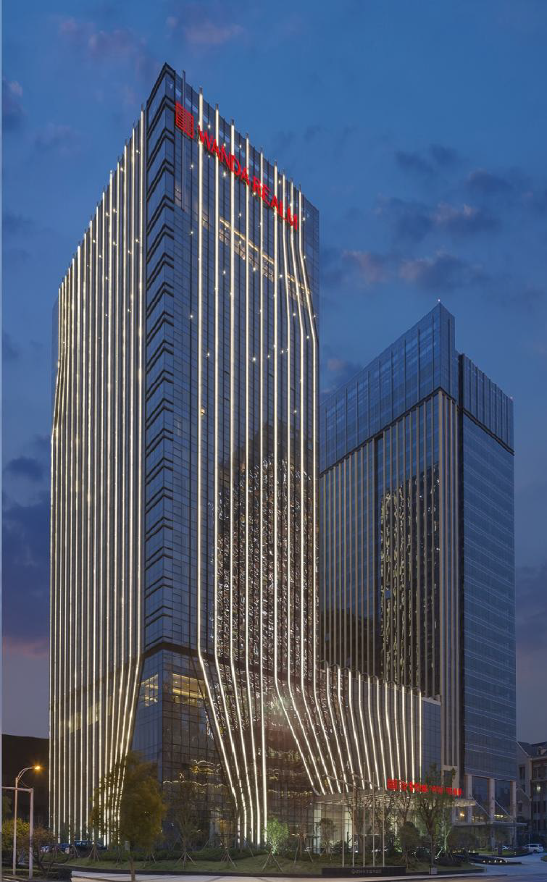
武汉富力万达嘉华酒店 Wanda Realm Wuhan
武汉富力万达嘉华酒店
Wanda Realm Wuhan
酒店拥有379间客房及套房，设计时尚而雅致。每间客房均配备温馨舒适的“万达嘉华之床”及“妙梦”助眠系列可供选择，为所有商旅宾客缔造温馨惬意的居停感受。酒店位于武汉中央文化区，坐拥楚河汉街美景，距火车站 6公里，天河国际机场45公里。
The hotel has 379 rooms and suites, fashionable and elegant design. The rooms are equipped with comfortable “Bed of Realm" and “Dream Catcher" sleeping series to choose from, for all business customers to create the warm and comfortable feeling make. Ideally situated in the city’s cultural heart, 6 kilometers from Wuchang railway station, 45 kilometers away from the Tianhe International airport.
Notes:
目录

Slide 6

武汉富力万达嘉华酒店 Wanda Realm Wuhan
客 房
Guest Rooms
酒店拥有379间品位独具的客房与套房：
• 装潢时尚舒适
• 独有的“万达嘉华之床”及“妙梦”助眠系列
• 免费高速上网设施
• 拥有国际卫星频道的平面液晶电视
• 数码保险箱
• 独立浴缸与热带雨林式淋浴设施
• 迷你酒吧及咖啡／茶冲煮设备
The hotel comprises 379 elegant rooms and suites:
• Stylish, comfortable décor
• “Bed of Realm” and “Dream Catcher”
• Complimentary high-speed Internet access
• LED TV with international satellite channels
• Digital safe
• Separate bath and rainforest shower
• Mini bar and coffee/tea making facilities
Notes:
目录

Slide 7
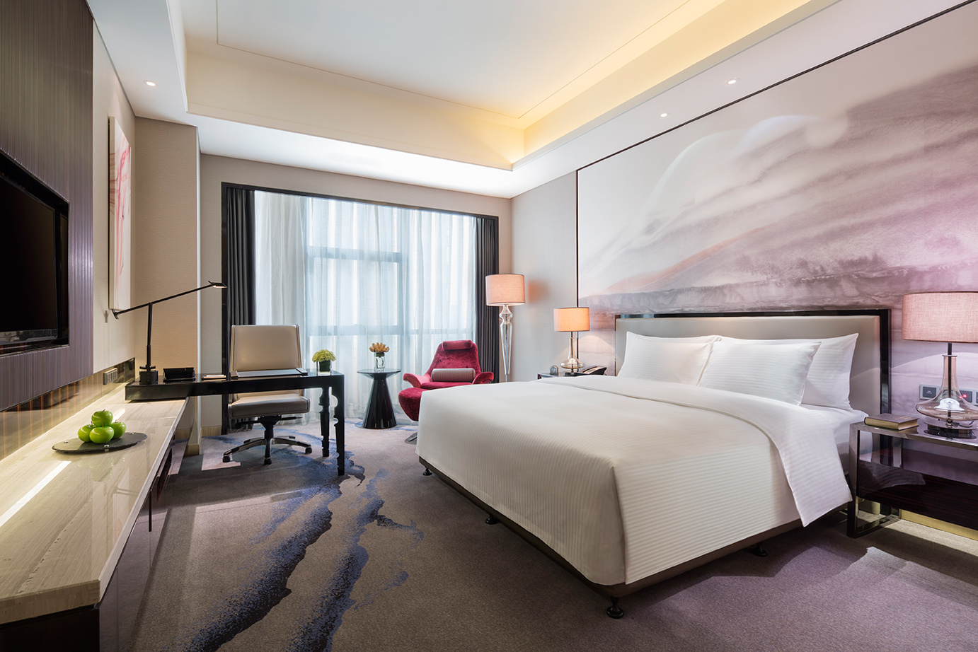
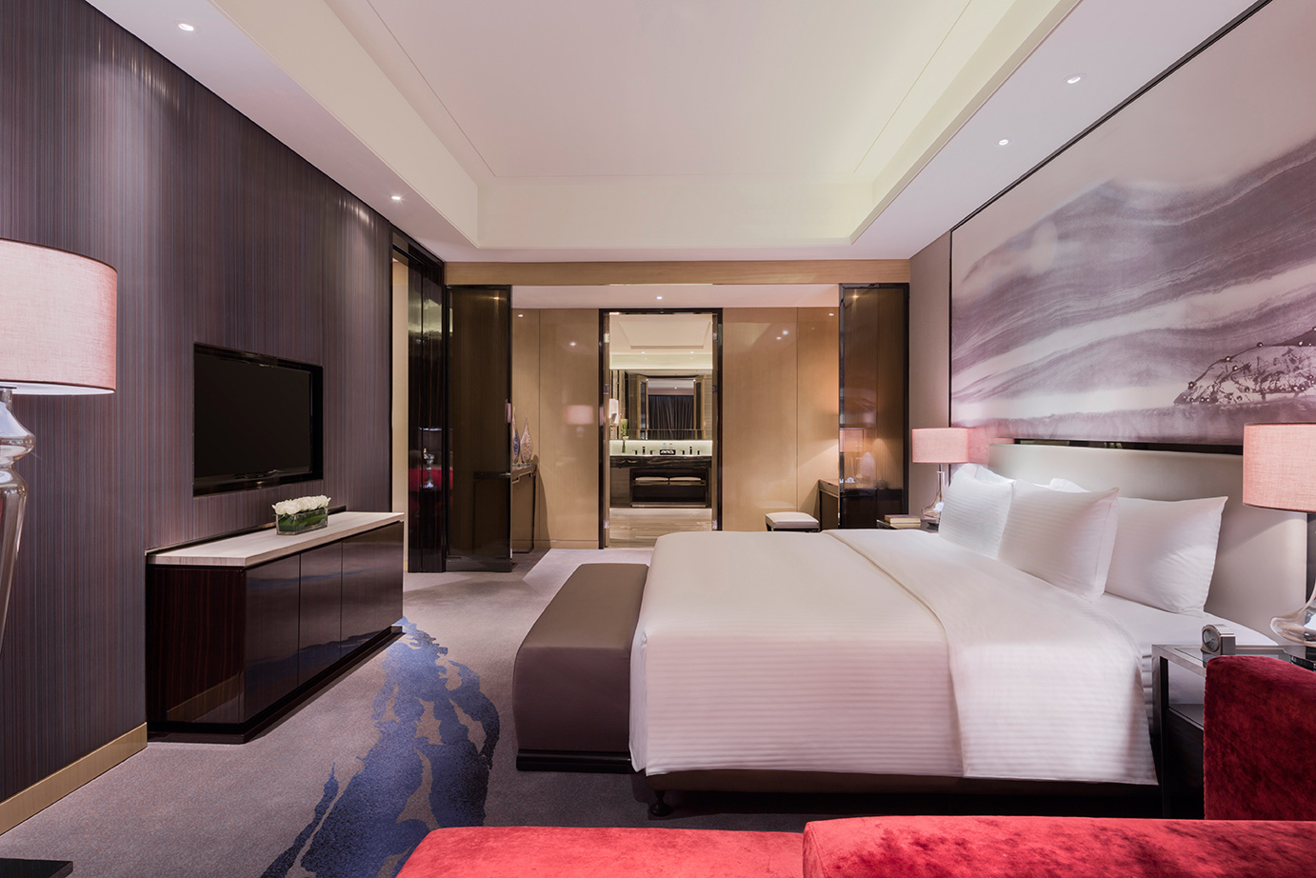
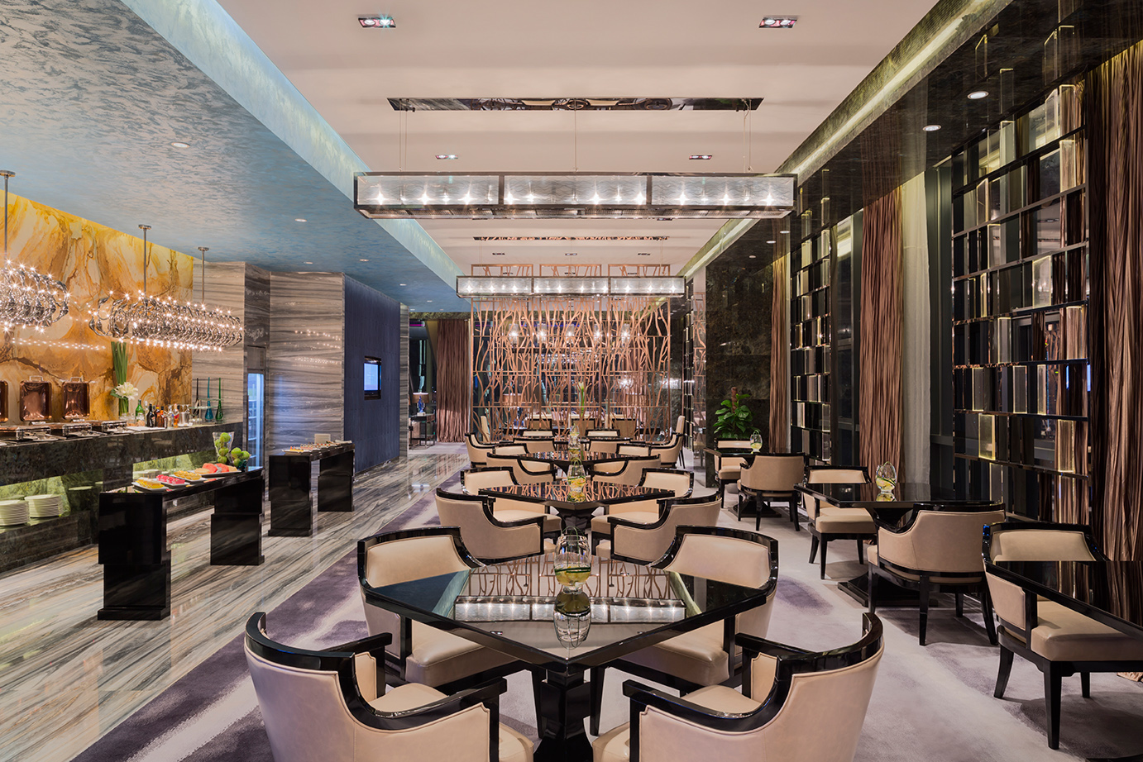
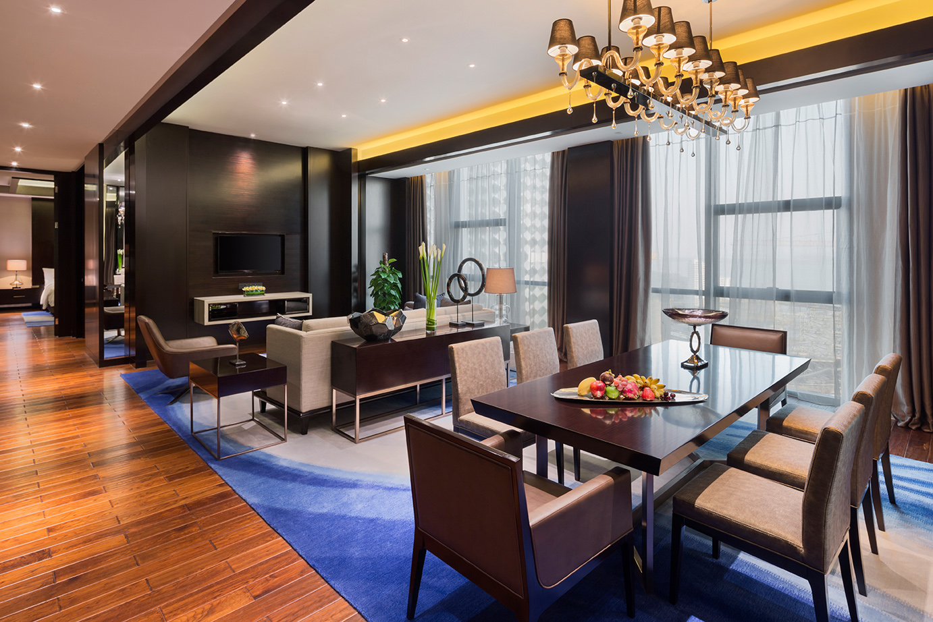
武汉富力万达嘉华酒店 Wanda Realm Wuhan
1 豪华大床房
Deluxe King Room
2 豪华套房
Deluxe Suite
3 行政酒廊
Executive Lounge
4 总统套房
Presidential Suite
1
2
3
4
Notes:
目录

Slide 8
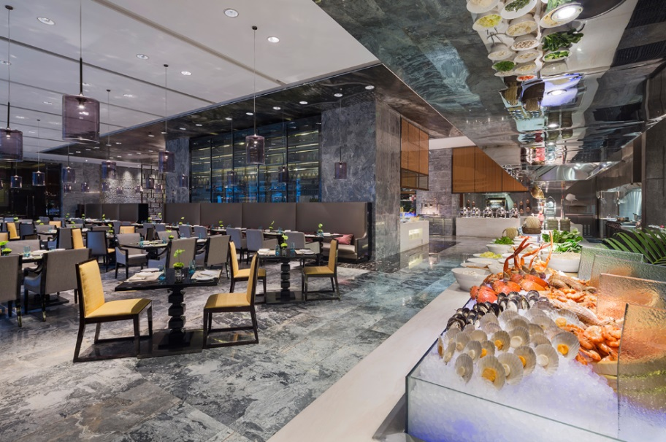
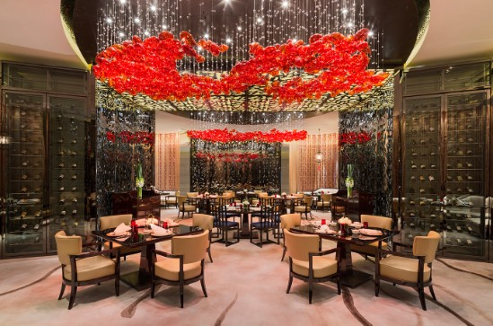
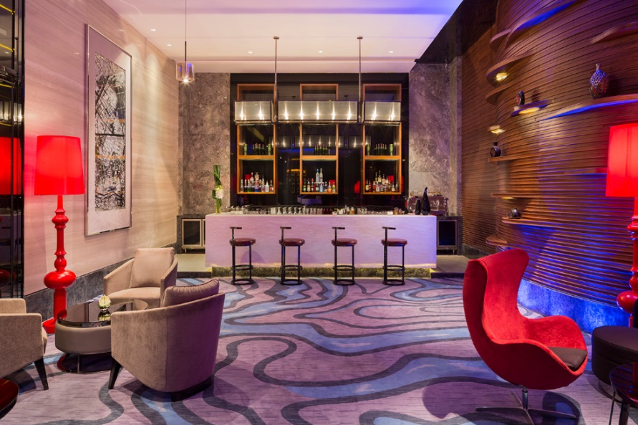
武汉富力万达嘉华酒店 Wanda Realm Wuhan
美食汇全日餐厅
Café Realm
品珍中餐厅
ZHEN
大堂酒廊
Lobby Lounge
全新定义了国际全日西餐厅；汇聚各国佳肴，惊喜不断！
The all-day-dining restaurant will surprise you and your guests during afternoon get-togethers or evening feasts.
以粤菜为主并吸纳本帮菜精华，专注于原汁原味以及均衡营养。
Combining Cantonese cuisine with the local essence, focusing on flavor and balanced nutrition.
优雅惬意，尽享舒适。
Indulge yourself at the elegant Lobby Lounge.
Notes:
目录

Slide 9
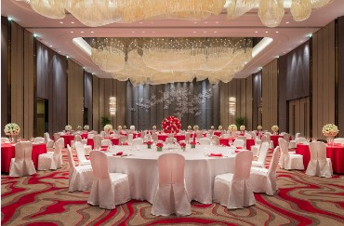
武汉富力万达嘉华酒店 Wanda Realm Wuhan
武汉万达嘉华酒店场地奢华瑰丽，设施完善，配备最新的视听与多媒体技术，更有免费高速上网设施。面积为880平方米的大宴会厅恢宏大气，规模之大在武汉市首屈一指，享有盛誉，巨型平面液晶屏幕令宴会添色不少，给来宾留下深刻印象。
When you choose Wanda Realm Wuhan for your event, you enjoy a selection of luxurious venues, all of them fully-equipped with the latest audio-visual and multimedia technologies, as well as complimentary high-speed wireless Internet access. The majestic 880㎡ Grand Ballroom is the largest and most prestigious of its kind in Wuhan, and also features a giant LED screen to make your event even more memorable.
会议及宴会
Meeting & Banquet
Notes:
目录

Slide 10
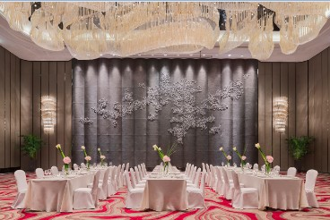

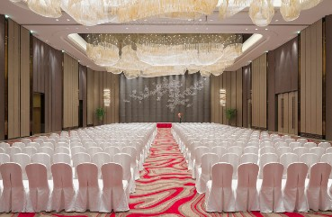
武汉富力万达嘉华酒店 Wanda Realm Wuhan
大宴会厅
Grand Ballroom
Notes:
目录

Slide 11
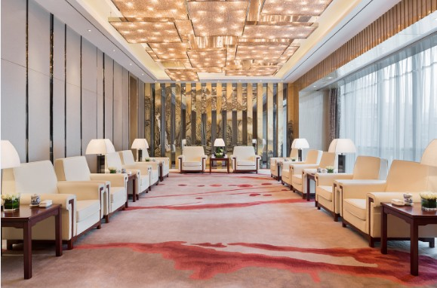
武汉富力万达嘉华酒店 Wanda Realm Wuhan
贵宾接待室
VIP Meeting Room
拥有配备数字单元系统的触摸式电子表决器、同声翻译系统、国际一流的视听与多媒体设备的多功能厅。
The function rooms provide electronic voting machines, simultaneous interpretation systems and state-of-the-art audio & visual equipment
董事会议室
Board Room
Notes:
目录

Slide 12
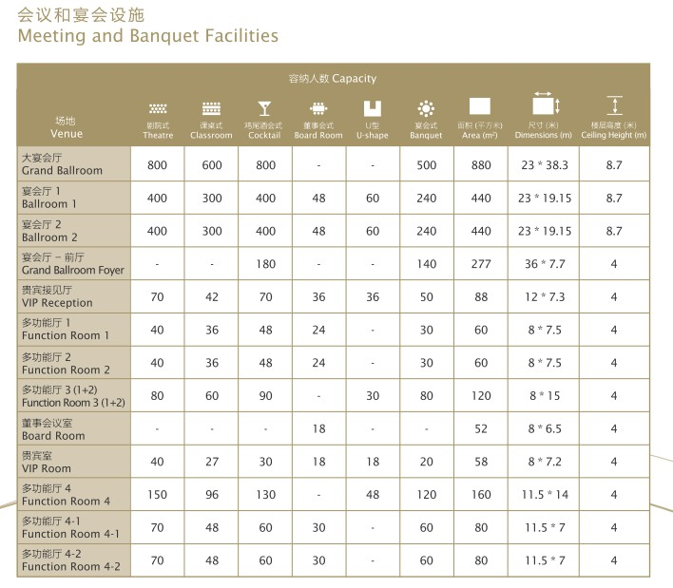
武汉富力万达嘉华酒店 Wanda Realm Wuhan
会议设施信息
Meeting Rooms Information
Notes:
目录

Slide 13
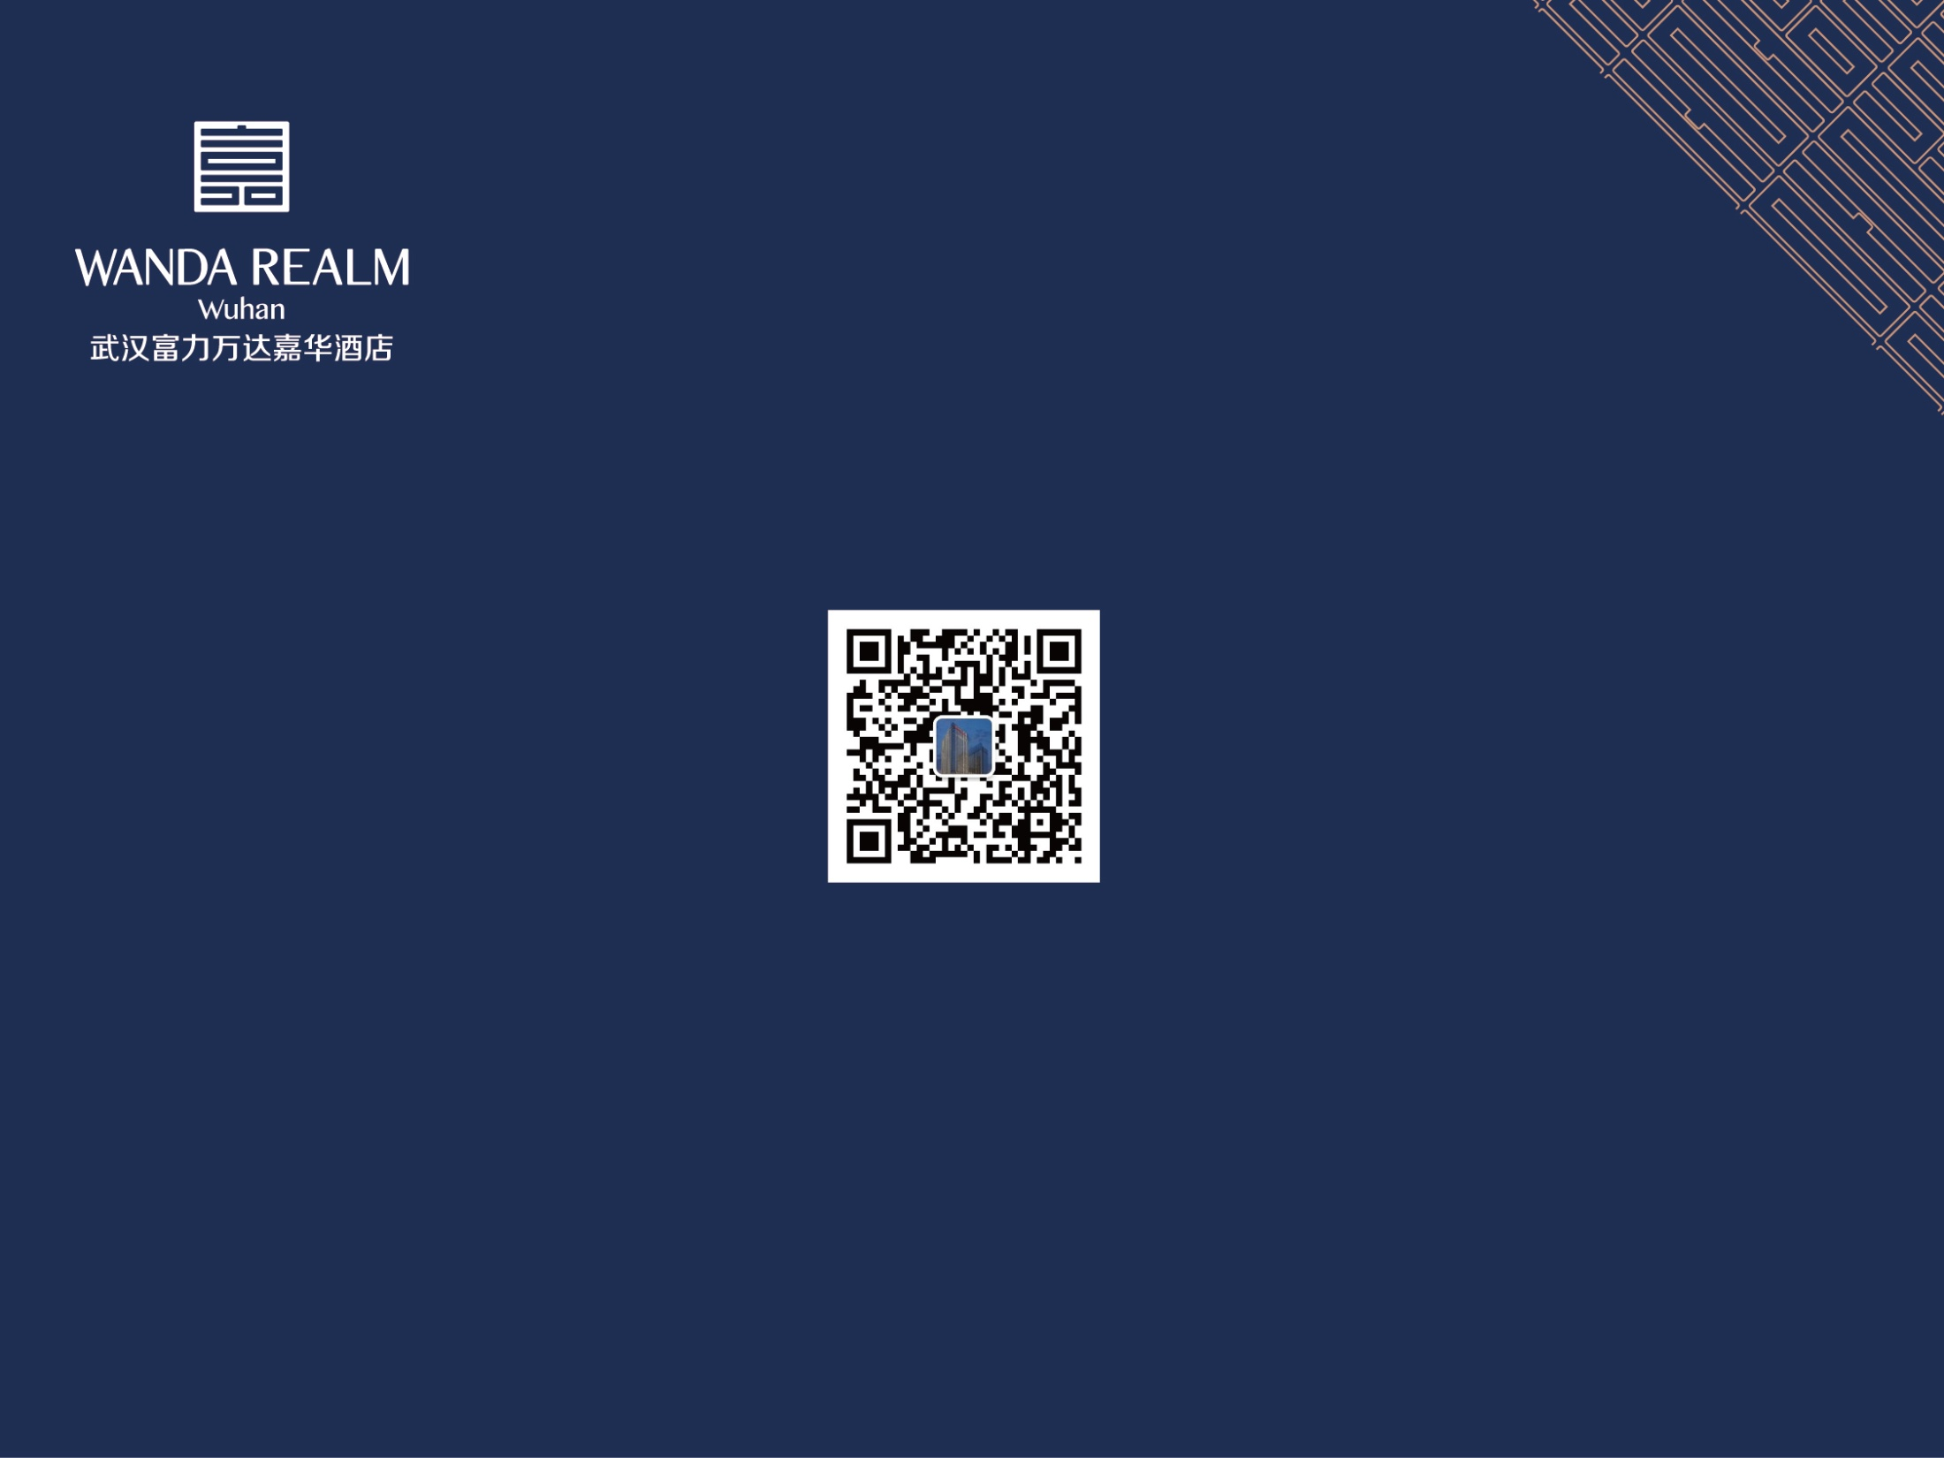
谢谢
中国湖北省武汉市武昌区水果湖街东湖路105号 邮编：430077
No.105 Donghu Road, Shuiguohu Street, Wuchang District, Wuhan, Hubei Province 430077, P.R. China
电话Tel: (86 027)5900 8888 传真Fax: 86 027)5988 6888
www.wandahotels.com
Notes:
封底

