Slide 1
我们专注于创造奢华的体验，
全球各地丽晶酒店均拥有一共有的特性
—与众不同且独一无二。
--Robert H. Burns, 丽晶品牌创始人
“The only thing we specialise in is luxury,
and the only thing our hotels have in common is the fact that they are all unique.”
--Robert H. Burns, founder of Regent Hotels

Slide 2
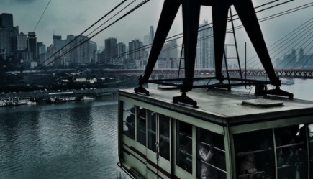
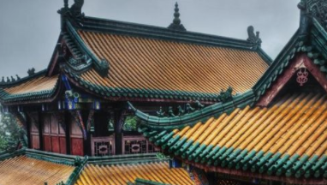
重庆：山水文化之城
CHONGQING: MOUNTAIN CITY
重庆位于中国西南部、长江上游，四周群山环绕，是一座繁荣的港口城市。拥有繁华的商业中心、丰富的夜生活、热闹的滨江地区和三千多年的悠久文化历史，更有着壮丽的景色和自然奇观。
Located in Southwest China, on the upper reaches of the Yangtze River, Chongqing is a thriving port city surrounded by a lush mountainous landscape. One of the most populous cities in China, it pulsates with many distinct energies, combining a dynamic business centre with a lively nightlife and the bustling riverfront, embraced by a rich cultural heritage built up over 3,000 years of history. Chongqing is also a great base to explore the region’s stunning scenery and natural wonders, such as the world-famous Three Gorges.

Slide 3
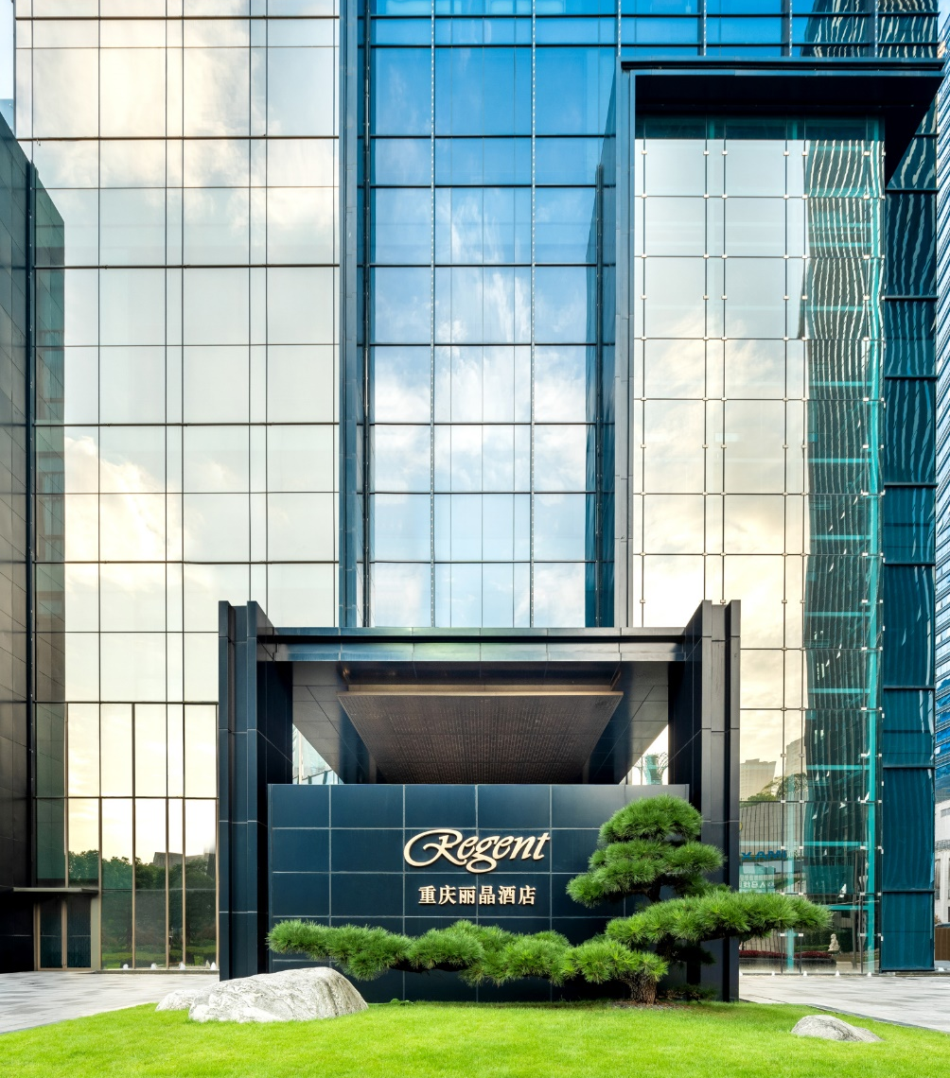
目录
CENTENT
关于酒店 ABOUT HOTEL
—品牌故事 ABOUT REGENT
—设计风格 DESIGN
酒店地理位置 LOCATION
酒店设施 ACCOMMODATION
—客房概况 ROOMS
—会议场地 MEETING & EVENTS
—餐饮体验 FOOD & BEVERAGE
—休闲娱乐 FITNESS & LEISURE
探索周边 DESTINATION

Slide 4
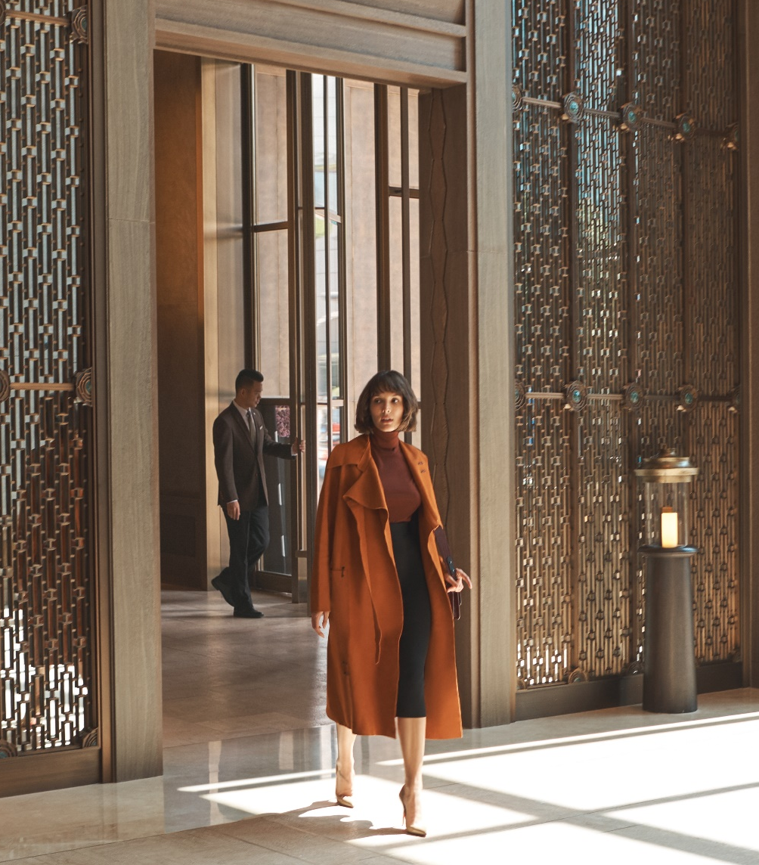
关于丽晶
ABOUT REGENT
全球知名的丽晶酒店传承着精致、魅力，以及完美服务的精神，一直是豪华尊贵酒店的代名词。
它是第一个源起于亚洲的国际奢华酒店集团，成功在欧美集团主导的业界中大放异彩。简单优雅的环境、无与伦比的舒适及亚洲独有的真诚服务之道一直是集团的宗旨，为业界树立了高水准的奢华典范、引领潮流超过40年。
For so long synonymous with glamour, sophistication and impeccable service, the world-renowned Regent hotels brand is steeped in heritage.
The first Asia-based global hospitality group to successfully challenge the industry’s European and US dominance, the company’s unshakeable belief in simple elegance, peerless comfort and traditional Asian hospitality has been raising the benchmark for luxury hotels for more than 40 years.

Slide 5
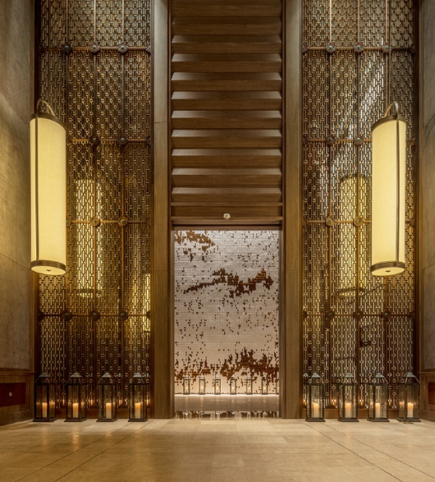
重庆丽晶酒店
REGENT CHONGQING
重庆丽晶酒店是丽晶品牌在中国内地的第二家酒店，位于重庆江北嘴国际金融中心。
Regent Chongqing is the second Regent hotel opened in the Mainland China, as well as the luxury hotel in Jiangbeizui Financial Centre, Chongqing.

Slide 6
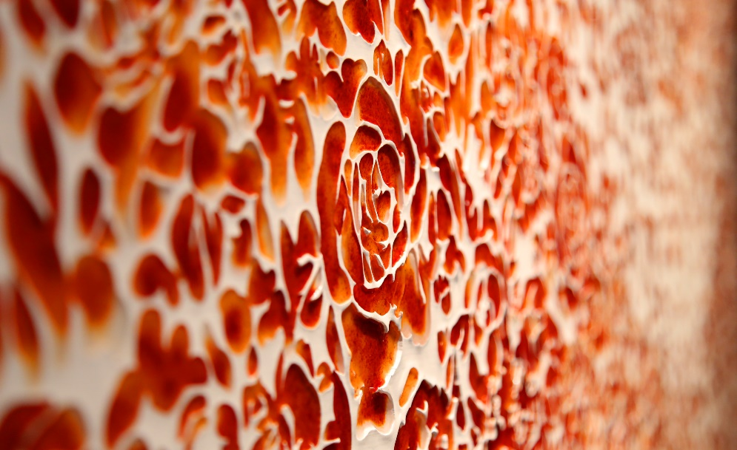
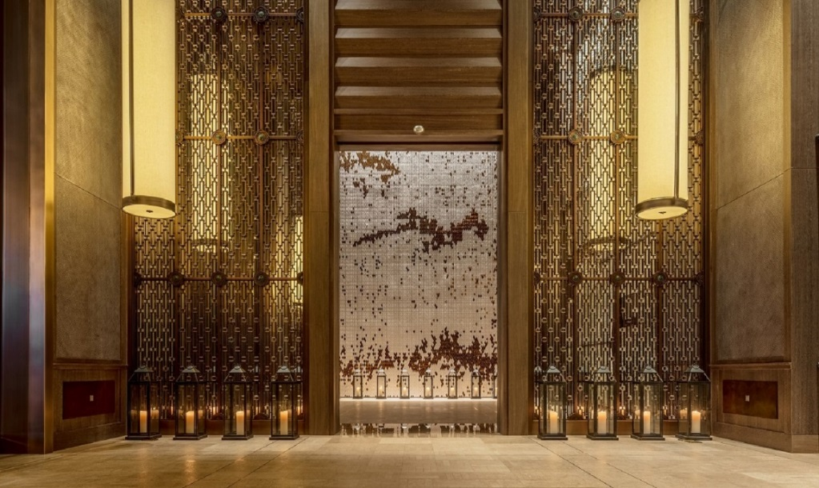
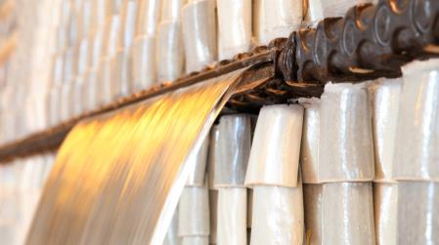
设计风格
DESIGN
酒店设计现代且雅致、满溢当地风情，融入重庆当代潮流元素以及人文历史风情，透过陶器、织布、金属以及漆器等当地传统建材，展现传承经典的使命。酒店是一处绝佳的展示平台，邀请知名艺术家前来发挥创意，匠心独选出艺术佳作，丰富酒店知性与文艺创作的氛围。
The hotel’s elegant and contemporary interiors are imbued with a sense of place and the design’s modern elements echo the economic importance of Chongqing. Through the clever use of traditional building materials - ceramic, textile, metal and lacquer, the hotel pays homage to Chongqing’s heritage and cultural past. The hotel interiors house an impressive assembly of art to invite the artist to inspire and design to recall the history and culture of Chongqing.

Slide 7
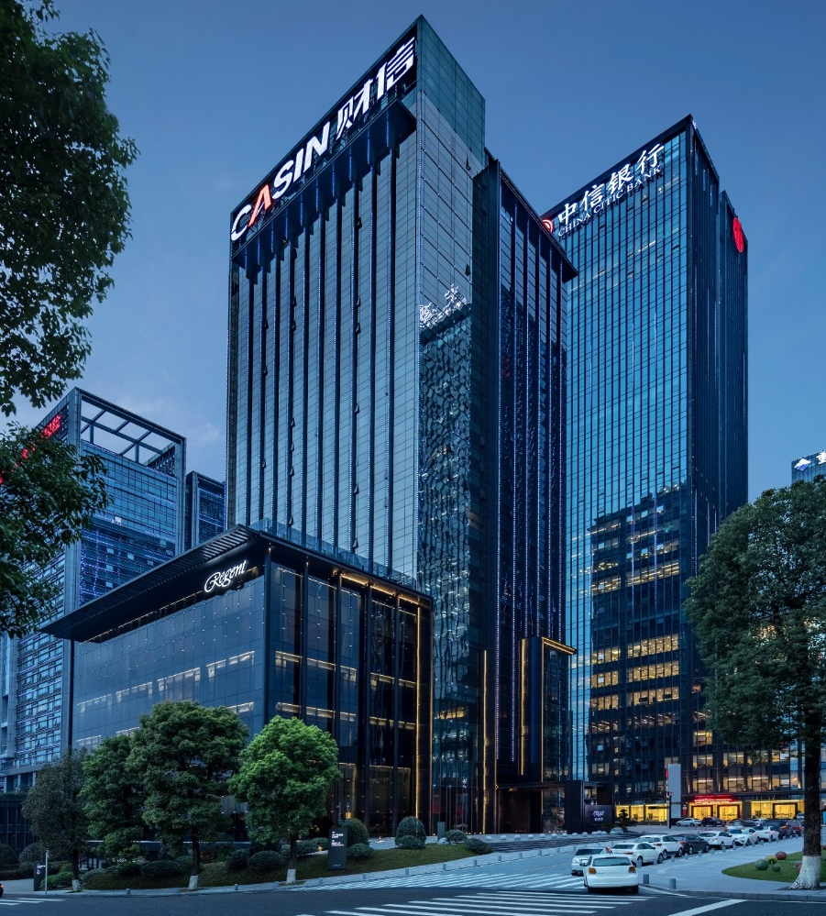
得天独厚的地理位置
LOCATION
重庆丽晶酒店位于重庆市江北嘴中央商务区，拥有完善的商务及旅游配套设施。
Regent Chongqing is situated at Jiangbeizui financial centre, in the new bustling business centre of Chongqing Southwest China.

Slide 8
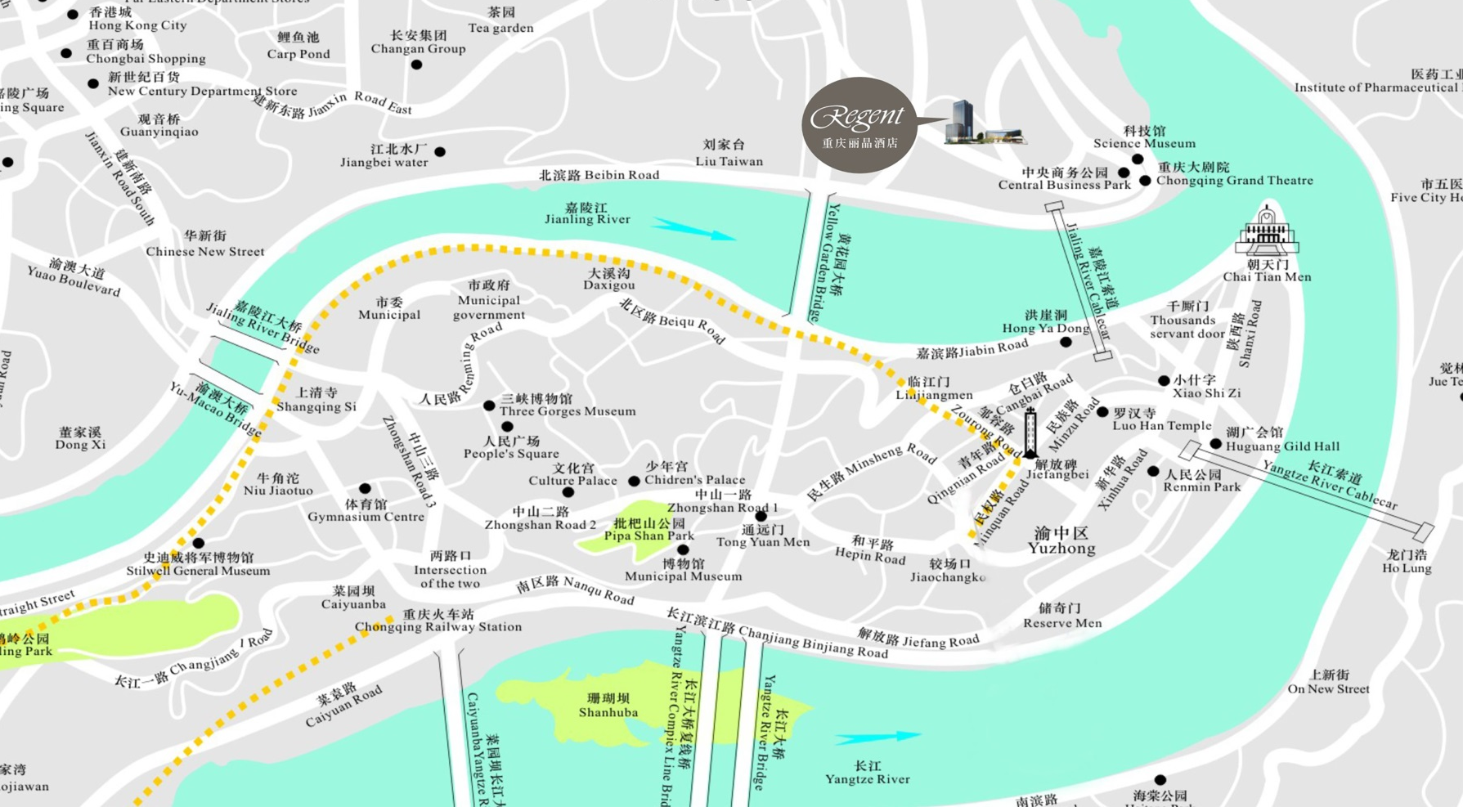
酒店位置
LOCATION

Slide 9
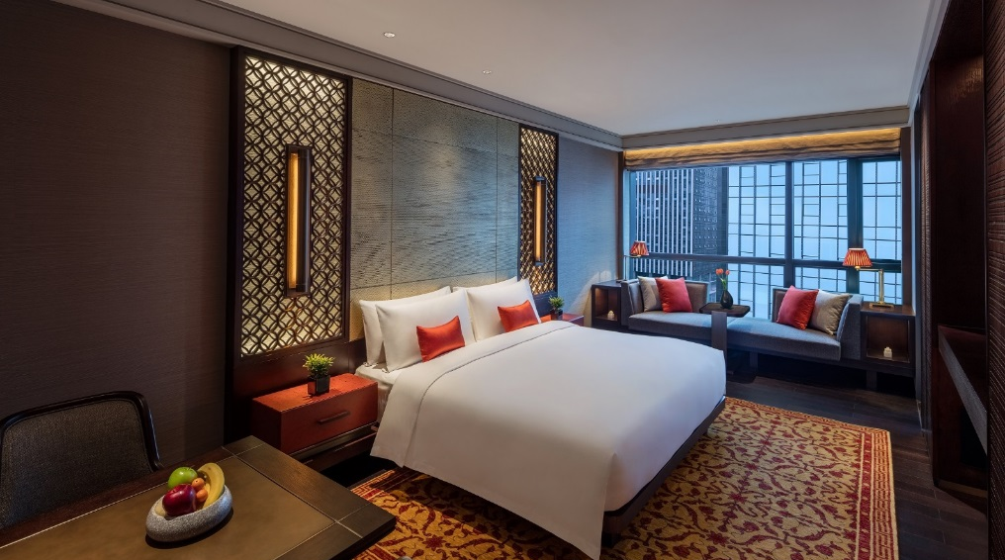
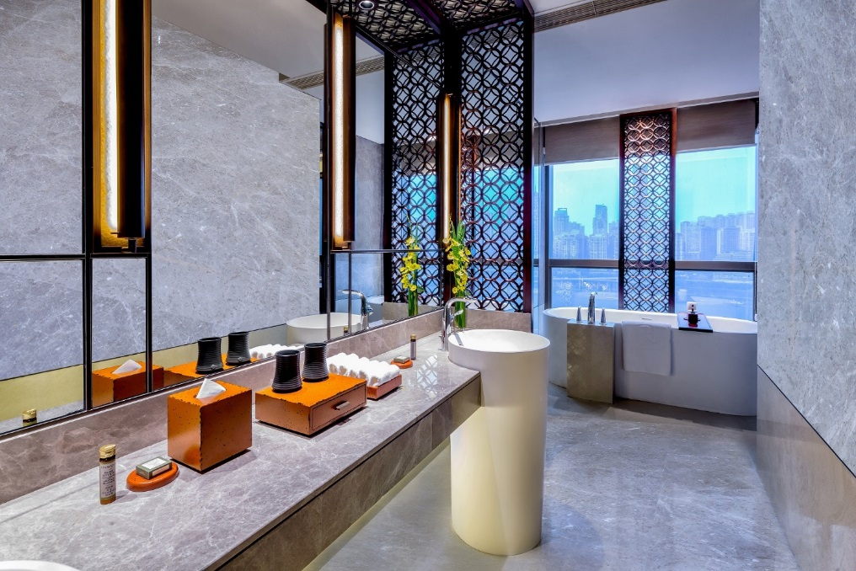
客房概况
ACCOMMODATION
酒店拥有202间客房，其中包括21间套房，空间舒适宽敞，豪华客房面积57平方米起，坐拥嘉陵江及渝中半岛的美丽景致。
• A total of 202 rooms, inclusive of 21 suites
• Deluxe Rooms size from 57 square meters
• Panoramic views of the Jialing river and
Yuzhong peninsula

Slide 10
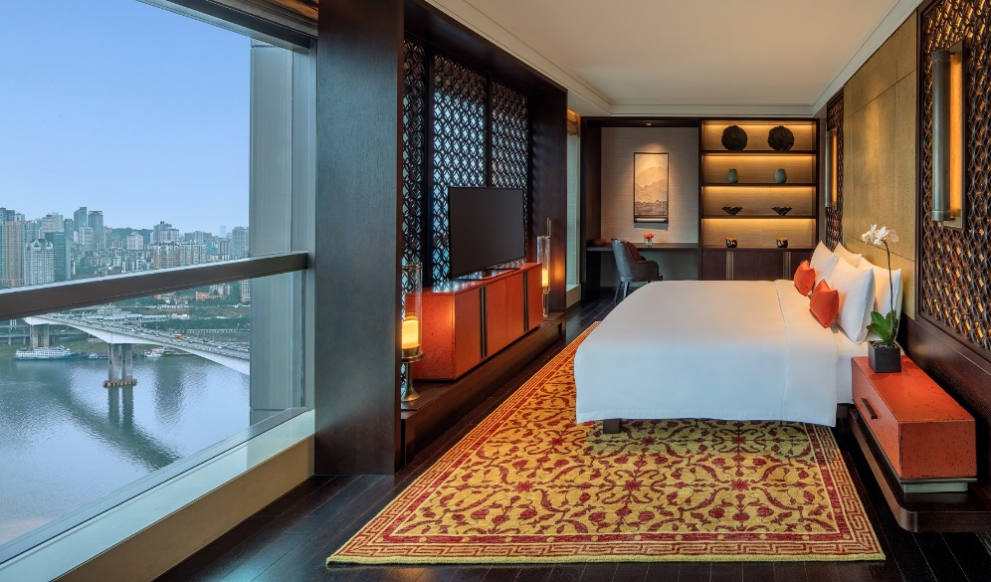
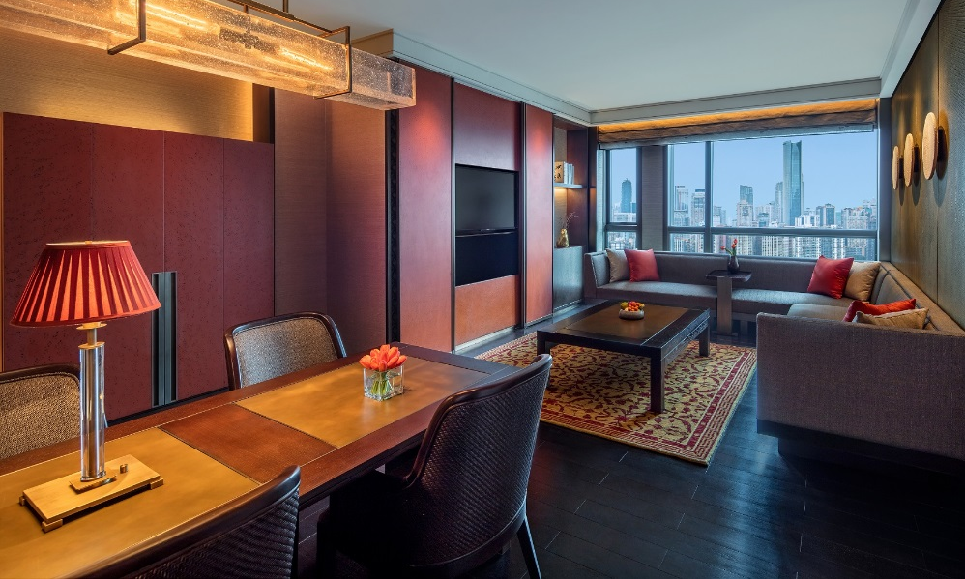
房间类型 Room Category | 面积(m²) Size(m²) | 房间数量 No. of Rooms
豪华客房 Deluxe Room | 57 | 104
贵宾江景客房 Premium Room River View | 57 | 53
行政客房 Club Room | 57 | 14
丽晶江景客房 Regent Club Room River View | 57 | 10
精致套房 Junior Suite | 83 | 16
行政套房 Executive Suite | 117 | 4
丽晶套房 Regent Suite | 215 | 1
 | 总计 Total | 202

Slide 11
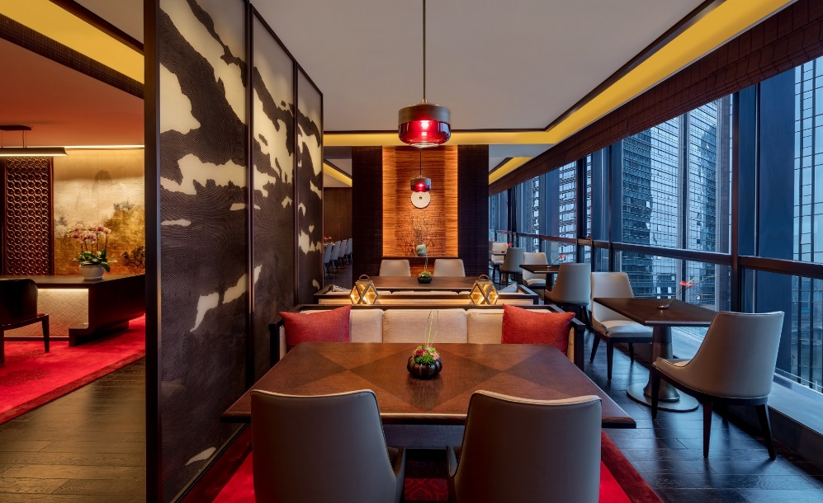
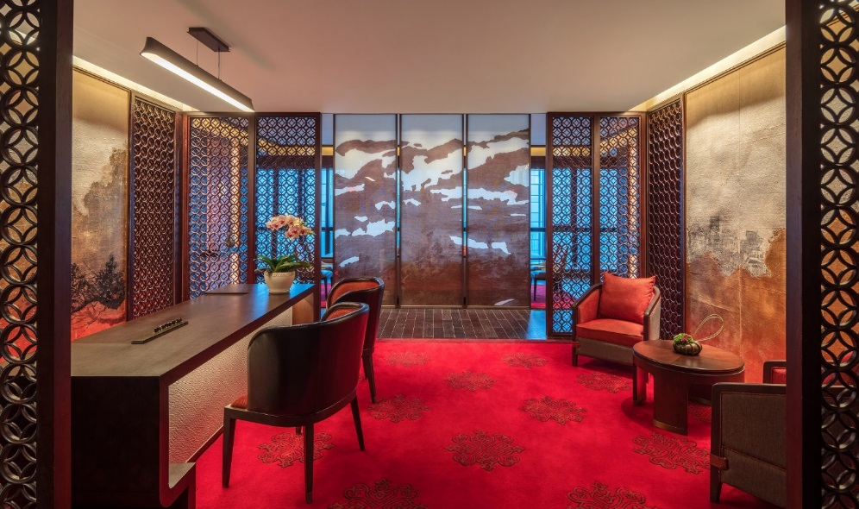
丽晶俱乐部
REGENT CLUB
高端商务人士专属的丽晶俱乐部，让尊贵宾客尽享便利与舒适。
Exclusive Regent Club to conveniently service the high-end business travellers with stunning river view.
地点：酒店25层
Location: 25th floor

Slide 12
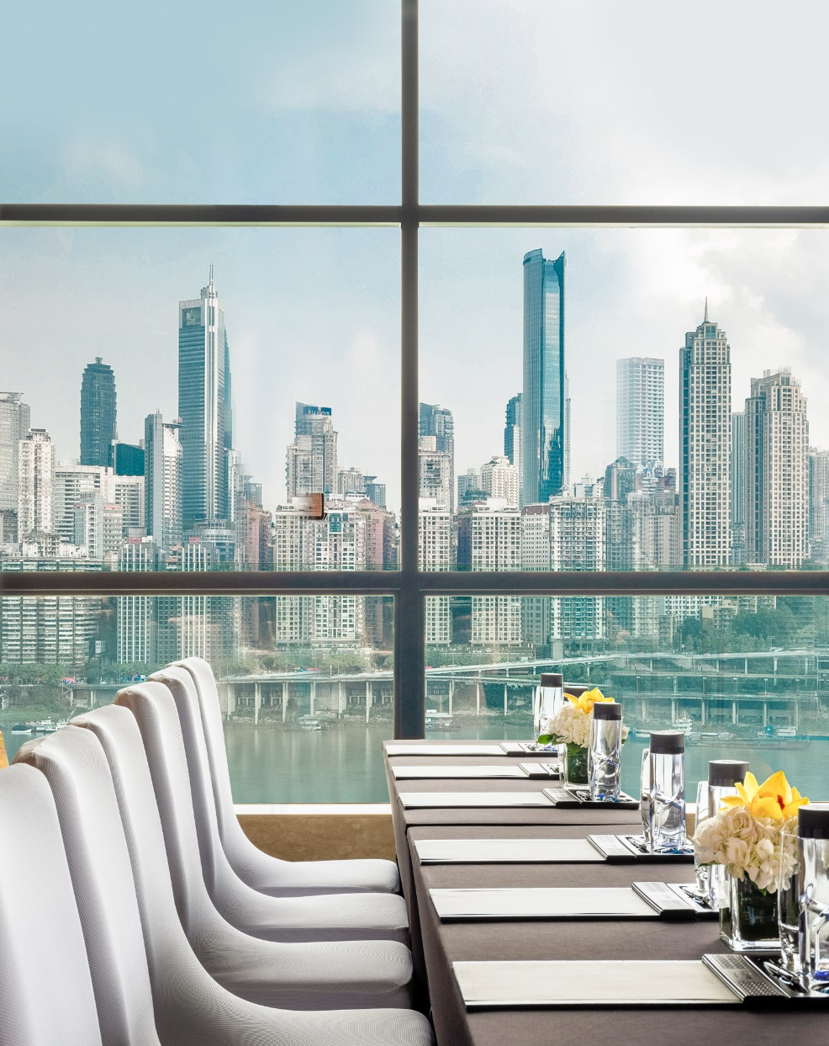
会议及宴会
MEETINGS & EVENTS
酒店会议空间约1800平米，拥有1个丽晶宴会厅及6个多功能厅，可满足不同会议及活动需求。专业的丽晶会议团队为组织者提供鼎力协助，确保会议的成功举行。
Totaling 1,800 square meters, the hotel has one grand ballroom and 6 function rooms and is easy to accommodate the event with various purposes. The professional event managers are ready to provide the timely assistance in order to ensure a successful yet smooth event in the hotel.

Slide 13
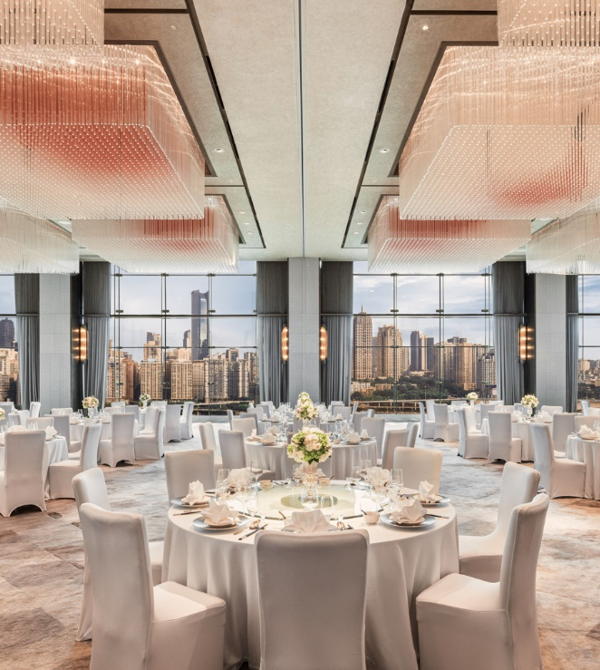
丽晶宴会厅
REGENT BALLROOM
全落地玻璃270度
饱览嘉陵江绝美景致，属全城唯一
先进的声光视听设备
免费无线WiFi
Regent Ballroom: floor-to-ceiling window
270 degree fantastic Jialing River View
advanced audio-video system
free Wifi
地点：酒店5层
Location: 5th floor

Slide 14
容纳人数
ROOM CAPACITY
会议功能区 Function Rooms | 位置 Location | 剧院式 Theatre | 课桌式 Classroom | 鸡尾酒会式Cocktail | 董事会式Boardroom | U型 U Shape | 宴会式 Banquet | 面积 Sqm | 长*宽L*M | 高度Ceiling
丽晶宴会厅 | 5F | 600 | 400 | 500 | / | / | 450 | 805 | 35*23 | 6
丽晶宴会厅Ⅰ | 5F | 300 | 200 | 260 | / | / | 200 | 391 | 18*21 | 6
丽晶宴会厅Ⅱ | 5F | 300 | 200 | 260 | / | / | 200 | 391 | 17*21 | 6
华蓥厅 | 4F | 80 | 54 | 60 | 30 | 30 | 60 | 80 | 8*10 | 3
缙云厅 | 4F | 80 | 54 | 60 | 30 | 30 | 60 | 80 | 8*10 | 3
海棠厅 | 4F | 80 | 54 | 60 | 30 | 30 | 60 | 80 | 8*10 | 3
龙门厅 | 4F | 90 | 72 | 70 | 30 | 39 | 60 | 100 | 10*10 | 3
云篆厅 | 4F | 64 | 30 | 50 | 30 | 30 | 40 | 70 | 7*10 | 3
董事厅 | 4F | / | / | / | 24 | / | / | 55 | 11*5 | 3
缙云厅+海棠厅 | 4F | 120 | 100 | 100 | / | 60 | 120 | 160 | 16*10 | 3

Slide 15
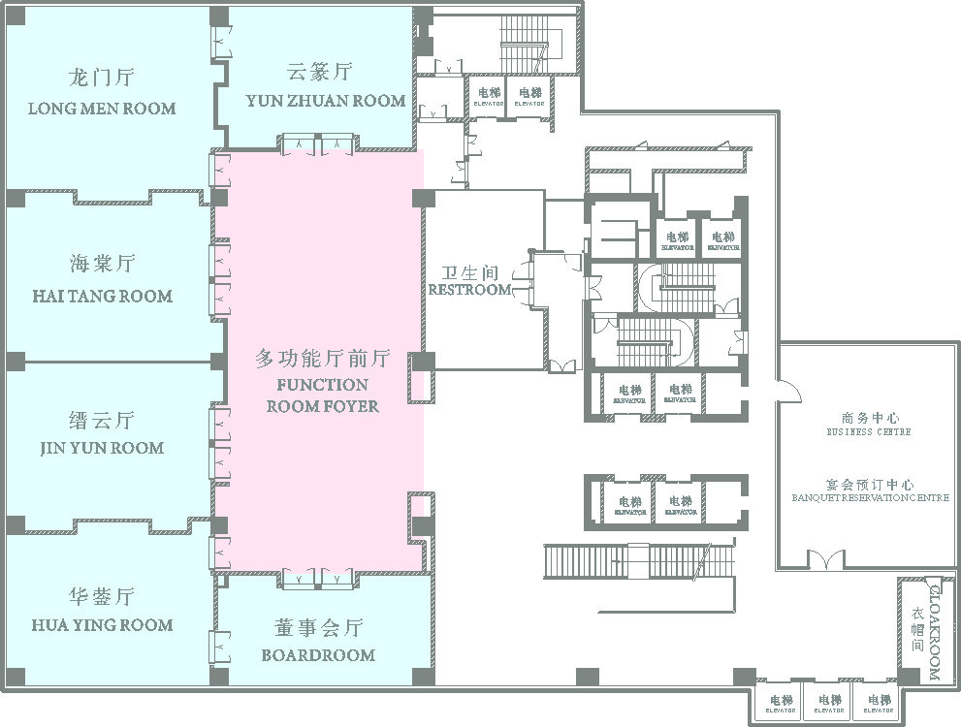
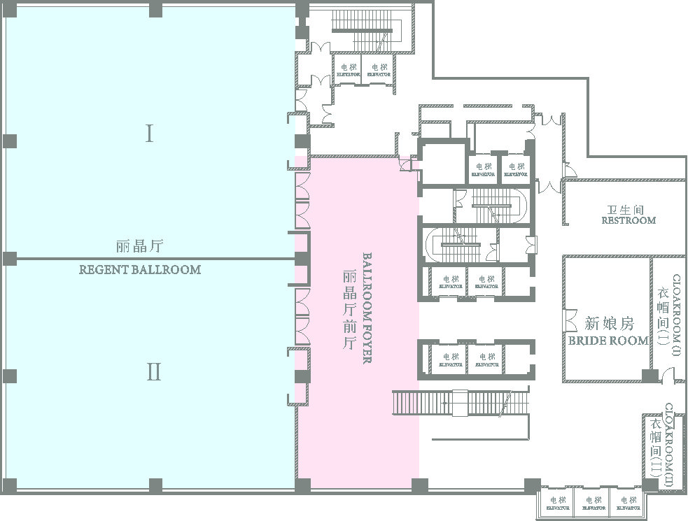
会议室平面图
FLOOR PLAN
4层会议室
4F Function Room
5层会议室
5F Banquet Room

Slide 16
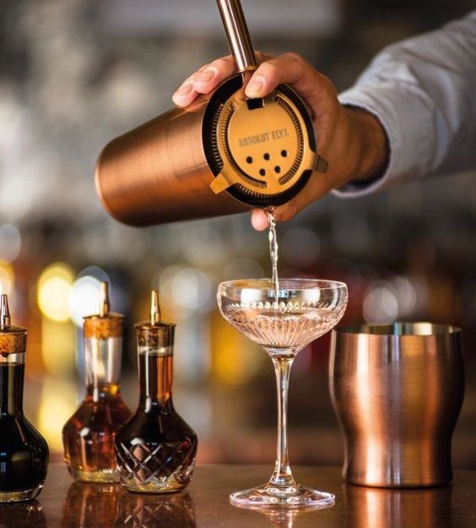
餐饮体验
FOOD & BEVERAGE
重庆丽晶酒店拥有3个餐厅及2个酒吧，丰富的餐饮服务为国际商旅以及本地品味人士提供至高的餐饮享受。
Regent Chongqing’s three restaurants and two bars offer international and local guests alike a complete range of cuisines to satisfy all palates.

Slide 17
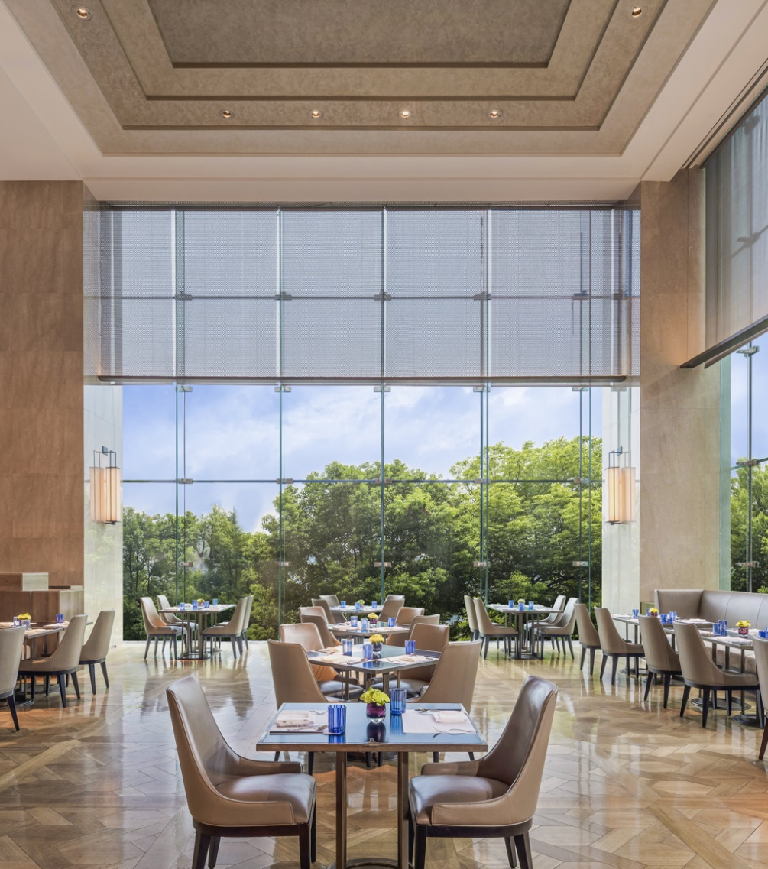

渝厨房
YU KITCHEN
全日制餐厅-渝厨房，
主厨精心烹饪，选取新鲜食材，为食客奉上丰富亚洲风味自助美食及菜单点餐服务。
Yu Kitchen celebrates the rich variety and authenticity of flavours from across Asia, presented a la carte and in seasonal buffet selections.
地点：酒店1层
Location: 1st floor

Slide 18
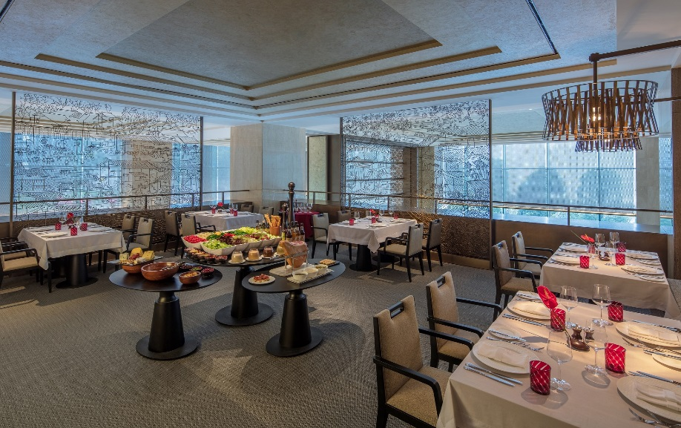
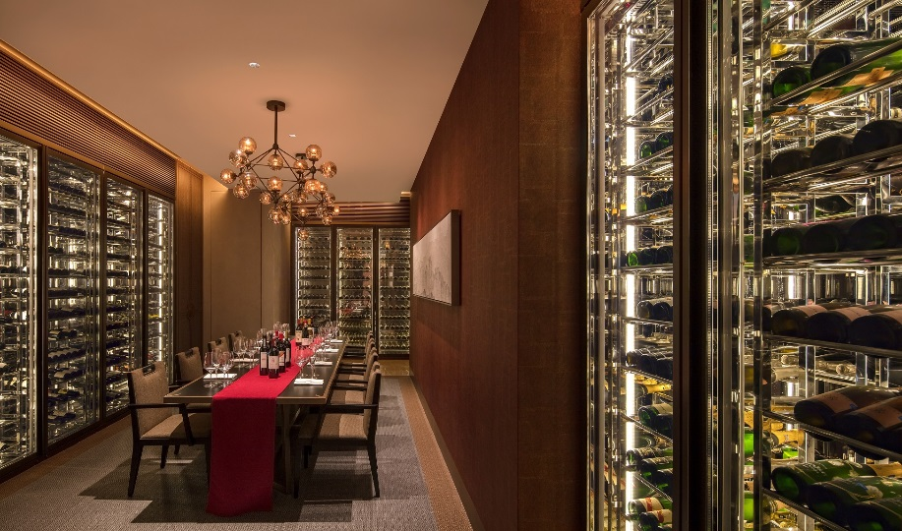
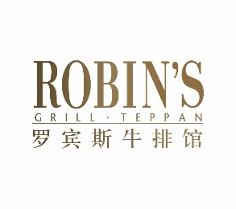
罗宾斯牛排馆
ROBIN’S GRILL & TAPPANYAKI
罗宾斯牛排馆提供精致牛排，铁板烧以及丰富藏酒，亦可在特色红酒窖内独享主厨菜单，搭配精选红酒，奢享美食佳酿。
It is the finest steak and teppanyaki restaurant that features with a dedicated wine cellar. Enjoy private dining at Chef’s table with bespoke gourmet and wine.
地点：酒店2层
Location: 2nd floor

Slide 19
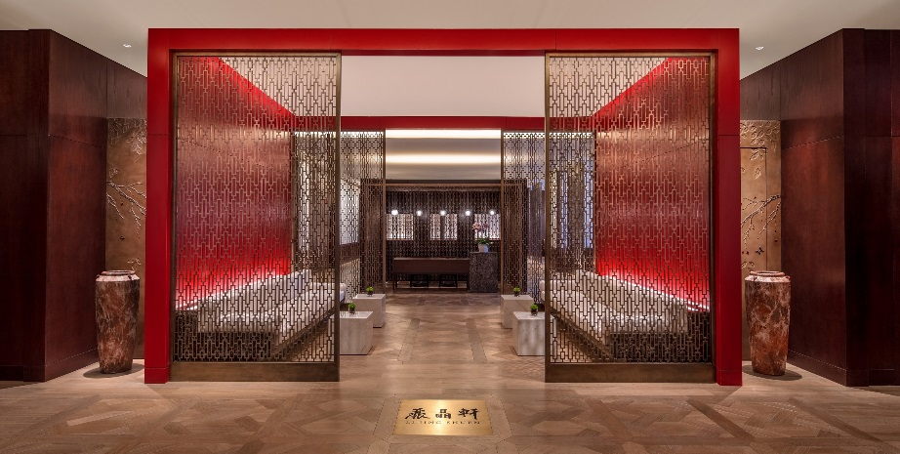
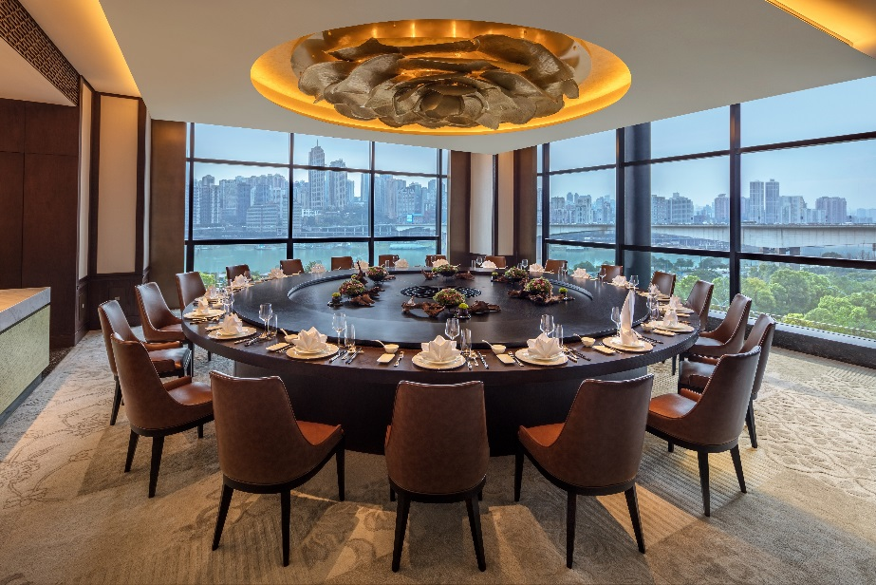
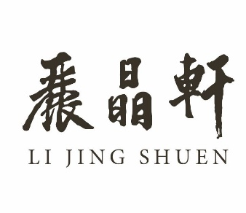
丽晶轩
LI JING SHUEN
丽晶轩提供地道粤菜,渝派川菜。十二间精心打造的私人包房，其中包括四间火锅包房，是私人聚会及商务宴请的理想场所。
It specializes in Chongqing & Cantonese cuisine. 12 private dining rooms with 4 famous hot pot rooms cater to social gatherings and business entertainment.
地点：酒店3层
Location: 3rd floor

Slide 20
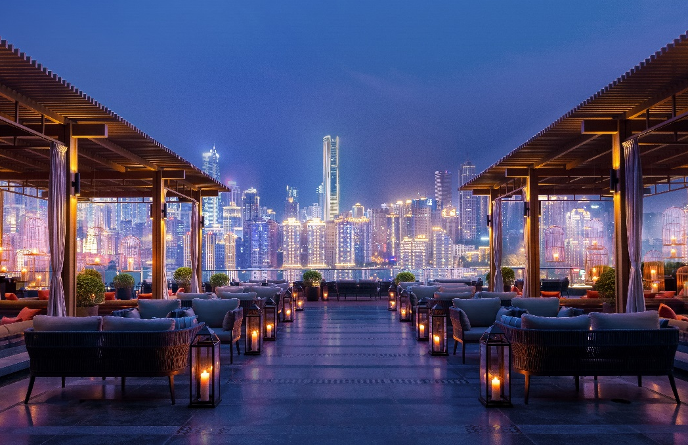

两江吧
RIVER TERRACE
位于酒店七层的户外露台酒吧--两江吧，提供精致小食，鸡尾酒及红酒，可尽揽迷人江景及渝中夜景，是朋友聚会或公司派对的首选。
Offering panoramic river views, our outdoor rooftop bar is an attractive setting for social party. Relax with your preferred tipple from our exquisite selection of cocktails, wines and spirits.
地点：酒店7层
Location: 7th floor

Slide 21
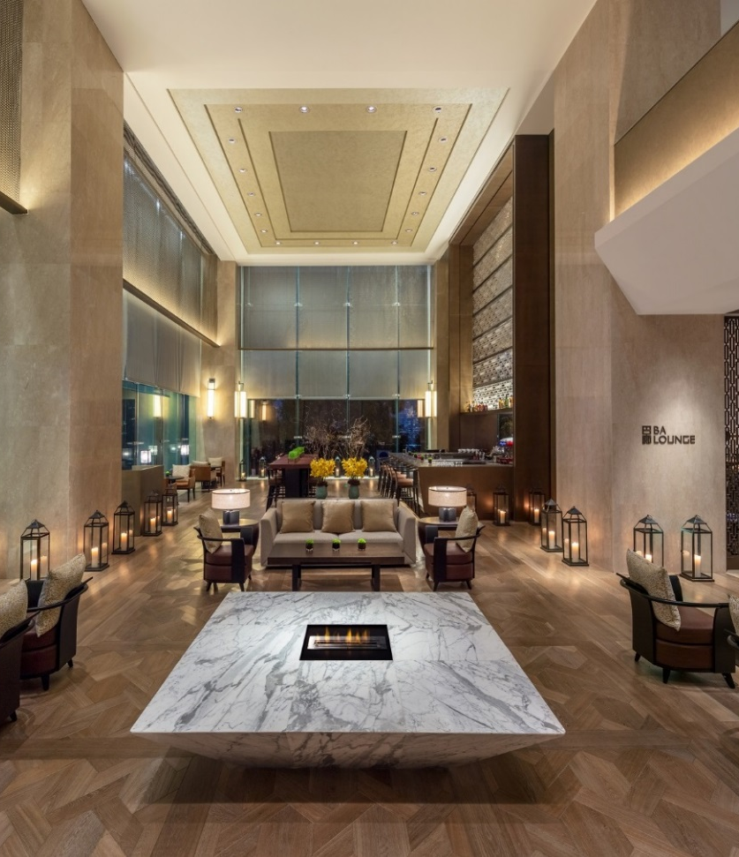

巴廊
BA LOUNGE
巴廊提供精致下午茶，咖啡及点心，是商务洽谈及亲朋聚会的不二之选。
Enjoy the delights of afternoon tea, refresh with our gourmet coffee, or choose from an extensive selection of wines, signature drinks and cocktails to relaxes the mood.
地点：酒店1层
Location: 1st floor

Slide 22
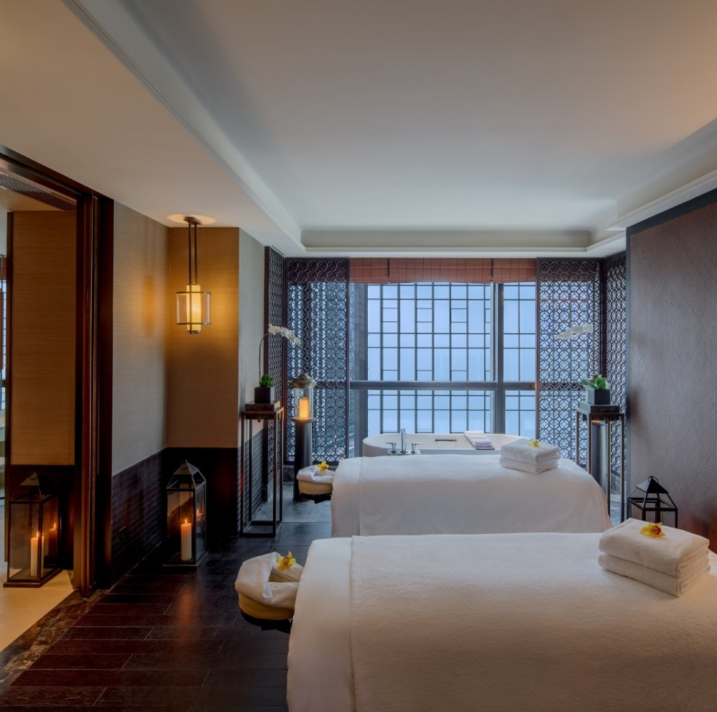
水疗中心
THE SPA
专业的水疗服务让您陶醉其中，神采奕奕。
Pamper yourself and get rejuvenated at the Spa.
地点：酒店7层
Location: 7th floor

Slide 23
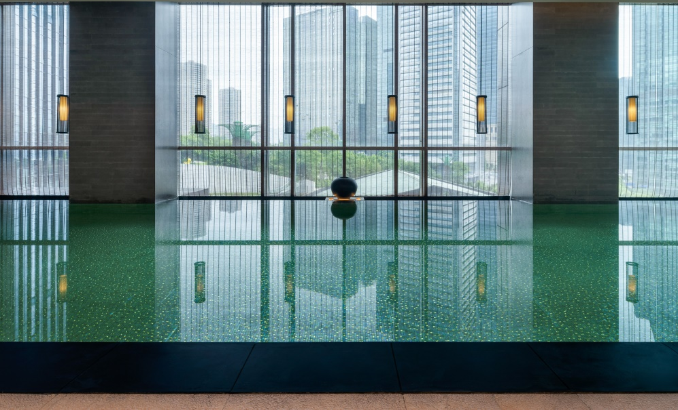
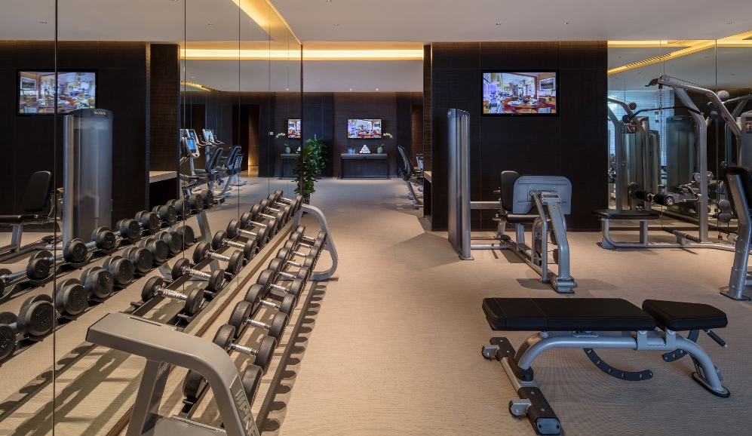
健身休闲
FITNESS & LEISURE
设施齐备的健身中心及室内恒温游泳池让您时刻精神焕发，享受运动的无限乐趣。
Fully-equipped gym and in-door heated swimming pool allow you to stay fresh and healthy.
地点：酒店8层
Location: 8th floor

Slide 24
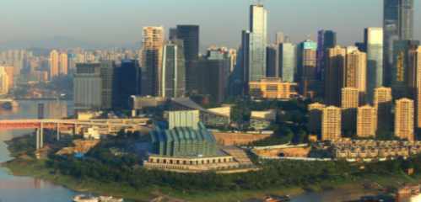

探索周边
DESTINATION
景点
Sightseeing
重庆大剧院
中央公园
重庆科技馆
解放碑
洪崖洞
Grand Theatre
Central Park
Chongqing Science Museum
Jiefangbei
Hongyadong
商场
Shopping Mall
财信广场
英利国际
北城天街
Casin Plaza
Yingli Centre
Longfor Paradise Walk
交通
Metro Station
地铁6号线
Line 6

Slide 25
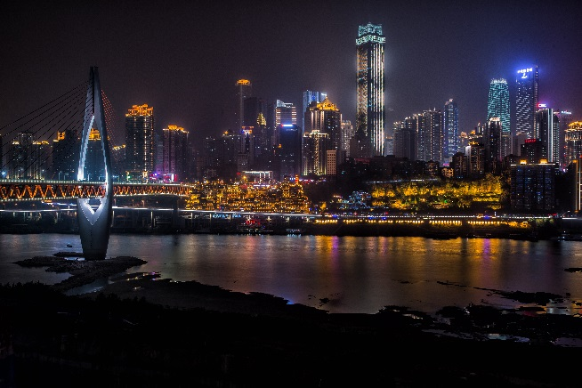
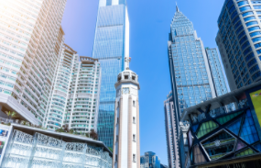
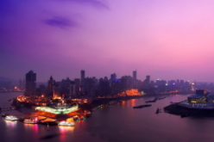
周边景点推荐
DESTINATIONS
洪崖洞
HONGYADONG
搭乘地铁跨江而过，您可以在这里品尝当地佳肴、购买手工艺品，在咖啡馆内放松休憩打发时间。
Take the subway across the river to this ancient district built on the hillside, an excellent place to sample local delicacies, shop for handicrafts, and enjoy tea in one its hidden cafés.
地铁5分钟即达
5 mins by subway
解放碑和观音桥
JIEFANGBEI & GUANYINQIAO
这两处热闹的步行街区是名副其实的购物天堂：大小商铺林立，商品琳琅满目，从高档商场到连锁商店，从中国传统的手工艺品店到时尚的精品店，充满着现代时尚气息。
This lively pedestrianized street is a veritable shoppers’ paradise with shops of every size and persuasion, from upscale malls to chain stores, from traditional Chinese artisan shops to trendy boutiques.
距酒店10分钟车程
10 mins drive
朝天门
PORT CHAOTIANMEN
朝天门是一个历史悠久的商业港口，长江和嘉陵江在此交汇，令人不禁赞叹大自然的神奇之处。
A commercial port with a long history, Chaotianmen offers an incredible sense of life on the river at the point where the Yangtze River and Jialing River meet.
距酒店15分钟车程
15 mins drive

Slide 26
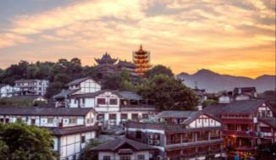
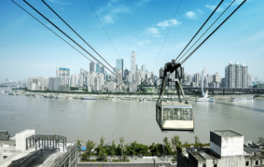
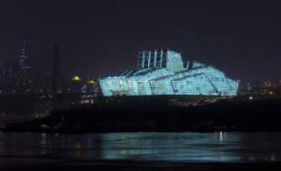
周边景点推荐
DESTINATIONS
磁器口-古镇
CIQIKOU-Ancient town
磁器口位于嘉陵江边，其历史可以追溯到1700年前，是重庆最古老、保存最完善的古镇。
Dating back 1,700 years, Ciqikou is Chongqing’s oldest and most well preserved township, set on the banks of the Jialing River.
距酒店30分钟车程
30 mins drive
长江索道
YANGTZE RIVER CABLEWAY
乘坐横跨长江索道缆车里，俯瞰重庆市区美景，体验在高楼间横渡长江的奇妙感觉。
Bird’s-eye views
Take in the full beauty of the city and its scenic surroundings as you sail over the Yangtze in a cable car.
距酒店11分钟车程
11 mins drive
重庆大剧院
CHONGQING GRAND THEATRE
大剧院的仿佛是长江边上一艘即将起航的帆船，灯光效果在夜晚看起来熠熠生辉，格外绚丽。
Uniquely designed to resemble a ship sailing along the Yangtze, this modern performing arts theatre overlooking the river is a dazzling sight at night.
步行15分钟即达
15 mins walk

Slide 27

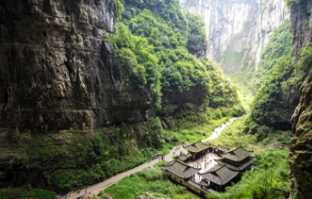
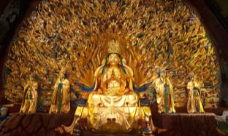
周边景点推荐
DESTINATIONS
三峡
SANXIA
长江三峡，山水画廊气象万千、群峰云遮雾绕，溪流妩媚多情。如诗如画的风景伴随优美的传说和动人的故事徐徐展开。
The new Three Gorges bring you infinite new views. New sceneries created by
the reservoir will add extra mysteries to you and make your trip rich and colorful.
开车8小时
8 hours drive
武隆仙女山
WULONG FAIRY MOUNTAIN
作为重庆东部武陵山脉的一部分，这里因其迷人的高地景色而被称为“东方瑞士”，电影《变形金刚4》的取景地。
Part of the Wuling Mountain Range in eastern Chongqing, the park is famed as the “Switzerland of the East” for its charming highland scenery, where scenes from the Hollywood movie “Transformers 4” were filmed.
车程3小时
3 hours drive
大足石刻
Dazu Rock Carvings
景区有5万多余尊雕刻在山壁上的石雕，历史可以追溯到7世纪，巧夺天工的石雕技艺令人惊叹。
Marvel at these magnificent carvings and over 50,000 religious sculptures carved into the stone cliffs of Dazu, dating back to the 7th century..
车程2个小时
2 hours drive

Slide 28
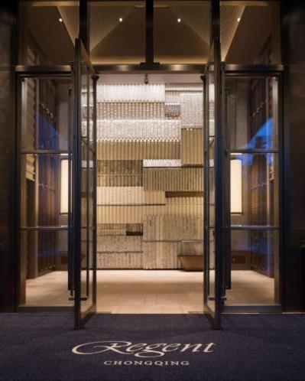


谢谢观看！
THANKS!
重庆丽晶酒店
REGENT CHONGQING
电话：86 023 89088888
地址：重庆市江北区金沙门路66号
网址：www.regenthotels.com
Tel: 86 023 89088888
Address: 66th Jinshamen Road, Jiangbei District, Chongqing
Web: www.regenthotels.com
微博 Weibo：
微信 WeChat：

