Slide 1
厦门喜来登酒店 Sheraton Xiamen Hotel

Slide 2
Where the World Comes Together
世界会聚
之所

Slide 3

加入“万豪旅享家”，探索更多缤纷体验 Reward all your adventures
享受美好生活
包括免费Wi-Fi 网络和手机登记入住服务，随时随地获享万豪优惠房价，享受延迟退房礼遇，还可参加会员专享特别活动，留下回味悠长的难忘回忆。
Enjoy the good life
The freedom of free Wi-Fi and mobile check-in. Our lowest rates, all the time. The luxury of late checkout. Plus, once-in-a-lifetime experiences for members only.
简单的积分赚取及使用方式
酒店住宿、飞行旅程及购物均可让您轻松赚取积分。您可用积分升级客房，兑换梦想假期或最新科技产品。
Easy ways to earn and use
Relax while you rack up points for hotel stays, airline travel and shopping. Then, use your points for a room upgrade, a dream vacation or the coolest new tech.
遍布全球的目的地
探索了解遍布全球的精彩酒店之选。从经典酒店到特色酒店，从奢华酒店到高级品牌或精选酒店，不论您喜爱哪种风格，我们都将热切期待您的光临。
A world of destinations
Explore stunning hotels in locations across the globe. From classic to distinctive, from luxury to premium to select, whatever your preference, we can’t wait to welcome you.
更多详情 For more information: https://marriottbonvoy.com/cn

Slide 4
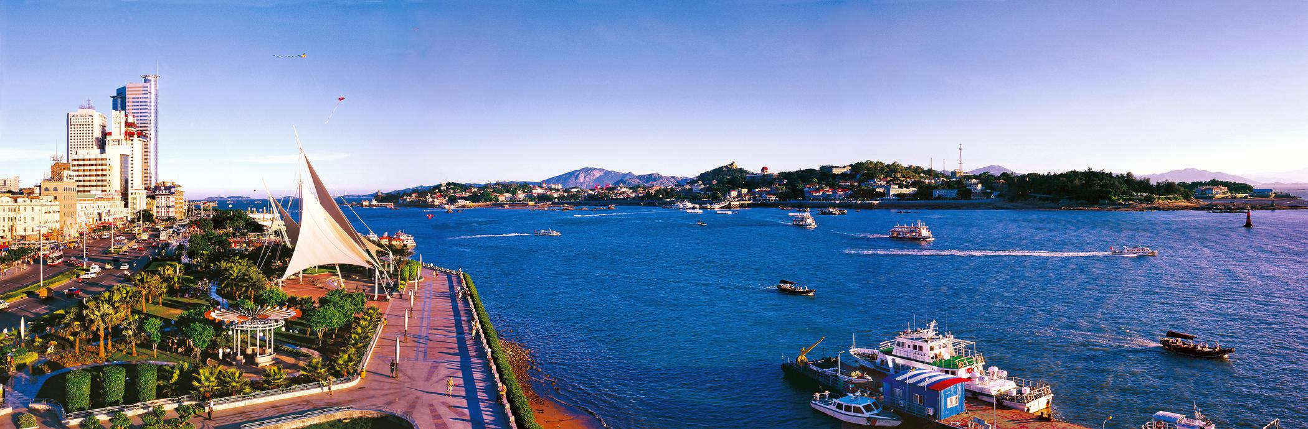
海上花园 Garden on the Sea
四季如春的海滨城市，被蔚蓝的大海环抱着，有”海上花园”的美称。风景秀丽，富有底蕴的人文历史及整洁的城市，
已成为知名的国际生态旅游城市，是中国最适合居住的城市之一。
Xiamen, the “Garden on the Sea”. The city is well known by its fascinating scenic views, rich cultural heritage and cleanness.
It is one of the ‘most suitable for living’ cities and the most popular tourist destinations in China.

Slide 5
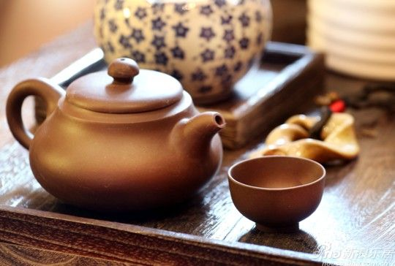
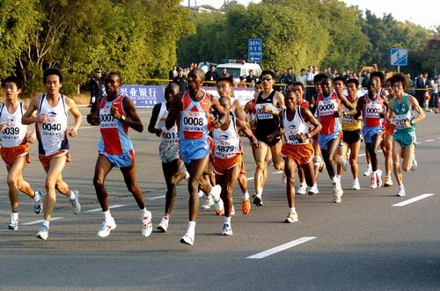
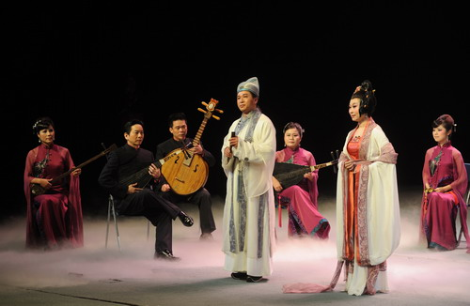

风情厦门 Xiamen Culture
_{功夫茶}
_{Kung Fu Tea}
_{国际马拉松}
_{International marathon}
_{南音}
_{Nanyin Music}
_{歌仔戏}
_{Ge Zai Opera}

Slide 6
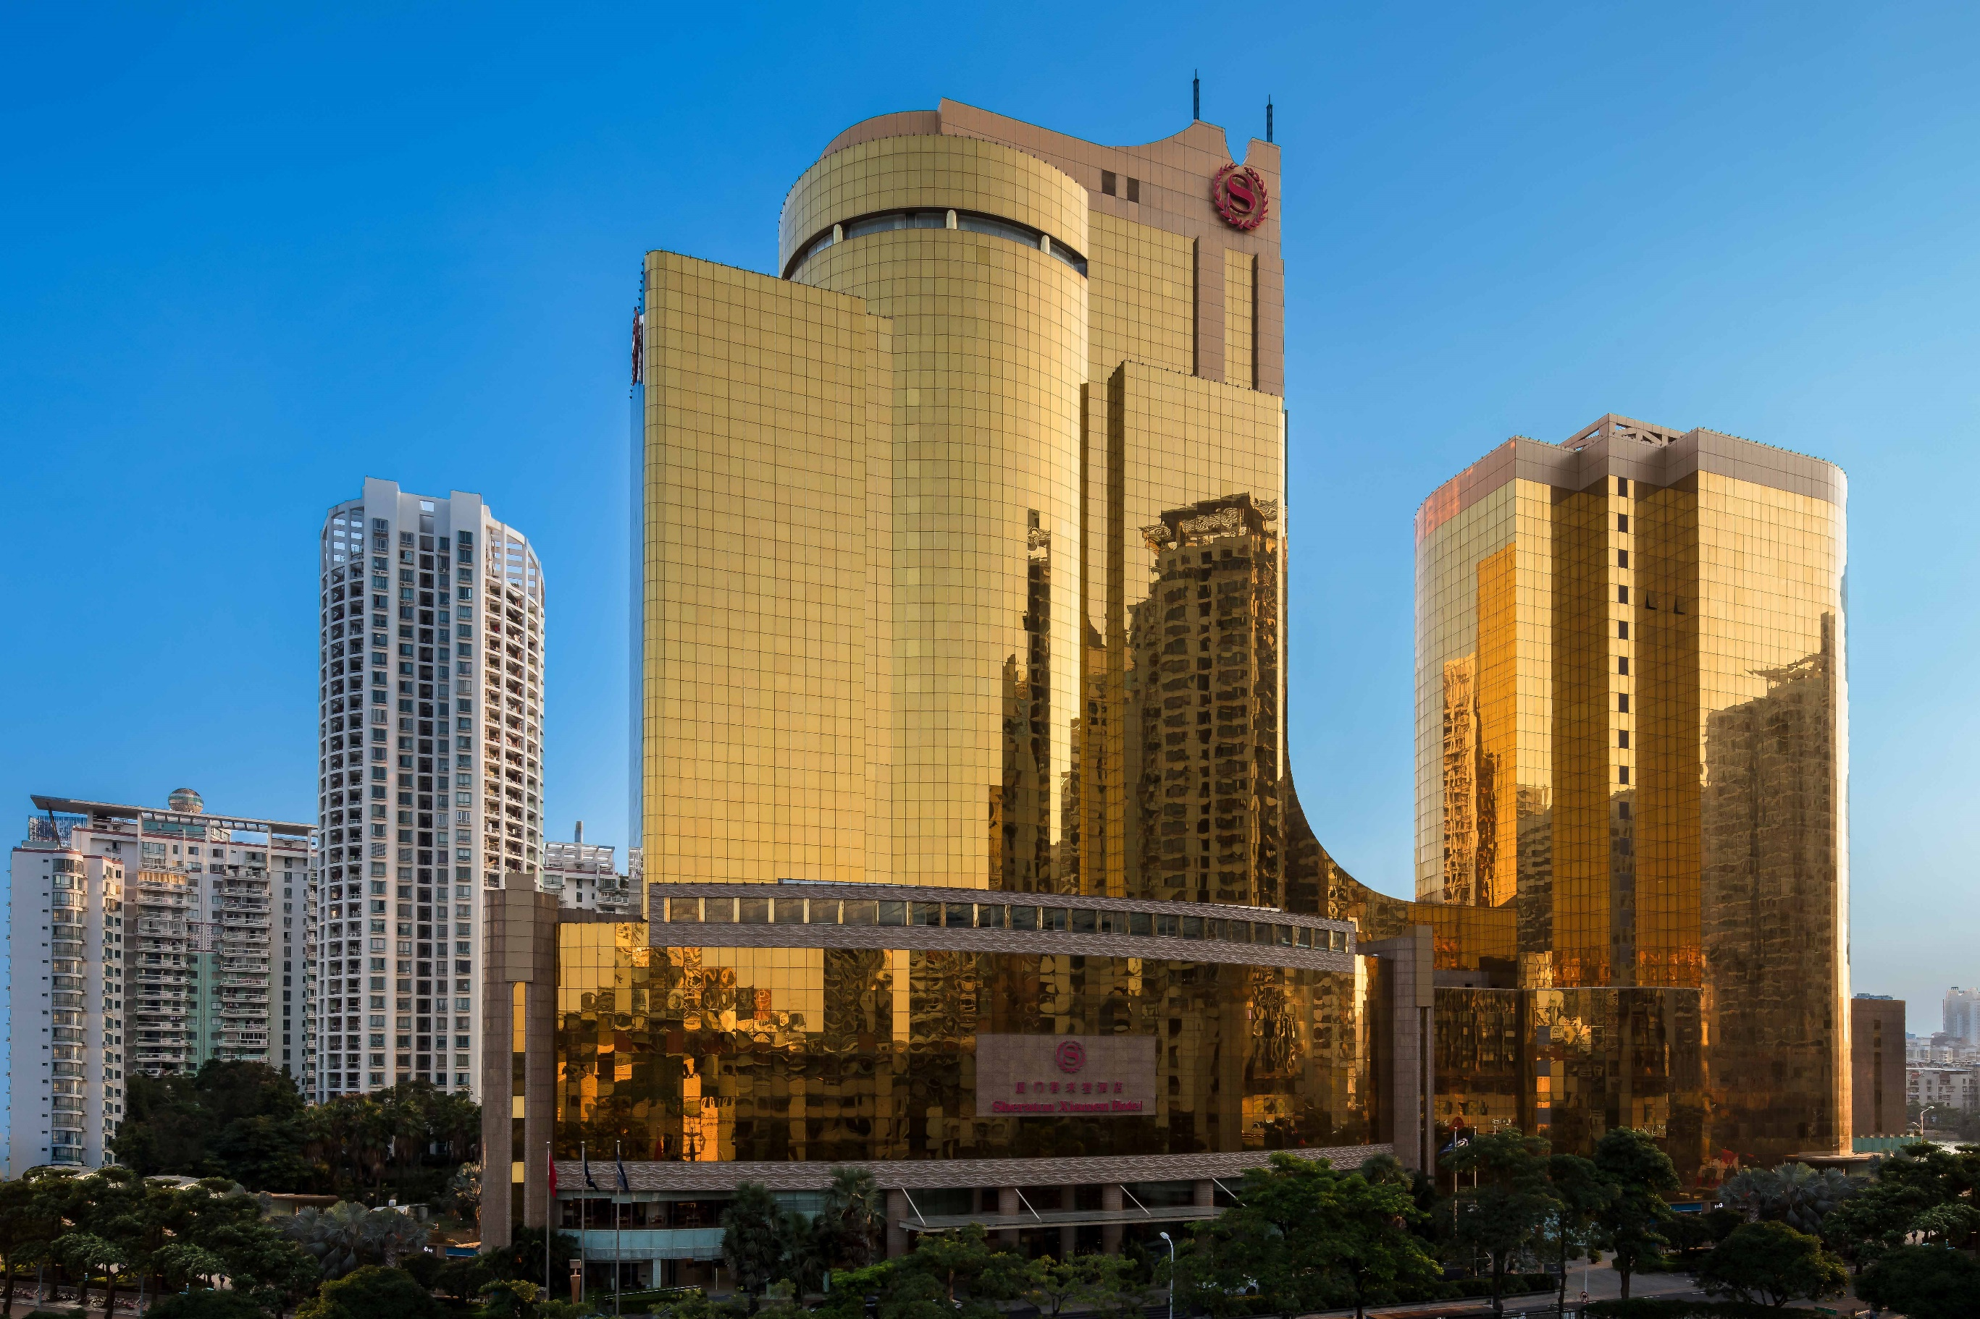
酒店信息 General Information
厦门喜来登酒店位于厦门市的商业、购物和贸易中心，地铁1号线和2号线交汇点。酒店拥有360间豪华宽敞的客房，包含48间精致套房，5个风格迥异的餐厅和酒吧及宴会厅。令宾客悠享下榻时光，深度发掘“花园城市”的独特魅力。
Sheraton Xiamen is ideally located at intersection of AMRT Line 1 & Line 2, which is the heart of the city's business, retail and commercial hub. Its proximity to major attractions and transpiration links means less time travelling and more time enjoying the sights and sounds of this exciting costal region.

Slide 7
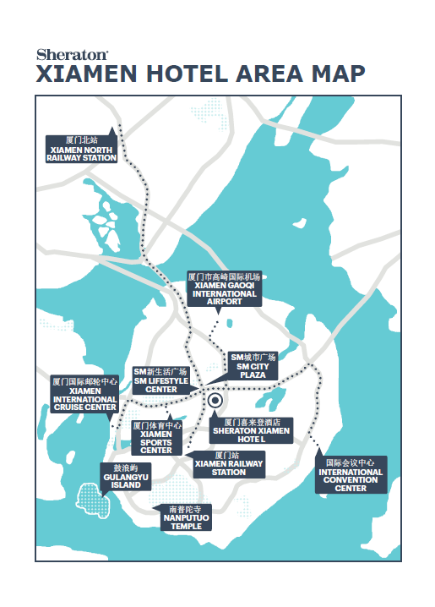
地理位置 Location
位于城市的商业、购物中心
Located in the heart of city’s business, retail and commercial hub
距厦门国际机场、火车站及轮渡码头仅需15分钟
15 minutes away from Xiamen International Airport, railway station and Ferry Terminal of Gulangyu Island
距厦门国际会展中心仅需15分钟
15 minutes away from Xiamen International Exhibition and Conference Center
毗邻主要政府单位，工业园区及大型写字楼
Close to municipal government offices, major industrial area, commercial buildings
步行可至城内最大的3家购物中心
Three largest shopping malls are within walking distance
门口即有出租车等候
Taxi is readily available at doorstep
步行5分钟即可至厦门地铁1号线吕厝站/乌石浦站
5 minutes walk to AMRT Line 1 Lü Cuo Station/ Wushipu Station

Slide 8
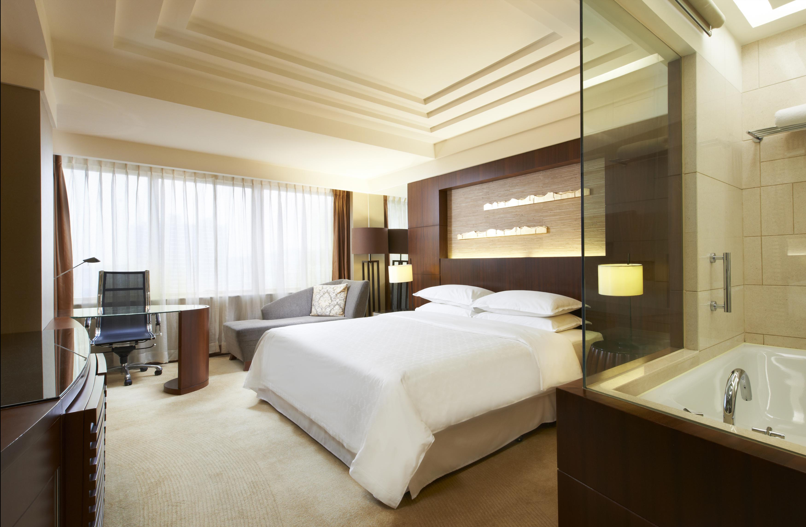
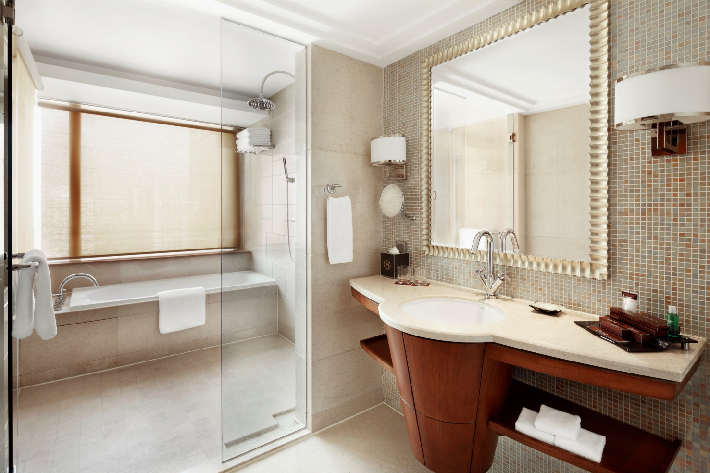
酒店客房 Guest Room
酒店设有 360 间宽敞客房，其中包括 57 间行政级别客房和 48 间装潢精美的套房，定会让您倍感舒适惬意。 所有客房均配喜来登特色睡眠体验、高速上网接入、本地和国外精选电视频道以及 24 小时客房送餐服务，将确保您获得舒适而便利的住宿体验。
Make yourself comfortable in our 360 spacious guest rooms, including 57 Club Level rooms and 48 beautifully appointed suites. All guest rooms feature the Sheraton Signature Sleeping Experience, High Speed Internet Access, a wide selection of local and foreign TV channels, and 24-hour room service to make your stay comfortable and convenient.

Slide 9
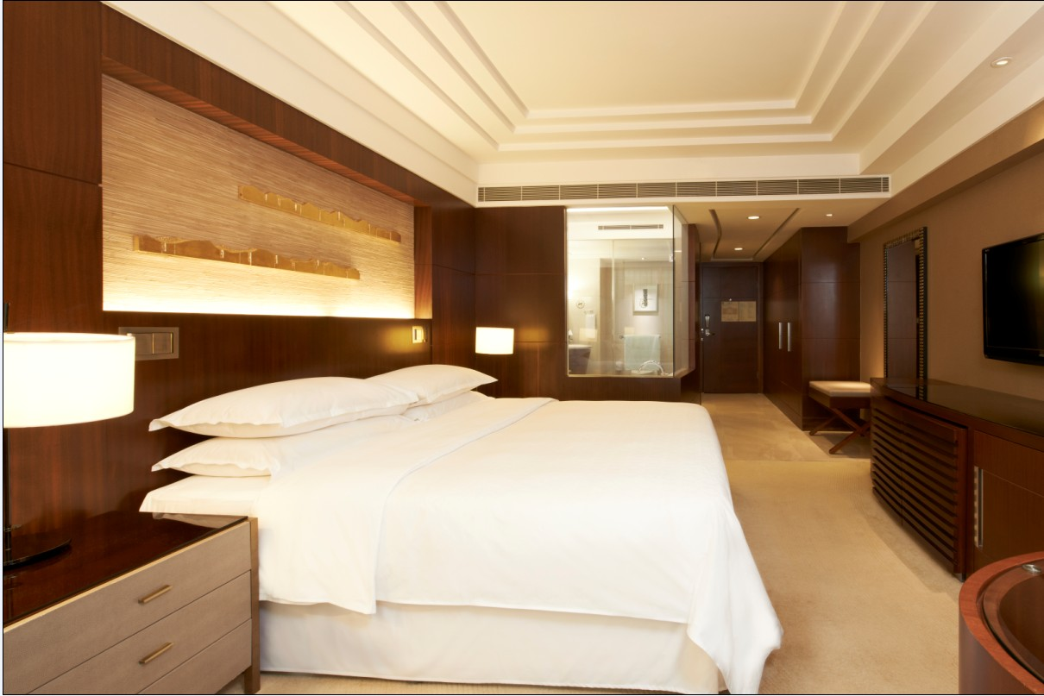
豪华房 Deluxe Room
共165间，典雅现代的设计，配有大床或双人床，热带雨林冲淋，独立工作区域及32寸液晶显示屏电视。
165 Elegant and contemporary design, features a king-size/twin-size bed, rain-forest shower, private work station and a 32-inch flat screen.

Slide 10
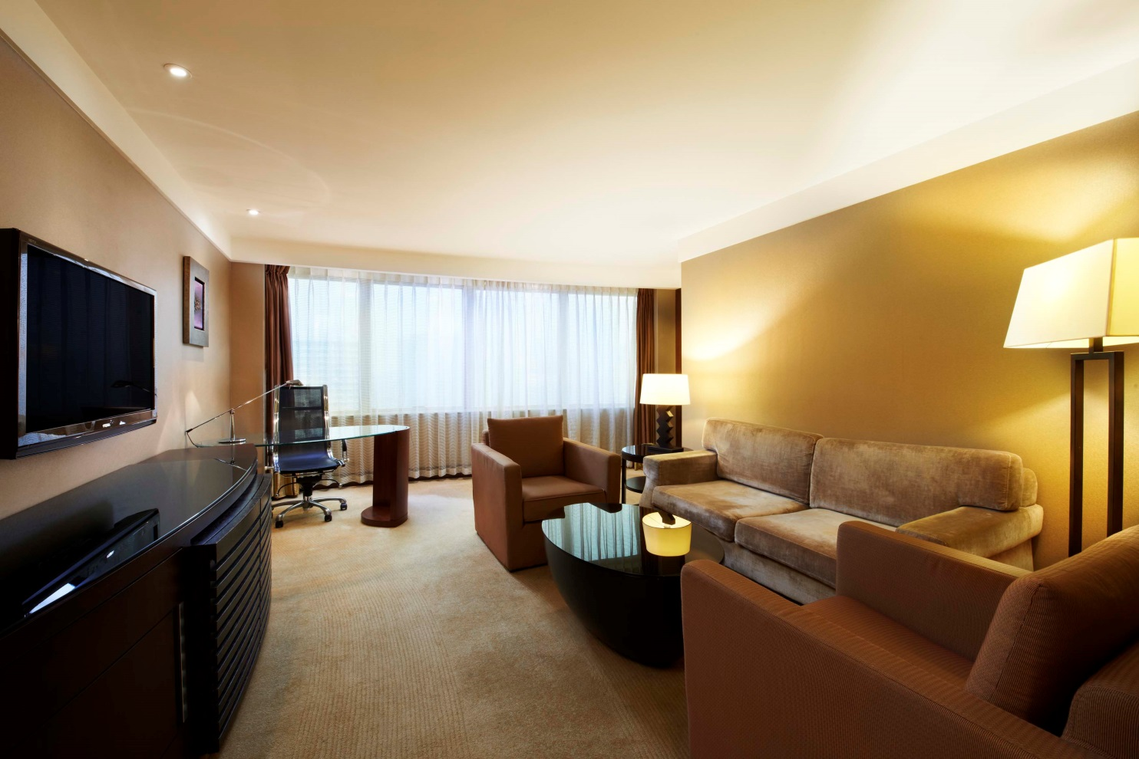
高级套房 Junior Suite
共57间，72平方米 - 精致的装修，营造出舒适的家居感。配有独立的客厅及办公区域，客人还可享受行政酒廊的多种专属礼遇。
72 sqm – 57 Exquisite furnishing with a residential feel, separate living room and work station with exclusive Club Lounge Benefits.

Slide 11
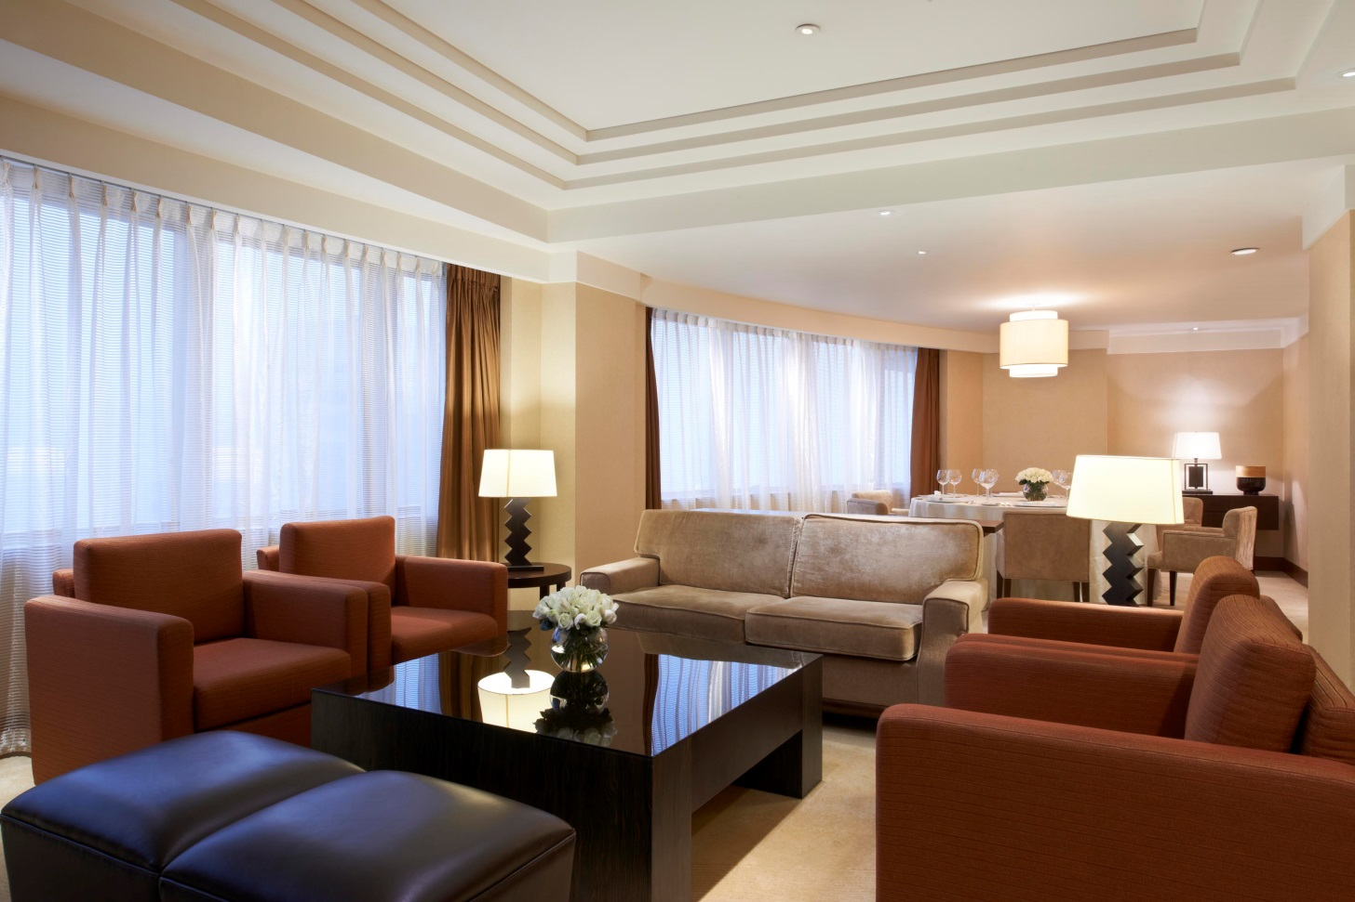
行政套房 Executive Suite
共6间，106 - 135平方米 – 现代豪华的设计，配有独立的客厅和全套设施配备齐全的厨房，客人还可享受行政酒廊的多种专属礼遇
106 - 135 sqm – luxury setting with contemporary design, feature a separate living room, fully equipped kitchenette exclusive Club Lounge benefits.

Slide 12
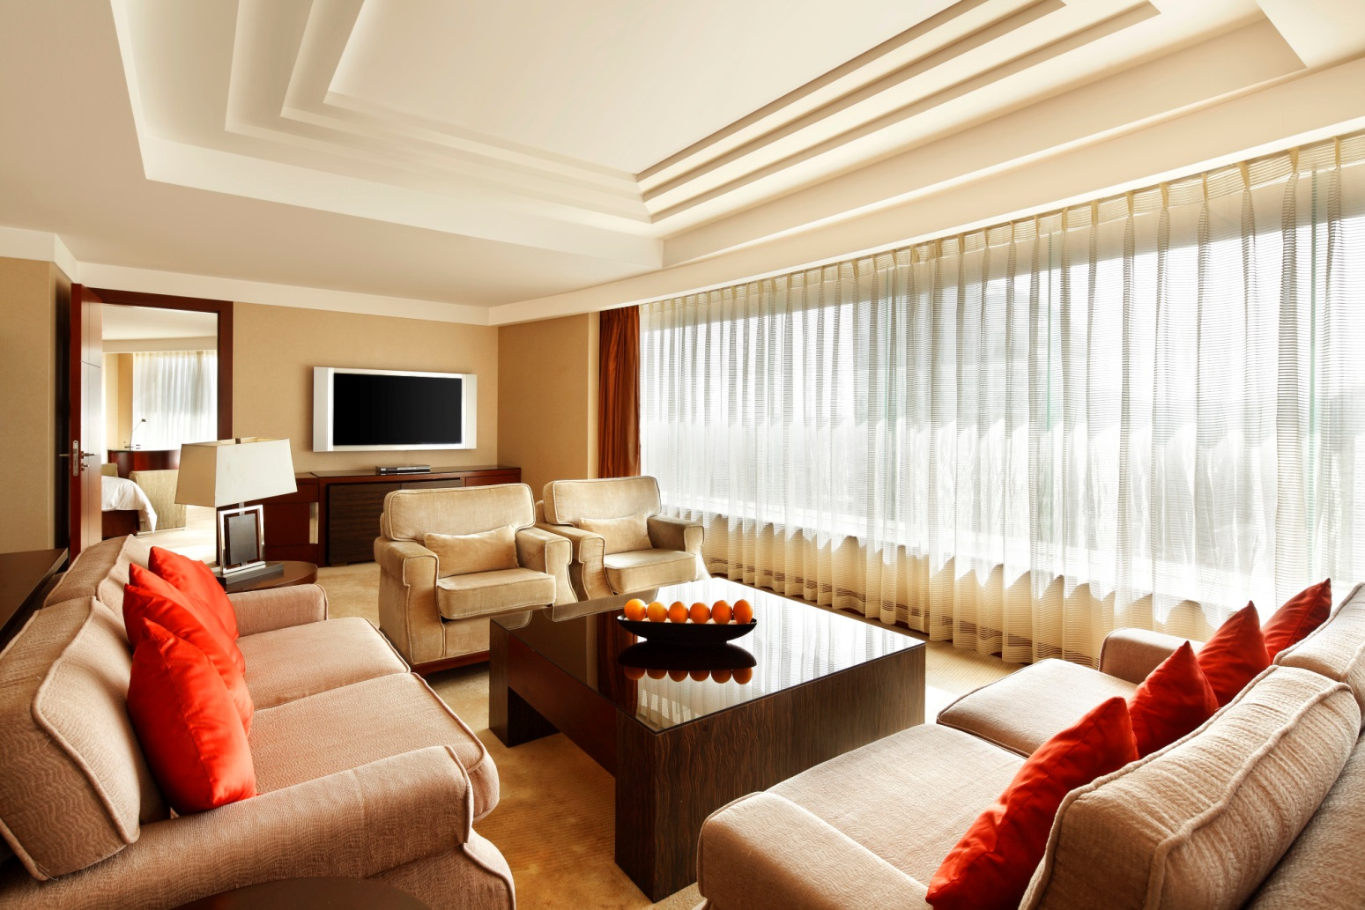
大使套房 Ambassador Suite
共1间，165平方米 – 配有豪华的家私及完善的设施，独立宽敞的客厅和配备齐全的厨房，客人还可享受行政酒廊的多种专属礼遇。
165 sqm – entertain lavishly in this beautifully appointed suite, features a spacious living room, a fully equipped kitchenette and exclusive Club Lounge benefits.

Slide 13
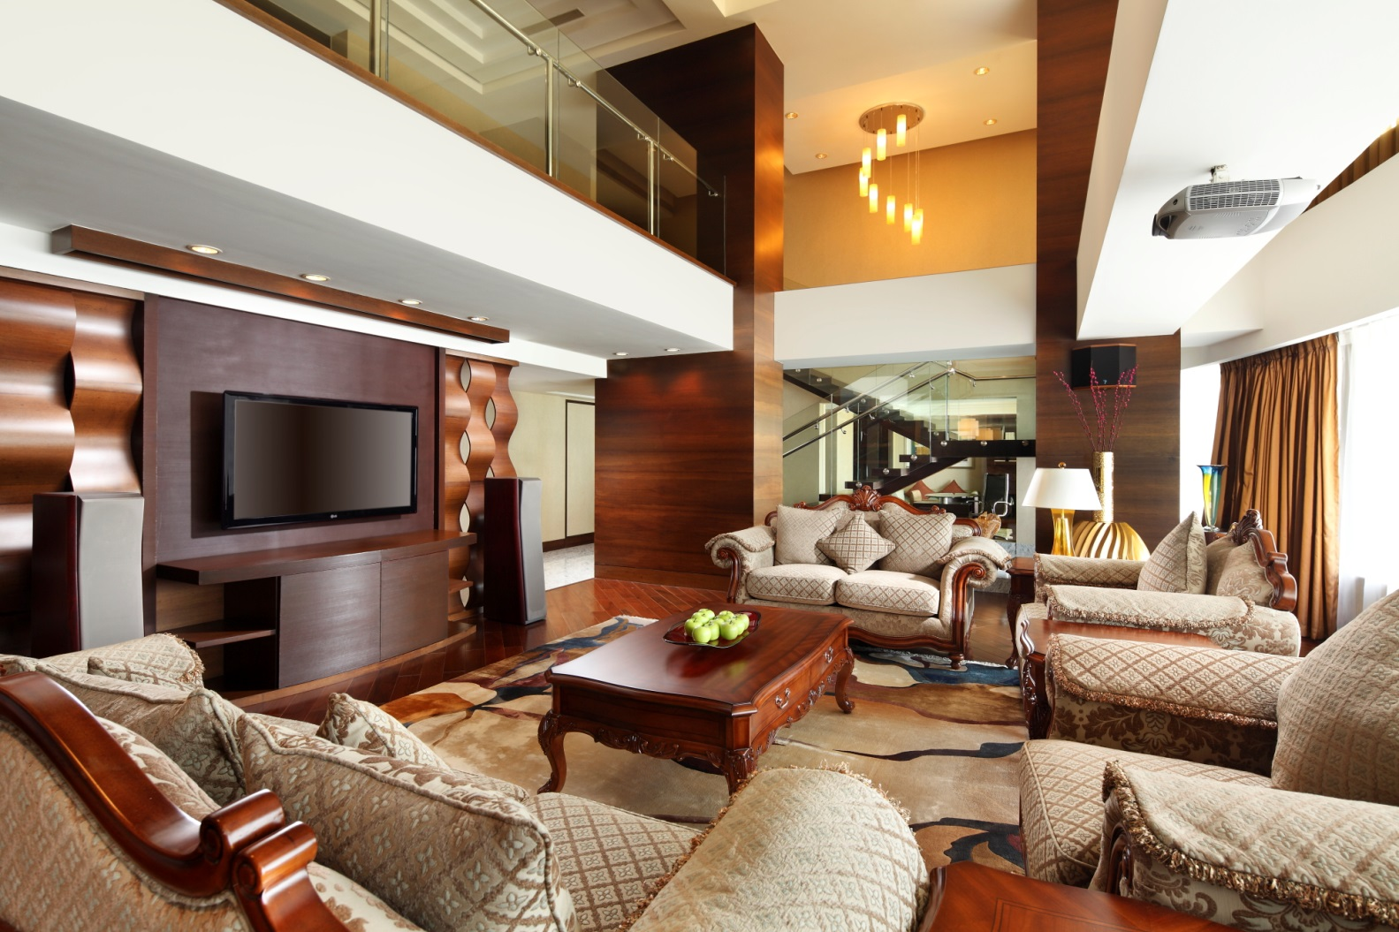
总统套房 Presidential Suite
共1间，236平方米 – 位于顶层的酒店最顶级套房。
别具一格的复式设计，设有气派非凡的客厅，宽敞的用餐区域，两个舒适客房及豪华大理石浴室，可饱览城市风光。
236 sqm – hotel’s premier suite located on the top of the hotel.
Unique duplex design featuring a refined living space, a dining area, two bedrooms and a luxury marble bathroom with panoramic city view.

Slide 14
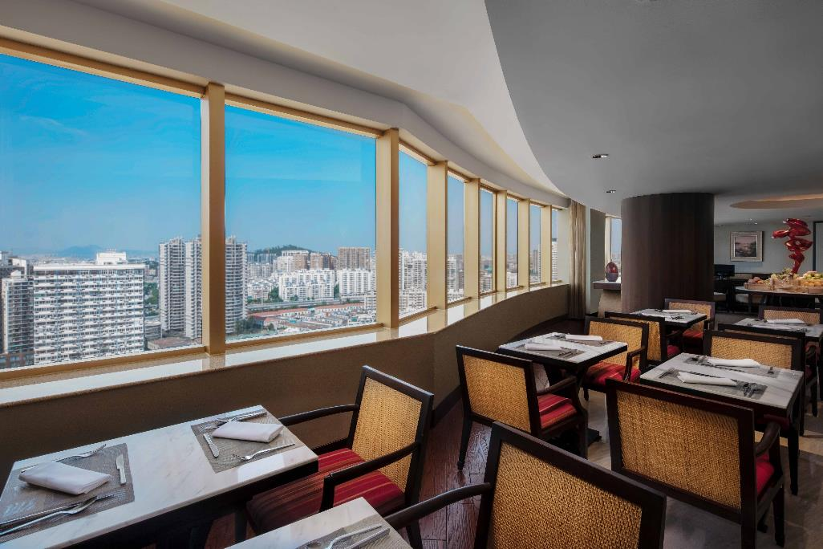
喜来登行政酒廊 Sheraton Club Lounge
客人入住行政楼层客房即可享有行政俱乐部专享礼遇：
Guests stay on Club Floors and suites are entitled to
exclusive Club Lounge benefits:
每天欧陆式早餐
Complimentary Daily Continental Breakfast
全天咖啡及茶
All day coffee and tea
免费客房内及行政俱乐部宽带联结
Complimentary internet in guestrooms and Club Lounge
每天免费使用行政俱乐部会议室一小时
One hour meeting room use per day
晚间鸡尾酒及小吃
Evening cocktail served with deluxe hors d’oeurves

Slide 15
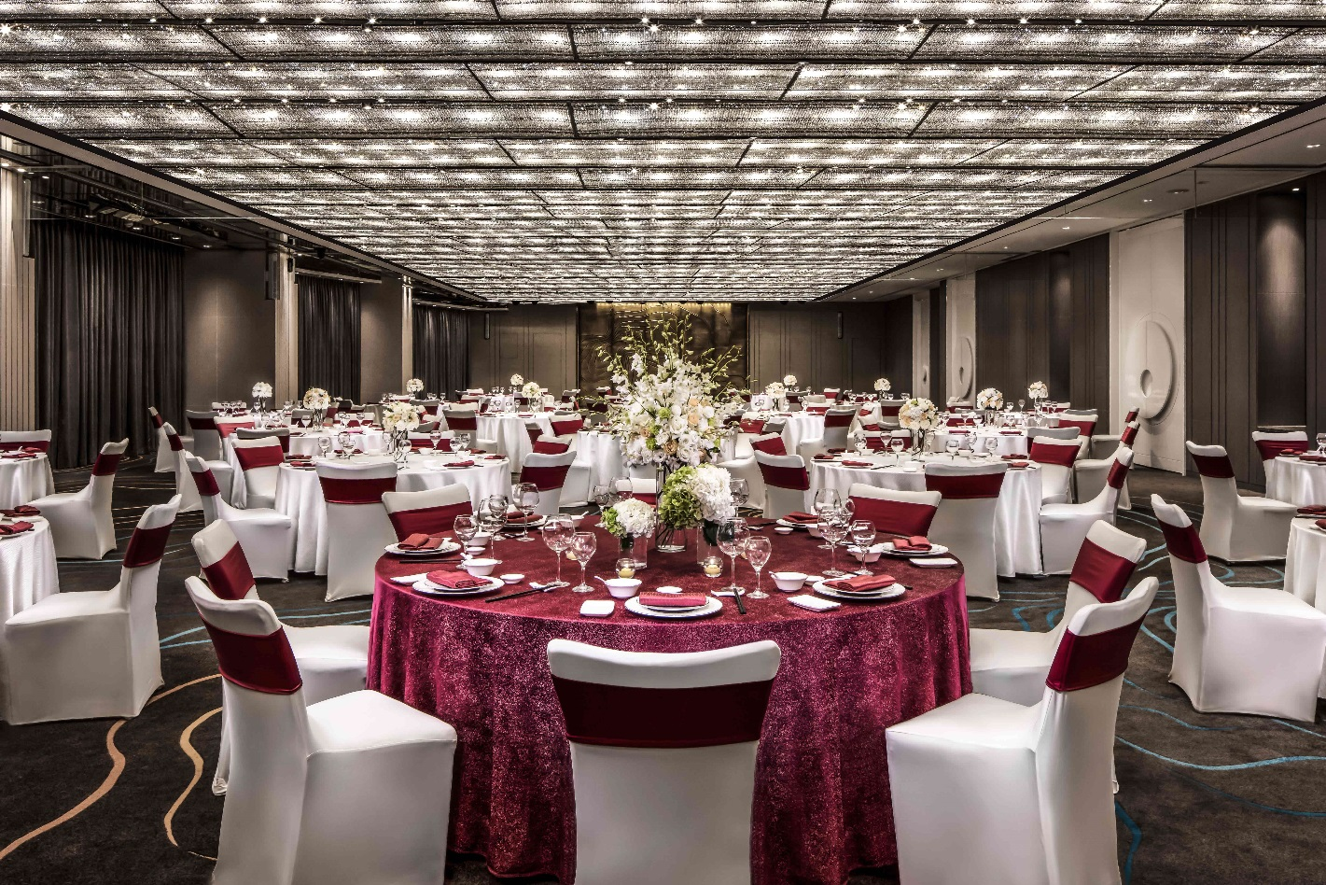
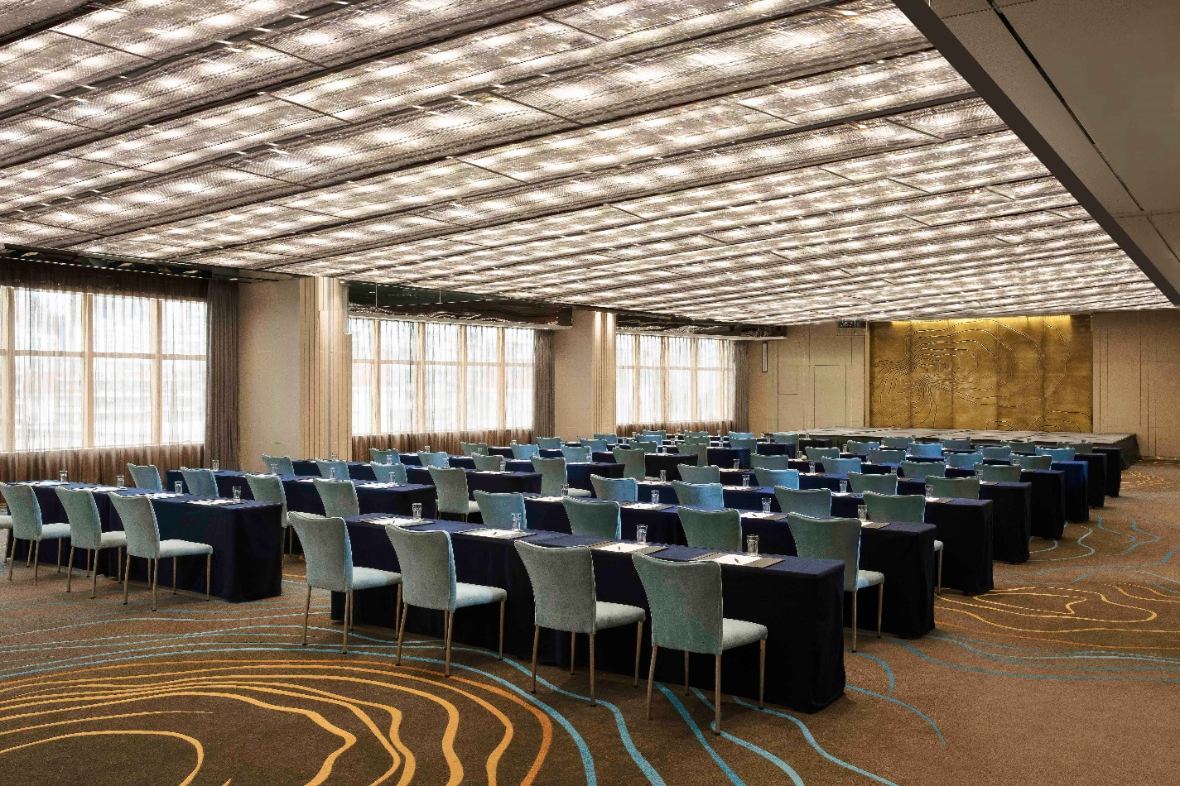
会议空间 Meeting Space
全新宴会厅升级装修，于2017年9月投入使用。Brand-new meeting space re-opened in September 2017
大宴会厅可分隔成3个小厅。One Grande Ballroom which can be configured into three sections
五个多功能厅。Five highly adoptable function rooms
大宴会厅及会议室可承接10到770人的大小不等的会议和宴会。Total meeting space can accommodate groups from 10 to 770
先进的视听和会议器材。State-of-the-art audio and video system
经验丰富的专业会议服务团队。A team of experienced and professional convention executives

Slide 16
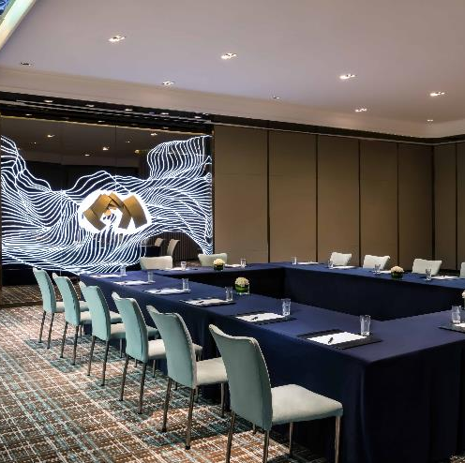
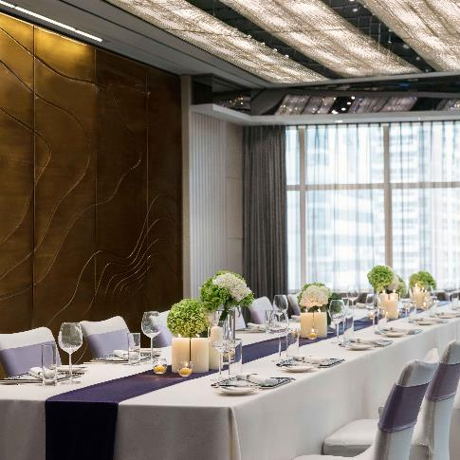
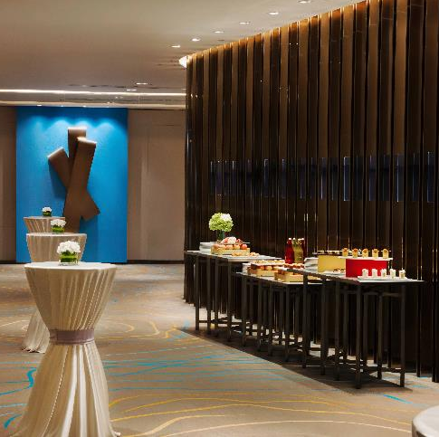
会议空间 Meeting Space

Slide 17
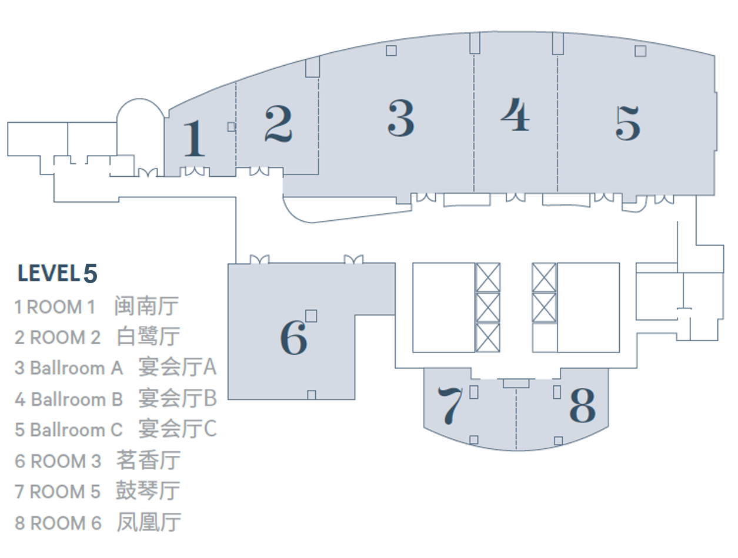

Slide 18








会议空间的容纳人数表 Capacity Charts
宴会厅名称 | 宽度 （米） | 长度 （米） | 天花板高度 （米） | 面积 （平米） | 宴会 | 剧院 | 会议 | 酒会 | 课桌 | U形 | 回形 | 晚餐舞会
五楼
大宴会厅 | 14.4 | 41 | 3.8 | 617 | 380 | 700 | 120 | 380 | 324 | 84 | 140 | 380
宴会厅 A | 14.4 | 16.3 | 3.8 | 246 | 110 | 200 | 48 | 120 | 126 | 39 | 80 | 160
宴会厅 B | 14.4 | 8.4 | 3.8 | 130 | 60 | 120 | 30 | 60 | 54 | 36 | 54 | 60
宴会厅 C | 14.4 | 16.3 | 3.8 | 240 | 110 | 200 | 48 | 120 | 126 | 39 | 80 | 160
闽南厅 | 5.3 | 6.9 | 2.5 | 51 | 10 | 28 | 12 | 10 | 15 | 9 | 12 | 10
白鹭厅 | 9.6 | 8.3 | 3.8 | 81 | 30 | 60 | 18 | 30 | 27 | 15 | 18 | 30
茗香厅 | 12.9 | 12 | 3.8 | 165 | 100 | 100 | 39 | 100 | 51 | 30 | 39 | 100
鼓琴厅 | 6.6 | 5 | 3.8 | 64 | 20 | 40 | 18 | 20 |  | 15 | 18 | 20
凤凰厅 | 6.6 | 5 | 3.8 | 64 | 20 | 40 | 18 | 20 |  | 15 | 18 | 20

Slide 19
会议空间的容纳人数表 Capacity Charts
Meeting Room Name | Width （Meters） | Length （Meters） | Ceiling Height | Room Area (M²) | Banquet | Theater | Conference | Reception | Classroom 3*6 | U-Shape | Hollow Square | Dinner/Dance
Fifth Floor
The Grande Ballroom | 14.4 | 41 | 3.8 | 617 | 380 | 700 | 120 | 380 | 324 | 84 | 140 | 380
Ballroom A | 14.4 | 16.3 | 3.8 | 246 | 110 | 200 | 48 | 120 | 126 | 39 | 80 | 160
Ballroom B | 14.4 | 8.4 | 3.8 | 130 | 60 | 120 | 30 | 60 | 54 | 36 | 54 | 60
Ballroom C | 14.4 | 16.3 | 3.8 | 240 | 110 | 200 | 48 | 120 | 126 | 39 | 80 | 160
Room 1 | 5.3 | 6.9 | 2.5 | 51 | 10 | 28 | 12 | 10 | 15 | 9 | 12 | 10
Room2 | 9.6 | 8.3 | 3.8 | 81 | 30 | 60 | 18 | 30 | 27 | 15 | 18 | 30
Room3 | 12.9 | 12 | 3.8 | 165 | 100 | 100 | 39 | 100 | 51 | 30 | 39 | 100
Room5 | 6.6 | 5 | 3.8 | 64 | 20 | 40 | 18 | 20 |  | 15 | 18 | 20
Room6 | 6.6 | 5 | 3.8 | 64 | 20 | 40 | 18 | 20 |  | 15 | 18 | 20

Slide 20
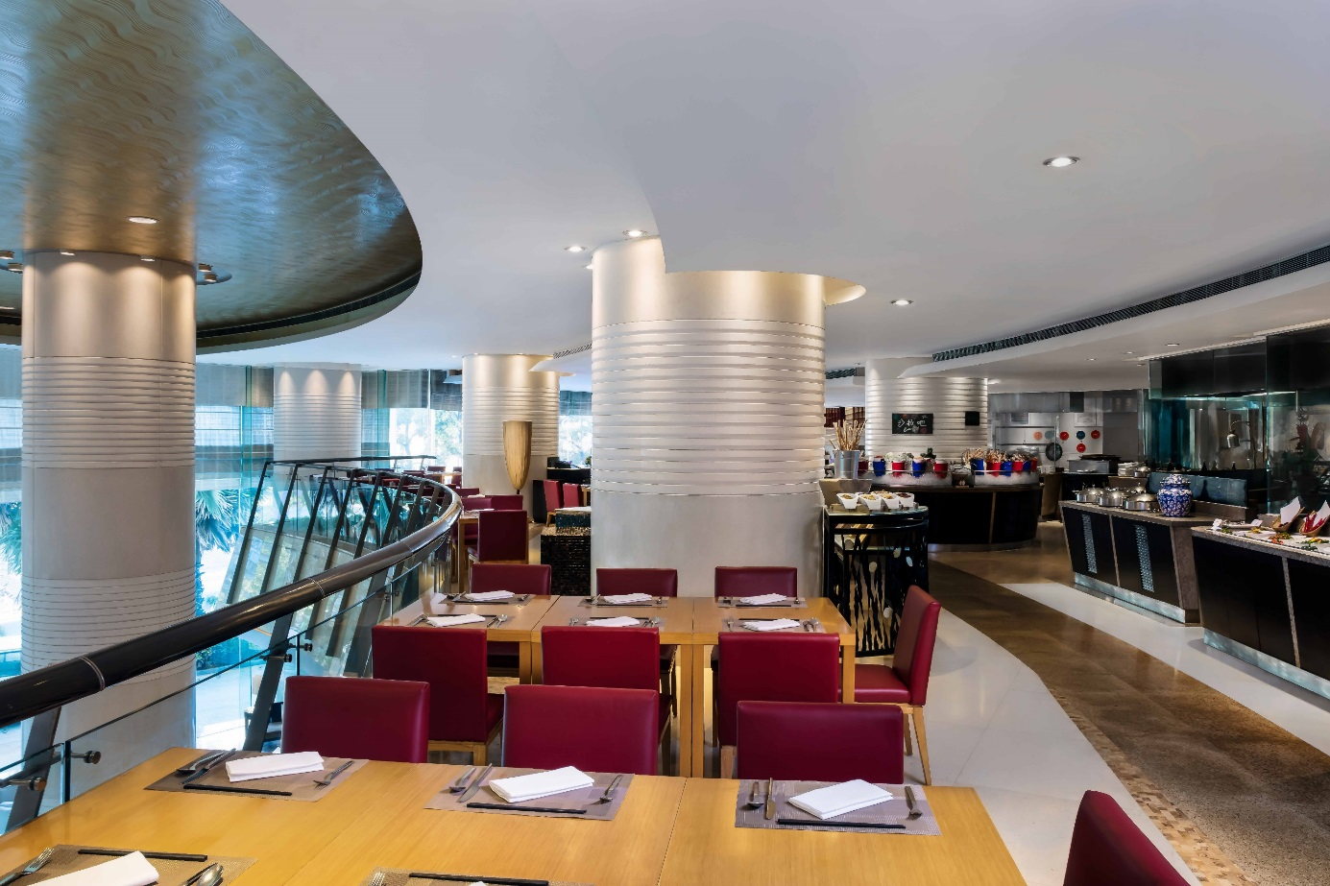

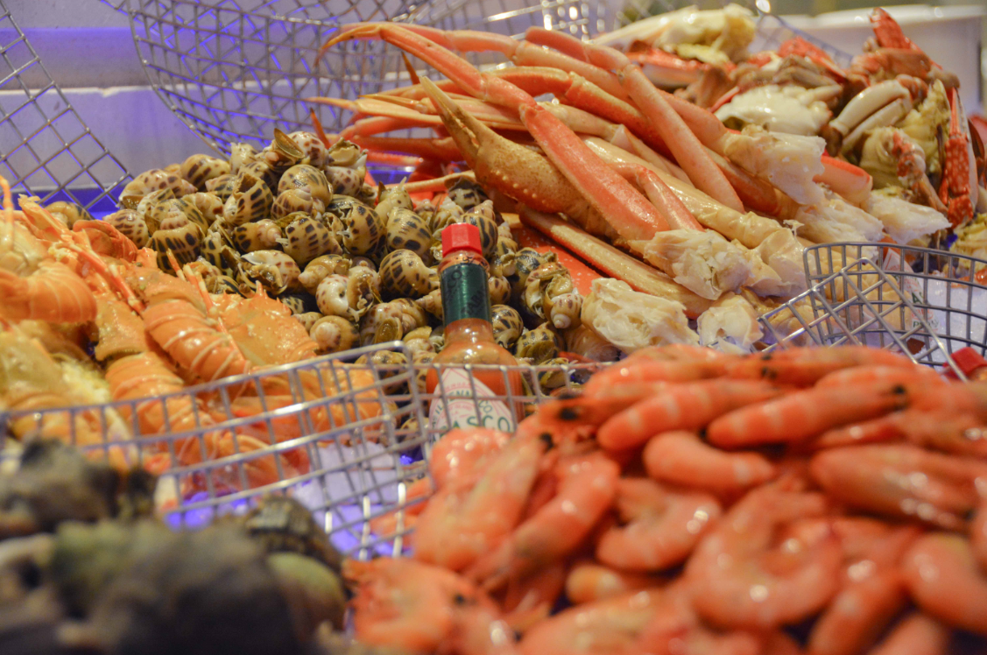
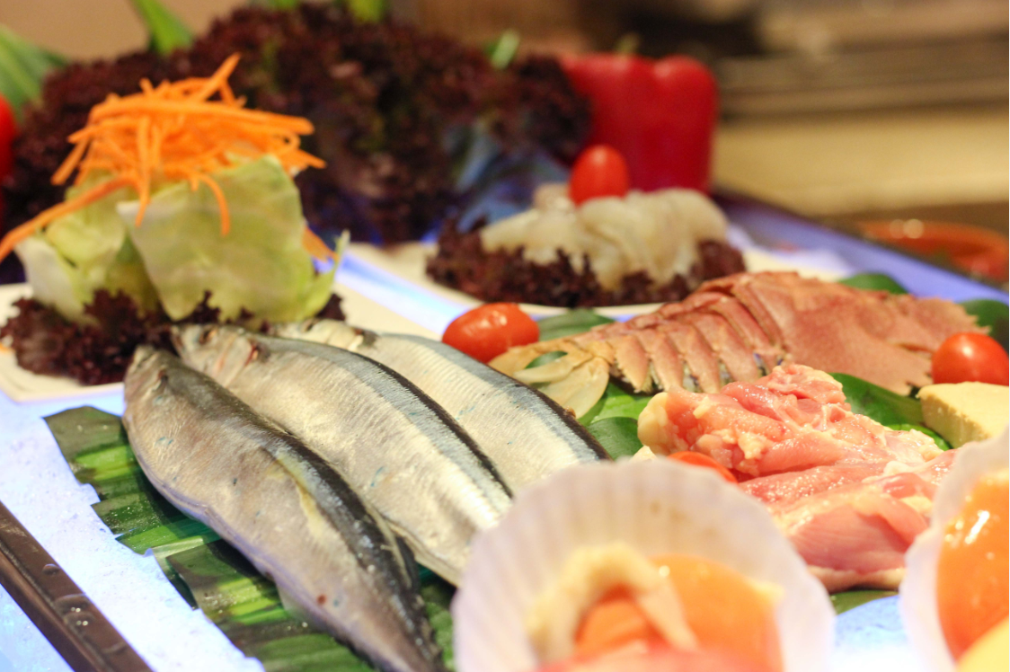
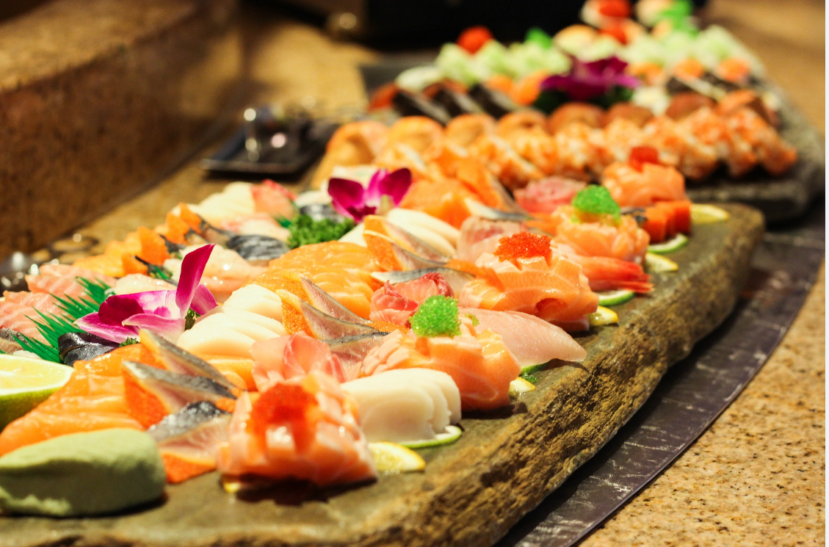
酒店餐厅 Hotel Restaurant
海浪泛亚餐厅
Waves Pan-Asian Restaurant
提供新鲜的欧陆及本地佳肴和丰盛的自助餐
Offers all-day buffet and a-la-carte dinning of International favorites and local delights
营业时间Operation Hours: 06:30 - 23:00 可容纳人数Capacity : 192

Slide 21
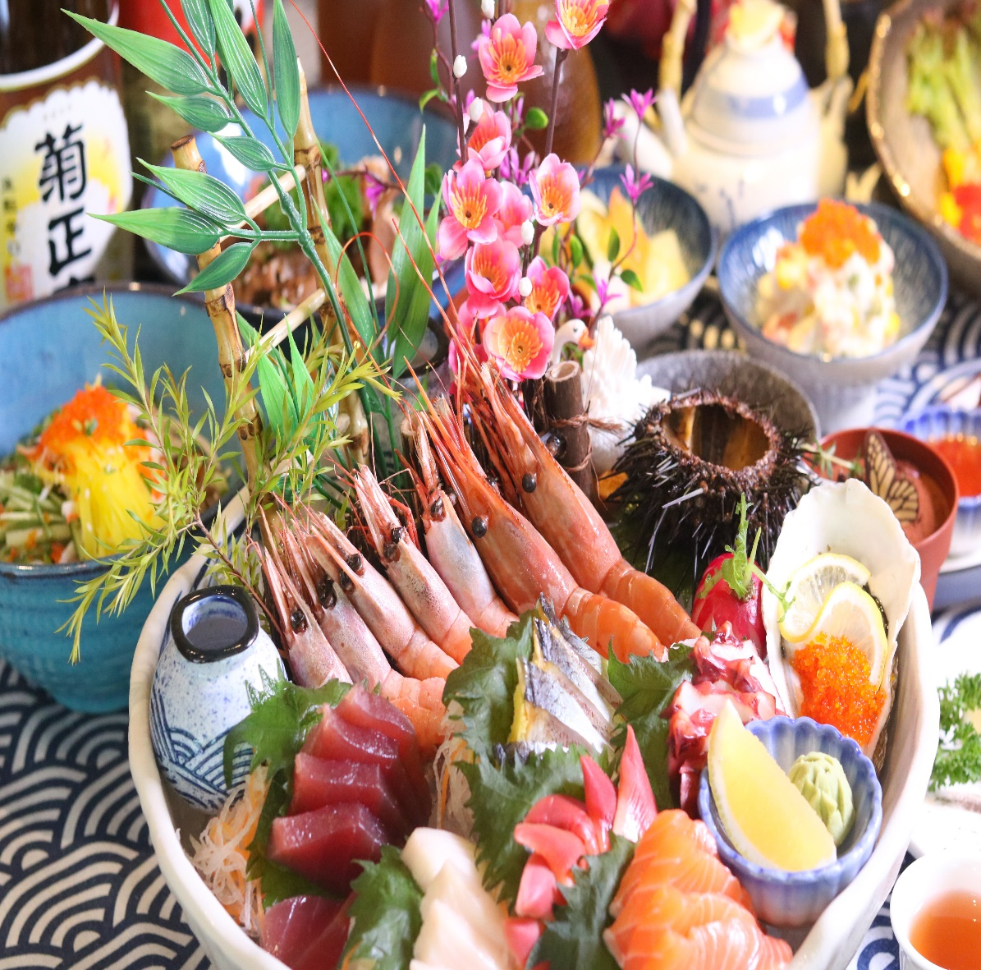
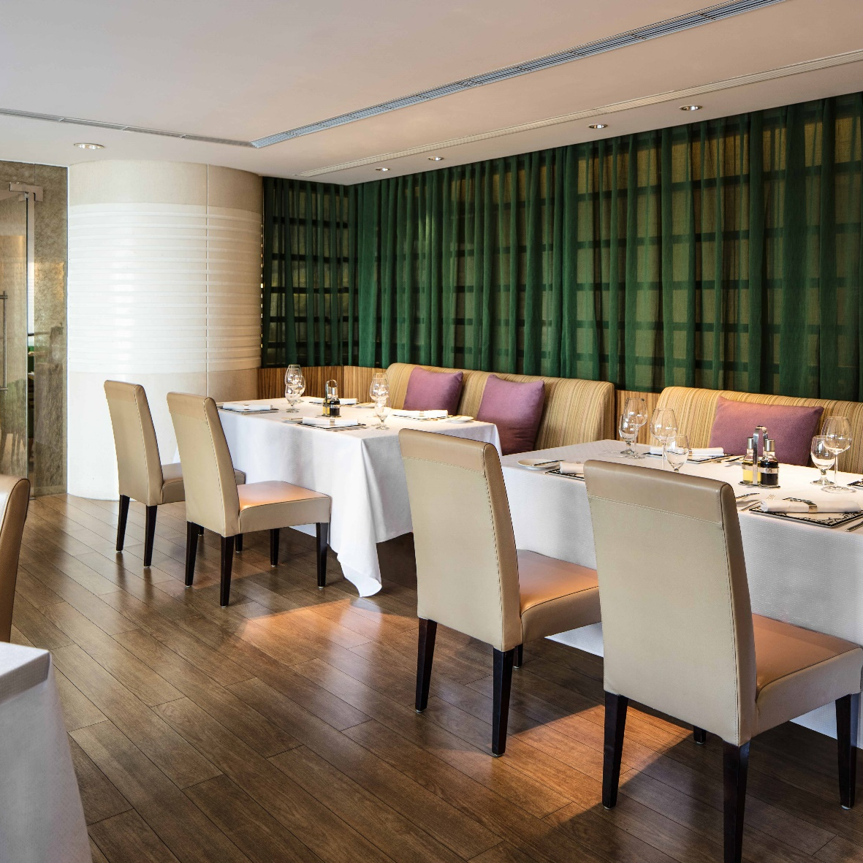
酒店餐厅 Hotel Restaurant
绿茵餐厅
Olea Restaurant
日式料理精致健康的饮食理念，在厦门喜来登酒店绿茵餐厅主厨用心细致的烹饪下，带您体验日式料理文化和传统的和风美味。
Explore the Japanese cuisine here of Olea Restaurant at Sheraton Xiamen Hotel, experience the Japanese healthy cuisine with the elegance touch of our chef preparations.
营业时间 Operation Hours: 18:00 - 22:00 可容纳人数Capacity：28

Slide 22
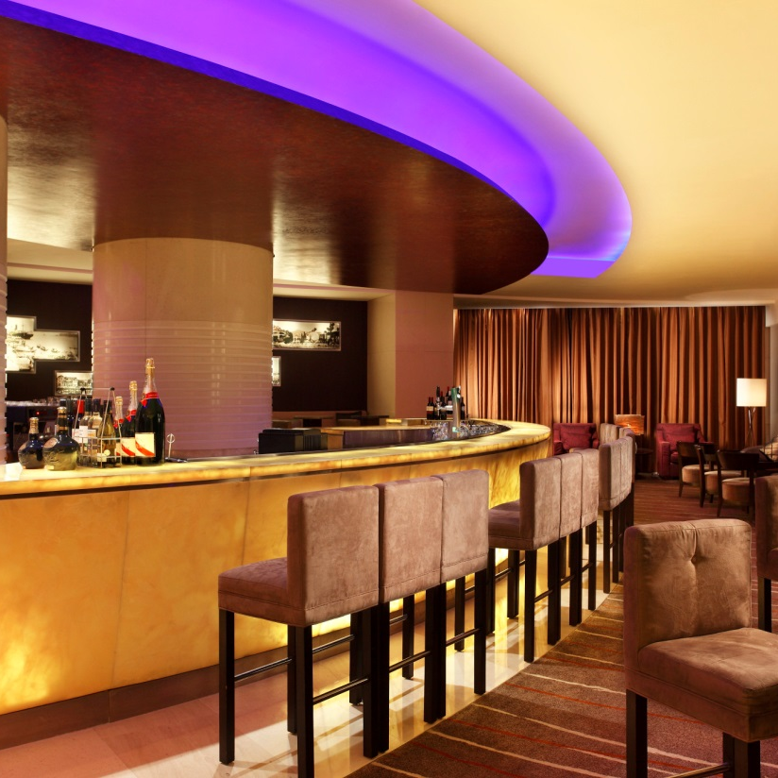
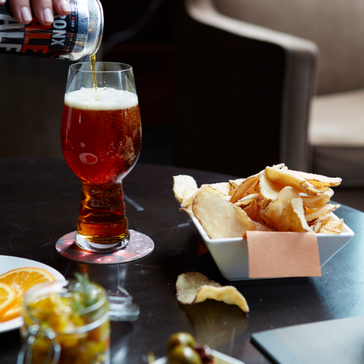

酒店餐厅 Hotel Restaurant
观景大堂吧
Vista Lounge
观景大堂吧设有舒适的沙发，现场爵士乐演奏及品种繁多的小点、鸡尾酒和红酒
Vista Lounge features comfy sofas, live jazz music and an unparalleled choice of snacks, cocktails and wines.
营业时间Operation Hours : 09:00 - 00:00 可容纳人数Capacity ：82

Slide 23
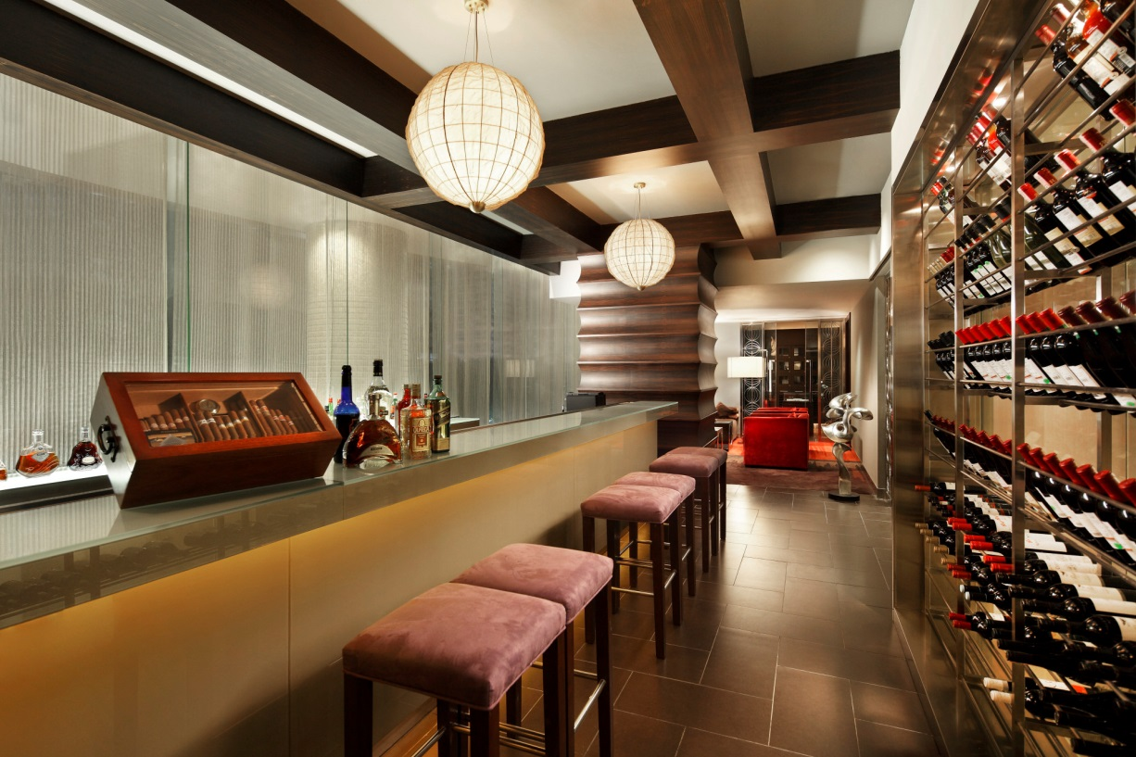
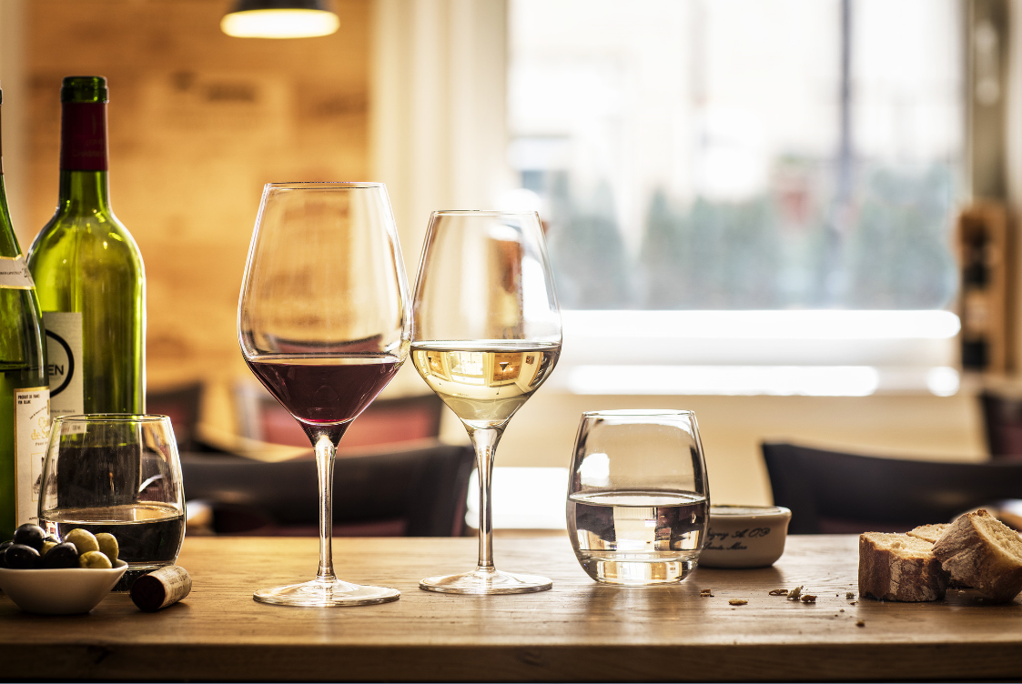
酒店餐厅 Hotel Restaurant
龙吧Loong Bar ——雪茄吧Cigar & Wine
谧静的氛围，是雪茄及红酒爱好者的最佳去处
An intimate venue for cigar aficionados and wine lovers
营业时间 Operation Hours ：18:00 - 00:00
可容纳人数 Capacity ：28

Slide 24
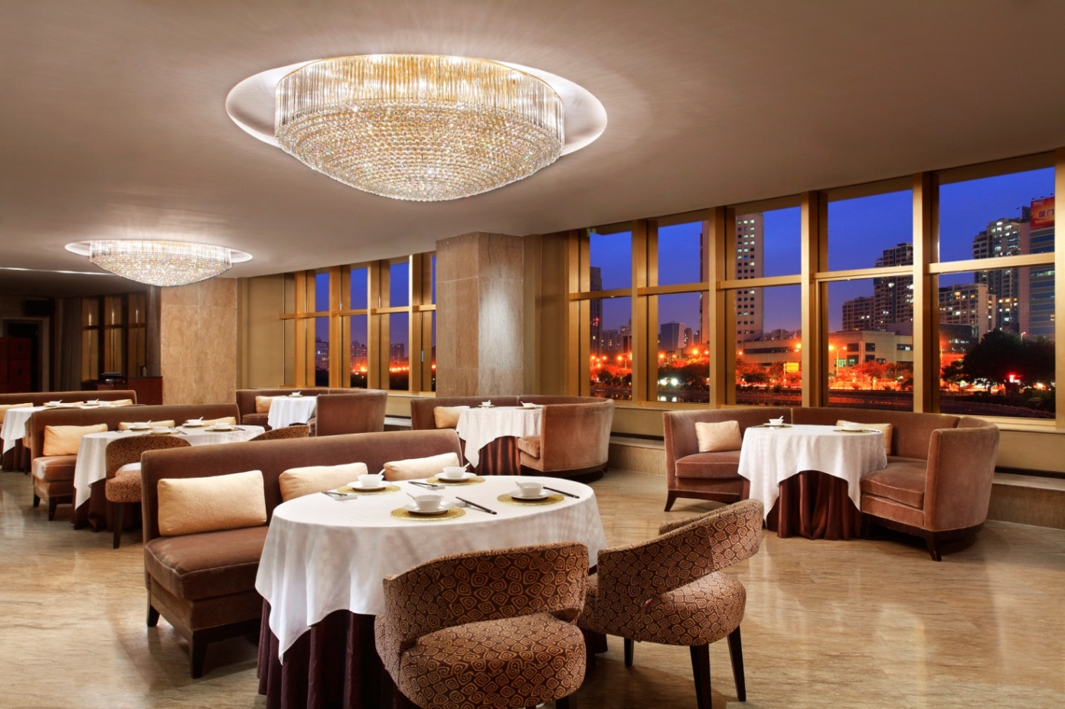
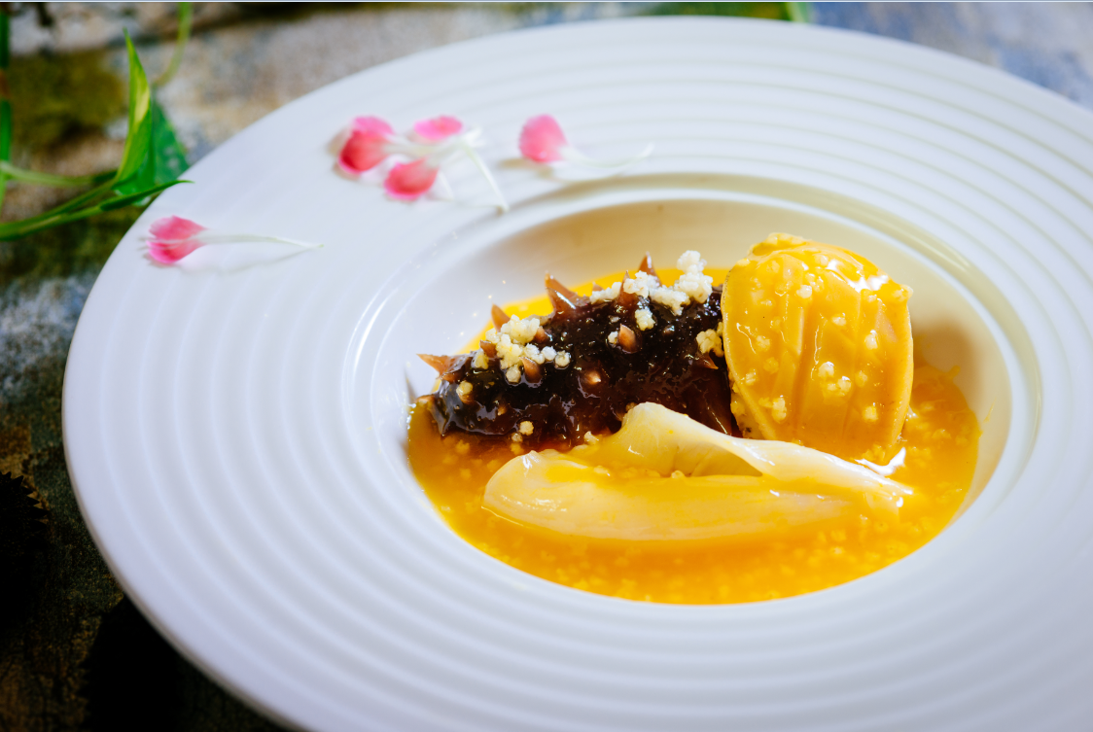
酒店餐厅 Hotel Restaurant
王子饭店
Prince Restaurant
这间由王子饭店及餐饮管理有限公司经营管理的餐厅可为您提供顶级的广东美食体验。
餐厅位于酒店三楼和四楼，拥有 5000 平米的主餐区和 25 间包房。
Dine on premium Cantonese cuisine at this eatery managed by Prince Hotels and Catering Management Co., Ltd.
Located on the 3rd and 4th floor of the hotel it boasts a main dining area of 5000 square meters and 25 private rooms

Slide 25
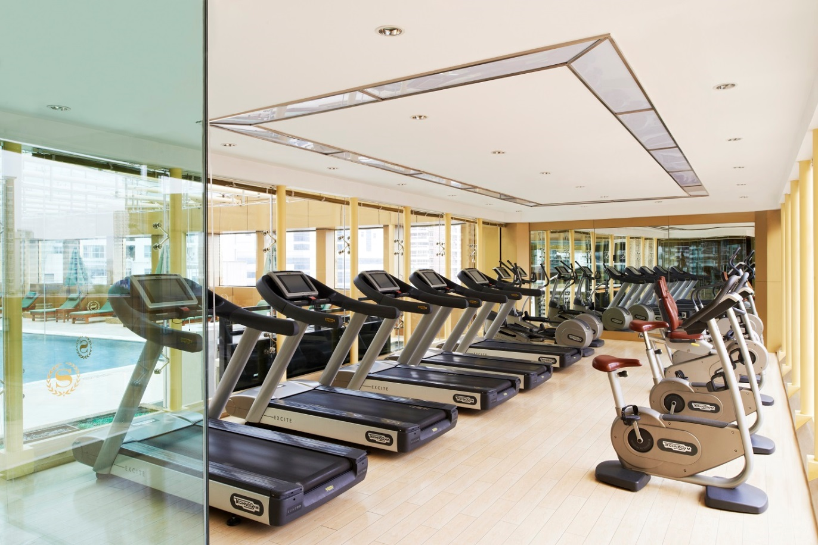
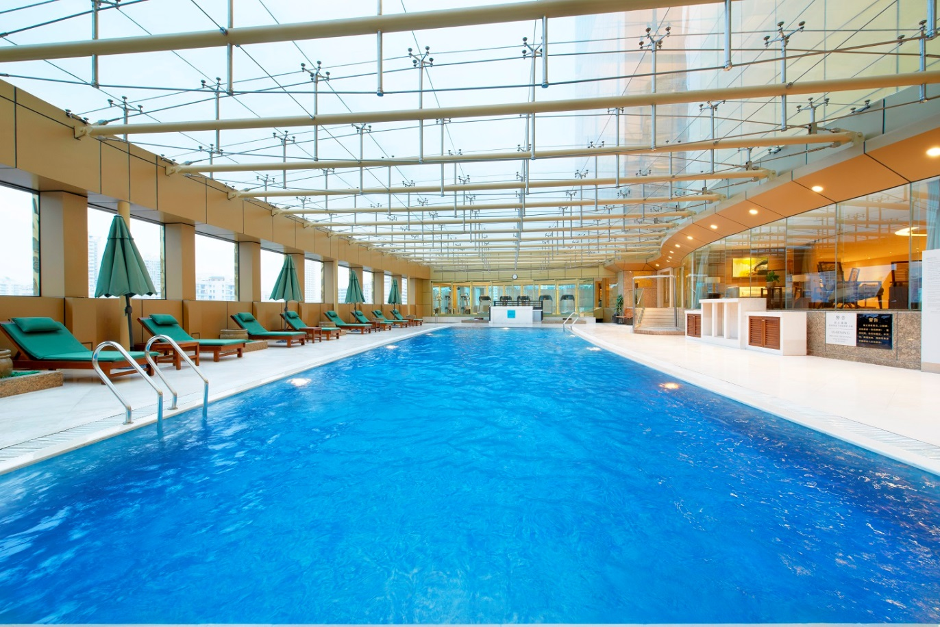
健身中心 Fitness Center
24小时全天侯健身中心
24-hours state-of-the-art fitness center
恒温游泳池
Swimming pool

Slide 26

联系我们 Contact Information
中国福建省厦门市嘉禾路386-1号 361009
386-1 Jiahe Road, Xiamen, Fujian 361009, P.R. China
电话 Tel: +86 592 552 5888
传真 Fax: +86 592 553 9088
官网 Website: Marriott.com.cn/xmnsi
官方微信 Official WeChat: sheratonxiamen

Slide 27
谢谢！ Thank You

