Slide 1
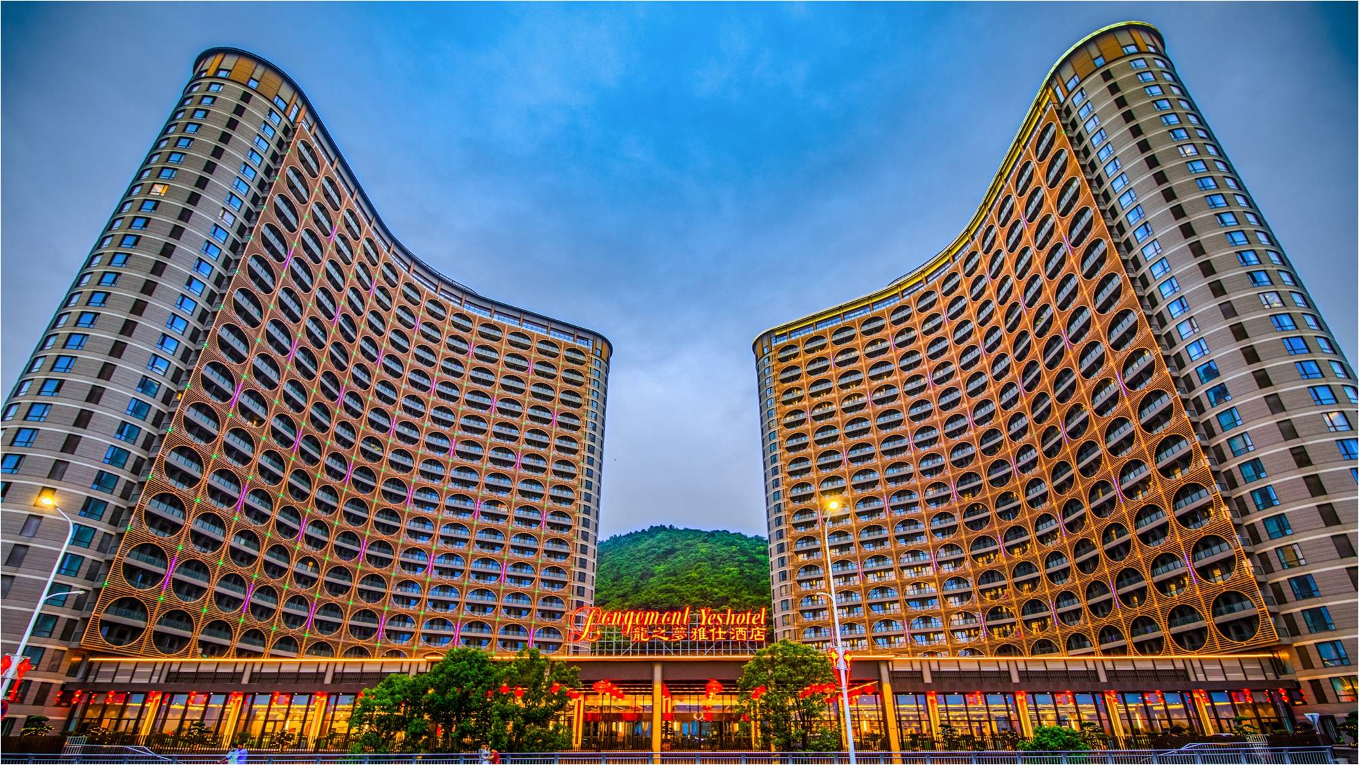

宴 会 会 议 手 册
Conference Manual

Slide 2
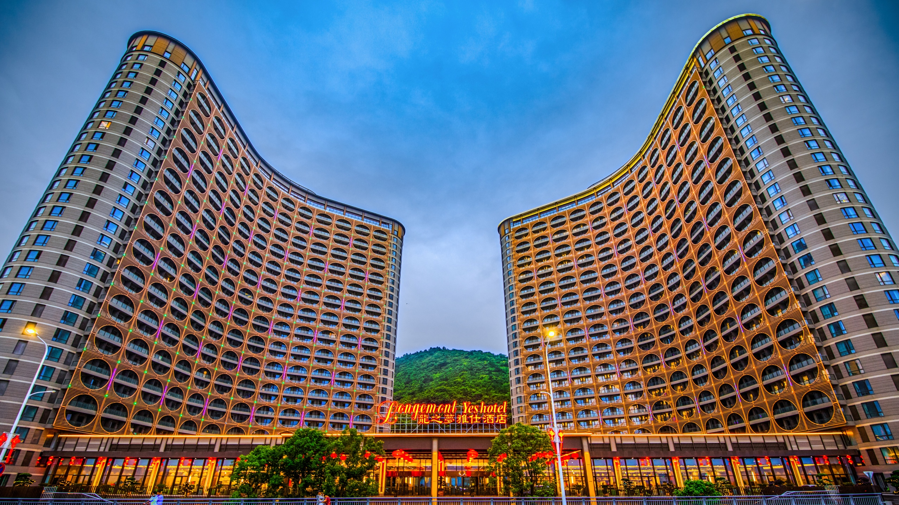
01
龙之梦雅仕湖畔酒店
Taihu Lake Longemont Yes Hotel
介绍 Introduction
坐标 Location
设施 Facility
客房 Room
餐饮 Catering
会议室 Conference Room
目录
Contents
02
会议礼仪服务
Conference Etiquette Service
03
太湖龙之梦乐园整体业态
Taihu Lake Longemont Paradis

Slide 3

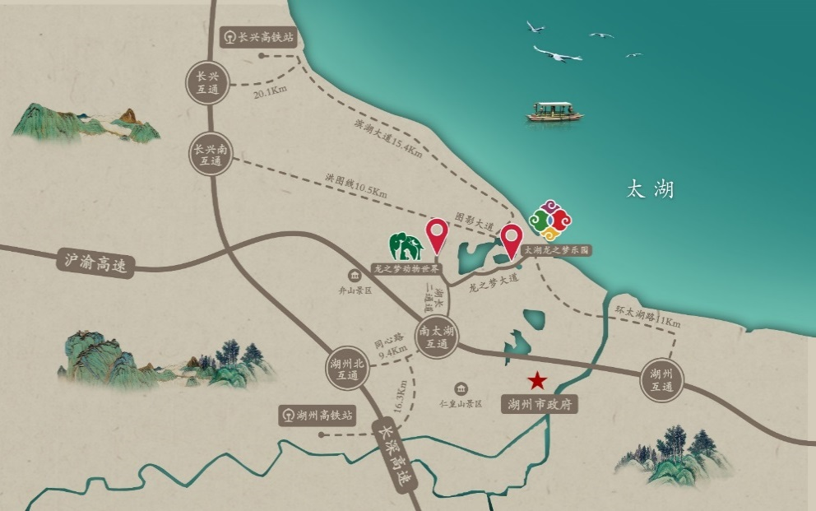
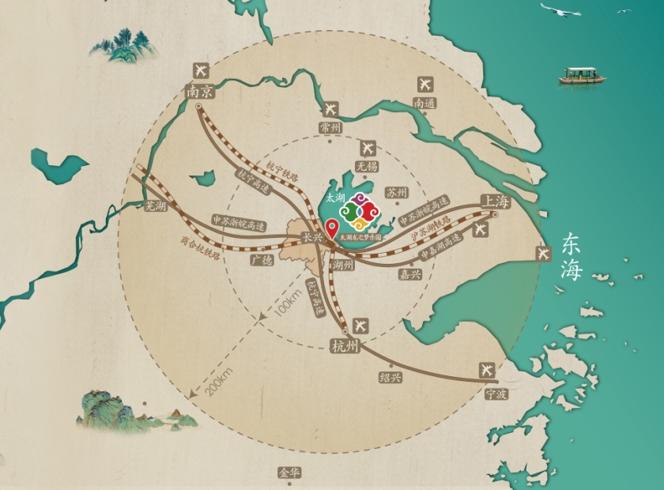
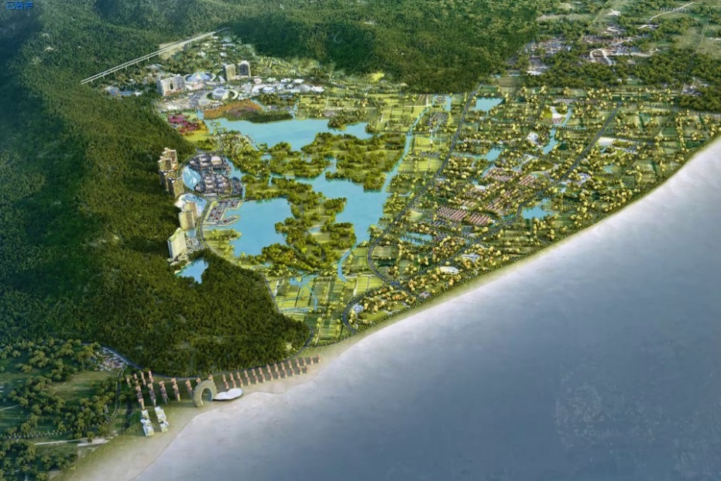
酒店坐标
Hotel Location
PART I
Location
太湖龙之梦乐园位于湖州长兴，地处三省交界、长三角几何中心，区位优势明显
Changxing, Huzhou, sitting in the middle of the Yangtze River Delta
高速公路：二横一纵，2小时直达长三角主要城市，G25杭宁高速、G50沪渝高速、S12申嘉湖高速 在此交汇
Intersection of 3 highways: G25, G50, S12, 2 hours to all Yangtze River Delta main cities
湖州/长兴-上海
Changxing - Shanghai
湖州/长兴-杭州
Changxing - Hangzhou
湖州/长兴-南京
Changxing - Nanjing
湖州/长兴-芜湖
Changxing - Wuhu
约150公里，驾车约2小时，高铁1.5小时，浦东机场190公里
150KM, 2-hour drive, 1.5-hour high-speed train, PVG 190KM
约100公里，驾车1.5小时，高铁30分钟，萧山机场126公里
100KM, 1.5-hour drive, 30-min high-speed train, ZSHC 126KM
约200公里，驾车约2.5小时，高铁1小时，禄口机场168公里
200KM, 2.5-hour drive, 1-hour high-speed train, NKG 168KM
约210公里，驾车约2.5小时，高铁2小时
210KM, 2.5-hour drive , 2-hour high-speed train,

Slide 4
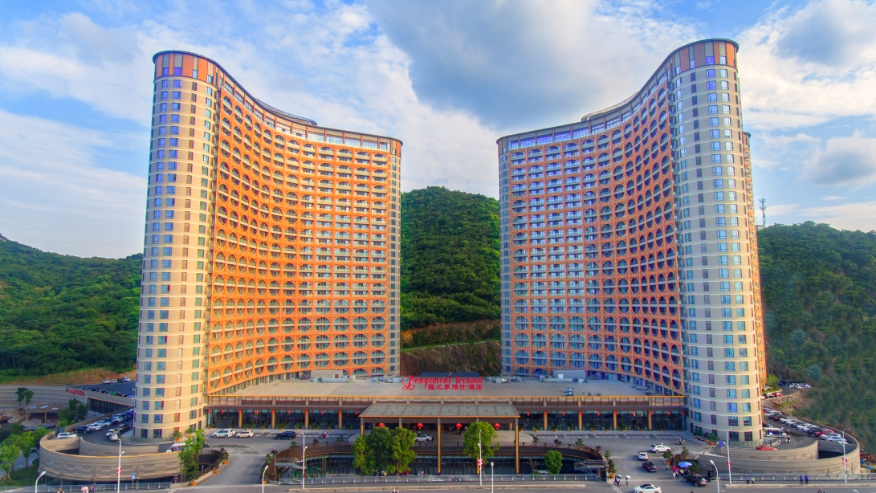
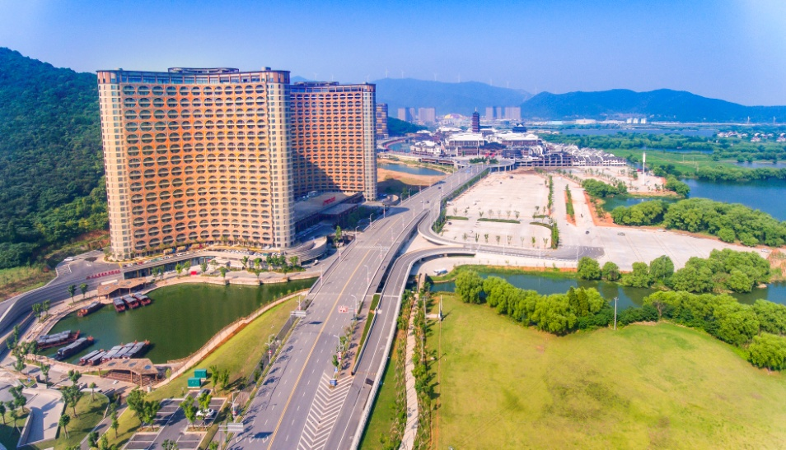
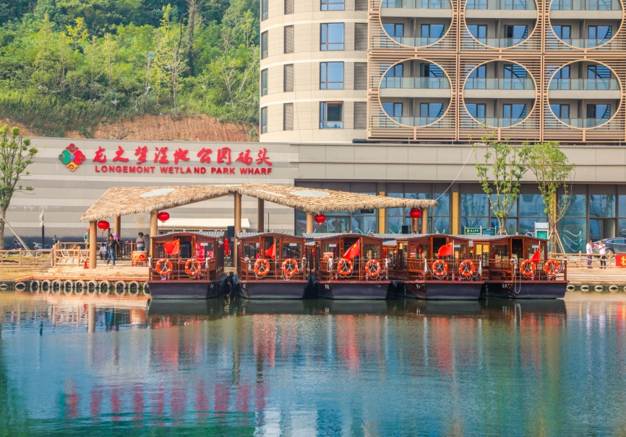
酒店简介
Hotel Introduction
PART II
Taihu Lake Longemont Yes Hotel
雅仕酒店是太湖龙之梦乐园酒店集群中体量最大的单体酒店，共有4443间客房，7380个床位，3个宴会厅，为游客提供大众化消费、星级酒店服务。酒店面朝5000亩浩瀚湿地，背靠弁山，位于园区内高架桥东段起点，处于钻石酒店与太湖古镇中间，地理位置绝佳。酒店东面建设有龙之梦湿地码头，酒店出门即可乘船游览龙之梦龙之梦图影湿地。
Yes Hotel is the largest single hotel in Taihu Lake Longemont hotel cluster, with a total of 4,443 rooms, 7,380 beds, 3 Dining Hall, providing mass consumption and star hotel services for tourists. The Hotel face the 5000 acres of wetland，back to Bianshan mountainsthe，hotel is located at the beginning of the east section of viaduct in Paradis, between the Diamond Hotel and Taihu Ancient Town, with an excellent geographical position. To the east of the hotel is built the Longemont Wetland Pier, and out of the hotel you can take a boat tour of the Longemont Longemont Picture Wetland.

Slide 5
酒店设施
Hotel Facility
PART II
Taihu Lake Longemont Yes Hotel
 | 设施 Facility | 规模 Scale
酒店客房 Hotel room | 房间数 Room Quantity | 4443间
 | 床位数 Bed Quantity | 7380个
宴会会议厅 Ballroom | 宴会厅 Dining Hall | 3个
 | 总面积 Area | 2790m²
停车场 Parking | 地下停车场 Underground Parking | 473个停车位
 | 露天停车场 Parking Ground | 882个小车，147个大巴
酒店餐饮 Food & Beverage | 负1楼团餐厅 -1F Restaurant | 5040个餐位
 | 29楼自助餐厅 29F Buffet Restaurant | 1128个餐位
观赏区 Viewing Area | 1楼狮园 1F Lion Garden

Slide 6
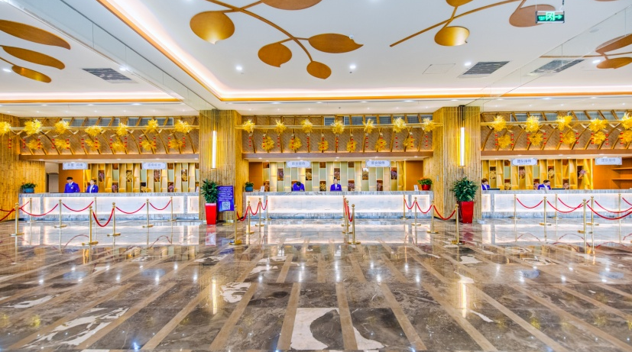
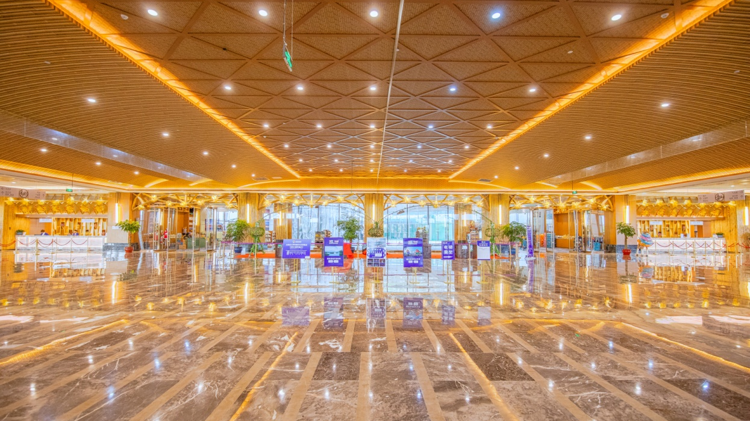
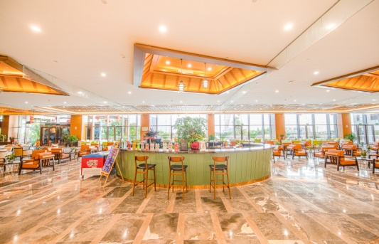
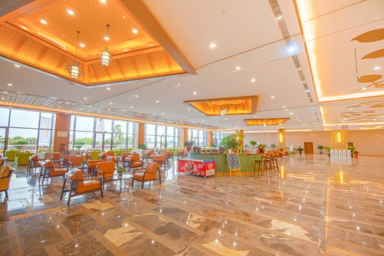
酒店大堂
Hotel Lobby
PART II
Taihu Lake Longemont Yes Hotel
雅仕湖畔酒店大堂
Yes Hotel Lobby
一楼大堂近6000平方米，恢弘而大气。
游客可在一楼狮园观赏西域雄狮。
The lobby on the first floor is almost 6000 square meters, magnificent and atmospheric. Visitors can watch the western lions in the lion Park on the first floor.
酒店前台 Reception
酒店吧台 Lobby Bar
大堂休息区 Lounge

Slide 7
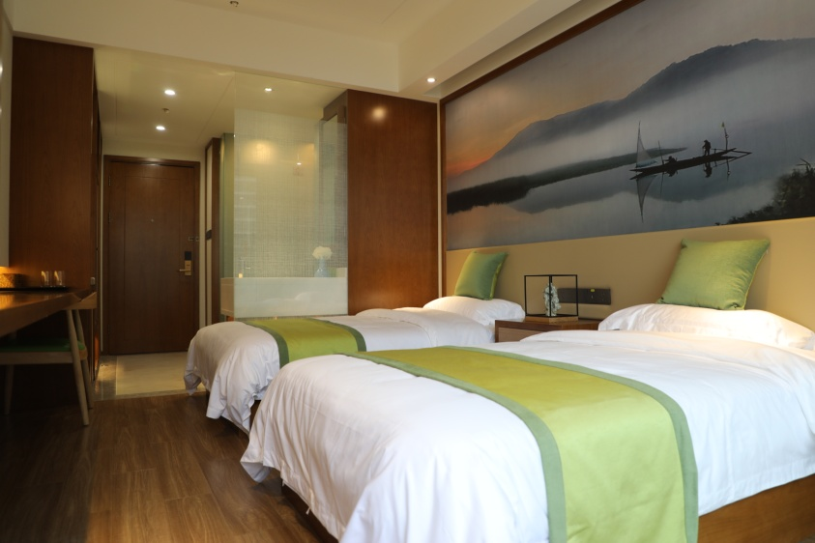
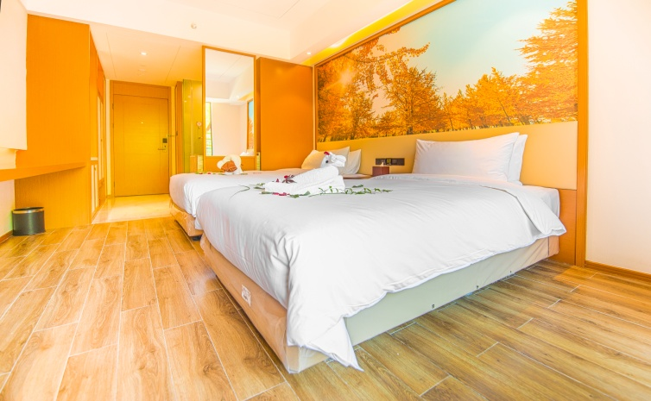
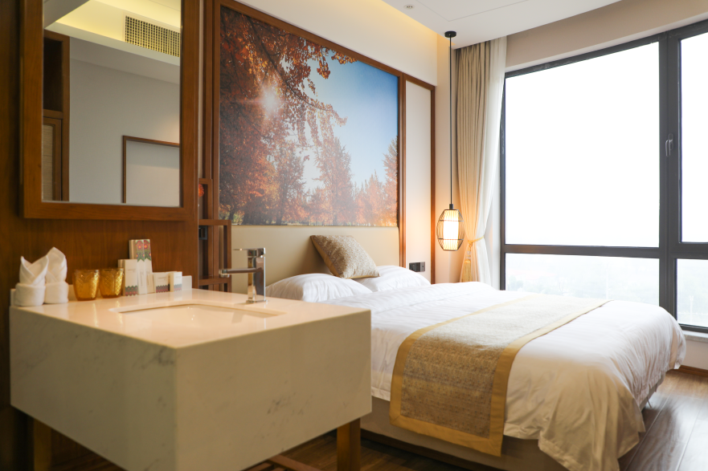
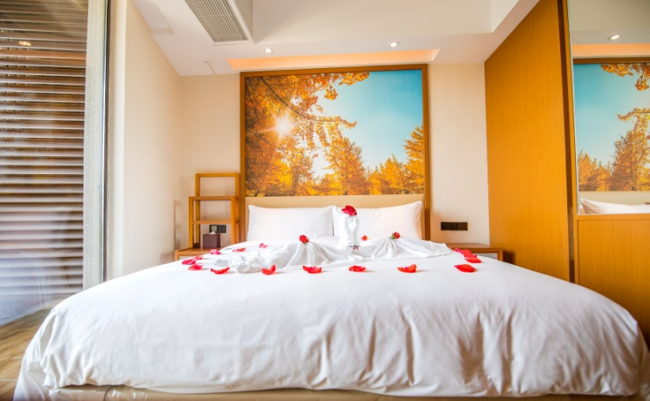
酒店客房
Hotel Room
PART II
Taihu Lake Longemont Yes Hotel
客房房型 Room Type | 楼层 Floor | 间数 Room Quantity
山景房 Mountain view room | 3F-28F | 1041
湖景房 Lake view room | 3F-28F | 2154
山景豪华房 Luxury mountain view room | 3F-28F | 170
湖景豪华房 Luxury lake view room | 3F-28F | 432
烟花景观房 Fireworks landscape room | 10F-28F
湖景双床房 Luxury Lake View Twin Room
面积 Area | 床型 Bed size
24m² | 1.2m*2m
山景豪华房 Luxury Mountain View Room
面积 Area | 床型 Bed size
21.6-22m² | 1.8m*2m

Slide 8
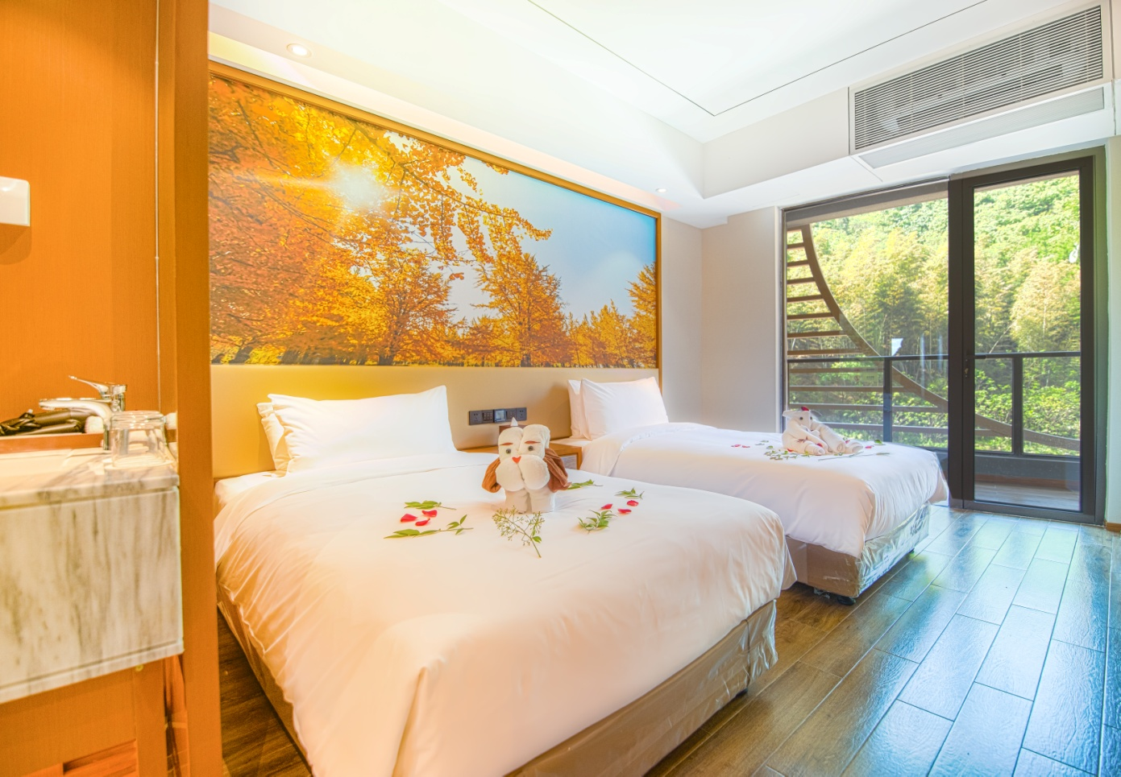
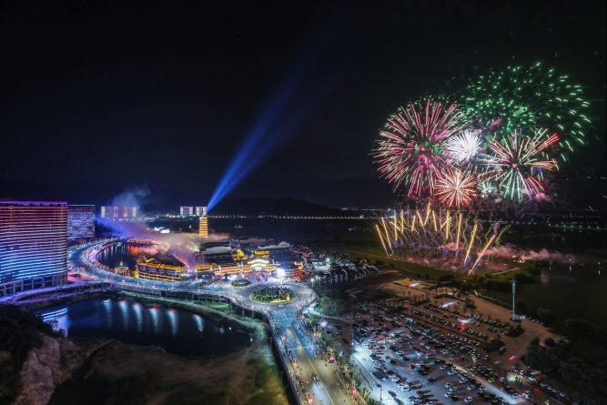
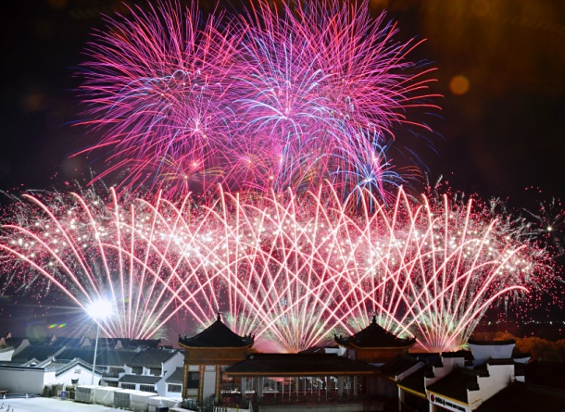
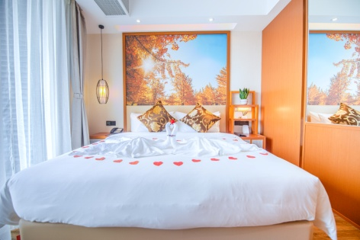
酒店客房
Hotel Room
PART II
Taihu Lake Longemont Yes Hotel
烟花大会
Fireworks show
10楼以上，面朝太湖古镇的烟花景观房，可以俯瞰每周五晚的烟花大会，长达12分钟，近万发最高可达220米高空的大型礼花弹，让您足不出房，就欣赏震撼烟花大会。
Above10 floors, fireworks landscape room facing Taihu Ancient Town, you can overlook the fireworks show every Friday evening. It lasts for 12 minutes and contains nearly 10,000 large fireworks which can reach a height of 220 meters. You can enjoy it without even leaving the room.
烟花景观房 Fireworks landscape room
面积 Area | 床型 Bed size
21.6-22m² | 1.8m*2m

Slide 9
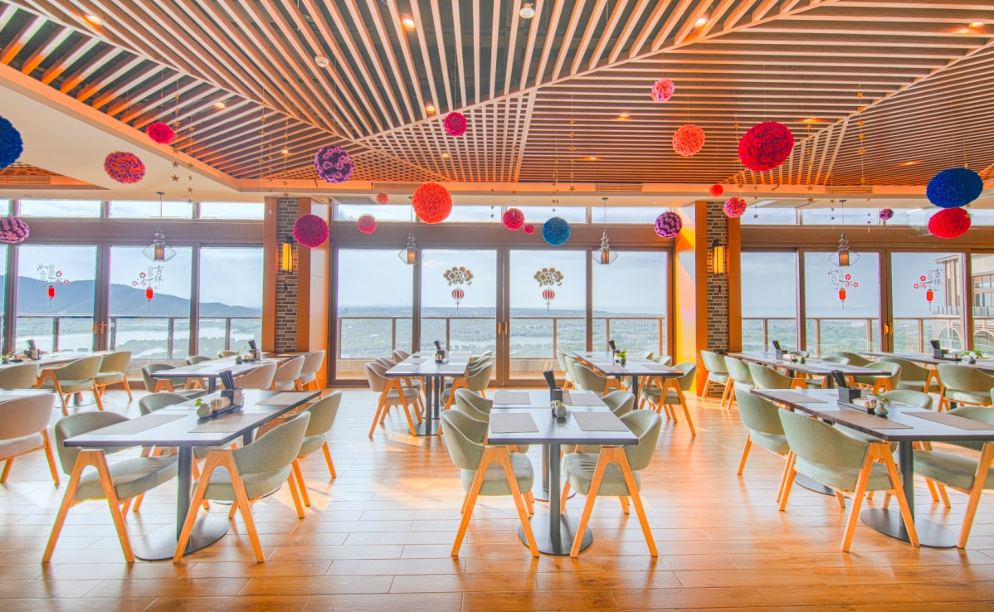
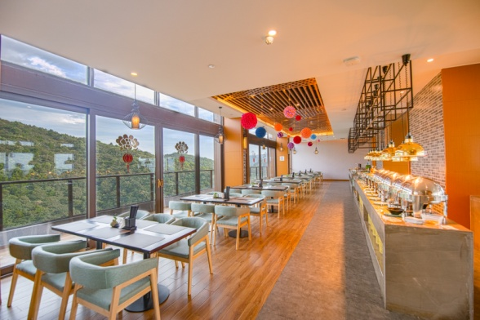
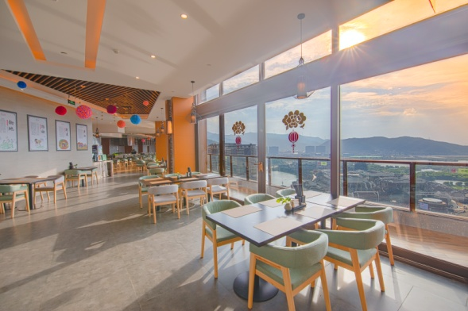
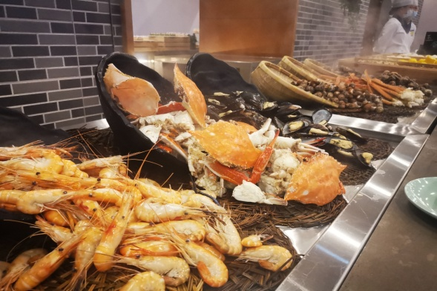
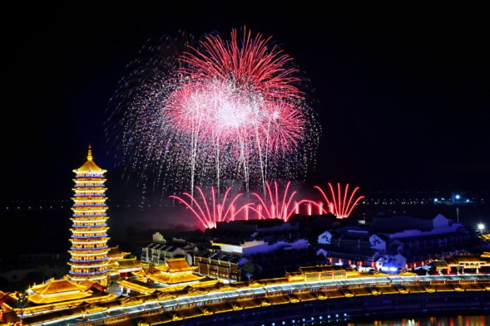
自助餐厅
Buffet Restaurant
PART II
Taihu Lake Longemont Yes Hotel
雅仕湖畔酒店29F 自助餐厅
Yes Hotel 29F Buffet Restaurant
自助餐厅位于雅仕湖畔酒店顶层自助餐厅合计拥有3400平米的1128个餐位，靠太湖古镇方向的100米外阳台，既可近距离观看烟花大会，又可以欣赏到灯火璀璨的太湖古镇。
The Buffet Restaurant is sitting on top of the Yes Hotel with 1125 seats, 3400m² , leaning on the balcony that 100 meters away from the Taihu Ancient Town, you can watch the fireworks up close and enjoy the lights of Taihu Ancient Town.

Slide 10
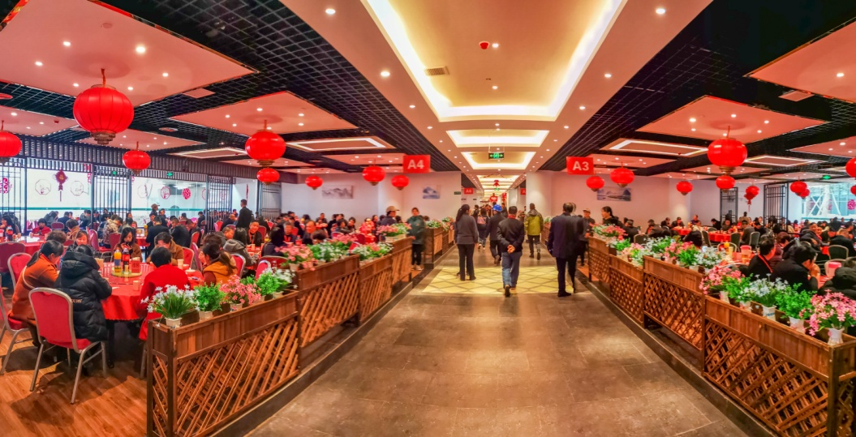
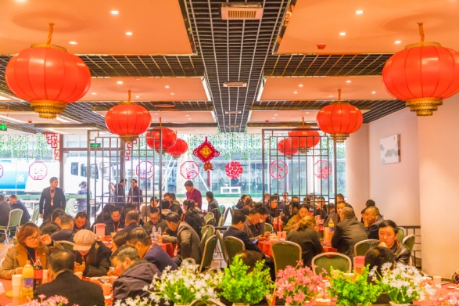
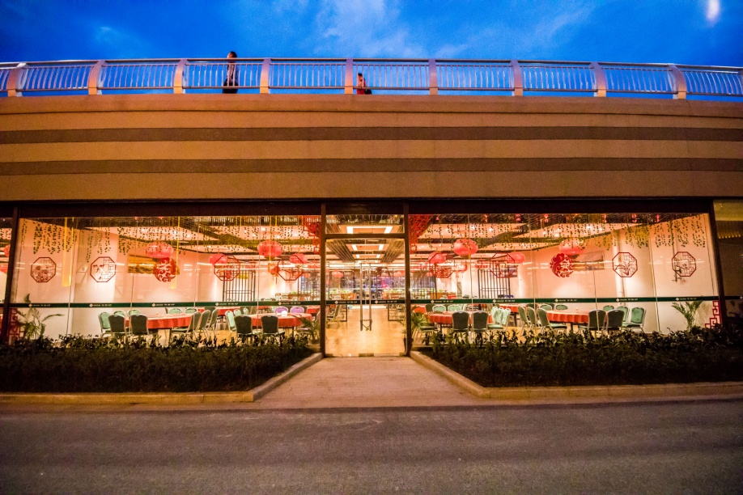
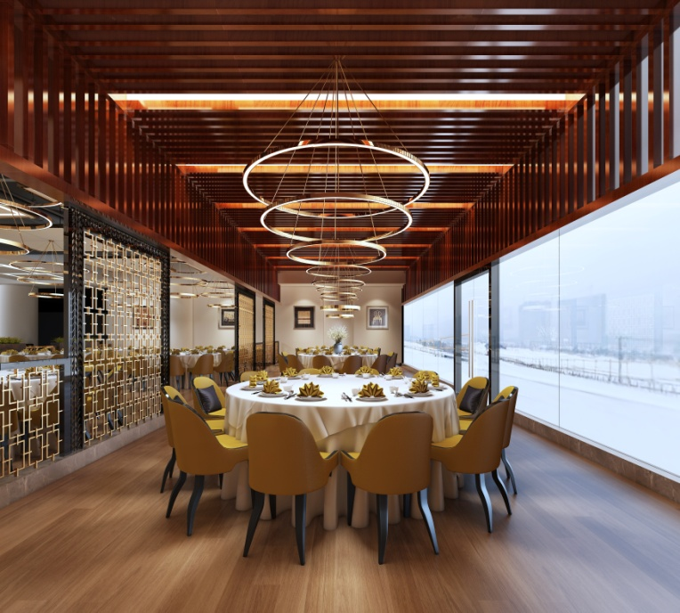
负1楼团餐厅
-1F Group Restaurant
PART II
Taihu Lake Longemont Yes Hotel
雅仕湖畔酒店-1F团餐厅
Yes Hotel -1F Group Restaurant
餐厅位于雅仕湖畔酒店负1楼，可同时接待5040人就餐，12人一桌，4桌一个区域，保证一辆50座大巴车能够在一个区域集中用餐。
The Group Restaurant sitting on -1st Floor , can serve 5040 people at the same time, 12 people per table, 4 tables per area, to ensure that a 50 visitors from the same bus can dine in one area.

Slide 11
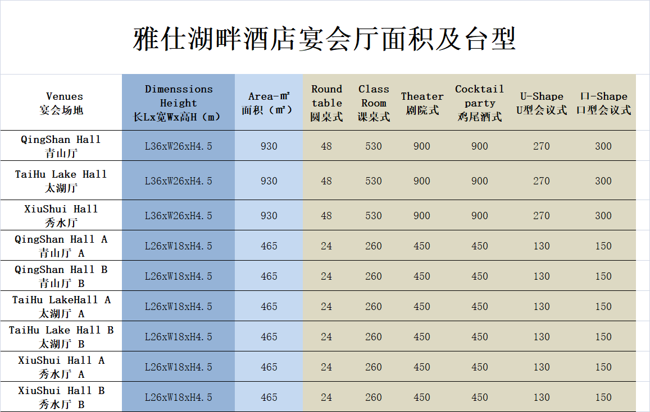
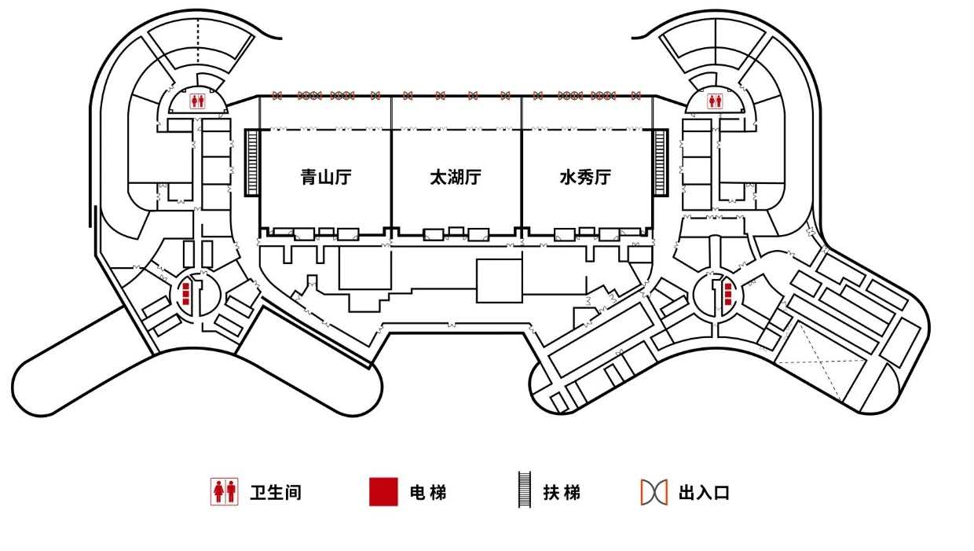
酒店宴会厅
Hotel Conference Center
PART II
Taihu Lake Longemont Yes Hotel
雅仕湖畔酒店-1F宴会厅
Yes Hotel -1F Dining Hall
雅仕湖畔酒店主楼负一楼，共拥有3个近1000平米的宴会厅，可容纳150桌宴席或2700人会议，可根据需求拆分成6个多功能厅。
On the -1st floor of the Yes Hotel, having 3 banquet halls of 1000 square meters, which can hold 150 tables or 2700 people, and can be divided into 6 multi-function halls according to the demand.

Slide 12
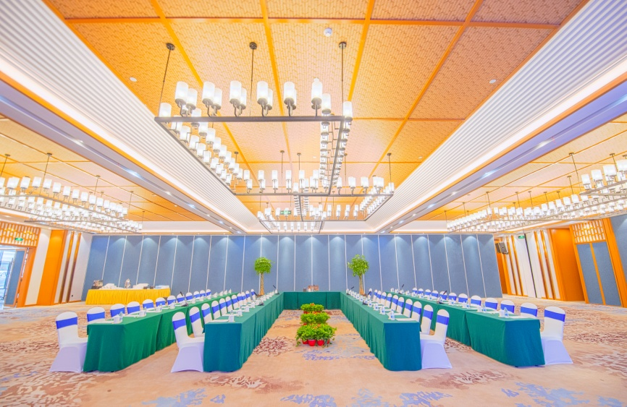
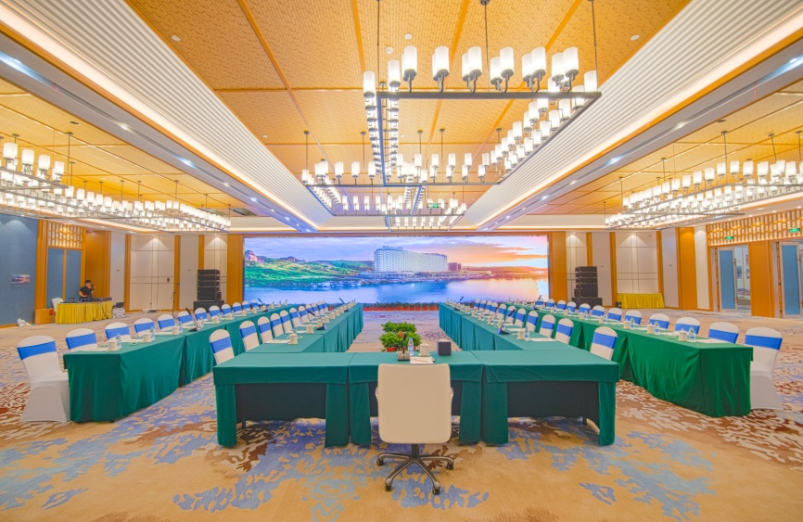
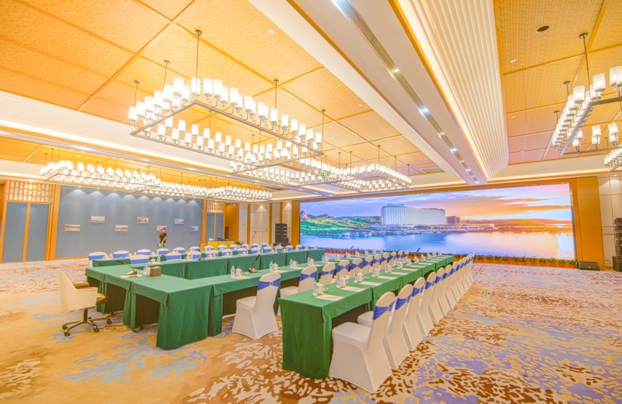
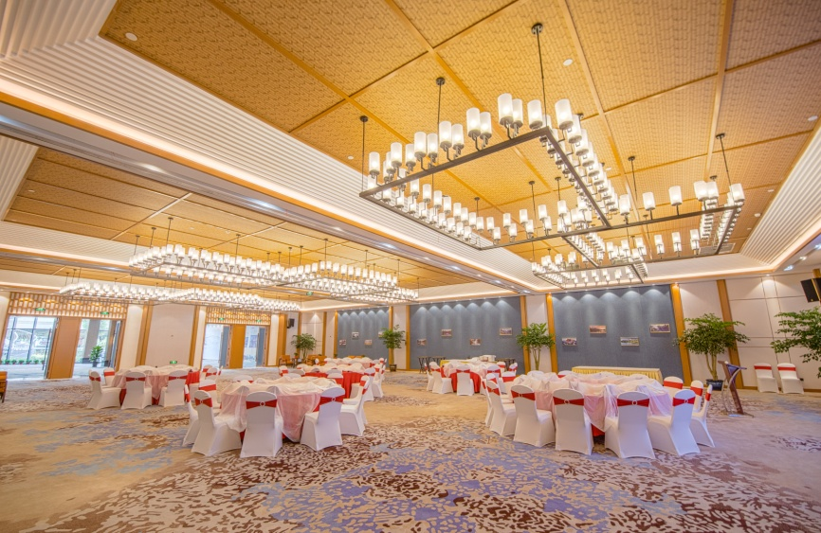
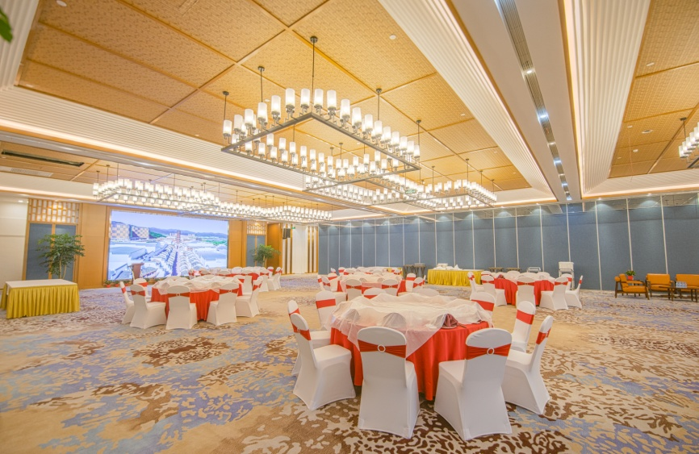
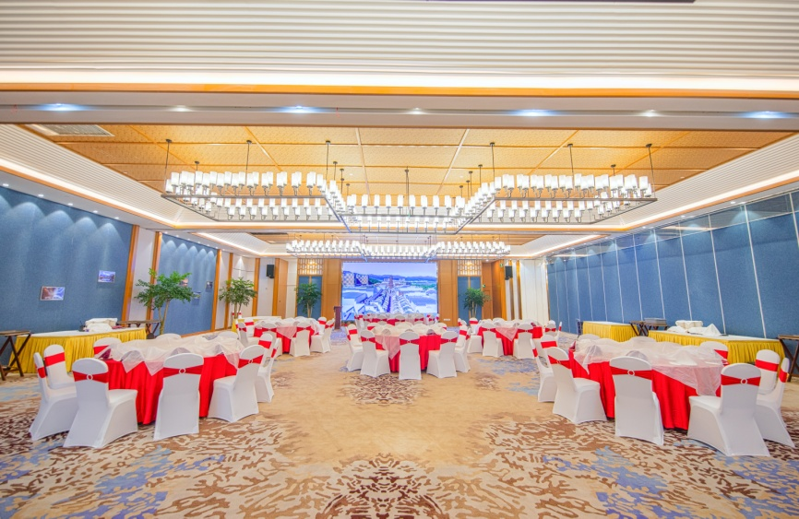
酒店宴会厅
Hotel Conference Center
PART II
Taihu Lake Longemont Yes Hotel

Slide 13
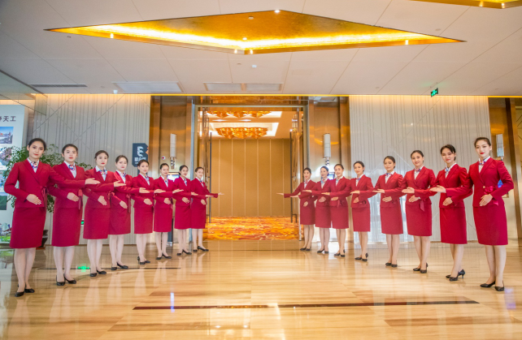
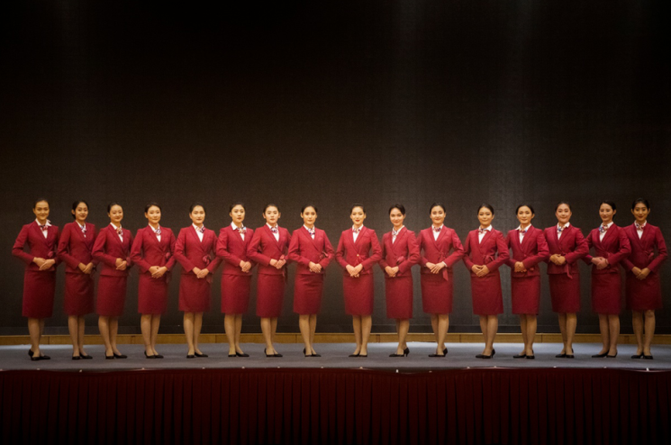
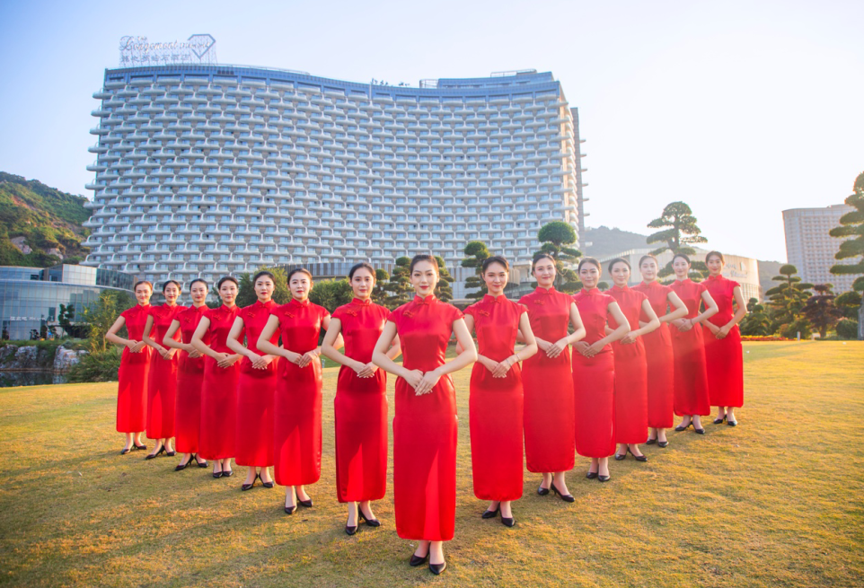
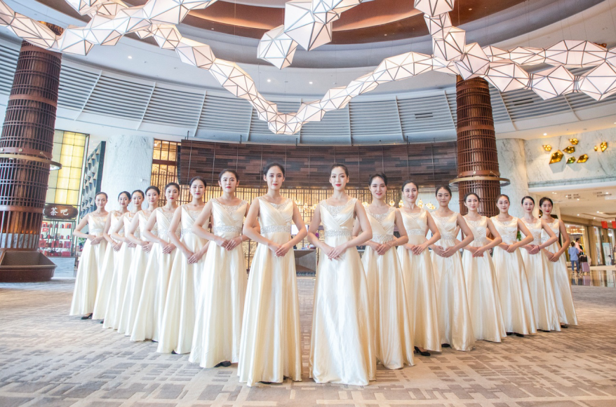
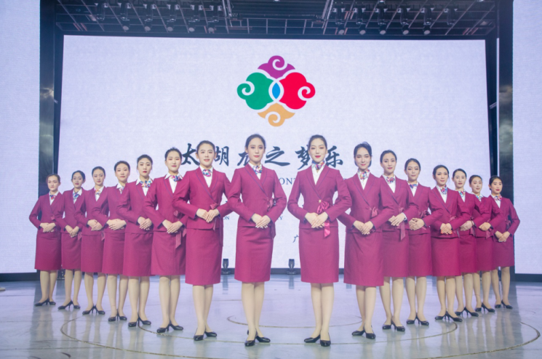
会议礼仪服务
International Conference Center 2F
PART II
International Conference Center
太湖龙之梦乐园礼仪队提供高水准礼仪增值服务
The Taihu lake Longemont Paradise Etiquette Team provides high standard etiquette value-added services

Slide 14
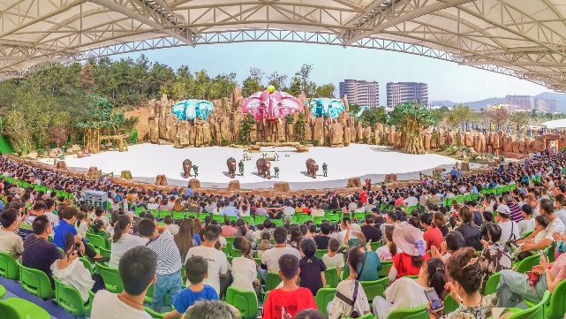
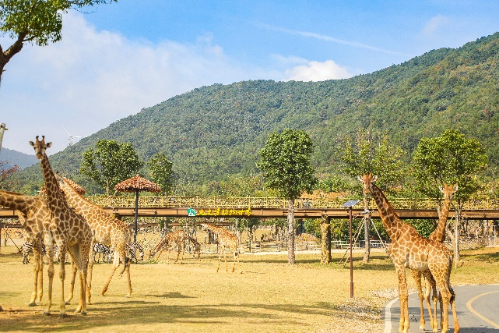

太湖龙之梦乐园整体业态
Taihu Lake Longemont Paradis Business Scale
PART III
Taihu Lake Longemont Paradis
已开放乐园游乐项目
7家酒店+62家客栈
合计约28000间客房
70000个床位
年2550万个床夜
500个床位三甲上海仁济医院+10000个床位养老公寓
89个、30000平米宴会会议厅+30万平米会展中心
45个演艺场点
75000个演艺席位
2000名专职演员
其中400名外籍演员
17270个地下停车位+
3294个地面大巴停车位
合计20564个停车位
500余种、30000余头只
陆生+海生动物
21张独立门票
12大主题业态
400栋房子
425万平米建筑
4.09公里园区主干道
60公里园区游览动线
20000平方米室内婚纱儿童摄影拍摄场地+400个室外婚纱儿童摄影拍摄点+300间专属婚房
龙之梦动物世界
占地1600亩，分步行区、车行区两个游览区域
数百种野生动物，与动物零距离接触
五大动物科普秀，寓教于乐
充满童趣的儿童乐园，八大项目畅玩
参观5000平米的古森林博物馆
龙之梦图影湿地公园
国家4A级景区，需乘船上岛
面朝太湖，三面环山
腹拥湿地，依山为图，映水为影
原生态展示农耕文化，旅游观光民俗风情体验

Slide 15

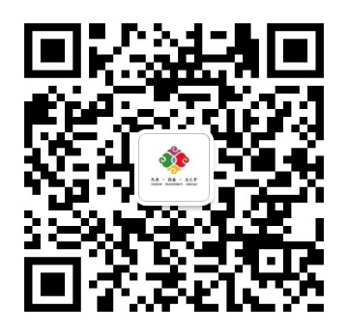
THANKS FOR YOUR ATTENTION
期待与您合作
地址：浙江省湖州市长兴县太湖图影旅游度假区, 313000
Taihutuying Holiday Resort,Changxing Count,Huzhou City,Zhejiang Province,China 313000
电话/T: 4006177878 +86 0572-6666199 传真/Fax: +86 0572-6099800

Slide 16
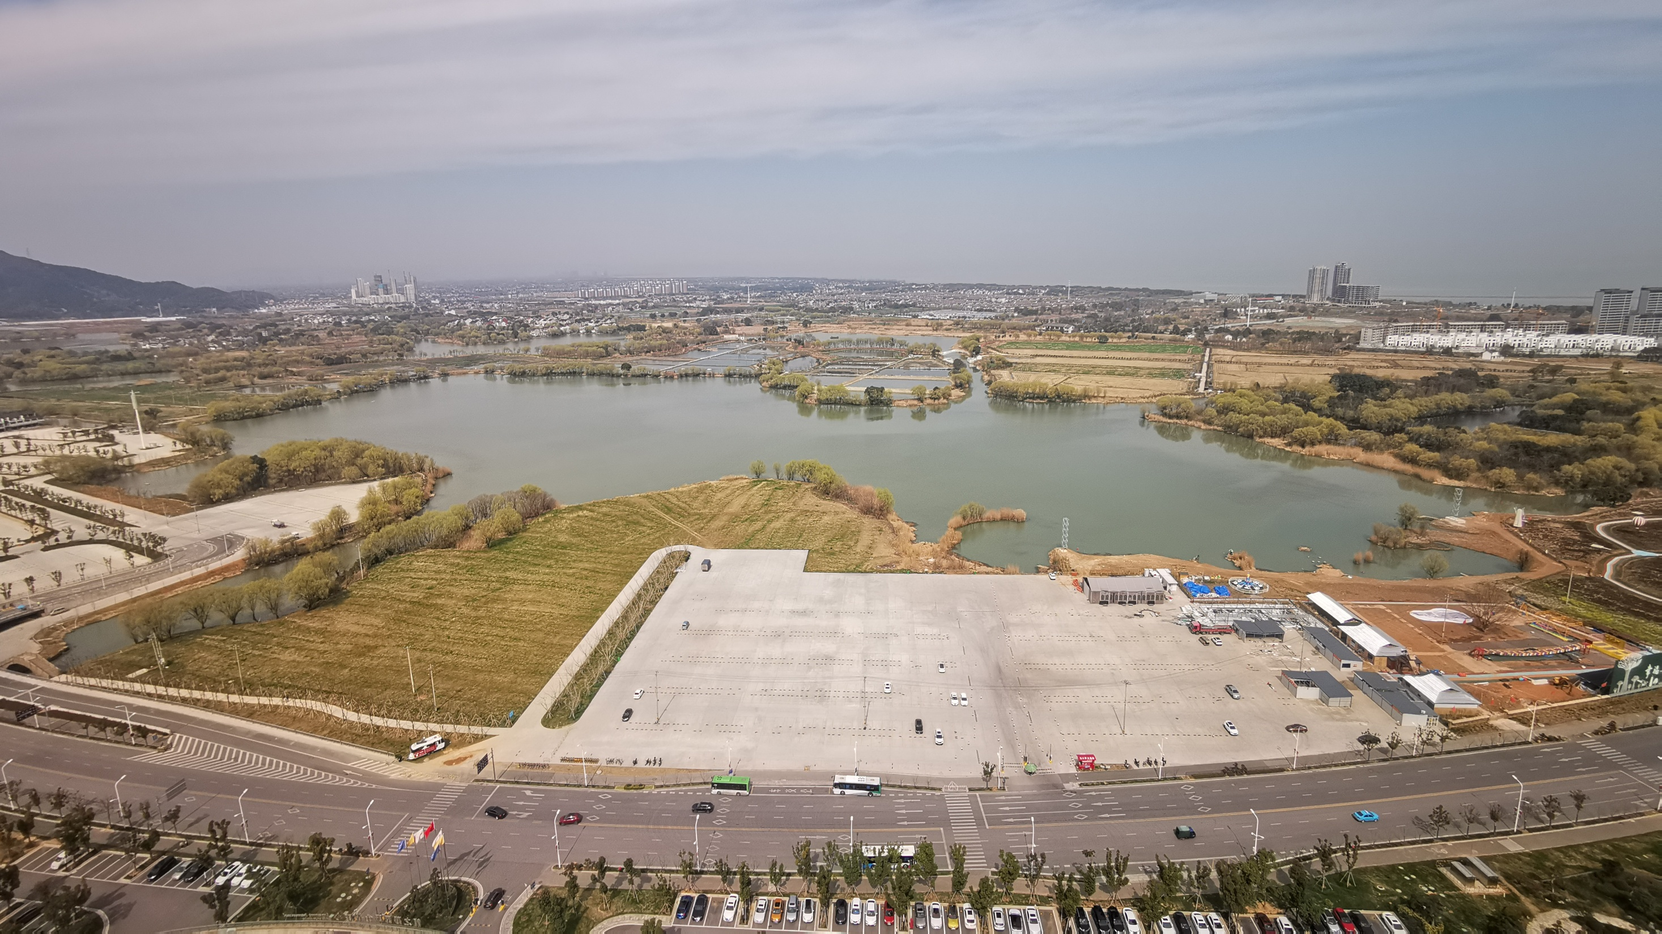
大型风筝造型户外展示区
游客风筝放飞区
大型专业风筝放飞区
主舞台
美食区/风筝DIY区
风筝观赏及风筝手休息区

