Slide 1

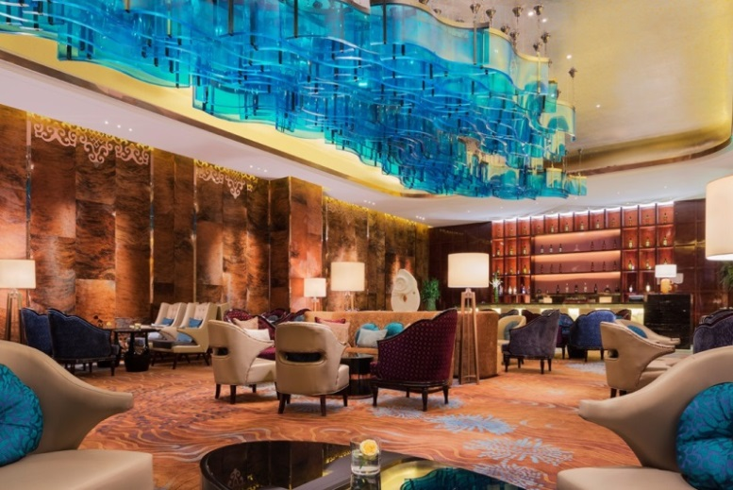
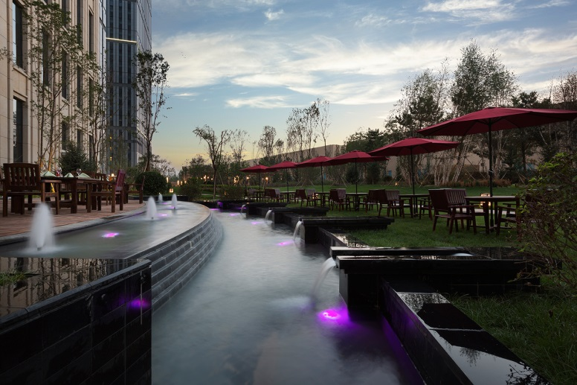
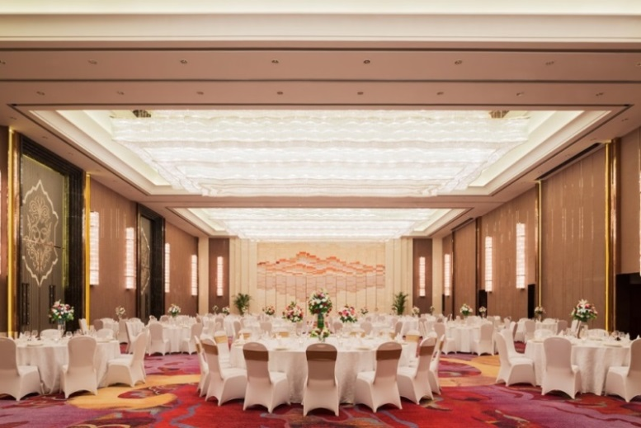
赤峰富力万达嘉华酒店
Wanda Realm Chifeng

Slide 2

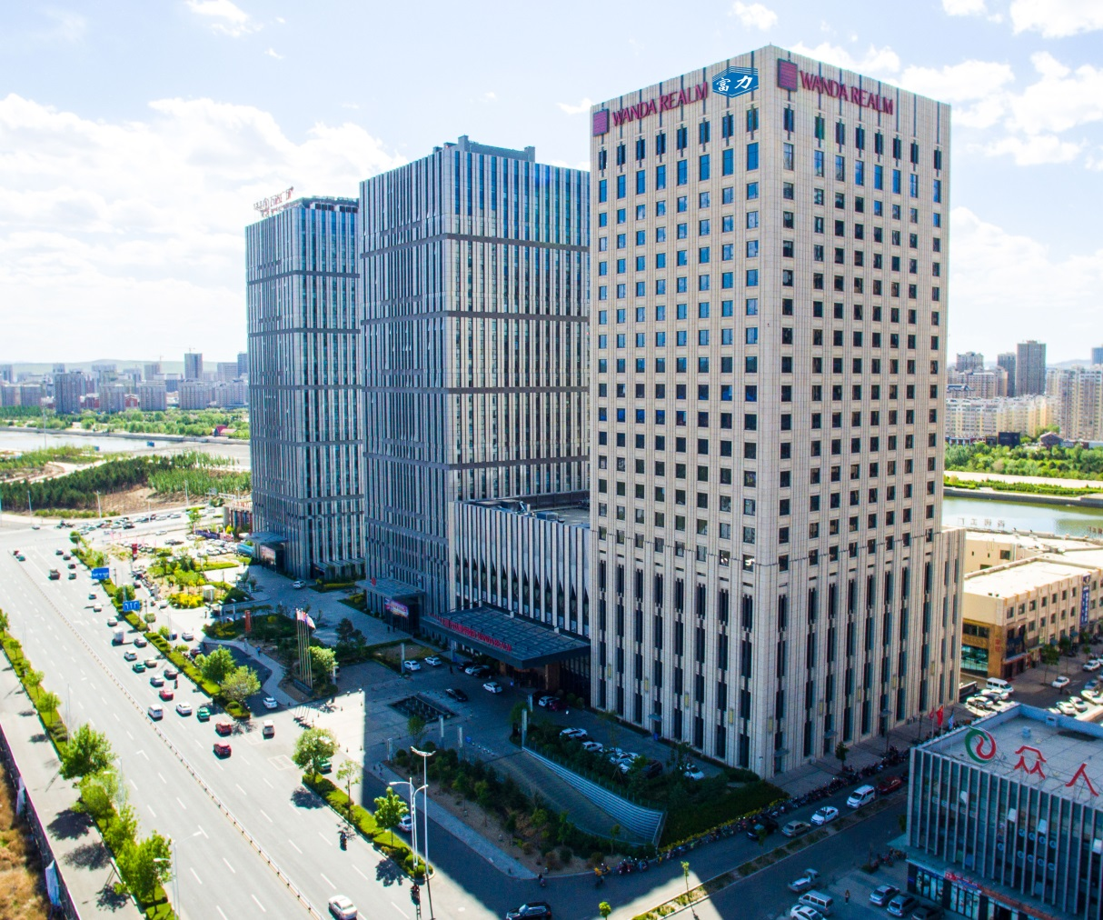
酒店介绍
Hotel Introduction
赤峰富力万达嘉华酒店承袭万达嘉华酒店的品牌荣耀，以奢华的客房、精致的美食、一流的设施及热情的服务，演绎草原明珠的待客之道。无论您是商务旅行或是休闲度假，赤峰富力万达嘉华酒店诚邀阁下莅临，体验完美的居停享受。
Wanda Realm Chifeng welcomes you to the jewel of Inner Mongolia exquisite rooms, superb dining, world-class facilities and the warm hospitality for which Wanda Realm is renowned. Whether you are visiting for business or leisure, Wanda Realm Chifeng is Proudly at your service to ensure you enjoy the perfect stay.

Slide 3

知您所需，心安为嘉！
为商务人士创造温馨、惬意的居停感受。
万达嘉华承诺：美妙的睡眠体验、独特的东方美食，定会令各方宾客难以忘怀。
As a warm and comfortable dream point for business travelers, Wanda Realm
Offers its guests an unforgettable journey and unique Oriental cuisine.

Slide 4
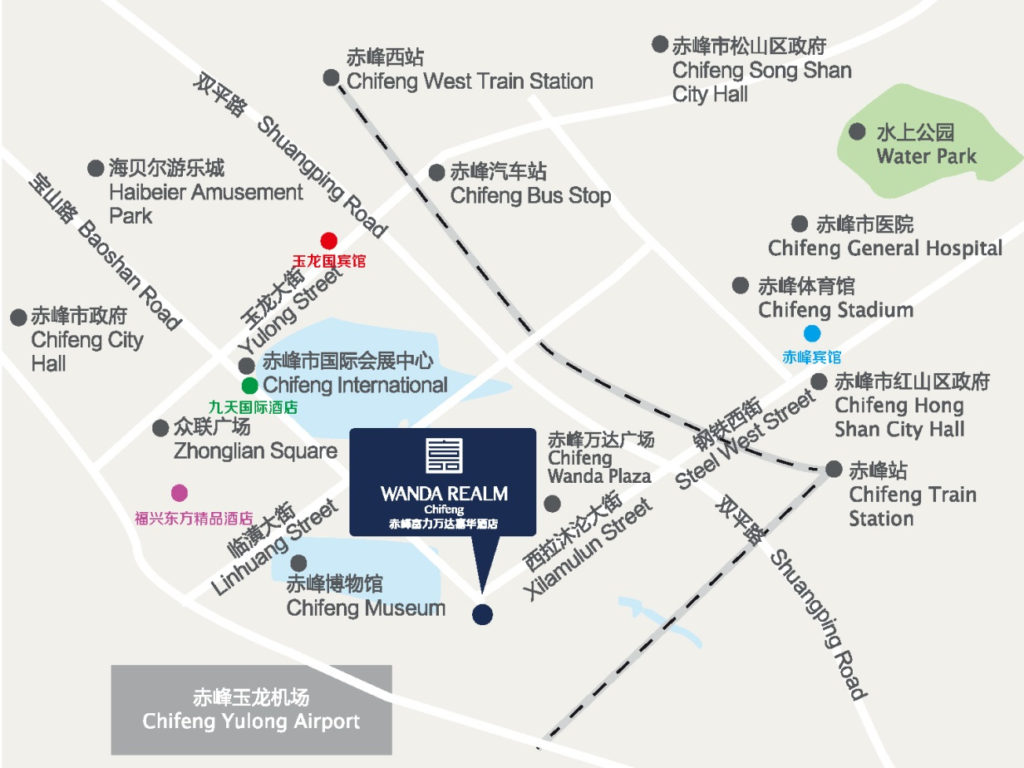
优越的地理位置
Ideal Location
赤峰玉龙机场
Chifeng Yulong Airport
仅需25分钟车程
Only 25 minutes’ drive to get there
赤峰火车站
Chifeng Train Station
仅需15分钟车程
Only 15 minutes’ drive from there
商务/会展 Business / Exhibition
1. 红山区政府 Hongshan City Hall
2. 松山区政府 Songshan City Hall
3. 赤峰市政府 Chifeng City Hall
4. 赤峰市国际会展中心 Chifeng International Conference and Exhibition Center
休闲 Leisure
1. 海贝尔游乐城 Haibeier Amusement Park
2. 赤峰博物馆 Chifeng Museum
3. 赤峰体育馆 Chifeng Stadium
4. 水上公园 Water Park

Slide 5


交通——火车抵达 Transportation-Train
出租车抵达酒店
By taxi
赤峰站(高铁)
Chifeng Station
Normal Train Station
赤峰富力
万达嘉华酒店
Wanda Realm Chifeng
车程约15分钟 15 Mins

Slide 6

交通——飞机抵达 Transportation-Airplane
全程486公里，飞行1小时
北京
首都国际机场
Beijing Capital
International Airport
赤峰富力
万达嘉华酒店
Wanda Realm Chifeng
486 Kilometers distance, 1 hours drive.

Slide 7
交通——飞机抵达 Transportation-Airplane
选择一：出租车，车程20分钟，费用50元左右
Option 1: Taxi, 20 minute, RMB 50 around.
选择二：酒店提供接机服务，
Option 2： Pick-up service from Chifeng airport offered by hotel. Please call：0476-599 8888
选择三：机场大巴，费用10元/人。停靠赤峰富力万达嘉华酒店下车。
Option 3： Airport bus, RMB 10/person. Get off at the Wanda Realm

Slide 8


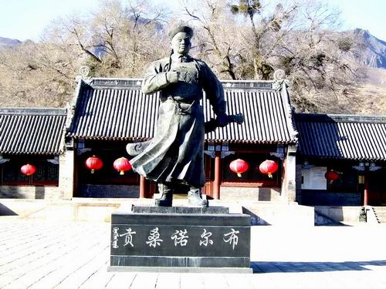

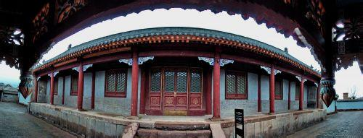
赤峰市旅游景点
Tourist Attractions
乌兰布统坝上草原
The Wulanbu Series Prairie
召庙
Zhao Temple
喀喇沁蒙古亲王府
Grass Prince Palace

Slide 9
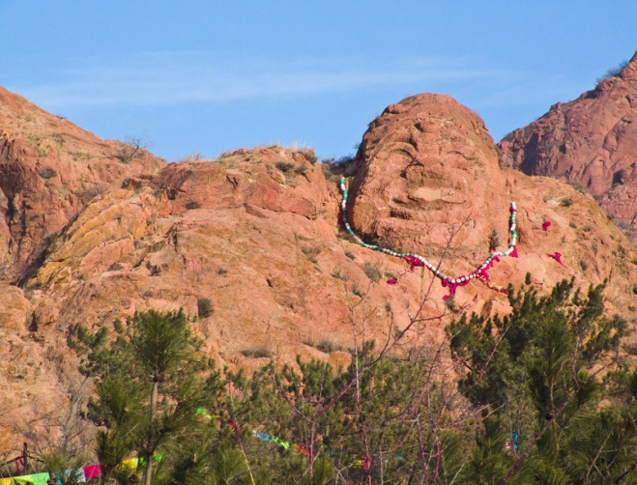

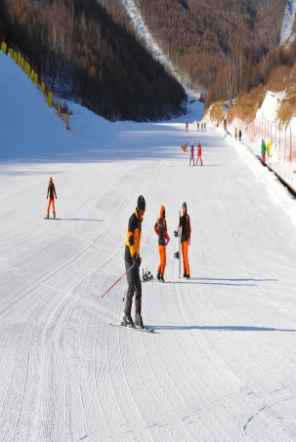

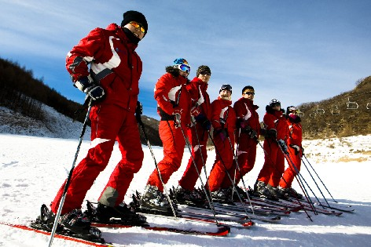

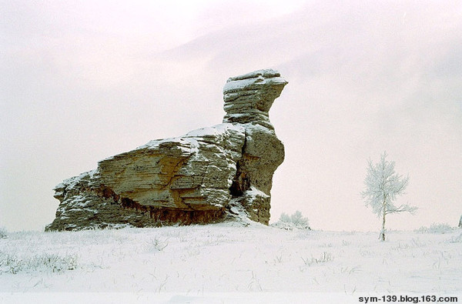
赤峰市旅游景点
Tourist Attractions
红山公园
Hongshan Park
阿斯哈图石林
Asihatu Stone Forest
美林谷滑雪场
Mylin Valley Ski Resort

Slide 10
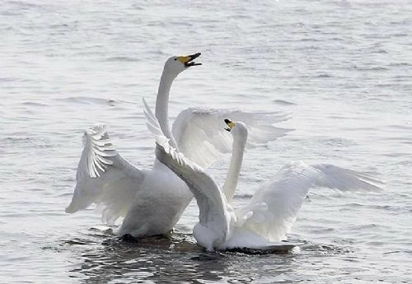


赤峰市旅游景点
Tourist Attractions
达里湖
Dali Lake
玉龙沙湖
Yulong Desert
青山岩臼
Greenhills and Caldera

Slide 11
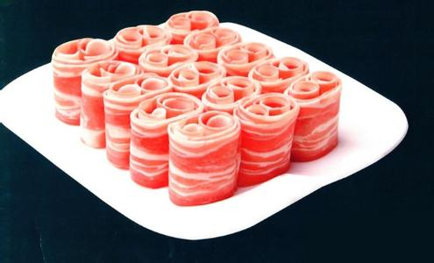
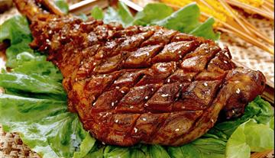
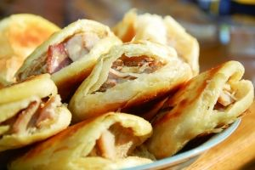
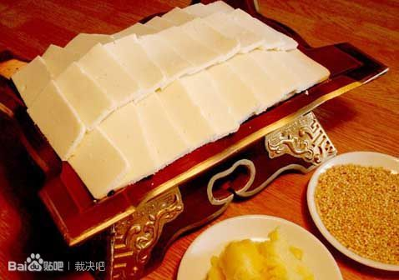

赤峰特色小吃
Local Cuisines
涮羊肉
Lamb Steam boil
烤羊腿
Roast Lamb Shank
对夹
Crispy Pancake with Smoked Meat
奶制品
Milk Production
达里湖华子鱼
Amur ide
from Dali Lake

Slide 12
酒店服务
Hotel Service
酒店拥有万达嘉华享誉盛名的精彩餐饮体验及贴心的服务，如闻名遐迩的“万达天使”、“茶之旅”、“万达嘉华之床”及“妙梦”助眠系列等众多特色服务，让您领略无与伦比的中国文华体验。
The hotel captures the essence of pure Wanda Realm in terms of creativity in Food and Beverage, outstanding service programs such as Realm Angels, Realm Walker, Bed of Realm and Dream Catcher, all which add to the feeling of an amazing service experience encompassing traditional Chinese cultures.
强大的餐饮厨师团队，集合了丰富的国际经验及传统的中式烹饪。无论是餐厅亦或是外卖活动您都可以品尝到精致的美味佳肴，让您慢慢体会味蕾上那番愉悦的惊喜。
A combination of rich international Food and Beverage experience and traditional Chinese cooking, creating variety of experiences and flavors in the hotels 5 food and beverage outlets, catering to every possible choice.

Slide 13
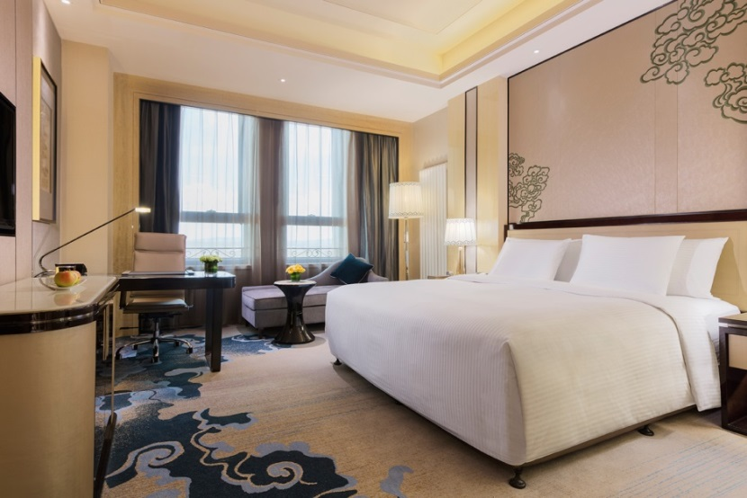
客房
Guest Rooms
房型 Room Category | 面积 Size (sqm) | 数量 No.
豪华大床房 Deluxe King | 46.8 | 57
豪华双床房 Deluxe Twin | 46.8 | 91
高级豪华大床房 Grand Deluxe King with River View | 46.8 | 21
高级豪华双床房 Grand Deluxe Twin with River View | 46.8 | 27
高级豪华江景大床房 Grand Deluxe King with River View | 46.8 | 60
高级豪华江景双床房 Grand Deluxe Twin with River View | 46.8 | 5
行政楼层豪华大床房 Executive Floor Deluxe King | 48.3 | 27
行政楼层豪华双床房 Executive Floor Deluxe Twin | 48.3 | 34
行政楼层豪华江景大床 Executive Floor Deluxe King, with River view | 48.3 | 7
行政楼层豪华江景双人床 Executive Floor Deluxe Twin, with River view | 48.3 | 2
豪华套房 Deluxe Suite | 92.8 | 13
行政套房 Executive Suite | 92.8 | 3
部长套房 Chairman Suite | 150 | 2
总统套房 Presidential Suite | 390 | 1
总计 Total |  | 350

Slide 14
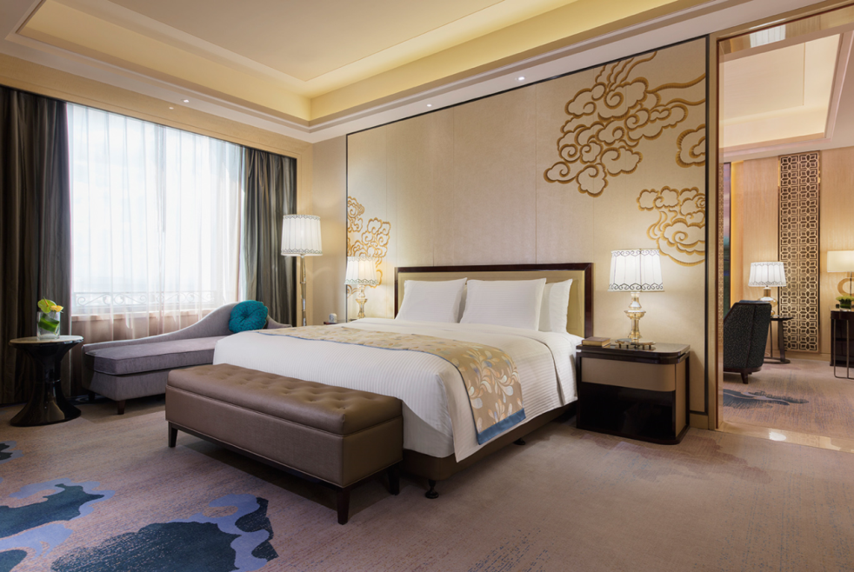
客房设施
Guest Room Features & Amenities
独有的“万达嘉华之床”及“妙梦”助眠系列
“Bed of Realm” and “Dream Catcher”
拥有国际卫星频道的高清液晶电视
HD TV with International Satellite Channels
免费的无线网络
Free Wi-Fi
可调节的房内中央空调
Individually Controlled Central Air-conditioning
数字保险箱
Digital Safes
熨斗熨烫板
Electric iron and ironing-board
独立浴缸及热带雨林式淋浴设施
Separate bath and rainforest shower
自动浴帘
Automatic shower curtain
吹风机
Hair-dryer
迷你吧酒水饮料及咖啡茶冲泡设备
Mini Bar & Coffee/Tea Making Facilities
房内三部电话及语音信箱系统
3 Telephones & Voice Mail System

Slide 15
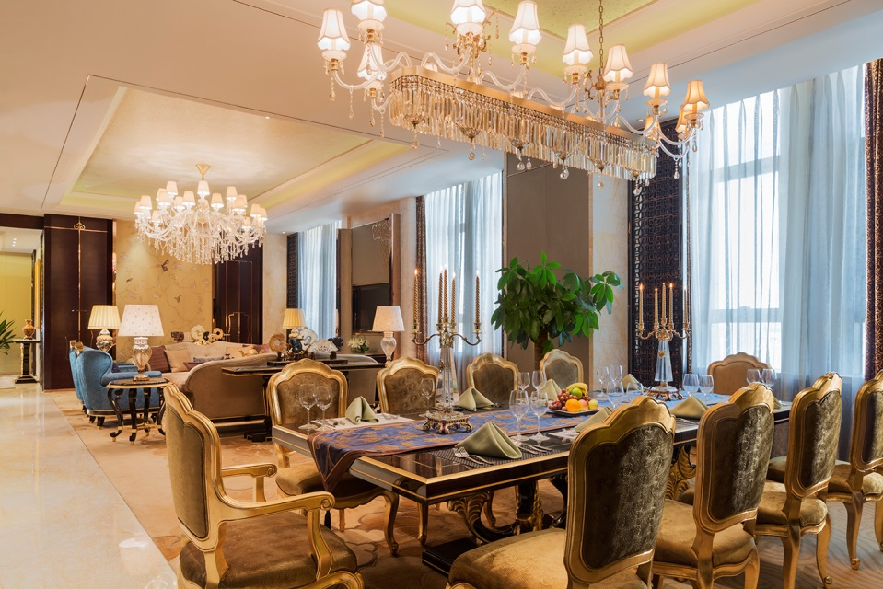
嘉华行政酒廊
Executive Lounge
行政楼层位于酒店 20-23层，房间总数：76间
Executive Floor Located From 20F To 23F, Total Rooms Number: 76
营业时间
Operation Hours: 06:30am-11:00pm
早餐 Breakfast: 06:30am-10:00am（每天Daily)
欢乐时光 Happy Hour: 6:00pm-8:00pm（每天Daily）
全天可在行政嘉华酒廊享用免费软饮
Complimentary soft drinks in the Executive Lounge during the day
座位Capacity: 28
楼层Location: 22层/F

Slide 16
嘉华行政酒廊
Executive Lounge
行政楼层礼遇
Executive Floor Benefits:
行政酒廊客人专享的入住登记及退房服务
Executive check-in and check-out services
行政酒廊营业时间内免费提供软饮
Soft drinks are available throughout the day
客房及行政酒廊免费提供宽带上网
Complimentary computer and Internet service
入住期间每房免费使用行政酒廊会议室两小时
Complimentary usage of the Lounge Meeting room for
2 hour per stay
免费延迟退房至下午2点（视当日入住情况）
Late check out until 2:00pm (subject to availability)
免费发送市内传真及拨打本地电话
Complimentary local fax and local call
每天可免费清洗一件衬衣或酒店提供一套西服的免费熨烫Complimentary laundry of 1 piece of shirt or pressing of
1 set of suit per day

Slide 17

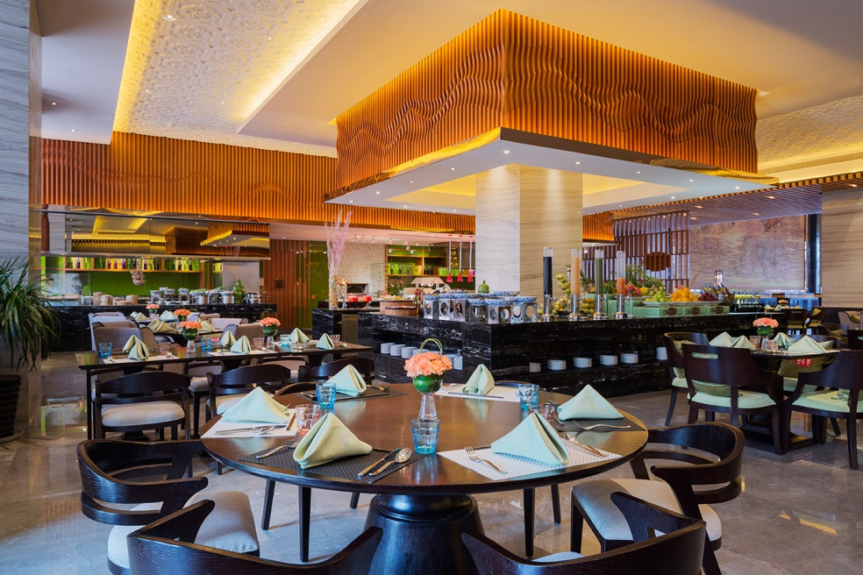
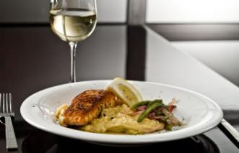
餐饮设施
Food & Beverage
一天24小时，从您下榻那一刻起，即可品尝到我们为您精心准备的令人垂涎欲滴的美味佳肴。汇集东西方珍馐美味的自助佳肴及本地菜品，创意与经典全新搭配；24小时乐奉的“环球精选早餐”；为您贴心准备“外带早餐”。您更可亲眼目睹大厨在开放式厨房制作各种精致佳肴。
A day has 24 hours and during this time you can enjoy the mouthwatering dishes. Café Vista will be showing a wide range of International and local cuisines, a global breakfast selection served 24 hours, indispensable for international hotels by introducing the “Takeaway Breakfast” and live cooking stations. Guests dining here can watch chefs create signature dishes.
营业时间 Operation Hours:
早餐Breakfast: 6:30am - 10:00am (平日Weekdays)
6:30am - 10:30am (周末Weekend)
午餐Lunch: 11:30am -2:00pm (每天Daily)
晚餐Dinner: 5:30pm - 9:30pm (每天Daily)
座位Capacity: 206
位置Location: 1层/F
美食汇-全日餐厅
Café Realm – All Day Dining

Slide 18
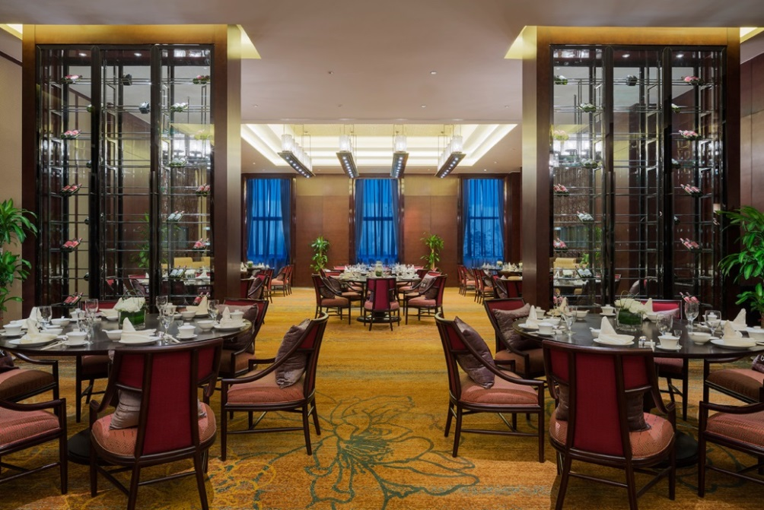
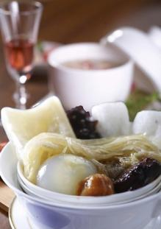
品珍 中餐厅
Zhen Chinese Restaurant
匠心独具的奢华氛围，粤菜，鲁菜及内蒙本地菜为主，吸纳赤峰本地佳肴精华，厨师精心甄选优质食材，为您烹饪原汁原味以及均衡营养的美馔佳肴。另设7间豪华气派的独立包房可供宾客尽享专属独特的用餐体验！
ZHEN Chinese Restaurant, unique luxurious atmosphere, our chef choose the fresh ingredients and devoted to the original flavor and balanced nutrition of Cantonese ，Shandong cuisine and Inner Mongolia dishes, and it captures the essence of local dishes. We also provide 7 private rooms for your family and friends and enjoy the unique dining experience.
营业时间 Operation Hours:
午餐Lunch: 11:30am - 2:00pm
晚餐Dinner: 5:30pm - 10:00pm
座位Capacity: 190
楼层Location: 2层/F

Slide 19
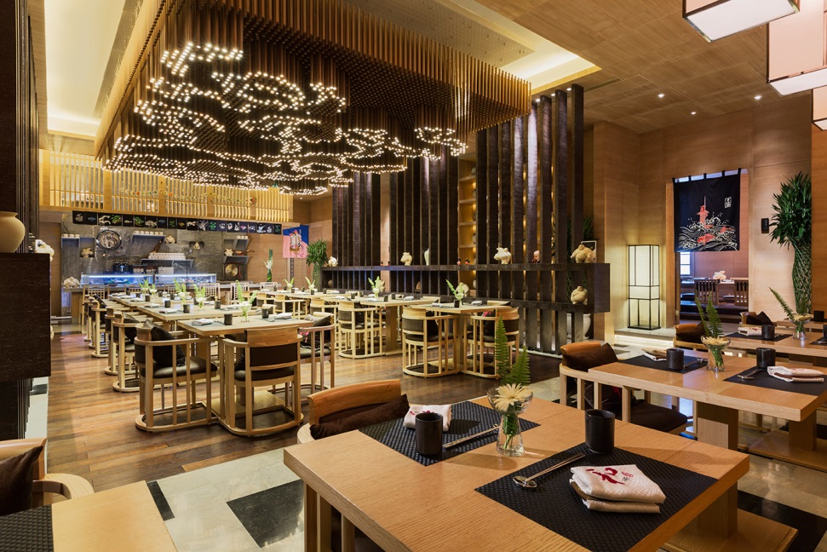
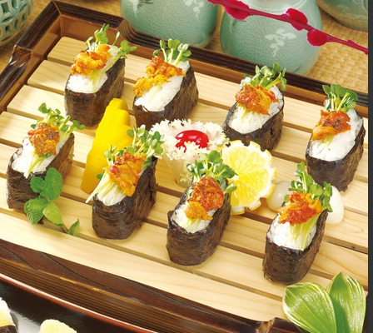
和 日式餐厅
HE Japanese Restaurant
和享誉盛名的日式餐厅，以精细、新鲜和东瀛风情为特色.提供最正宗的日式料理美味。新鲜的生鱼片，多样的创意寿司，传统的日式拉面，美味的天妇罗以及令人垂涎欲滴的铁板烧，在加上琳琅清酒，让您的客人细品美馔，倍感尊崇。
“He” Japanese Restaurant presents the most authentic Japanese cuisine. The fresh sashimi, multiple creative sushi presentations, traditional Japanese ramen noodles, delicious tempura and mouth watering teppanyaki coupling with wide selection of Sake allow guests to savour and enjoy delicate Japanese cuisine.
营业时间 Operation Hours:
午餐Lunch：11:30am – 2:00pm
晚餐Dinner: 5:30pm – 10:00pm
座位Capacity: 71
楼层Location: 2层/F

Slide 20


大堂酒廊
Lobby Lounge
大堂酒廊 :是您尽情享受休闲时光的绝佳之选。香浓咖啡，简约的中西小食，地道的中式茶和休闲的英式下午茶及各种舒怀饮品。纵情于曼妙轻柔的音乐，品味经典高雅奢华。
Lobby Lounge：The ideal place to relax and unwind, here you can savor your favorite edibles, fragrant coffee light Chinese and Western snacks, Western afternoon teas, authentic Chinese tea and wide range of drinks. Enjoy the live music and the elegant environment.
营业时间 Operation Hours:
每天Everyday: 7:00am - 0:00am
座位Capacity: 65
楼层Location: 1层/F

Slide 21
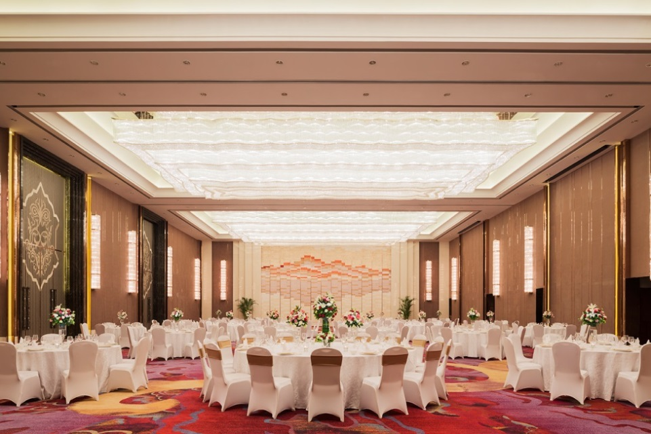
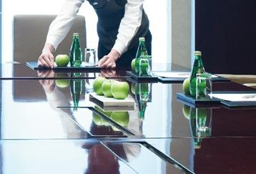
会议与宴会
Meeting and Banquet
独享三楼的1,200平方米超大无柱式宴会厅 配有全城唯一的内置式 超大 LED显示屏（73平方米）,1间贵宾休息室
The largest Grand Ballroom in the city at 1,200m² (pillar- free) in a whole floor the feature unique to the hotel is an outstanding LED screen measuring 73M² Accompanied with 1VIP rooms for our guests
专属三楼的4间可灵活分隔的多功能会议厅
4 flexible multi-function meeting rooms in the second floor
配备先进的视听与多媒体设施
State-of-the-art audio-visual and multimedia facilities
专属会议管家及国际水准的会议和宴会统筹服务
Exclusive Meeting Butler and world-class event-management profession services

Slide 22

万达浪漫婚典
Wanda Romance Wedding Ceremony
穿越千年的缘分，以盛世典仪再现。汉朝的大气尊贵，唐宋的似锦奢华，明清的婉约青纯，古风古韵、与众不同的婚礼让新人和好友亲朋一起感受爱情的神圣和承诺的郑重，于无比瑰丽、典雅的气氛中共同见证一生难忘时刻。
Traversing the history, the fate recurs in a glorious ceremony. Styles from the noble Han Dynasty. The luxurious Tang & Song Dynasty and the graceful Ming & Qing Dynasty are uniquely presented in the design of each wedding. It’s an inviting place for family members to value true love and witness this memorable moment.
大宴会厅：容纳60桌
Grand Ballroom: 60tables
大宴会厅 1+2/2+3 ：容纳32桌
Grand Ballroom 1+2/2+3: 32tables
大宴会厅 1/2/3 ：容纳20桌
Grand Ballroom 1/2/3: 20tables
多功能厅4间：分别容纳2-16桌
4 Function Rooms: 2-16tables

Slide 23
会议与宴会
Meeting and Banquet
宴会厅名称 Name of Room | 平方米 Area(Square meter) | 宴会式 Banquet | 剧场式 Theatre | 课堂式 Classroom | 招待会式 Reception | U-型式 U-shape | 回型 Hollow Shape | 长型 Board Meeting
大宴会厅 Wanda Grand Ballroom | 1200 | 600 | 1000 | 600 | 700 | NA | NA | NA
大宴会厅1 Ballroom 1 | 400 | 200 | 300 | 200 | 240 | 60 | 60 | 60
大宴会厅2 Ballroom 2 | 400 | 200 | 300 | 200 | 240 | 60 | 60 | 60
大宴会厅3 Ballroom 3 | 400 | 200 | 300 | 200 | 240 | 60 | 60 | 60
大宴会厅1+2 Ballroom 1+2 | 800 | 320 | 550 | 350 | 450 | NA | NA | NA
大宴会厅2+3 Ballroom 2+3 | 800 | 320 | 550 | 350 | 450 | NA | NA | NA
宴会前厅 Ballroom Foyer | 435 | NA | NA | NA | 270 | NA | NA | NA

Slide 24
会议与宴会
Meeting and Banquet
宴会厅名称 Name of Room | 平方米 Area(Square meter) | 宴会式 Banquet | 剧场式 Theatre | 课堂式 Classroom | 招待会式 Reception | U-型式 U-shape | 回型 Hollow Shape | 长型 Board Meeting
多功能厅1 Function Room 1 | 66.7 | 20 | 30 | 30 | 30 | 18 | 18 | 30
多功能厅 2 Function Room 2 | 66.7 | 20 | 30 | 30 | 30 | 18 | 18 | 30
多功能厅 3 Function Room 3 | 65 | 20 | 30 | 30 | 30 | 16 | 16 | 30
多功能厅 5 Function Room 5 | 77.5 | 24 | 40 | 40 | 50 | 20 | 20 | 40
董事会议室 Board Meeting | 98 | NA | NA | NA | NA | NA | NA | NA
贵宾室 VIP Room | 143 | 50 | 80 | 50 | 80 | 36 | 36 | 80

Slide 25
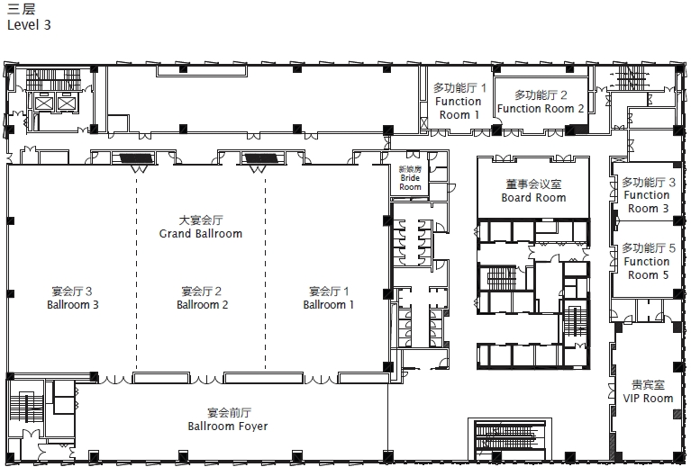
楼层平面图
Floor Plan – 3F
楼层平面图
Floor Plan – 2F

Slide 26
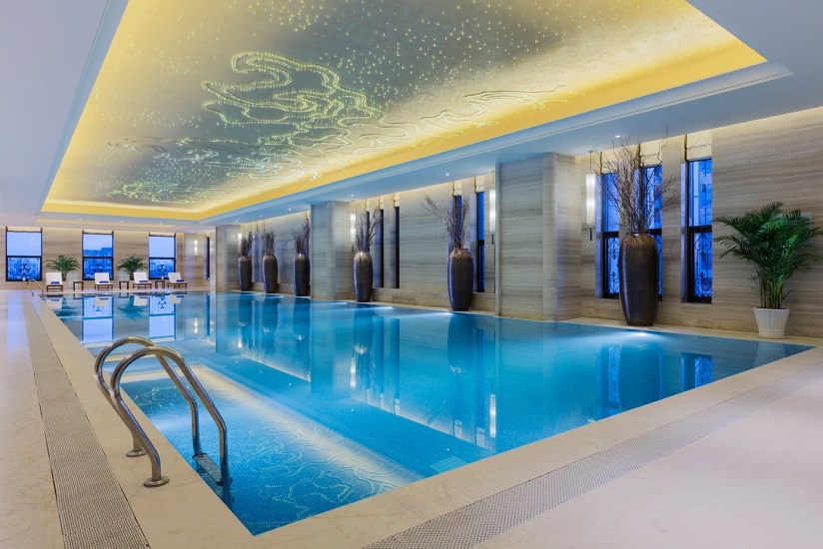

健身中心
Health Club
营业时间 Operation Hours:
健身中心Health Club: 6:00am – 11:00pm
游泳池 Swimming Pool: 6:00am – 11:00pm
美发沙龙Hair Salon: 10:00am –11:00pm
楼层Location: 5层/F
20米室内恒温游泳池
20meters indoor heated swimming pool
泰诺健知名先进健身设施
Health Club by Technogym with state-of-
the- art facilities
瑜伽室
Yoga
美发沙龙
Hair Salon

Slide 27

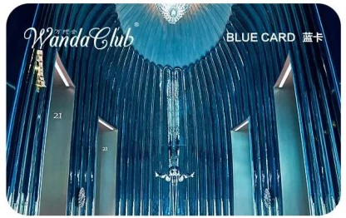

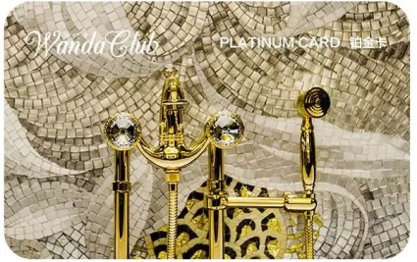
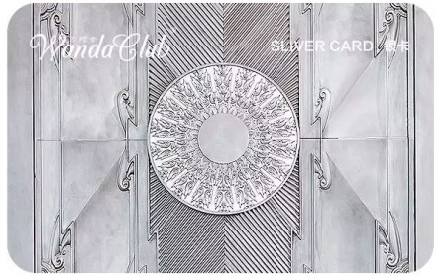

万悦会
Wanda Club
www.clubwanda.com.cn
酒店客人免费登记入会后，会员在万达酒店及度假村任一酒店内的住宿、餐饮等消费均可获得积分，并可以没有任何日期限制地将其兑换成免费客房住宿、免费客房升级或者航空里程，更可专项万达集团旗下娱乐、休闲、购物场所的各类礼券兑换服务和特别礼遇。
After registering for a free membership, enrollees can receive credits when spending at any hotel under Wanda Hotels & Resorts, such as on accommodation or dining. These can then be redeemed for free hotel stays, free room upgrades or air miles without any time limit. Members can also take advantage of various exclusive gift certificate exchange services and special treatments in any recreational, leisure and shopping premise in the Wanda Group.
蓝卡 SUPERIOR
银卡 SILVER
金卡GOLD
铂金卡PLATINUM
钻石卡 DIAMOND

Slide 28
万悦会
Wanda Club
万悦会会议奖励计划适用于在万悦会所有加盟酒店组织会议者，是一个独立的奖励计划。会议组织者可通过万悦会网站或万悦会会员服务中心申请，获取会议奖励计划账户，并可享有：
· 积分永久 · 积分称心兑换
· 积分自由购买 · 尊享预定通道
· 性化积分转赠 · 享受办理入住手续优先权
The Wanda Club Meeting Rewards Program is available for meeting planner individuals only. The program is independent of the Wanda Hotels & Resorts rewards program. Wanda Club Meeting Rewards membership may be applied for via the Wanda Club website or Wanda Club Service Center. Upon membership approval by Wanda Hotels & Resorts, a Meeting Reward Program member will enjoy:
· Non-expiration of points · Points redemption
· Points purchases · Dedicated reservation channel
· Points transfers · Exclusive staying at Wanda Club
Floor Priority check-in

Slide 29

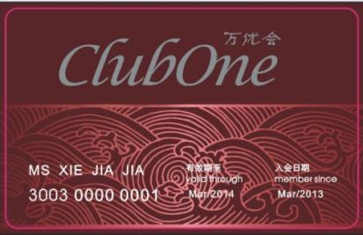
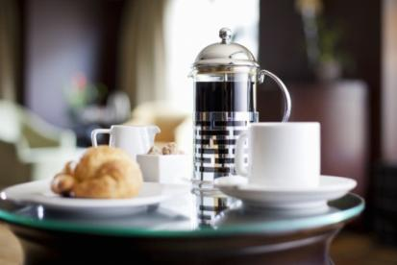
万优会
Club One
“万优会”是万达酒店及度假村管理有限公司的餐饮常客计划，作为万优会的成员，您可以享受独一无二的专属优惠，包括：
在参与活动的餐厅内享受无限次数的餐饮折扣
10次最优惠房价八折的住宿礼遇
在当地酒店享受一系列额外优惠，如免费住宿，免费自助餐，现金抵 用券以及更多超乎预期的优惠。
Club One is paid membership that offers discount privileges for food and beverage. As a member of Club One, you will enjoy exclusive privileges including:
Unlimited dining discounts at participating restaurants and bars.
10 times of special 20% off Best Available Rate.
A range of amazing bonus benefits such as free accommodation, complimentary buffet, cash vouchers and many more that exceed your expectation at your host hotel.

Slide 30


万达儿童基金会
Wanda Children’s Foundation
万达儿童基金是由万达酒店及度假村管理有限公司创立，与中华慈善总会合作，面向全球推出的针对儿童的专项公益慈善项目。万达酒店及度假村旗下各酒店邀请每位住店客人每次入住捐助人民币5月以及酒店员工的义卖捐款，汇聚点滴爱心，帮助需要帮助的儿童。
Established by Wanda Hotels & Resorts and in collaboration with the China Charity Federation, Wanda Children’s Foundation is developed as a special charity programme for children across the world. All of our hotels are helping children in need by encouraging every guest to donate RMB 5 during each stay. Hotel associates also donate their time in hosting a charity sale.

Slide 31

赤峰富力万达嘉华酒店
Wanda Realm Chifeng
沈阳万达文华酒店
Wanda Vista Shenyang
Thank You！
内蒙古赤峰市红山区西拉沐沦大街12号 邮编：024000
12 Xilamulun Street , Hongshan District, Chifeng City, Inner Mongolia 024000, P.R. China
电话/Tel: +86 (0)476 599 8888 传真/Fax:+86 (0)476 599 8999
www.wandahotels.com

